Slide 1
Pilot subcarriers considering new tone plan

Slide 2
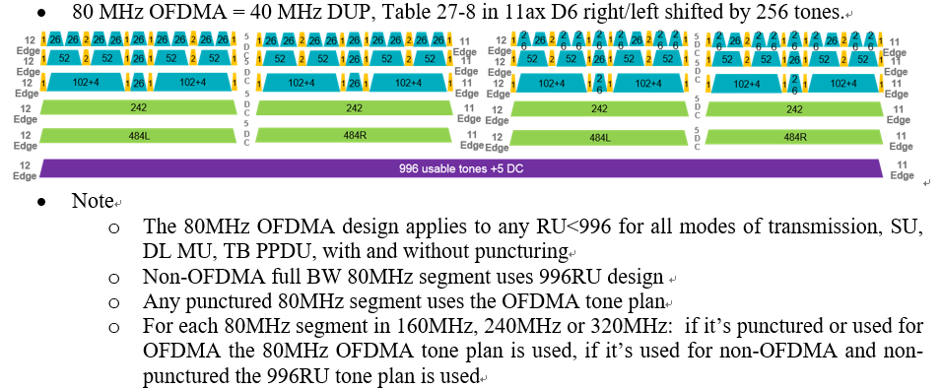
Background
The new tone plan was passed [1].
Here I’d like to check the pilot subcarriers for the new tone plan.
  The RU location is changed from [-258:-17, 17:258] to [-253:-12, 12:253] in 80MHz segment. And the location of pilot subcarriers may not be suitable in the below cases.
    26/52/106/242/484-tone RUs (some RU location is changed)
    n*996-tone RUs (n>=1) (the RU location is not changed)
    RU combinations

Slide 3
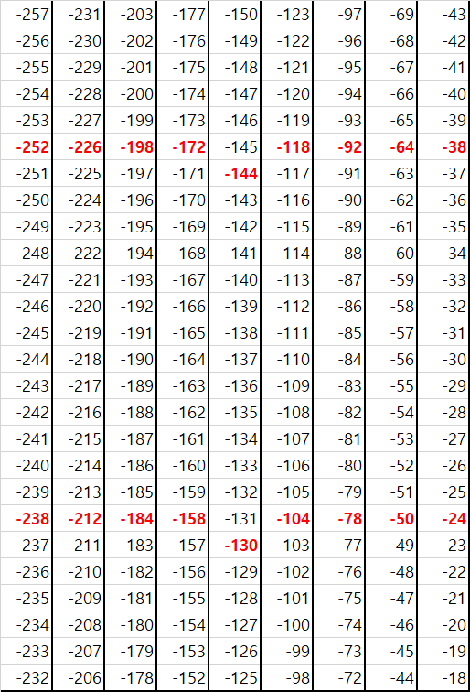
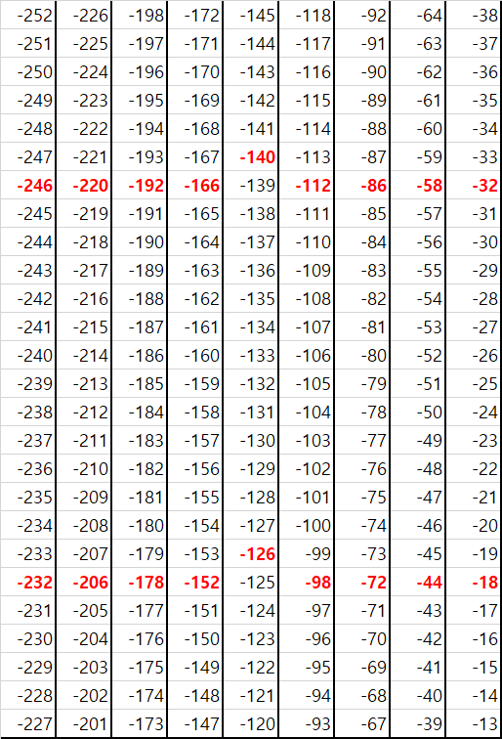
Pilot indices for under 996RUs (1/3)
There are data and pilot subcarriers in some 26 RUs of old/new tone plan.
  The 11ax pilot subcarriers were decided in (6 or 7) and (20 or 21) index with even tone among 26-tone RU[2]. So we also consider the 11be pilot subcarriers in new tone plan as red color in the below right figure.
26RUs in [-258:-17] of old tone plan
26RUs in [-253:-12] of new tone plan

Slide 4
Pilot indices for under 996RUs (2/3)
So the pilot indices are as below in 26/52/106/242/484 RU.
  in a OFDMA/non-OFDMA 80MHz EHT PPDU
  in a OFDMA/non-OFDA 160MHz EHT PPDU
  in a OFDMA/non-OFDMA 320MHz EHT PPDU
26-tone RU | {-494, -480}, {-468, -454}, {-440, -426}, {-414, -400}, {-386, -372}, {-360, -346}, {-334, -320}, {-306, -292}, {-280, -266}, {-246, -232}, {-220, -206}, {-192, -178}, {-166, -152}, {-140, -126}, {-112, -98}, {-86, -72}, {-58, -44}, {-32, -18}, {18, 32}, {44, 58}, {72, 86}, {98, 112}, {126, 140}, {152, 166}, {178, 192}, {206, 220}, {232, 246}, {266, 280}, {292, 306}, {320, 334}, {346, 360}, {372, 386}, {400, 414}, {426, 440}, {454, 468}, {480, 494}
52-tone RU | {-494, -480, -468, -454}, {-440, -426, -414, -400}, {-360, -346, -334, -320}, {-306, -292, -280, -266}, {-246, -232, -220, -206}, {-192, -178, -166, -152}, {-112, -98, -86, -72}, {-58, -44, -32, -18}, {18, 32, 44, 58}, {72, 86, 98, 112}, {152, 166, 178, 192}, {206, 220, 232, 246}, {266, 280, 292, 306}, {320, 334, 346, 360}, {400, 414, 426, 440}, {454, 468, 480, 494}
106-tone RU | {-494, -468, -426, -400}, {-360, -334, -292, -266}, {-246, -220, -178, -152}, {-112, -86, -44, -18}, {18, 44, 86, 112}, {152, 178, 220, 246}, {266, 292, 334, 360}, {400, 426, 468, 494}
242-tone RU | {-494, -468, -426, -400, -360, -334, -292, -266, -246}, {-220, -178, -152, -112, -86, -44, -18}, {18, 44, 86, 112, 152, 178, 220, 246}, {266, 292, 334, 360, 400, 426, 468, 494}
484-tone RU | {-494, -468, -426, -400, -360, -334, -292, -266, -246, -220, -178, -152, -112, -86, -44, -18}, {18, 44, 86, 112, 152, 178, 220, 246, 266, 292, 334, 360, 400, 426, 468, 494}
26/52/106/242/484-tone RU | [Pilot indices in 80MHz]-512, [Pilot indices in 80MHz]+512
26/52/106/242/484-tone RU | [Pilot indices in 80MHz]-1024, [Pilot indices in 80MHz]-512, [Pilot indices in 80MHz]+512, [Pilot indices in 80MHz]+1024

Slide 5
Pilot indices for under 996RUs (3/3)
In case of Small/Large RU combinations [3], pilot subcarriers includes the pilots in each RU. For example,
  In 26+52RU, 2 pilots of 26RU and 4 pilots of 52RU (total 6)
  In 996+484RU: 16 pilots of 996RU and 16 pilots of 484RU (total 32)
  Actually it’s already agreed in the discussion of LDPC mapper.[4]

Slide 6
Pilot indices for n*996RUs (n≥1) (1/2)
Subcarriers of 996RU are not changed in[-500:-3 3:500]. So we can consider two options to decide pilot subcarriers for n*996RUs.
  Option1: We can use pilot subcarriers as it is in 11ax, but the alignment of pilot subcarriers with 26/52/106/242/484-tone RU is broken.
  Option2: We can change pilot subcarriers to be aligned with other RUs.
  As a reference, we check the PAPR performance of LTF sequences and option1 has lower PAPR in 80/160MHz. Please see the next page. But option2 is easy to set pilot subcarriers same with other RUs.
  The two options have pros and cons. So we need to discuss it.
996-tone RU | {-468, -400, -334, -266, -226, -158, -92, -24, 24, 92, 158, 226, 266, 334, 400, 468}
996-tone RU | {-468, -400, -334, -266, -220, -152, -86, -18, 18, 86, 152, 220, 266, 334, 400, 468}

Slide 7
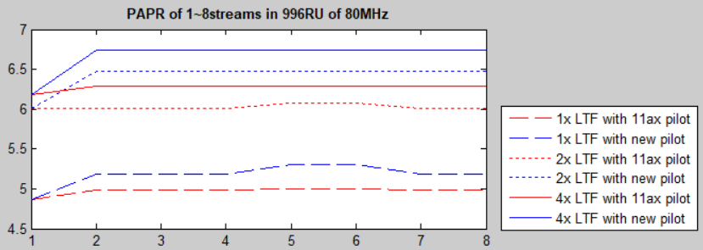
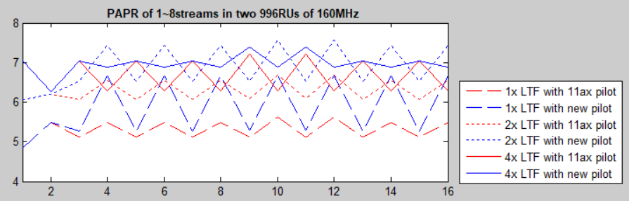
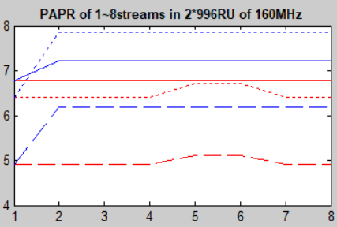
Pilot indices for n*996RUs (n≥1) (2/2)
PAPRs per stream(1~8streams) in 80MHz
  In all cases, LTF sequences with 11ax pilot subcarriers has about 0.1~0.5dB lower PAPRs with new pilots.
PAPRs per stream of two 996RUs in the left figure and of 2*996RU in the right figure in 160MHz
  It has the same trend.

Slide 8
Reference
[1] IEEE802.11-20/0566r21, “Compendium of straw polls and potential changes to the Specification Framework Document”
[2] IEEE802.11-15/0819r1, “11ax OFDMA Tone Plan Leftover Tones and Pilot Structure”
[3] IEEE802.11-19/1262r9, “Specification Framework for Tgbe”
[4] IEEE802.11-20/0394r1, “Thoughts on RU Aggregation and Interleaving”

Slide 9
Straw poll 1
Do you support that two pilot subcarriers are located in even tone index of 26-tone RU as below?
  A pilot is located in either 6th or 7th subcarrier from the lowest frequency index within 26-tone RU
  The other pilot is located in either 20th or 21th subcarrier from the lowest frequency index within 26-tone RU
  Y/N/Abs

Slide 10
Straw poll 2
Do you support to pilot indices in slide 4 in 11be?
  Y/N/Abs

Slide 11
Straw poll 3
Do you support that pilot subcarriers for small/large RU combinations includes the pilots in each RU?
  Y/N/Abs

Slide 12
Straw poll 4
Which one do you prefer as the pilot subcarriers in n*996RUs (n≥1)?
  Option1: Pilot subcarriers as it is in 11ax.
  Option2: Pilot subcarriers to be changed with other RUs as SP1.
  Other:
  Abs:

