Slide 1
11az Secure LTF Design
Date: 2020-05-29
Authors:
Name | Affiliations | Address | Phone | Email
Bin Tian | Qualcomm |  |  | btian@qti.qualcomm.com
Steve Shellhammer
Ali Raissinia
Youhan Kim
Mithat Dogan | Apple | One Apple Park Way Cupertino, CA 95014
Anuj Batra
Tianyu Wu
Ahmet Cepni
Nehru Bhandaru | Broadcom
Manas Deb
Mengchang Doong
Luis Gutierrez
Marcellus Forbes
Vinko Erceg
Notes:
September 2012

Slide 2
Authors (continued):
Name | Affiliations | Address | Phone | Email
Erik Lindskog | Samsung
Srinivas Kandala
Wook Bong Lee
Ashok Ranganath
Stuart Walker Strickland | HPE
Jerome Henry | Cisco
HanGyu Cho | LGE
Sang Gook Kim
Roy Want | Google
Mingguang Xu
Christian Berger | NXP
Manish Kumar
Notes:
September 2012

Slide 3
11az LB249 CID 3911
CID | Page/Line | Clause | Comment | Proposed resolution
3911 | 153.00 | 11.22.6.4.6 | The Secure LTF mechanism for TB and NTB ranging needs to be improved. A submission will be provided. | As in comment.

Slide 4
Overview
11az secure LTF design and attack models have been discussed in many contributions (e.g. [1]-[6])
Improvements to secure LTF design can be considered in following directions
  Increase PHY signal entropy to deter attack [2]
  Mitigate unintentional beamforming [4]
    In current multi-stream design all antennas transmit the same signal
  Relieve MAC/PHY interface burden from passing large number of bits
    Increasing PHY signal entropy requires large number of pseudo-random bits
Maintain PAPR no worse than normal data portion
Keep other aspects of existing secure LTF design
  E.g. zero GI, 2x LTF, LTF repetition, no pilots, etc.

Slide 5
Outline
Security performance analysis of secure LTF modulation scheme
  Single tone (slicer) detection
  Sequential detection using Viterbi algorithm
Multi-stream transmission
PAPR analysis
Pseudo-random Generator
Summary of our proposals

Slide 6
Introduction
Secure LTF OFDM Symbol
Observation Period
Computation Period
Attack Period
Parameters
  Observation period T_{ob}, Computation period T_{c} and Attack period T_{atk}, are all normalized by the OFDM symbol duration.
  Some attacker capability discussions are given in [1].
  Worst case: T_{c}= 0 is used for in this study. For T_{c}>0 cases, T_{atk} will be smaller which lead to less attacker effectiveness.
Metric of attack effectiveness
  Attacker frequency domain estimation bit error rate : indirect metric
  Time domain cross-correlation coefficient, Corr, between secure LTF signal and the estimated (attack) signal during the attack period [6].
    Attack success rate depends on time domain correlation during the attack period and the duration of the attack period. Longer attack period and higher correlation in the attack period will lead to higher attack success rate.

Slide 7
Per Tone (SLICING) Attack

Slide 8
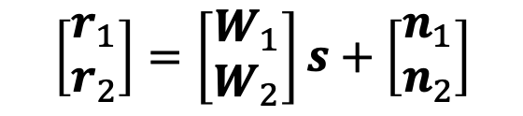
Per Tone (Slicing) Attack
Attacker processes each tone to estimate original signal[1][3]
  Secure LTF: per tone secure pseudo random sequence. The following analysis focus on attacker effectiveness with different modulation levels for secure LTF.
Signal model
Assumption for the attacker
  AWGN channel, known channel phase
  Modulation knowledge (e.g. QPSK, )
Estimation based on partial observation during the observation
  Zero pad the observed signal to entire symbol then do FFT
  Use slicer to estimate original signal
Computation cost is minimal.
$$\left[\begin{matrix}r_{1} \\ r_{2}\end{matrix}\right]=\left[\begin{matrix}W_{1} \\ W_{2}\end{matrix}\right]s+\left[\begin{matrix}n_{1} \\ n_{2}\end{matrix}\right]$$

Slide 9
BER and Corr: T_{ob}=5/8, T_{atk}=3/8
CDF of correlation coefficient of attacker signal with true signal
(Computed over attack period)
BER increases as modulation order
QAM signal achieves similar correlation performance (at 95% tail)
  About half of QPSK correlation coefficient
  About double of the optimal case of using time domain Gaussian random signal

Slide 10
An Example of Attack in AWGN channel
20MHz QPSK received with SNR = 30 dB
After T_{ob}=5/8 , an attack signal with corr = 0.58 is received during T_{atk}=3/8
To generate a false peak with FP = -10dB from signal path, during attack period the attack signal power must be –20*log10(T_{atk} corr) +FP = 3.21dB higher than original signal
This reduces SINR at the receiver to around 1.1 dB.
SIR reduction effects of an attack are detailed next.
Slide 10

Slide 11
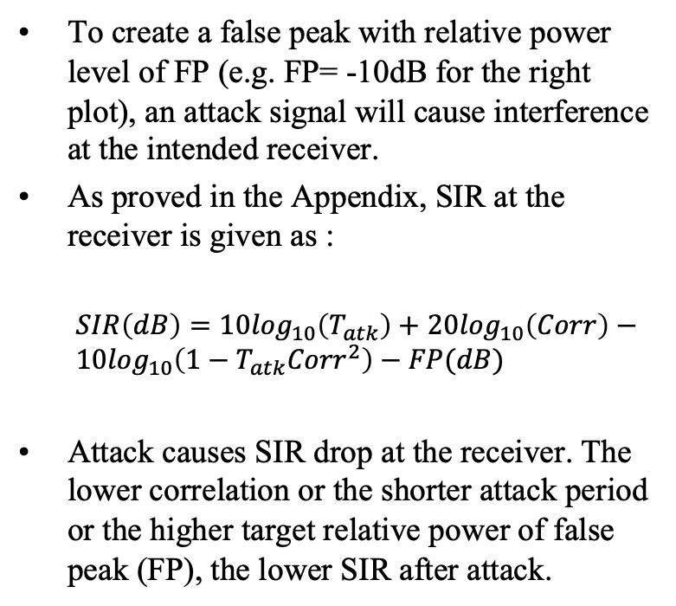
Big Picture: Attack Leads to SIR Drop
To create a false peak with relative power level of FP (e.g. FP= -10dB for the right plot), an attack signal will cause interference at the intended receiver.
As proved in the Appendix, SIR at the receiver is given as :
  $SIR\left(dB\right)=10\log_{10}\left(T_{atk}\right)+$ $20\log_{10}\left(Corr\right)−10\log_{10}\left({1−T}_{atk}{Corr}^{2}\right)−FP(dB)$
Attack causes SIR drop at the receiver. The lower correlation or the shorter attack period or the higher target relative power of false peak (FP), the lower SIR after attack.
95% Corr range for T_{atk}=3/8 and T_{ob}=5/8
Time Domain random : <=0.25
All QAMs: <=0.4
:QPSK: <= 0.7
Slide 11

Slide 12
SIR with different FP
Golay Attack [3]
SIR curves move opposite direction to changes in FP
  for FP = -15dB, curves move up by 5dB comparing to FP=-10dB case.

Slide 13
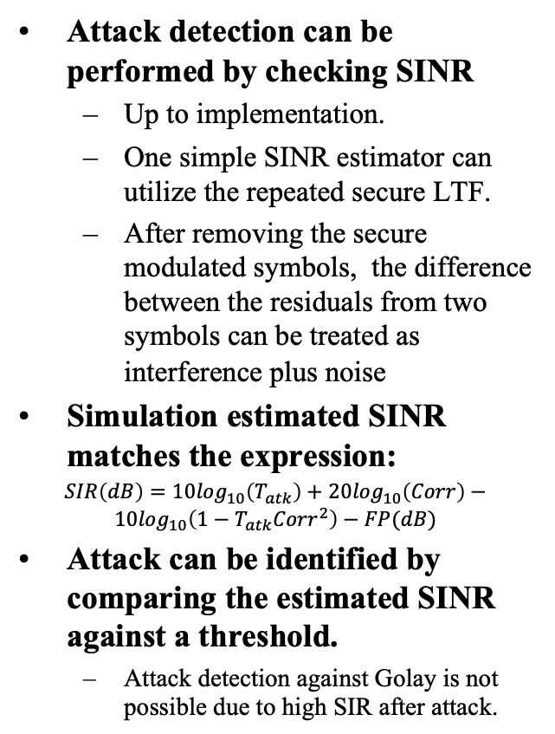
Attack Detection Simulation
Attack detection can be performed by checking SINR
  Up to implementation.
  One simple SINR estimator can utilize the repeated secure LTF.
  After removing the secure modulated symbols, the difference between the residuals from two symbols can be treated as interference plus noise
Simulation estimated SINR matches the expression:
$SIR\left(dB\right)=10\log_{10}\left(T_{atk}\right)+$ $20\log_{10}\left(Corr\right)−10\log_{10}\left({1−T}_{atk}{Corr}^{2}\right)−FP(dB)$
Attack can be identified by comparing the estimated SINR against a threshold.
  Attack detection against Golay is not possible due to high SIR after attack.
SNR = 30 dB, Attack Period = 0.375, Observe Period = 0.625
16/64/256 QAM: secure. Similar correlation. Attack leads to <0dB SINR which can be easily detected
QPSK: marginally secure. Attack leads to <5dB SNR.
Ideal attack (assuming attack knows the signal perfectly (100% corr) after the observation period).

Slide 14
Remarks on
Results of Per-Tone Estimation Attack
Security of LTF is not just about whether an attacker can recover the sequence
  Delay attacker from generating a correlated attack signal
  Shrink potential attack duration to make attack more detectable
If attacker uses per-tone processing, 16QAM and above QAM modulation based LTF is secure
  Potential attack signal correlation is relatively small.
  Partially correlated, part-time attack signal forces SINR below 0 dB at the receiver, which makes the attack easily detectable.

Slide 15
Sequential Detection Based attack via Viterbi Algorithm

Slide 16
Overview
In the past analysis, we have shown that 16QAM is secure enough if attacker employs per tone slicing.
The question remains what if the attacker using sequential detection scheme
  Brute force ML is computational prohibitive given the short duration of LTF symbol and amount of entropy from PHY signal
  Viterbi scheme is more computationally efficient and its performance close to ML.
In this analysis we study the performance when Viterbi scheme is used

Slide 17
Viterbi Equalizer
The Viterbi equalizer approach is described in [3, 6]
  Apply windowing in the time domain over the observation period.
  Prefer Hamming window to reduce the equalizer tap in frequency domain
  Time domain windowing is equivalent to frequency domain convolution which leads to ICI
  Viterbi equalizer can be used to solve this problem optimally
    Performance depends on the number of filter taps to be modeled in Viterbi equalizer
Computational cost mainly depends on the number of states in Viterbi, K. K= 2^(bit per symbol * (tap-1))
  For 16QAM, K= 256 and 64k for tap 3 and 5 filter
  For 64QAM, K= 4k and 16M for tap 3 and 5 filter
  Number of states and metric computations are illustrated next.

Slide 18
Frequency response due to partial observation and filtering
Frequency responses as function of partial observation duration in dB
Choose a threshold to determine number of taps to include in Viterbi decoder and number of states.
Lower threshold is required (more taps) for success of MLSE for higher order of modulation
  To capture taps >-20dB, needs to have 7 taps for Viterbi when observation period=1/2
  M: number of observation samples
  N: number of total samples in OFDM symbol

Slide 19
Number of Viterbi states vs. Partial Observation
Figure shows:
Accommodate taps that are within -20 dB of maximum
Metric calculations only for one-round on trellis
Does not include retracing, comparison, elimination
  M: number of observation samples
  N: number of total samples in OFDM symbol

Slide 20
16QAM with Viterbi Equalizer (64K States, 5 Taps)
BER and Corr: T_{ob} = 1/2
CDF of Bit Error Rate at Attacker after partial observation
CDF of correlation coefficient of attacker signal with true signal
SNR = 30 dB, Norm. Observation Period = 0.5
SNR = 30 dB, Norm. Attack Period = 0.5
5-tap Viterbi can not recover the signal, with observation period of 1/2
Attack performance is worse than per-tone (slicer) based approach

Slide 21
16QAM with Viterbi Equalizer (64K States, 5 Taps)
BER and Corr: T_{ob} = 9/16
CDF of Bit Error Rate at Attacker after partial observation
CDF of correlation coefficient of attacker signal with true signal
SNR = 30 dB, Norm. Observation Period = 0.5625
SNR = 30 dB, Norm. Attack Period = 0.4375
When observation duration gets longer, like 6/19, Viterbi equalizer starts to show better performance and generate highly correlated (>0.9) attack signal

Slide 22
16QAM with Viterbi Equalizer (256 States, 3 Taps)
BER and Corr: T_{ob} = 9/16
CDF of Bit Error Rate at Attacker after partial observation
CDF of correlation coefficient of attacker signal with true signal
SNR = 30 dB, Norm. Observation Period = 0.5625
SNR = 30 dB, Norm. Attack Period = 0.4375
For 256-State Viterbi, even 9/16 observation period is not sufficient to generate highly correlated attack signal
Performance is even worse than per-tone (slicing) approach

Slide 23
16QAM with Viterbi Equalizer (256 States, 3 Taps)
BER and Corr: T_{ob} = 3/4
CDF of Bit Error Rate at Attacker after partial observation
CDF of correlation coefficient of attacker signal with true signal
SNR = 30 dB, Norm. Observation Period = 0.75
SNR = 30 dB, Norm. Attack Period = 0.25
256-State Viterbi equalizer needs long observation period (e.g. ¾) to generate highly correlated attack signal

Slide 24
64QAM Viterbi Equalizer (4096 States, 3 Taps) T_{ob} = 3/4
CDF of correlation coefficient of attacker signal with true signal
SNR = 30 dB, Norm. Attack Period = 0.25
If secure LTF is using 64QAM, despite a large observation period of 3/4, attacker can not generate highly correlated attack signal using 3 tap Viterbi algorithm.

Slide 25
256QAM Viterbi Equalizer (64k States, 3 Taps)
T_{ob} = 3/4
CDF of Bit Error Rate at Attacker after partial observation
CDF of correlation coefficient of attacker signal with true signal
SNR = 30 dB, Norm. Observation Period = 0.75
SNR = 30 dB, Norm. Attack Period = 0.25
For 256QAM modulated LTF, even after observation period of 3/4 the attacker still can not generate high correlation signal using 3 tap Viterbi algorithm
5 Tap Viterbi requires 4G states!

Slide 26
Remarks on Sequence Detection Results
16QAM: marginally secure
  5 Tap, 64k state Viterbi equalizer can generate a highly correlated attack signal after observation period of 9/16
64 QAM or equivalent entropy: secure
  3 Tap, 4096 state Viterbi equalizer can NOT generate a highly correlated attack signal even after observation period of 3/4
  5 Tap filter requires 16M state Viterbi. Even with millions of states, still requires significant observation period
256 QAM or equivalent entropy: very secure
  3 Tap, 64k state Viterbi equalizer can NOT generate highly correlated attack signal even after observation period of 3/4
  5 Tap Viterbi requires 4G (2^32) states
Our recommendation: 64 QAM
  Balance the security, complexity and ranging performance

Slide 27
Multi-Stream Signal Case

Slide 28
Introduction
In previous sections, we discussed the security performance of different modulations for secure LTF. Those results were for the single stream case
  Assuming the worst-case scenario: attacker achieves AWGN channel from the transmitter
Now, we want to expand the analysis to multi-stream case:
  Assume the worst-case scenario: attacker achieves AWGN channel for each TX antenna. It can receive each stream signal separately with degradation from only AWGN noise
  It can combine the observations from all the streams in computation
To mitigate unintentional beamforming, we might consider introducing per stream phase rotation

Slide 29
Case I per SS Fixed Phase Rotation (1ss vs 4ss)
CDF of Bit Error Rate at Attacker (fixed phase)
CDF of correlation coefficient of attacker signal with true signal (fixed phase)
SNR = 100 dB, Norm. Observation Period = 0.625
SNR = 100 dB, Norm. Attack Period = 0.375
When each stream applies fixed phase rotation to all the tones, attacker can not gain much from combining multi-streams
  ICI is dominant but ICI is the same across different streams so it can not be averaged.
However, per SS fixed phase rotation causes unintentional beamforming at certain direction

Slide 30
Case II per SS Pseudo-random Phase Rotation
(1ss vs 4ss)
CDF of Bit Error Rate at Attacker (random phase rotation)
CDF of correlation coefficient of attack signal with true (random phase rotation)
SNR = 100 dB, Norm. Observation Period = 0.625
SNR = 100 dB, Norm. Attack Period = 0.375
When each stream applies pseudo-random phase rotation on each tone, it provides ICI diversity to attacker
  Cross correlation between attack signal and signal >0.8 for QAM
  Different phase rotation causes ICI variation among different streams and provides combining gain to reduce ICI.

Slide 31
Discussion
Per tone randomized per stream phase rotation provides ICI diversity to attacker and introduces a security vulnerability
Per stream phase rotation must be constant for all the tones in all the LTF symbols within a repetition
We propose time diversity from secure LTF repetitions to mitigate unintentional BF issue:
  For reach repetition, apply the same beamforming direction on all the tones
  Beamforming direction changes per repetition such that any negative impact from unintentional BF doesn’t persist across repetitions

Slide 32
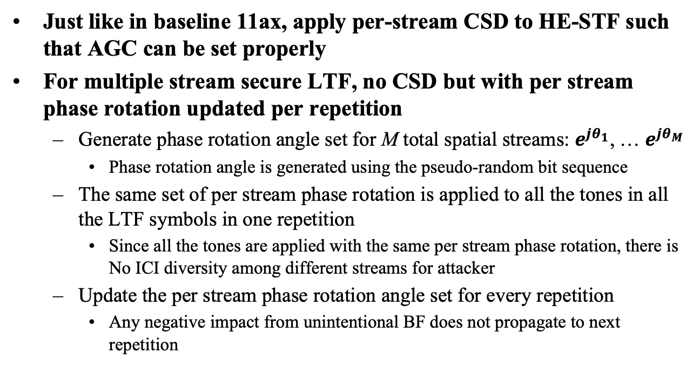
Proposals on Multi-Stream Signal Generation
Just like in baseline 11ax, apply per-stream CSD to HE-STF such that AGC can be set properly
For multiple stream secure LTF, no CSD but with per stream phase rotation updated per repetition
  Generate phase rotation angle set for M total spatial streams: $e^{jθ_{1}}$, … $e^{jθ_{M}}$
    Phase rotation angle is generated using the pseudo-random bit sequence
  The same set of per stream phase rotation is applied to all the tones in all the LTF symbols in one repetition
    Since all the tones are applied with the same per stream phase rotation, there is No ICI diversity among different streams for attacker
  Update the per stream phase rotation angle set for every repetition
    Any negative impact from unintentional BF does not propagate to next repetition

Slide 33

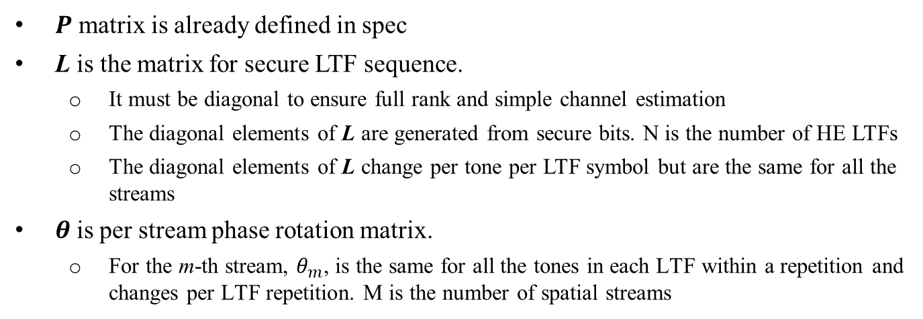
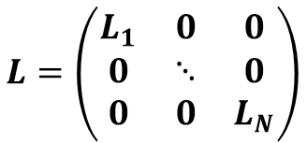
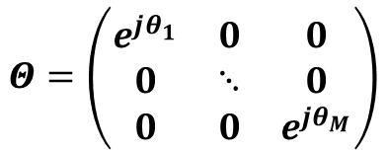
Multi-stream LTF Generation: Equations
The (per-tone) operation can be written as,
$$X=Θ P L$$
where $Θ$ and $L$ are diagonal matrices
$$Θ=\left(\begin{matrix}e^{jθ_{1}} & 0 & 0 \\ 0 & ⋱ & 0 \\ 0 & 0 & e^{{jθ}_{M}}\end{matrix}\right)$$
$$L=\left(\begin{matrix}L_{1} & 0 & 0 \\ 0 & ⋱ & 0 \\ 0 & 0 & L_{N}\end{matrix}\right)$$
$P$ matrix is already defined in spec
L is the matrix for secure LTF sequence.
  It must be diagonal to ensure full rank and simple channel estimation
  The diagonal elements of L are generated from secure bits. N is the number of HE LTFs
  The diagonal elements of L change per tone per LTF symbol but are the same for all the streams
$θ$is per stream phase rotation matrix.
  For the m-th stream, $θ_{m}$, is the same for all the tones in each LTF within a repetition and changes per LTF repetition. M is the number of spatial streams

Slide 34
Multi Stream Secure LTF Generation
Per stream phase rotation angle is the same for all the tones and all the LTFs in one repetition, and updated every repetition

Slide 35
PAPR Analysis

Slide 36
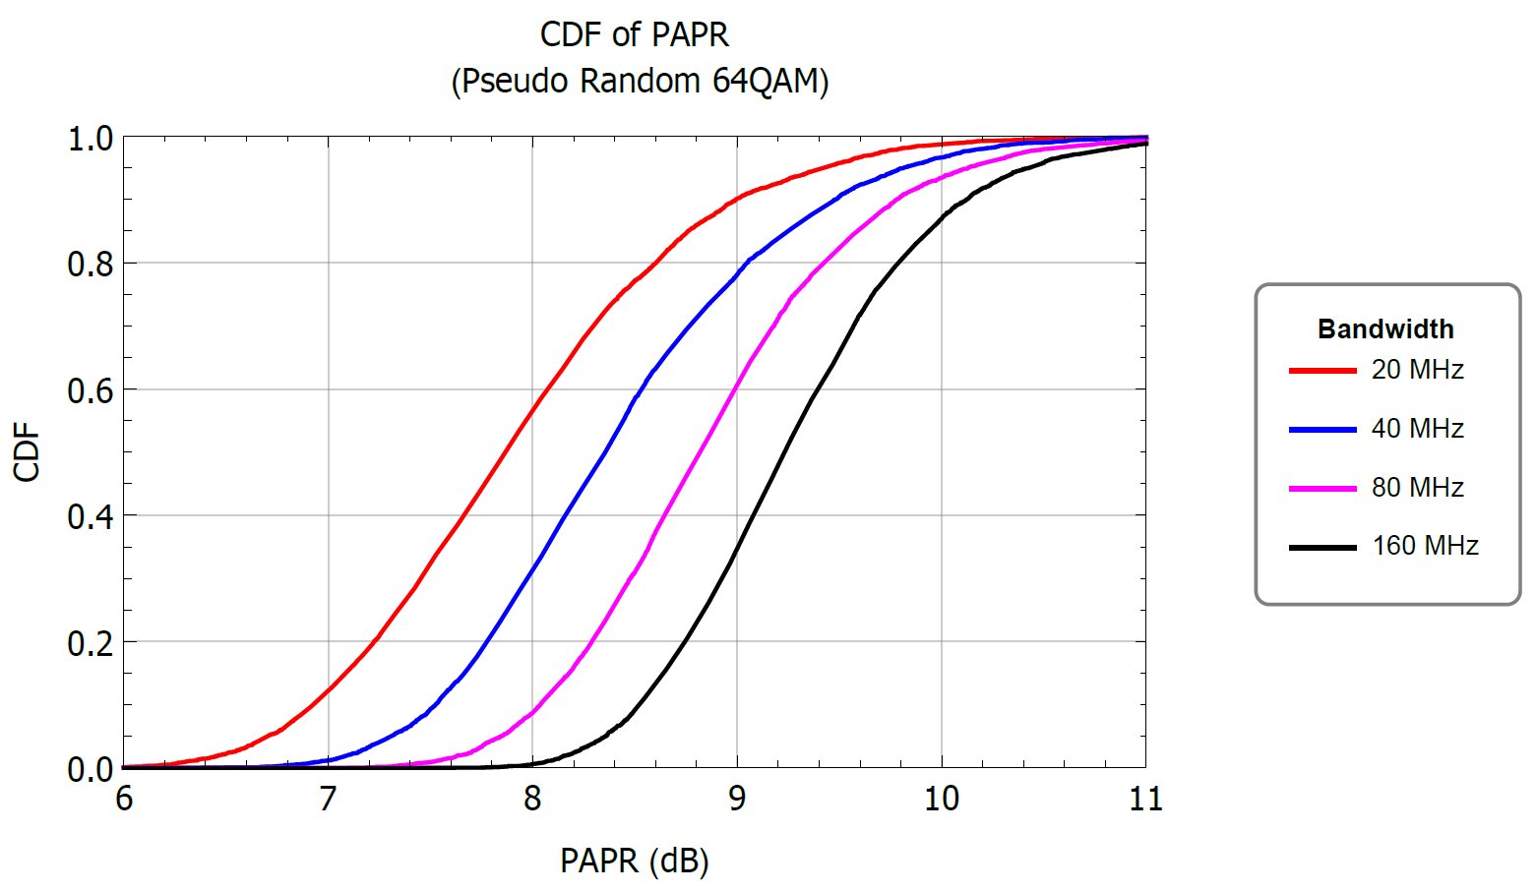
PAPR – Pseudo Random 64-QAM
PAPR for pseudo-random 64QAM is the same as pseudo-random QPSK

Slide 37
PN pseudo-random Generator

Slide 38
Secure PN Generator
Need for Secure PN Generator
  It is necessary to add a Secure PN Generator to PHY Layer since the number of bits required exceeded the capacity of the MAC/PHY control interface in many implementations
Choice of Secure PN Generator
  Here, we propose use of the AES-128 Counter Mode (AES-128 CTR) block cipher to generate the Secure PN bit needed to construct the Secure LTF sequences
  AES-128 CTR has been approved by NIST and is widely considered very secure
  AES is familiar to IEEE 802.11 engineers since it is used for MAC layer security

Slide 39
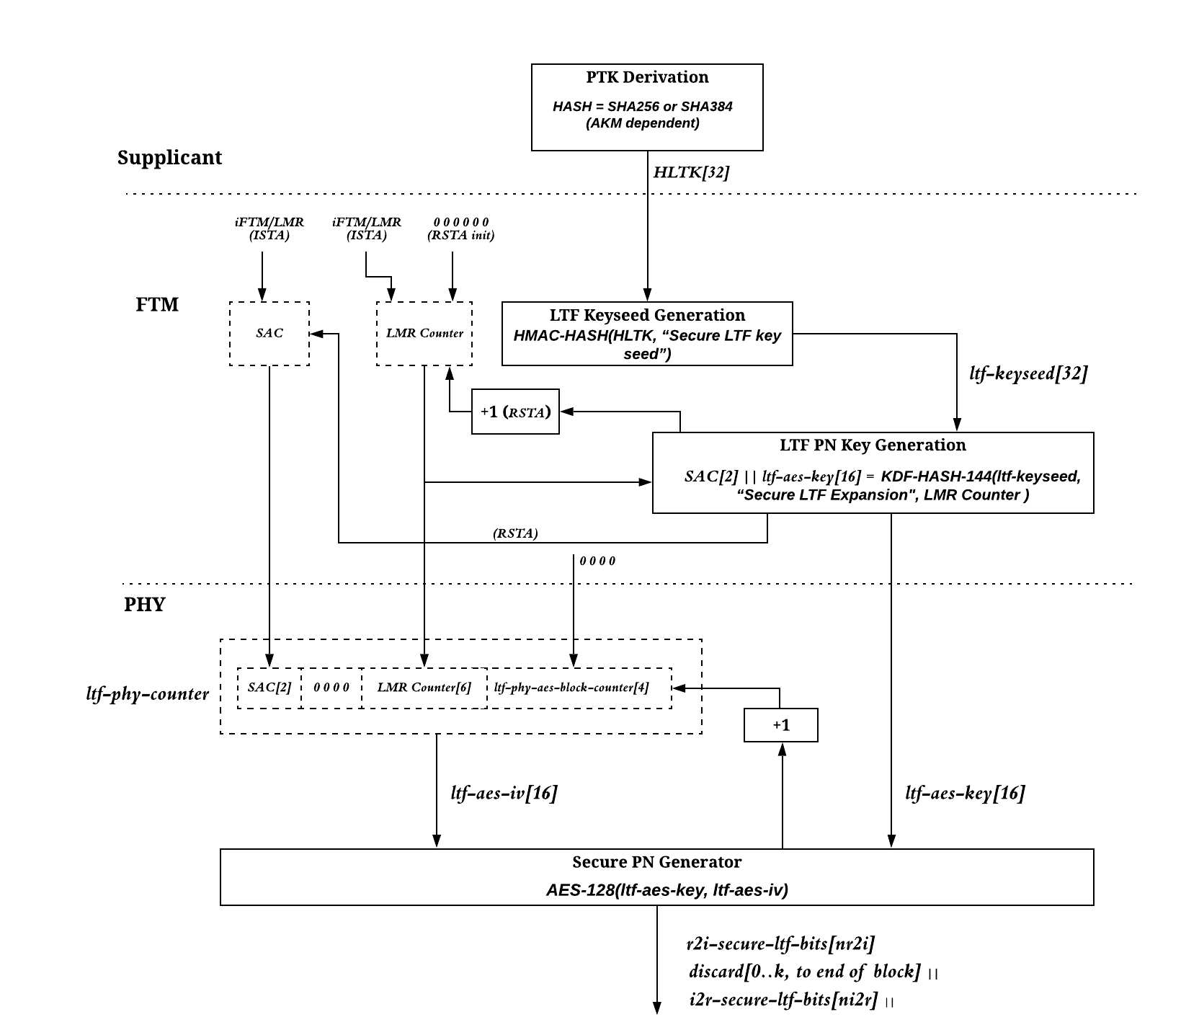
Secure PN Generation

Slide 40
Secure PN Generator
AES-128 Counter Mode Operation
  AES-128 is reinitialized at the beginning of each Secure NDP
  The 128-bit Key and the 128-bit Initiation Vector are provided by the MAC Layer at the beginning of the NDP
  The MAC uses the Key Derivation Function (KDF) to generate the 128-bit Key and 128-bit Initialization Vector
  So the MAC provides 256 bits over MAC/PHY Control Interface
  The AES engine provides all the required PN bits for the entire NDP before reinitialization at the beginning of the next NDP
  This applies to all bandwidths (20/40/80/160 MHz)

Slide 41
Number of Pseudo-random Bits Required
For one secure LTF symbol
For entire NDP, the needed pseudo-random bits = per LTF bits x Number of secure LTFs
  Max number of secure LTF is 64
Bandwidth (MHz) | Number of Non-Zero Tones | Number of Secure Bits for One Secure LTF (8PSK with Golay Structure) | Number of Secure Bits Needed for One Secure LTF (QPSK Modulation) | Number of Secure Bits Needed for One Secure LTF (16-QAM Modulation) | Number of Secure Bits Needed for One Secure LTF (64-QAM Modulation)
20 | 122 | 31 | 244 | 488 | 732
40 | 242 | 35 | 484 | 968 | 1452
80 | 498 | 39 | 996 | 1992 | 2988
160 | 996 | 43 | 1992 | 3984 | 5976

Slide 42
Summary of Proposal

Slide 43
Proposals on 11az Secure LTF Changes
Secure PN Generation at PHY using AES-128 CTR
New modulation to increase signal entropy
  64QAM
Per stream phase rotation updated every secure LTF repetition
  Per stream phase rotation angles are the same for all the tones and all the LTFs in one repetition

Slide 44
SP 1
Do you agree to replace the existing 11az secure LTF design parameters with the following changes
  Using secure pseudo random 64QAM modulation
    A single secure LTF value is used across all streams for a single tone
  Using AES-128 CTR as pseudo random bit generator for sounding NDP sequence
    A 256-bit sequence from KDF is used to initialize AES128-CTR by using 1st 128 bits as the Key and 2nd 128 bits as IV
  Using per stream phase rotation which is updated every secure LTF repetition
    Per stream phase rotation angles are the same for all the tones and all the LTFs in one repetition
Y/N/ABS

Slide 45
References
[1] 802.11-20/0374r0 Computational Attacks on 11az PHY Secure Ranging
[2] 802.11-20/0375r1 Improved Secure LTF
[3] 802.11-20/0381r1 On Brute Force Attack to 11az Secure mode
[4] 802.11-19/1572r5 Secure LTF: Unintentional Beamforming problem and a Solution Proposal
[5] 802.11-20/0378r0 Secure LTF Attack Simulation
[6] 802.11-20/0710r1 Attacks to Fully Random QPSK Sounding Signal

Slide 46
Appendix

Slide 47
BER and Corr: T_{ob} = 3/8, T_{atk} = 5/8
CDF of Bit Error Rate at Attacker
CDF of correlation coefficient of attacker signal with true signal
SNR = 30 dB, Norm. Observation Period = 0.375
SNR = 30 dB, Norm. Attack Period = 0.625
(Computed over attack period)
Not much difference among different modulation orders
All close to time domain pseudo-random Gaussian waveform

Slide 48
BER and Corr: T_{ob} = 1/2, T_{atk} = 1/2
CDF of Bit Error Rate at Attacker
CDF of correlation coefficient of attacker signal with true signal
SNR = 30 dB, Norm. Observation Period = 0.5
SNR = 30 dB, Norm. Attack Period = 0.5
(Computed over attack period)

Slide 49
BER and Corr: T_{ob} = 3/4, T_{atk} = 1/4
CDF of Bit Error Rate at Attacker
CDF of correlation coefficient of attacker signal with true signal
SNR = 30 dB, Norm. Observation Period = 0.75
SNR = 30 dB, Norm. Attack Period = 0.25
(Computed over attack period)

Slide 50
If Viterbi Equalizer uses a lower order modulation to approximate signal (64k States, Tap 5) T_{ob} = 3/4
CDF of correlation coefficient of attacker signal with true signal
SNR = 30 dB, Norm. Attack Period = 0.25
(Computed over attack period)
If LTF using 64QAM or 256QAM while attacker using 16QAM in equalizer to approximate the signal, the attack signal correlation is small every for T_{ob} = 3/4

Slide 51
SIR degradation due to Computational Attacks (Derivation)

Slide 52
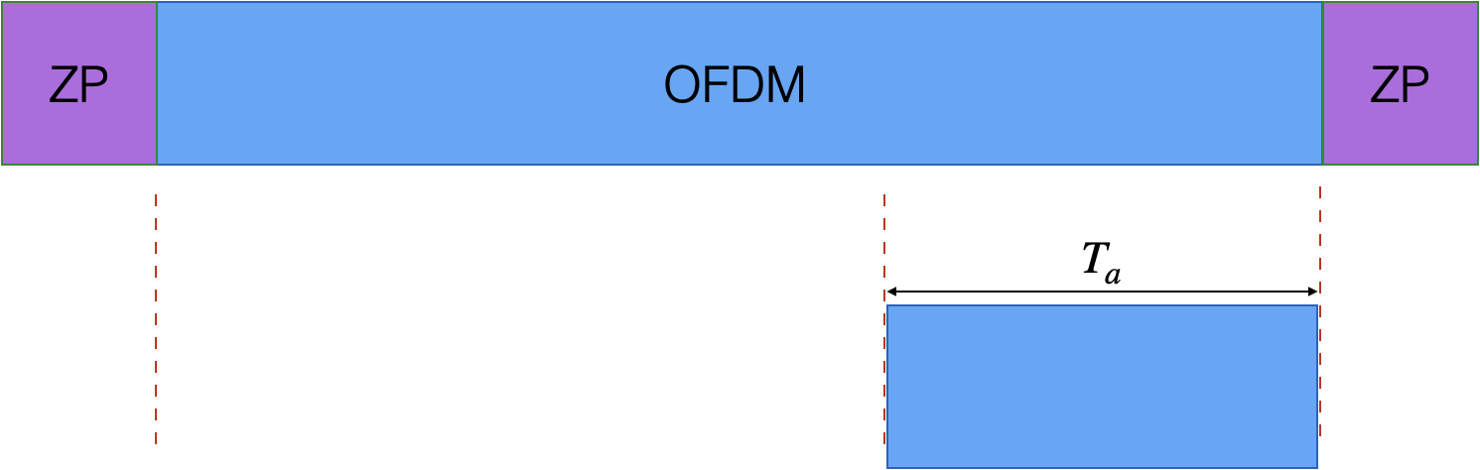







Definitions
OFDM symbols at the receiver (ignoring multipath for simplicity)
Attacker Contribution (above)
$$s\left(t\right)+n(t)$$
$$Attempted Time Advance:τ$$
$$A∙\left(ρ∙s\left(t+τ\right)+\sqrt{1−ρ^{2}∙}u(t)\right)$$
$$0<τ≪T_{a}$$
Fractional attack period: $T_{a}, 0≤T_{a}≤1$
All signals are unit variance except noise
Correlation coefficient: $ρ, 0≤ρ≤1$
(Computed over attack period)
Uncorrelated component in attack: $u(t)$

Slide 53
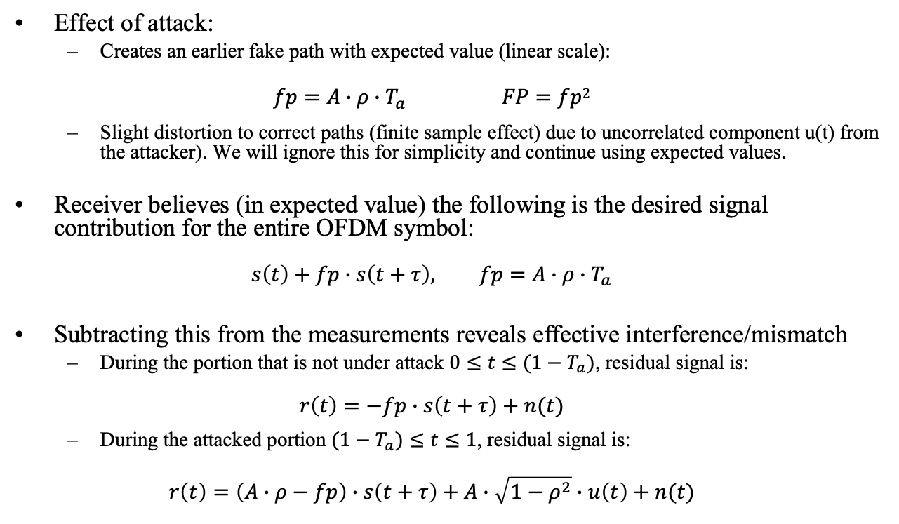
Effects of Attack
Effect of attack:
  Creates an earlier fake path with expected value (linear scale):
  $$fp=A∙ρ∙T_{a} FP=fp2$$
  Slight distortion to correct paths (finite sample effect) due to uncorrelated component u(t) from the attacker). We will ignore this for simplicity and continue using expected values.
Receiver believes (in expected value) the following is the desired signal contribution for the entire OFDM symbol:
  $$s\left(t\right)+fp∙s\left(t+τ\right), fp=A∙ρ∙T_{a}$$
Subtracting this from the measurements reveals effective interference/mismatch
  During the portion that is not under attack $0≤t≤(1−T_{a})$, residual signal is:
  $$r\left(t\right)=−fp∙s\left(t+τ\right)+n(t)$$
  During the attacked portion $(1−T_{a})≤t≤1$, residual signal is:
  $$r\left(t\right)=\left(A∙ρ−fp\right)∙s\left(t+τ\right)+A∙\sqrt{1−ρ^{2}}∙u\left(t\right)+n(t)$$

Slide 54

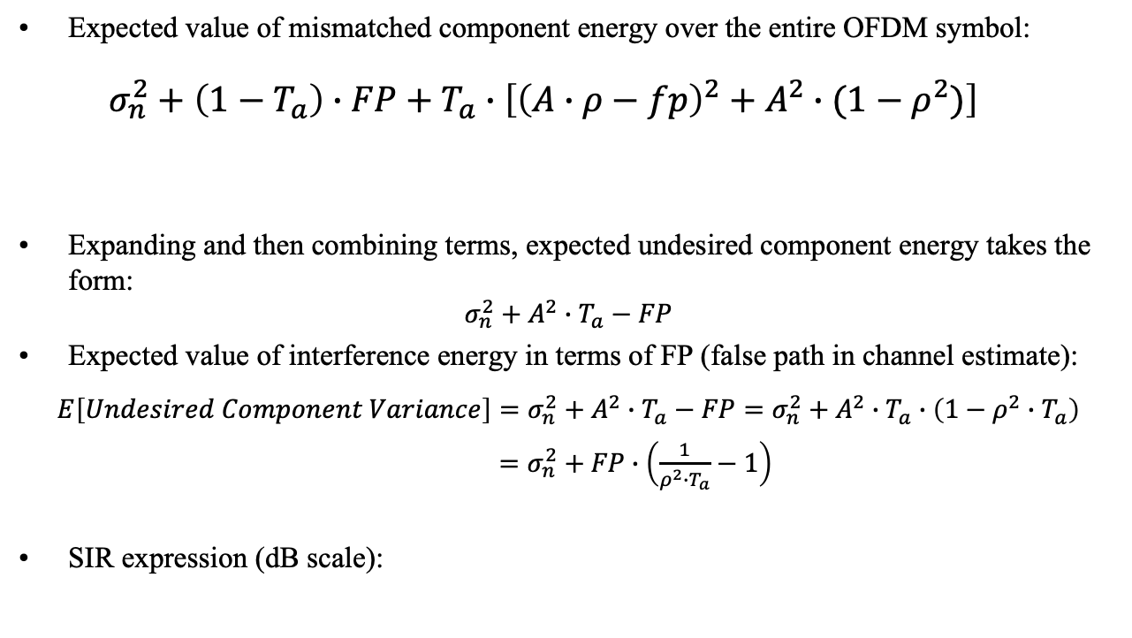
Energy of Mismatched Components
Expected value of mismatched component energy over the entire OFDM symbol:
  $$σ_{n}^{2}+\left(1−T_{a}\right)∙FP+T_{a}∙\left[{\left(A∙ρ−fp\right)}^{2}+A^{2}∙(1−ρ^{2})\right]$$
Expanding and then combining terms, expected undesired component energy takes the form:
$$σ_{n}^{2}+A^{2}∙T_{a}−FP$$
Expected value of interference energy in terms of FP (false path in channel estimate):
$$E\left[Undesired Component Variance\right]=σ_{n}^{2}+A^{2}∙T_{a}−FP=σ_{n}^{2}+A^{2}∙T_{a}∙\left(1−ρ^{2}∙T_{a}\right)$$
  $=σ_{n}^{2}+FP∙\left(\frac{1}{ρ^{2}∙T_{a}}−1\right)$
SIR expression (dB scale):
Noise
Duty factor of
un-attacked portion
Duty factor of
attacked portion
Perfect attack: $ρ^{2}∙T_{a}→1:Variance→σ_{n}^{2}$
SIR(dB) = $−FP(dB)$+ 10 $∙$log₁₀($ρ^{2}∙T_{a}$)$−\text{1}0∙\text{log}\text{10}\text{(}\text{1}−ρ^{2}∙T_{a}\text{)}$

Slide 55

Illustration: Ignore Noise, FP = -10 dB, Vary $ρ$
Golay Attack

Slide 56
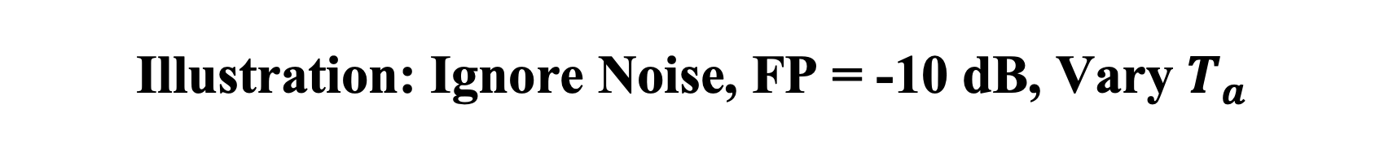
Illustration: Ignore Noise, FP = -10 dB, Vary $T_{a}$
Golay Attack

