Slide 1
Pilot Locations in 996 RU
Date: 2020-05-29
Authors:
Name | Affiliations | Address | Phone | email
Ron Porat | Broadcom |  |  | ron.porat@broadcom.com
Leo Montreuil | Broadcom

Slide 2
Abstract
Previously agreed on a tone plan for 80MHz OFDMA (20/0666) that uses a 40MHz DUP structure.
We have looked at the pilot locations in the 996RU and propose to shift them so they are aligned with the pilot locations in the smaller RU (as was done in 11ax)

Slide 3
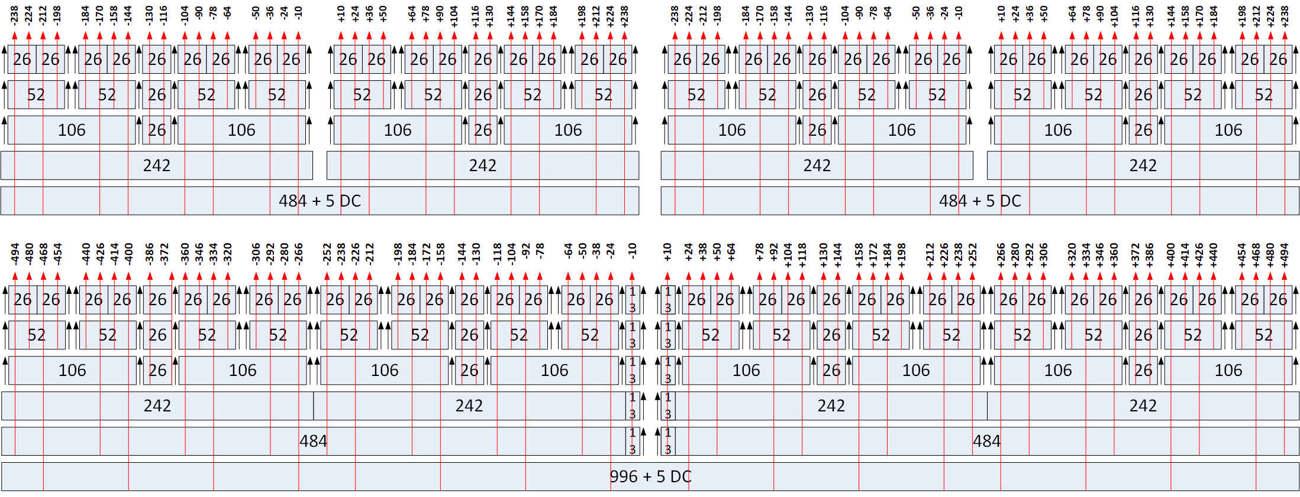
Pilot locations in 996 RU
Proposed 996RU pilots : {-468 -400 -334 -266 -220 -152 -86 -18 +18 +86 +152 +220 +266 +334 +400 +468}
11ax 996RU pilots : {-468 -400 -334 -266 -226 -158 -92 -24 +24 +92 +158 +226 +266 +334 +400 +468}
Subtract 256
11be 80 MHz OFDMA Tone Plan
Add 256
11ax 80 MHz Tone Plan

Slide 4
Discussion
As discussed in 20/0666, the only change in the new 80MHz OFDMA tone plan is a shift towards DC of the two inner 242RUs
Hence, out of the 16 pilots in the 996 RU only 8 are impacted in the proposal and are shifted in a similar way by 6 tones towards DC.
The proposed alignment of pilot locations also helps with sounding feedback and beamformed transmissions.
If NDP uses full BW 80MHz then 8 inner pilot locations (that require interpolation) will actually be used for data transmissions in OFDMA which is undesirable
If NDP uses punctured 80MHz, hence the OFDMA tone plan, then STA needs to do interpolation around different pilot locations which is also undesirable

Slide 5
Summary
Proposed to align pilot locations of 996 RU with the 80MHz OFDMA tone plan

Slide 6
SP #1
Do you support aligning the inner 8 pilot locations with the smaller RU pilot locations as shown in the red?
{-468 -400 -334 -266 -220 -152 -86 -18 +18 +86 +152 +220 +266 +334 +400 +468}
Y
N
A

