Slide 1
Tentative (Re)Association for Non-AP MLD
Date: 2020-05-19
Authors:
Name | Affiliations | Address | Phone | Email
Guogang Huang | Huawei | Shenzhen, China |  | huangguogang1@huawei.com
Ming Gan |  |  |  | ming.gan@huawei.com
Yunbo Li |  |  |  | liyunbo@huawei.com
Yuchen Guo |  |  |  | guoyuchen@huawei.com
Yifan Zhou |  |  |  | zhouyifan8@huawei.com
Yiqing Li |  |  |  | liyiqing3@huawei.com

Slide 2
Introduction
For a STA with one single radio, the data delivery will be interrupted during a roaming until the re-association with a new AP is completely finished
Contribution [1] first proposed the “Make Before Break” concept to reduce the gap in data delivery during a roaming in 2003
  Exploit the power save mechanism to communicate to both old AP and new AP on the different channels
  Considering the fact of inter-frequency deployment and the limitation of only one single radio, the data delivery will be still interrupted during the tentative association with the new AP on a different channel
This contribution will address how to implement the “Make Before Break” scheme under the MLD framework

Slide 3
Recap-Association Operation
Necessary Actions before data transfer
  802.11 open system authentication
  Exchange Association Request/Response frames
  802.1X authentication if needed
    Derived PMK
  4-way handshake if needed
    Derived PTK and GTK
(PMK)

Slide 4
Recap-Association Operation
802.11 Spec-2016. At any given instant, a STA is associated with no more than one AP. This allows the DS to determine a unique answer to the question, “Which AP is serving STA X?” Once an association is completed, a STA can make full use of a DS (via the AP) to communicate.
DS-STA-NOTIFY.request primitive
  Update STA-AP Mapping info
When to send DS-STA-NOTIFY.request primitive to the DS is not specifically defined in the current Spec.
  The reason may be that it doesn’t matter for the single-radio client

Slide 5
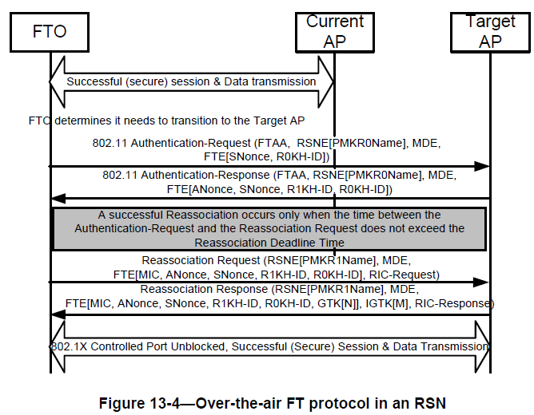
Recap-Fast BSS Transition
AC/AS
The data delivery is interrupted during this period.
Maybe need to go to AC/AS to inquire PMKID info

Slide 6
Recap-Make Before Break [1]
Main Idea
  In order to minimize or eliminate any gap in data connectivity while roaming, it is proposed to let a STA make a partial connection with a new AP without dropping the connection with the old AP.
  Then the STA can negotiate with the new AP to set up the correct conditions for data connectivity, while still using the old AP for data connectivity.
  Once the correct conditions are set up, the new AP will trigger DS-STA-Notify.request to update STA-AP mapping info. The STA can then break the connection with the old AP, and the new AP start using the new AP for data connectivity.

Slide 7
Recap-Make Before Break (Cont.)
Split necessary actions before data transfer into two parts
  Part-1 action. All necessary actions except of STA-AP Mapping Notification
    e.g. Authentication, Association Request/Response, 802.1 X authentication, 4-way handshake to generate PTK and GTK, even BA agreement setup
    Note that existing EAPOL security communications are, strictly speaking, between the STA and the AP; the AP proxies these messages to the DS using its own MAC address, rather than the MAC address of the STA.
      In other word, during this period, communication is only allowed between STA and AP, but not from STA to DS directly.
  Part-2 action. STA-AP Mapping Notification by using the DS-STA-NOTIFY.request primitive to the DS

Slide 8
Recap-Make Before Break (Cont.)
Procedure of Make Before Break
  Step 1. STA sends a Tentative Association Request to the new AP.
  Step 2. Once the new AP responds to this request with a Tentative Association Response, the new AP and the STA would then be free to do Part-1 actions in order
  Step 3. STA sends a Complete Association Request to the new AP
  Step 4. In response, the new AP sends a Complete Association Response to the STA, and the STA-AP Mapping Notification to the DS.
    At this point, the association is complete, and the data delivery can go through the new AP.

Slide 9
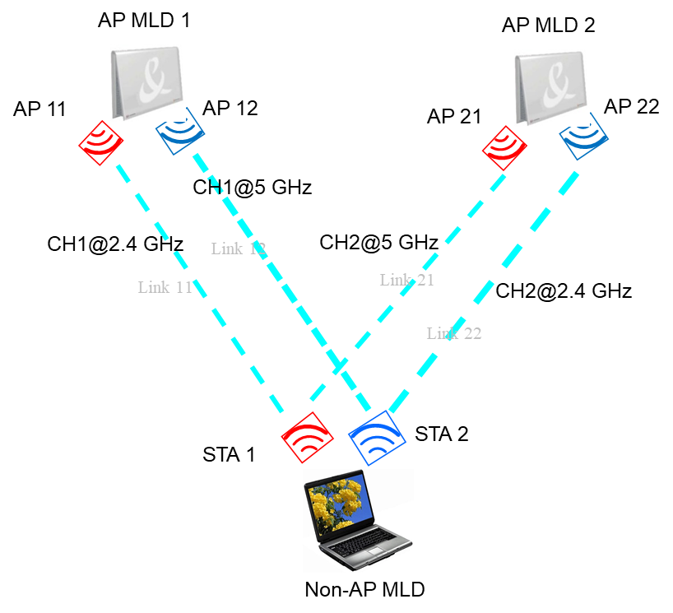
Make Before Break for Non-AP MLD
In the following, we will give a possible procedure to describe the Make Before Break scheme under the MLD framework
  Step 1. Non-AP MLD disable one link with AP MLD 1, e.g. link 12, and the corresponding Reason Code is set to Tentative Association. Perhaps the TID-to-link mapping needs to be renegotiate with AP MLD 1
  Step 2. STA 2@Non-AP MLD switches to CH2@2.4 GHz and sends a tentative Multi-link Association Request to AP 22@ AP MLD 2, while indicating the status of STA 1@Non-AP MLD is disable
  Step 3. AP MLD 2 replies a tentative Multi-link Association Response
  Step 4. Then Non-AP MLD is free to do any action of Part-1.
  Step 5. Non-AP MLD sends a frame (named STA-AP Mapping Notify) to trigger AP MLD 2 to sending DS-STA-NOTIFY.request to DS.
  Step 6. To minimize the gap in data delivery during a roaming, STA 1@non-AP MLD can switch to CH2@5 GHz at a certain point after AP MLD 2 sending DS-STA-NOTIFY.request to DS

Slide 10
Make Before Break under MLD Framework
Extension 1
  For the roaming scenario, assuming that Non-AP MLD having 3 links, it can disable two links and initiate tentative re-association with two neighboring AP MLDs simultaneously. Finally, the Non-AP MLD would have to complete the association with only one AP MLD by sending STA-AP Mapping Notify frame.
    Pros. Increase the success rate of roaming considering the roaming may be rejected by candidate AP MLD for some reason

Slide 11
Make Before Break under MLD Framework
Extension 2
  Similarly, for the initial association scenario, assuming that Non-AP MLD having 3 links, it can initiate tentative association with three neighboring AP MLDs simultaneously. Finally, the Non-AP MLD would have to complete the association with only one AP MLD by sending STA-AP Mapping Notify frame
    Pros. Increase the success rate of association considering the association may be rejected by AP MLD due to the specific admission control policy
    To avoid performing 802.1X authentication with multiple AP MLDs, non-AP MLD maybe send a new defined frame to initiate the 802.1X authentication via only one selected AP MLD

Slide 12
Related Signaling Indication
Signaling of link status
  Option 1(Prefer) . Non-AP MLD needs to explicitly indicate the status of each non-transmitted link in the Association Request frame
    Disable. For the disable link, maybe further indicate the corresponding Reason Code, e.g. power save, low RSSI, tentative association and so on.
    Enable.
  Option 2. use the TID-to-link mapping to implicitly indicate the status of each non-transmitted link in the Association Request frame
Capability indication for tentative association
  Can be carried in Fast BSS Transition element , Mobility Domain element, RSNE or EHT Capabilities element

Slide 13
Related Signaling Indication (Cont.)
Signaling of tentative association
  In the conventional association, the 802.1X authentication, 4-way handshake and sending DS-STA-NOTIFY.request is automatically followed by successful (Re)association Request/Response exchange. In order to allow non-AP MLD simultaneously initiating tentative association with multiple AP MLDs, a new frame needs to be defined to trigger AP MLD sending DS-STA-NOTIFY.request, named as Non-AP MLD Trigger STA-AP Mapping Notify
  To differentiate with the conventional association, a signaling indication for tentative association needs to be carried in the Association Request frame
    One method is to define a new element, named Tentative Association element, which includes the following info
      Non-AP MLD Trigger STA-AP Mapping Notify. Set to 1, indicate the non-AP MLD will proactively send a frame to trigger the STA-AP Mapping Notify procedure
      Tentative Association Lifetime. Indicate the tentative association age-out time. Any communication between the non-AP MLD and AP MLD will reset the timer.
Element ID
Length
Tentative Association Control
Tentative Association Lifetime
B0
B1
B2
B3
B7
Non-AP MLD Trigger STA-AP Mapping Notify
Non-AP MLD Trigger 802.1X Authentication Notify (Optional)
Non-AP MLD Trigger 4-way Handshake Notify (Optional)
Reserved

Slide 14
Summary
In this contribution, we describe that how to implement the “Make before Break” scheme [1] under the MLD framework.
  This scheme can really realize that the data delivery is not interrupted during the roaming by exploiting the multiple radios of non-AP MLD

Slide 15
Reference
[1] 11-03-0770-06-frfh-make-before-break

Slide 16
Straw Poll 1
Do you support to standardize tentative (re)association scheme for the non-AP MLD?
  Y
  N
  A

Slide 17
Annex 802.1X Authentication
IEEE 802.16 Spec.-2016. A single IEEE 802.1X Port maps to one association, and each association maps to an IEEE 802.1X Port. Each association between a pair of STAs creates a unique pair of IEEE 802.1X Ports, and authentication takes place relative to those ports alone.
An IEEE 802.1X Port consists of an IEEE 802.1X Controlled Port and an IEEE 802.1X Uncontrolled Port.
  The IEEE 802.1X Controlled Port is blocked from passing general data traffic between two STAs until an IEEE 802.1X authentication procedure completes successfully over the IEEE 802.1X Uncontrolled Port.
Within IEEE Std 802.11, EAPOL PDUs are carried as MSDUs within one or more Data frames

