Slide 1
Trigger Frame for Frequency-domain A-PPDU Support
Date: 2020-05-20
Authors:

Slide 2
Background
Frequency-domain (FD) A-PPDU will be supported in 11be
We need a MAC protocol to support it
  Announcement/Trigger frame
DCN 0674r3 [2] contribution provides MAC requirements to support A-PPDU
  [Downlink] enhanced downlink (DL) announcement frame
  [Uplink] enhanced uplink (UL) trigger frame
In this contribution, we propose several design options for trigger frame to support FD A-PPDU

Slide 3
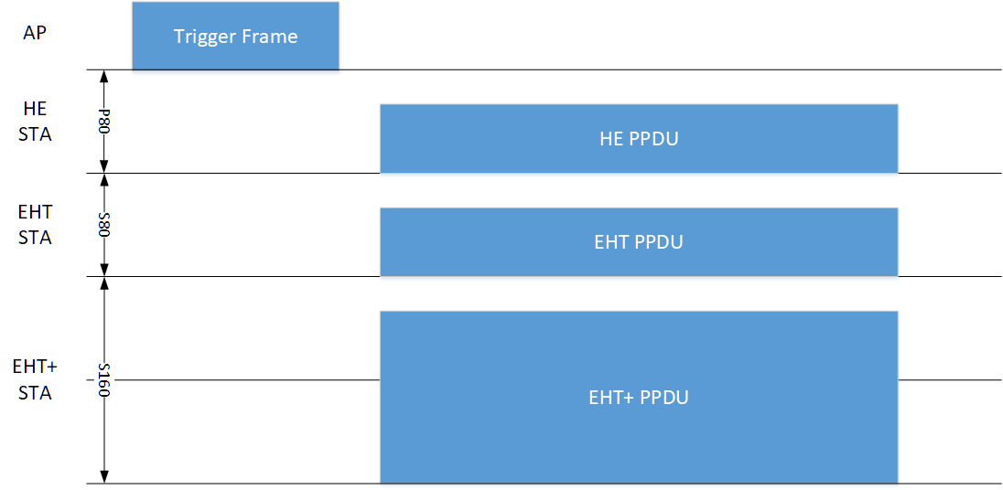
Expected UL Operation
Trigger frame allocates the 80MHz segment(s) to be used for UL
  HE STA will be assigned to use P80 or P160 (backward compatibility)
  EHT and EHT+* STA will be assigned to use secondary segments
* EHT+: the amendments after EHT

Slide 4
Design Principles for Trigger Frame
MAC requirements
  New design should support any combination of HE, EHT and EHT+ PPDUs to support UL FD A-PPDUs
  New design should incorporate “EHT and EHT+ specific” fields
    E.g., UL BW extension, RU allocation, etc.
Backward compatibility
  HE STA shall not be affected by the new design
Forward compatibility
  New design should be easily extendable for EHT+

Slide 5
Design Options for Trigger Frame
[Option1] Aggregated-MPDU design
  Define EHT/EHT+ variant of the trigger frame
  To trigger HE, EHT and EHT+ STAs with one PPDU, AP should use the A-MPDU
    E.g., Trigger frame (for HE STA) and trigger frame variant(s) (for EHT and EHT+ STA) are aggregated
[Option2] Single-MPDU design
  [Option 2a] Extend common/user info of the trigger frame by using reserved AID
    Assign specific AID(s) to indicate the common/user info fields for EHT and EHT+ STAs
  [Option 2b] Extend common/user info of the trigger frame by setting AID subfield to 4095
    Use AID 4095 (Start of padding field) for HE STA(s) not to decode EHT/EHT+ information

Slide 6
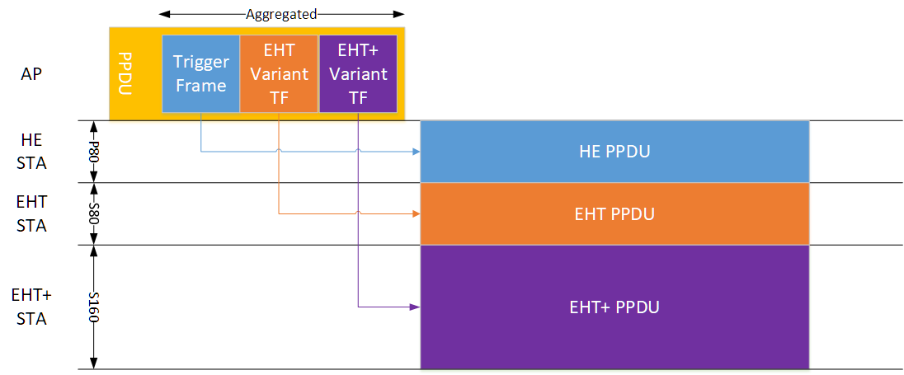
Option 1: Aggregated-MPDU Design
Operation example

Slide 7
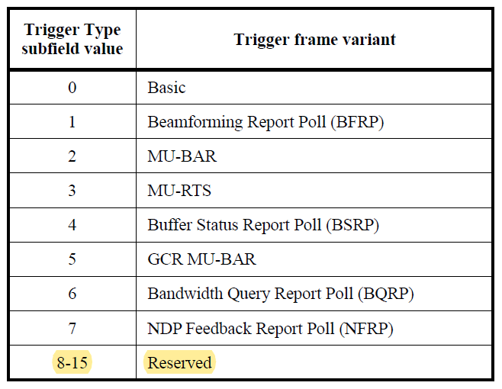
Option 1: Aggregated-MPDU Design
Trigger type subfield encoding
  Trigger type subfield is 4-bit in the trigger frame
  MSB of trigger type subfield is currently reserved
  Candidate options for indicating EHT and EHT+ variant
    [1-bit] Use MSB 1-bit as a EHT/EHT+ indication e.g., 0000: HE Basic, 1000: EHT/EHT+ Basic
    [1-subtype] Assign one subfield value. e.g., 8: EHT, 9:EHT+, 10-15: Reserved

Slide 8
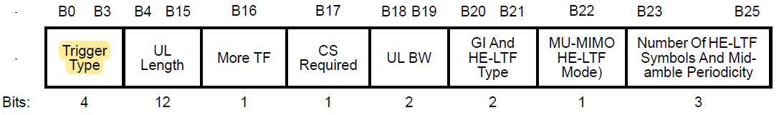
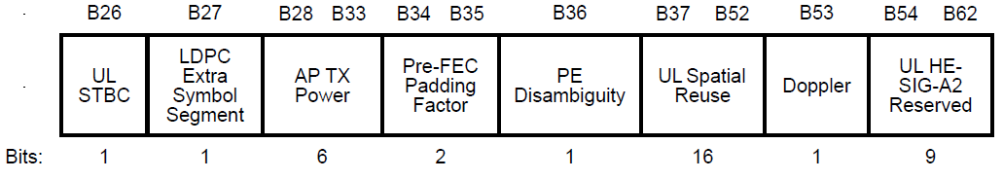
Option 1: Aggregated-MPDU Design
Common info field of EHT variant TF
  If trigger type is EHT Basic Trigger (subtype 8), then the rest of common info field can be re-defined to support EHT information
    E.g., UL BW field can be extended to support 320MHz
  We may include “protocol subfield” to indicate exact amendment instead of assigning separate trigger type value for each amendment after HE
    E.g., 00: EHT, 01:EHT+, …

Slide 9
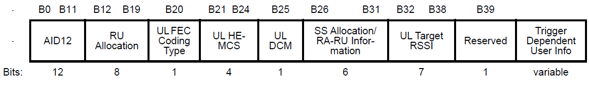
Option 1: Aggregated-MPDU Design
User info field of EHT variant TF
  If trigger type is EHT Basic Trigger (subtype 8), then User info field can also be re-defined to support EHT user-specific information
    E.g., RU allocation can be extended to support multi-RU
  We may include “protocol subfield” to indicate exact amendment instead of assigning separate trigger type value for each amendment after HE
    E.g., 00: EHT, 01:EHT+, …

Slide 10
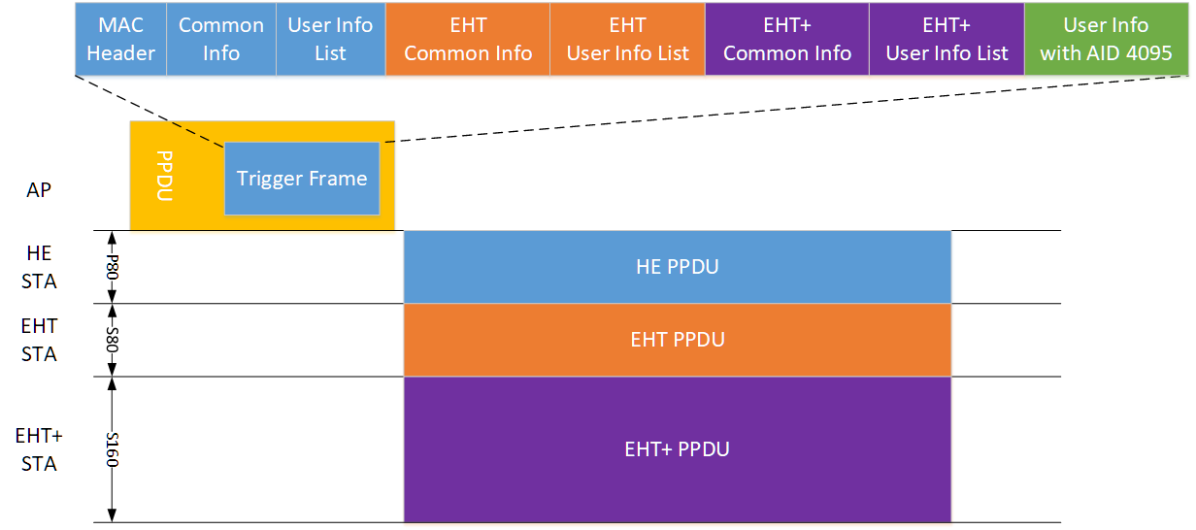
Option 2a: Single-MPDU Design w/ Reserved AID
Operation example

Slide 11
Option 2a: Single-MPDU Design w/ Reserved AID
Common/user info field
  stays the same
EHT or EHT+ STAs can obtain the common info field and additionally obtain EHT or EHT+ specific common info
EHT or EHT+ specific common info
  Assign one of the reserved AID (2008-2044, 2047-4094) to indicate EHT or EHT+ common info
  Example of EHT common info field
    EHT STAs obtain EHT-specific common information from the user info field with AID 2008 while HE STAs ignore it
    Length of EHT common info should be the same with that of the user info field since this field reuses the existing user info field format (5-bytes)
  Instead of assigning separate AID for EHT and EHT+ common info, EHT common info field may include protocol subfield to indicate amendment
AID (2008) | EHT UL BW | Other EHT-specific parameters

Slide 12
Option 2a: Single-MPDU Design w/ Reserved AID
EHT or EHT+ specific user info
  Assign one of the reserved AID (2008-2044, 2047-4094) to EHT or EHT+ user info
  Example of EHT user info field
    EHT STAs obtain EHT-specific user information from the user info field with AID 2010 while HE STAs ignore it
    Additional (EHT) AID field is required to specify EHT STA
    Length of EHT user info should be the same with that of the user info field since this field reuses the existing user info field format (5-bytes)
  Only 2-bytes are free to use per-user info field
  We may need to integrate multiple user info fields for the same (EHT) AID
  Instead of assigning separate AID for EHT and EHT+ user info, EHT user info field may include protocol subfield to indicate amendment
12-bit
12-bit
16-bit
AID (2010) | (EHT) AID | RU allocation | Other EHT user-specific parameters

Slide 13
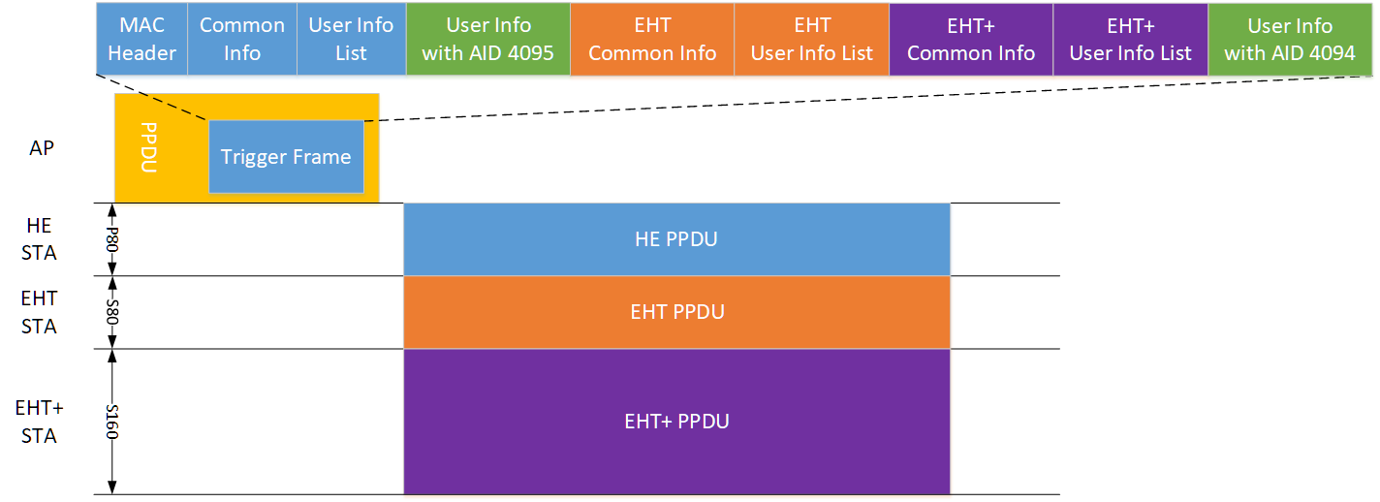
Option 2b: Single-MPDU Design w/ AID 4095
Operation example
Notes:
byte alignment

Slide 14
Option 2b: Single-MPDU Design w/ AID 4095
Common/user info field
  stays the same
The user info field with AID 4095 (Start of padding field) in 11ax
  Padding is optionally present to give the recipient STAs enough time to prepare a response
[Proposal] EHT/EHT+ specific common info and user info will be followed by the user info field with AID 4095
  HE STAs believe there are no meaningful information after AID 4095
  EHT STAs will decode after the user info field with AID 4095, since all EHT or EHT+ specific information will be followed
  EHT or EHT+ specific common info and user info format can be re-designed with full flexibility
  The padding AID for EHT/EHT+ STAs should be additionally assigned

Slide 15
Pros and Cons of Candidates
Summary table
Candidates | Pros | Cons
[Option 1] Aggregate-MPDU | Simple – just adding new trigger variants | Cannot use non-HT duplicate format
[Option 2a] Single-PPDU with the reserved AID | Can use non-HT duplicate format | Overhead of indicating EHT user info Lack of remaining bits in user info field
[Option 2b] Single-PPDU with the AID 4095 | Can use non-HT duplicate format High design flexibility (no format limitation of EHT common/user info) | Potential unexpected operation of HE STA

Slide 16
Summary
New trigger frame design options to support UL FD A-PPDU
  Aggregate-PPDU approach
  Single-PPDU approach
    Using the user info field with reserved AIDs
    Using the user info field with AID 4095 (Preferred)
We investigate pros and cons of each option

Slide 17
Straw Poll
Do you support in 11be using user info field with AID 4095 to add EHT/EHT+ common/user info field after the user info field with AID 4095 to trigger A-PPDU comprised of HE and EHT/EHT+ PPDUs?
  EHT+: the amendments after EHT
  The AID for padding indication of EHT/EHT+ STA(s) may be additionally defined
  The format of EHT/EHT+ common/user info fields is TBD

Slide 18
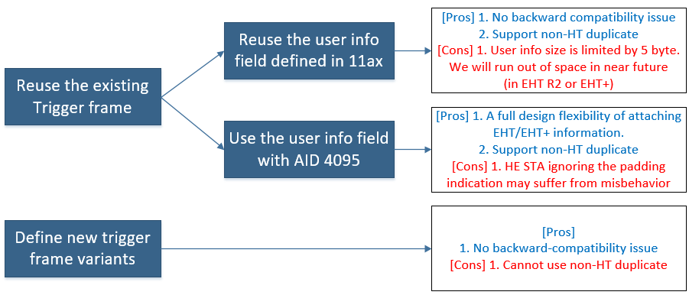
Summary
Option 2a
We proposed option 2b for EHT trigger frame.
Option 2b is splitting HE info and EHT info with the user info with AID 4095
Option 2b does not limit the exact format of EHT information
Option 2b can support for forward-compatible design
Option 2b
Option 1

Slide 19
Comment Resolution on R2
UORA support
  Our option 2b support UORA. AP can assign RA-RUs separately for HE STAs and EHT STAs.
Aggregating all user info to one trigger frame causes long duration
  AP can transmit trigger frame in HE PPDU with RTS/CTS
Concern about HE STA’s malfunctioning due to using the information after the user info with AID 4095
  Valid point. In general, no meaningful information is included after padding. So it is better not to parse or use the information after padding But some STAs are implemented to do so. The option 2b, for now, cannot cover those STAs’ potential malfunction. But I believe that the intention of the spec is definitely ignoring the information contained in the rest of the frame after the user info field with AID 4095. That is what padding actually means.
Parking channel indication/assignment
  Not a focus of this contribution. We assume the info is shared in advance.

