Slide 1
RU Allocation Subfield Design for EHT Trigger Frame
Date: 2020-05-26
Authors:

Slide 2
Introduction
11be task group has approved that 11be shall allow the following PHY features [1].
  320 MHz and 160+160 MHz PPDU
  802.11be shall allow more than one RUs to be assigned to a single STA.
Design aspects regarding Trigger frame to support these above features have been discussed in several contributions [2][3].
In this contribution, we address the modified 9-bit RU Allocation subfield for Trigger frame so that RU allocation signaling for Trigger based UL MU transmissions can cover the supported bandwidths and multi-RU combinations.

Slide 3
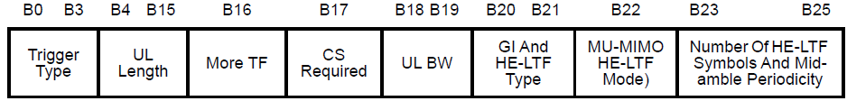
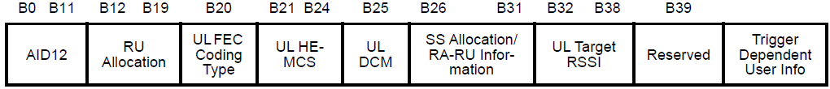
EHT Trigger Frame Format
In 11ax, a Trigger frame allocates resources for and solicits one or more HE TB PPDU transmissions. The Trigger frame also carries other information required by the responding STA to send an HE TB PPDU.
  Trigger frame format in 11ax
EHT Trigger frame can be designed by modifying an existing HE Trigger frame in order to allocate RU or multi-RU to STAs for UL MU transmissions in EHT.
  E.g., UL BW in Common Info is expanded to support BW of 320MHz. (2 bits => 3 bits)
  E.g., RU Allocation subfield in User Info field is expanded to indicate multi-RU assignment.
We focus on RU Allocation subfield design to enable trigger based UL MU in 11be to support BW of 320MHz and Multi-RU aggregation.
Frame Control | Duration | RA | TA | Common Info | User Info List | Padding | FCS

Slide 4
Structure of RU Allocation subfield for Each STA
Existing 8-bit RU Allocation subfield in User info field in Trigger frame does not allow indicating BW of 320MHz and multiple RU allocation information.
To support the larger bandwidths and multi-RU combinations, we can consider the extended 9-bit RU allocation subfield.
  2 bits of [X1 X0]: Used to indicate the location of channel that RU allocation applies
  7 bits of [X8 - X2]: Used to indicate RU or multi-RU assignment
RU Allocation subfield for EHT
X8 X7 X6 X5 X4 X3 X2 X1 X0

Slide 5
RU Allocation Subfield for 320 MHz BW
In 11ax, one bit (B0) in the RU Allocation subfield in Trigger frame is used to indicate the Primary 80MHz or Secondary 80MHz channel.
To cover the supported bandwidth of 320 MHz in EHT, it is preferred to use two bits, [X1 X0], to indicate the location of channel that RU or MRU allocation applies as follows.
  Note that lower/higher(upper) channel indication can be used instead of primary/secondary channel indication.
Example
X0 | If the UL BW subfield indicates 160+160 (TBD) MHz or 320 MHz, X0 of the RU Allocation subfield is set to 0 to indicate that the RU allocation applies to the primary 160 MHz channel and set to 1 to indicate that the RU allocation applies to the secondary 160 MHz channel.
X1 | If the UL BW subfield indicates 160+160 (TBD) MHz or 320 MHz, X1 of the RU Allocation subfield is set to 0 to indicate that the RU allocation applies to the primary 80 MHZ or lower 80 MHz channel in 160 MHz as indicated by X0 of the RU Allocation subfield and set to 1 to indicate that the RU allocation applies to the secondary 80 MHz or higher 80 MHz channel in 160 MHz as indicated by X0 of the RU Allocation subfield. If the UL BW subfield indicates 80+80 (TBD) MHz or 160 MHz, X1 of the RU Allocation subfield is set to 0 to indicate that the RU allocation applies to the primary 80 MHz channel and set to 1 to indicate that the RU allocation applies to the secondary 80 MHz channel.
 | [X1 X0]
 | Primary 160MHz |  | Secondary 160MHz
 | Primary 80MHz | Secondary 80MHz | Lower 80MHz | Higher 80MHz
80+80 MHz and 160MHz | [0 x] | [1 x] | - | -
160+160 MHz and 320 MHz | [0 0] | [1 0] | [0 1] | [1 1]

Slide 6
Indication for Multiple RU Allocation Info
Considering the number of entries needed for multi-RU combinations, it is possible to indicate the allocated multi-RU aggregation to STAs with the reserved entries of RU Allocation subfield table for the Trigger frame in 11ax .
First, we define indices for multi-RU combinations based on data and pilot subcarrier indices for RUs.
Then, based on the defined indices for multi-RU combinations, new entries to indicate various combinations for multi-RU aggregation are added to the existing RU Allocation subfield in 11ax.
In the followings, the details of RU Allocation subfield design for indication of allocated multi-RU are described.

Slide 7
X8–X2 of RU Allocation Subfield for EHT
To indicate various combinations for multi-RU aggregation, new entries are added to the existing RU Allocation subfield in 11ax based on the defined indices for multi-RU combinations.
The mapping of X8–X2 of the RU Allocation subfield for EHT is defined as follows.
X8-X2of RU Allocation subfield | UL BW subfield | RU size | RU Index | Entry
0-8 | 20 MHz, 40 MHz, 80 MHz, 80+80 MHz or 160 MHz, 160+160 MHz or 320 MHz | RU26 | RU1 to RU9, respectively | 9
9–17 | 40 MHz, 80 MHz, 80+80 MHz or 160 MHz, 160+160 MHz or 320 MHz |  | RU10 to RU18, respectively | 9
18–35 | 80 MHz, 80+80 MHz or 160 MHz, 160+160 MHz or 320 MHz |  | RU19 to RU36, respectively | 18
36–39 | 20 MHz, 40 MHz, 80 MHz, 80+80 MHz or 160 MHz, 160+160 MHz or 320 MHz | RU52 | RU1 to RU4, respectively | 4
40–43 | 40 MHz, 80 MHz, 80+80 MHz or 160 MHz, 160+160 MHz or 320 MHz |  | RU5 to RU8, respectively | 4
44–51 | 80 MHz, 80+80 MHz or 160 MHz, 160+160 MHz or 320 MHz |  | RU9 to RU16, respectively | 8
52, 53 | 20 MHz, 40 MHz, 80 MHz, 80+80 MHz or 160 MHz, 160+160 MHz or 320 MHz | RU106 | RU1 and RU2, respectively | 2
54, 55 | 40 MHz, 80 MHz, 80+80 MHz or 160 MHz, 160+160 MHz or 320 MHz |  | RU3 and RU4, respectively | 2
56–59 | 80 MHz, 80+80 MHz or 160 MHz, 160+160 MHz or 320 MHz |  | RU5 to RU8, respectively | 4
60 | 20 MHz, 40 MHz, 80 MHz, 80+80 MHz or 160 MHz, 160+160 MHz or 320 MHz | RU242 | RU1 | 1
61 | 40 MHz, 80 MHz, 80+80 MHz or 160 MHz, 160+160 MHz or 320 MHz |  | RU2 | 1
62,63 | 80 MHz, 80+80 MHz or 160 MHz, 160+160 MHz or 320 MHz |  | RU3 and RU4, respectively | 2
64 | 40 MHz, 80 MHz, 80+80 MHz or 160 MHz, 160+160 MHz or 320 MHz | RU484 | RU1 | 1
65 | 80 MHz, 80+80 MHz or 160 MHz, 160+160 MHz or 320 MHz |  | RU2 | 1
66 | 80 MHz, 80+80 MHz or 160 MHz, 160+160 MHz or 320 MHz | RU996 | RU1 | 1
67 | 80+80 MHz or 160 MHz, 160+160 MHz or 320 MHz | 2×RU996 | RU1 | 1
68 | 160+160 MHz or 320 MHz | 4×RU996 | RU1 | 1
69-71 | 20 MHz, 40 MHz, 80 MHz, 80+80 MHz or 160 MHz, 160+160 MHz or 320 MHz | RU52+RU26 | MRU1 to MRU3, respectively | 3
72-74 | 40 MHz, 80 MHz, 80+80 MHz or 160 MHz, 160+160 MHz or 320 MHz |  | MRU4 to MRU6, respectively | 3
75, 76 | 80 MHz, 80+80 MHz or 160 MHz, 160+160 MHz or 320 MHz |  | MRU7 and MRU8, respectively | 2
77, 78 | 20 MHz, 40 MHz, 80 MHz, 80+80 MHz or 160 MHz, 160+160 MHz or 320 MHz | RU106+RU26 | MRU1 and MRU2, respectively | 2
79, 80 | 40 MHz, 80 MHz, 80+80 MHz or 160 MHz, 160+160 MHz or 320 MHz |  | MRU3 and MRU4, respectively | 2
81-84 | 80 MHz, 80+80 MHz or 160 MHz, 160+160 MHz or 320 MHz | RU484+RU242 | MRU1 to MRU4, respectively | 4
85-88 | 80+80 MHz or 160 MHz, 160+160 MHz or 320 MHz | RU996+RU484 | MRU1 to MRU4, respectively | 4
89-96 | 80+80 MHz or 160 MHz, 160+160 MHz or 320 MHz | RU996+RU484+RU242 | MRU1 to MRU8, respectively | 8
97-108 | 160+160 MHz or 320 MHz | 2×RU996+RU484 | MRU1 to MRU12, respectively | 12
109-112 | 160+160 MHz or 320 MHz | 3×RU996 | MRU1 to MRU4, respectively | 4
113-120 | 160+160 MHz or 320 MHz | 3×RU996+RU484 | MRU1 to MRU8, respectively | 8

Slide 8
Define Indices for MRUs
Based on Table 27-7 & Table 27-8 in 11ax and Table 36.5 in 11be, the location of MRUs are defined as follows.
  Indices for MRUs in an OFDMA 20 MHz EHT PPDU and
    Indices for MRUs are defined based on RU indices in Table 27-7 (Data and pilot subcarrier indices for RUs in a 20 MHz HE PPDU and in a non-OFDMA 20 MHz HE PPDU).
  Indices for MRUs in an OFDMA 40 MHz EHT PPDU
    Indices for MRUs are defined based on RU indices in Table 27-8 (Data and pilot subcarrier indices for RUs in a 40 MHz HE PPDU and in a non-OFDMA 40 MHz HE PPDU).
MRU type | MRU index | MRU combination
RU52+RU26 | MRU 1 | 52-tone RU 2 + 26-tone RU 2
 | MRU 2 | 52-tone RU 2 + 26-tone RU 5
 | MRU 3 | 52-tone RU 3 + 26-tone RU 8
RU106+RU26 | MRU 1 | 106-tone RU 1 + 26-tone RU 5
 | MRU 2 | 106-tone RU 2 + 26-tone RU 5
MRU type | MRU index | MRU combination
RU52+RU26 | MRU 1 | 52-tone RU 2 + 26-tone RU 2
 | MRU 2 | 52-tone RU 2 + 26-tone RU 5
 | MRU 3 | 52-tone RU 3 + 26-tone RU 8
 | MRU 4 | 52-tone RU 6 + 26-tone RU 11
 | MRU 5 | 52-tone RU 6 + 26-tone RU 14
 | MRU 6 | 52-tone RU 7 + 26-tone RU 17
RU106+RU26 | MRU 1 | 106-tone RU 1 + 26-tone RU 5
 | MRU 2 | 106-tone RU 2 + 26-tone RU 5
 | MRU 3 | 106-tone RU 3 + 26-tone RU 14
 | MRU 4 | 106-tone RU 4 + 26-tone RU 14

Slide 9
Define Indices for MRUs (Cont’d)
The location of MRUs are defined as follows.
  Indices for MRUs in an 80 MHz EHT PPDU and in a non-OFDMA 80 MHz EHT PPDU
    Indices for MRUs are defined based on RU indices in Table 36.5 (Data and pilot subcarrier indices for RUs in an 80 MHz EHT PPDU (11be D0.1)).
MRU type | MRU index | MRU combination
RU52+RU26 (Only for OFDMA) | MRU 1 | 52-tone RU 2 + 26-tone RU 5
 | MRU 2 | 52-tone RU 3 + 26-tone RU 8
 | MRU 3 | 52-tone RU 6 + 26-tone RU 11
 | MRU 4 | 52-tone RU 6 + 26-tone RU 14
 | MRU 5 | 52-tone RU 10 + 26-tone RU 23
 | MRU 6 | 52-tone RU 11 + 26-tone RU 26
 | MRU 7 | 52-tone RU 14 + 26-tone RU 29
 | MRU 8 | 52-tone RU 14 + 26-tone RU 32
RU106+RU26 (Only for OFDMA) | MRU 1 | 106-tone RU 1 + 26-tone RU 5
 | MRU 2 | 106-tone RU 4 + 26-tone RU 14
 | MRU 3 | 106-tone RU 5 + 26-tone RU 23
 | MRU 4 | 106-tone RU 8 + 26-tone RU 32
RU484+RU242 | MRU 1 | RU484+RU242; [empty-RU242 RU242 RU484]
 | MRU 2 | RU484+RU242; [RU242 empty-RU242 RU484]
 | MRU 3 | RU484+RU242; [RU484 empty-RU242 RU242]
 | MRU 4 | RU484+RU242; [RU484 RU242 empty-RU242]

Slide 10
Define Indices for MRUs (Cont’d)
The location of MRUs are defined as follows.
  Indices for MRUs in an 80+80 (TBD) MHz or 160MHz EHT PPDU and in a non-OFDMA 80+80 (TBD) MHz or 160MHz EHT PPDU
MRU type | MRU index | MRU combination
RU996+RU484 | MRU 1 | RU996+RU484; [empty-RU484 RU484 RU996]
 | MRU 2 | RU996+RU484; [RU484 empty-RU484 RU996]
 | MRU 3 | RU996+RU484; [RU996 empty-RU484 RU484]
 | MRU 4 | RU996+RU484; [RU996 RU484 empty-RU484]
RU996+RU484+ RU242 (Only for non-OFDMA) | MRU 1 | RU996+RU484+RU242; [empty-RU242 RU242 RU484 RU996]
 | MRU 2 | RU996+RU484+RU242; [RU242 empty-RU242 RU484 RU996]
 | MRU 3 | RU996+RU484+RU242; [RU484 empty-RU242 RU242 RU996]
 | MRU 4 | RU996+RU484+RU242; [RU484 RU242 empty-RU242 RU996]
 | MRU 5 | RU996+RU484+RU242; [RU996 empty-RU242 RU242 RU484]
 | MRU 6 | RU996+RU484+RU242; [RU996 RU242 empty-RU242 RU484]
 | MRU 7 | RU996+RU484+RU242; [RU996 RU484 empty-RU242 RU242]
 | MRU 8 | RU996+RU484+RU242; [RU996 RU484 RU242 empty-RU242]

Slide 11
Define Indices for MRUs (Cont’d)
The location of MRUs are defined as follows.
  Indices for MRUs in a 160+160 (TBD) MHz or 320MHz EHT PPDU and in a non-OFDMA 160+160 (TBD) MHz or 320MHz EHT PPDU
MRU type | MRU index | MRU combination
2×RU996+RU484 | MRU 1 | 2×RU996+RU484; [empty-RU484 RU484 RU996 RU996 empty-RU996]
 | MRU 2 | 2×RU996+RU484; [RU484 empty-RU484 RU996 RU996 empty-RU996]
 | MRU 3 | 2×RU996+RU484; [RU996 empty-RU484 RU484 RU996 empty-RU996]
 | MRU 4 | 2×RU996+RU484; [RU996 RU484 empty-RU484 RU996 empty-RU996]
 | MRU 5 | 2×RU996+RU484; [RU996 RU996 empty-RU484 RU484 empty-RU996]
 | MRU 6 | 2×RU996+RU484; [RU996 RU996 RU484 empty-RU484 empty-RU996]
 | MRU 7 | 2×RU996+RU484; [empty-RU996 empty-RU484 RU484 RU996 RU996]
 | MRU 8 | 2×RU996+RU484; [empty-RU996 RU484 empty-RU484 RU996 RU996]
 | MRU 9 | 2×RU996+RU484; [empty-RU996 RU996 empty-RU484 RU484 RU996]
 | MRU 10 | 2×RU996+RU484; [empty-RU996 RU996 RU484 empty-RU484 RU996]
 | MRU 11 | 2×RU996+RU484; [empty-RU996 RU996 RU996 empty-RU484 RU484]
 | MRU 12 | 2×RU996+RU484; [empty-RU996 RU996 RU996 RU484 empty-RU484]
3×RU996 | MRU 1 | 3×RU996; [empty-RU996 RU996 RU996 RU996]
 | MRU 2 | 3×RU996; [RU996 empty-RU996 RU996 RU996]
 | MRU 3 | 3×RU996; [RU996 RU996 empty-RU996 RU996]
 | MRU 4 | 3×RU996; [RU996 RU996 RU996 empty-RU996]
3×RU996+RU484 | MRU 1 | 3×RU996+RU484; [empty-RU484 RU484 RU996 RU996 RU996]
 | MRU 2 | 3×RU996+RU484; [RU484 empty-RU484 RU996 RU996 RU996]
 | MRU 3 | 3×RU996+RU484; [RU996 empty-RU484 RU484 RU996 RU996]
 | MRU 4 | 3×RU996+RU484; [RU996 RU484 empty-RU484 RU996 RU996]
 | MRU 5 | 3×RU996+RU484; [RU996 RU996 empty-RU484 RU484 RU996]
 | MRU 6 | 3×RU996+RU484; [RU996 RU996 RU484 empty-RU484 RU996]
 | MRU 7 | 3×RU996+RU484; [RU996 RU996 RU996 empty-RU484 RU484]
 | MRU 8 | 3×RU996+RU484; [RU996 RU996 RU996 RU484 empty-RU484]

Slide 12
X8–X2 of RU Allocation Subfield for EHT (Cont’d)
For RUs,
  If the UL BW subfield indicates 20 MHz, the mapping of the RU index to RU is defined in Table 27-7 (Data and pilot subcarrier indices for RUs in a 20 MHz HE PPDU and in a non-OFDMA 20 MHz HE PPDU) in increasing order.
  If the UL BW subfield indicates 40 MHz, the mapping of the RU index to RU is defined in Table 27-8 (Data and pilot subcarrier indices for RUs in a 40 MHz HE PPDU and in a non-OFDMA 40 MHz HE PPDU) in increasing order.
  If the UL BW subfield indicates 80 MHz, 160 MHz or 80+80 MHz, and 320 MHz or 160+160 MHz, the mapping of the RU index to RU is defined in Table 36-5 (Data and pilot subcarrier indices for RUs in an 80 MHz EHT PPDU) in increasing order.
  If the UL BW subfield indicates 320 MHz or 160+160 MHz, X8–X2 of the RU Allocation subfield is set to 67 to indicate a 2×996-tone RU. A non-AP STA ignores X1 for 2×996-tone RU indication.
  If the UL BW subfield indicates 320 MHz or 160+160 MHz, X8–X2 of the RU Allocation subfield is set to 68 to indicate a 4×996-tone RU. A non-AP STA ignores X1-X0 for 4×996-tone RU indication.
  RU index starts from the lowest frequency and continues to the highest frequency within the channel indicated by X1-X0.

Slide 13
X8–X2 of RU Allocation Subfield for EHT (Cont’d)
For MRUs,
  If the UL BW subfield indicates 20 MHz, the mapping of the MRU index to MRU is defined in the proposed table of “Indices for MRUs in an OFDMA 20 MHz EHT PPDU” in increasing order to indicate the combinations of 52+26 tone MRU and 106+26 tone MRU.
  If the UL BW subfield indicates 40 MHz, the mapping of the MRU index to MRU is defined in the proposed table of “Indices for MRUs in an OFDMA 40 MHz EHT PPDU” in increasing order to indicate the combinations of 52+26 tone MRU and 106+26 tone MRU.
  If the UL BW subfield indicates 80 MHz , 160 MHz or 80+80 MHz, and 320 MHz or 160+160 MHz, the mapping of the MRU index to MRU is defined in the proposed table of “Indices for MRUs in an 80 MHz EHT PPDU and in a non-OFDMA 80 MHz EHT PPDU” in increasing order to indicate the combinations of 52+26 tone MRU, 106+26 tone MRU, and 484+242 tone MRU.
  If the UL BW subfield indicates 160 MHz or 80+80 MHz and 320 MHz or 160+160 MHz, the mapping of the MRU index to MRU is defined in the proposed table of “Indices for MRUs in an 80+80 (TBD) MHz or 160MHz EHT PPDU and in a non-OFDMA 80+80 (TBD) MHz or 160MHz EHT PPDU
  ” in increasing order to indicate the combinations of 996+484 tone MRU and 996+484+242 tone MRU.
  If the UL BW subfield indicates 320 MHz or 160+160 MHz, the mapping of the MRU index to MRU is defined in the proposed table of “Indices for MRUs in a 160+160 (TBD) MHz or 320MHz EHT PPDU and in a non-OFDMA 160+160 (TBD) MHz or 320MHz EHT PPDU” in increasing order to indicate the combinations of 2×996+484 tone MRU, 3×996-tone MRU, and 3×996+484 tone MRU.
  If the UL BW subfield indicates 320 MHz or 160+160 MHz, X8–X2 of the RU Allocation subfield is set to a value between 85 and 96 to indicate a 996+484 tone MRU or 996+484+242 tone MRU. A non-AP STA ignores X1 for 996+484 tone MRU or 996+484+242 tone MRU indication.
  If the UL BW subfield indicates 320 MHz or 160+160 MHz, X8–X2 of the RU Allocation subfield is set to a value between 97 and 120 to indicate a 2×996+484 tone MRU or 3×996-tone MRU or 3×996+484 tone MRU. A non-AP STA ignores X1-X0 for 2×996+484 tone MRU or 3×996-tone MRU or 3×996+484 tone MRU indication.
  MRU index starts from the lowest frequency and continues to the highest frequency within the channel indicated by X1-X0.

Slide 14
Examples of Proposed RU Allocation Subfield for EHT
Examples
  UL BW=320MHz
  STA1: MRU3 of 484+242 in Primary 80 MHz
  STA2: RU2 of 242 in lower 80 MHz segment of Secondary 160MHz
STA 1
STA 1
484
242
242
  UL BW=320MHz
Primary 80
Secondary 80
80 MHz
80MHz
STA 2
242
242
484
RU Allocation subfield | STA 1 | STA 2
X1X0 | 00 | 01
X8-X2 | 1010011 (83) | 0111101 (61)

Slide 15
Updated Content (Rev2 and Rev3)
In updated slides, we further address RU Allocation subfield design for EHT Trigger frame according to SU/MU cases. (Rev2)
We also describe the details to interpret the proposed RU Allocation subfield table. (Rev3)

Slide 16
RU Allocation Subfield for SU/MU Cases
In 11be, it is considered that SU and MU cases can have a different format of user info field for EHT trigger frame, respectively. [4]
In SU case, our original proposed 9-bit RU allocation subfield can be used.
Some of RU and MRU combinations in the proposed RU allocation table are not needed for MU transmission in 11be because the minimum RU size for EHT to support MU-MIMO shall be 242-tone RU.
So, we propose RU allocation subfield for MU case in EHT Trigger frame.

Slide 17
RU Allocation Subfield Design for MU Case
We introduce two options for RU Allocation subfield design for MU case.
  Option 1: Leverage the proposed 9-bit RU Allocation subfield to indicate RU or multi-RU assignments for MU case
    E.g., 8-bit RU Allocation subfield in the following slides
  Option 2: Redesign the RU Allocation subfield only for MU case to reduce the bit-width of RU Allocation subfield
    E.g., 7-bit RU Allocation subfield in following slides
For each option, the details of RU Allocation subfield design are described in the following slides.

Slide 18
RU Allocation Subfield Design for MU Case – Option 1
Option 1 is to leverage the proposed 9-bit RU Allocation subfield to indicate RU or multi-RU assignments for MU case.
To support the larger bandwidths and multi-RU combinations for MU case, we can consider 8-bit RU allocation subfield.
  2 bits of [Y1 Y0]: Used to indicate the location of channel that RU allocation applies
  6 bits of [Y7- Y2]: Used to indicate RU or multi-RU assignment for MU transmission
Two bits of [Y1 Y0] can be set to the same as two bits of [X1 X0] in the proposed 9-bit RU allocation subfield to indicate the location of channel that RU or MRU allocation applies.
The remaining six bits of [Y7- Y2] are used to indicate various RU and MRU combinations for MU transmission while sharing the RU allocation mapping table for SU transmission.
RU Allocation subfield for MU case
Y7 Y6 Y5 Y4 Y3 Y2 Y1 Y0

Slide 19
RU Allocation Subfield Design for MU Case – Option 1
To indicate various RU and MRU combinations for MU transmission, some entries are removed from the mapping table of X8–X2 of the proposed 9-bit RU Allocation subfield.
The mapping of Y7–Y2 of the RU Allocation subfield for EHT is defined as follows.
X8-X2of RU Allocation subfield for SU case | Y7-Y2of RU Allocation subfield for MU case | UL BW subfield | RU size | RU Index | Entry
0-8 | - | 20 MHz, 40 MHz, 80 MHz, 80+80 MHz or 160 MHz, 160+160 MHz or 320 MHz | RU26 | RU1 to RU9, respectively | 9
9–17 |  | 40 MHz, 80 MHz, 80+80 MHz or 160 MHz, 160+160 MHz or 320 MHz |  | RU10 to RU18, respectively | 9
18–35 |  | 80 MHz, 80+80 MHz or 160 MHz, 160+160 MHz or 320 MHz |  | RU19 to RU36, respectively | 18
36–39 |  | 20 MHz, 40 MHz, 80 MHz, 80+80 MHz or 160 MHz, 160+160 MHz or 320 MHz | RU52 | RU1 to RU4, respectively | 4
40–43 |  | 40 MHz, 80 MHz, 80+80 MHz or 160 MHz, 160+160 MHz or 320 MHz |  | RU5 to RU8, respectively | 4
44–51 |  | 80 MHz, 80+80 MHz or 160 MHz, 160+160 MHz or 320 MHz |  | RU9 to RU16, respectively | 8
52, 53 |  | 20 MHz, 40 MHz, 80 MHz, 80+80 MHz or 160 MHz, 160+160 MHz or 320 MHz | RU106 | RU1 and RU2, respectively | 2
54, 55 |  | 40 MHz, 80 MHz, 80+80 MHz or 160 MHz, 160+160 MHz or 320 MHz |  | RU3 and RU4, respectively | 2
56–59 |  | 80 MHz, 80+80 MHz or 160 MHz, 160+160 MHz or 320 MHz |  | RU5 to RU8, respectively | 4
60 | 0 | 20 MHz, 40 MHz, 80 MHz, 80+80 MHz or 160 MHz, 160+160 MHz or 320 MHz | RU242 | RU1 | 1
61 | 1 | 40 MHz, 80 MHz, 80+80 MHz or 160 MHz, 160+160 MHz or 320 MHz |  | RU2 | 1
62,63 | 2,3 | 80 MHz, 80+80 MHz or 160 MHz, 160+160 MHz or 320 MHz |  | RU3 and RU4, respectively | 2
64 | 4 | 40 MHz, 80 MHz, 80+80 MHz or 160 MHz, 160+160 MHz or 320 MHz | RU484 | RU1 | 1
65 | 5 | 80 MHz, 80+80 MHz or 160 MHz, 160+160 MHz or 320 MHz |  | RU2 | 1
66 | 6 | 80 MHz, 80+80 MHz or 160 MHz, 160+160 MHz or 320 MHz | RU996 | RU1 | 1
67 | 7 | 80+80 MHz or 160 MHz, 160+160 MHz or 320 MHz | 2×RU996 | RU1 | 1
68 | 8 | 160+160 MHz or 320 MHz | 4×RU996 | RU1 | 1
69-71 | - | 20 MHz, 40 MHz, 80 MHz, 80+80 MHz or 160 MHz, 160+160 MHz or 320 MHz | RU52+RU26 | MRU1 to MRU3, respectively | 3
72-74 |  | 40 MHz, 80 MHz, 80+80 MHz or 160 MHz, 160+160 MHz or 320 MHz |  | MRU4 to MRU6, respectively | 3
75, 76 |  | 80 MHz, 80+80 MHz or 160 MHz, 160+160 MHz or 320 MHz |  | MRU7 and MRU8, respectively | 2
77, 78 |  | 20 MHz, 40 MHz, 80 MHz, 80+80 MHz or 160 MHz, 160+160 MHz or 320 MHz | RU106+RU26 | MRU1 and MRU2, respectively | 2
79, 80 |  | 40 MHz, 80 MHz, 80+80 MHz or 160 MHz, 160+160 MHz or 320 MHz |  | MRU3 and MRU4, respectively | 2
81-84 | 9-12 | 80 MHz, 80+80 MHz or 160 MHz, 160+160 MHz or 320 MHz | RU484+RU242 | MRU1 to MRU4, respectively | 4
85-88 | 13-16 | 80+80 MHz or 160 MHz, 160+160 MHz or 320 MHz | RU996+RU484 | MRU1 to MRU4, respectively | 4
89-96 | 17-24 | 80+80 MHz or 160 MHz, 160+160 MHz or 320 MHz | RU996+RU484+RU242 | MRU1 to MRU8, respectively | 8
97-108 | 25-36 | 160+160 MHz or 320 MHz | 2×RU996+RU484 | MRU1 to MRU12, respectively | 12
109-112 | 37-30 | 160+160 MHz or 320 MHz | 3×RU996 | MRU1 to MRU4, respectively | 4
113-120 | 41-48 | 160+160 MHz or 320 MHz | 3×RU996+RU484 | MRU1 to MRU8, respectively | 8

Slide 20
RU Allocation Subfield Design for MU Case – Option 2
Option 2 is to redesign the RU Allocation subfield only for MU case to reduce the bit-width of RU Allocation subfield.
We can consider 7-bit RU allocation subfield (Z6-Z0) to indicate RU and MRU combinations for MU transmission by defining the mapping of the RU Allocation subfield as follows.
Z6-Z0 of RU Allocation subfield | UL BW subfield | RU size | RU Index | Entry
0 | 20 MHz, 40 MHz, 80 MHz, 80+80 MHz or 160 MHz, 160+160 MHz or 320 MHz | RU242 | RU1 | 1
1 | 40 MHz, 80 MHz, 80+80 MHz or 160 MHz, 160+160 MHz or 320 MHz |  | RU2 | 1
2,3 | 80 MHz, 80+80 MHz or 160 MHz, 160+160 MHz or 320 MHz |  | RU3 and RU4, respectively | 2
4-7 | 80+80 MHz or 160 MHz, 160+160 MHz or 320 MHz |  | RU5 to RU8, respectively | 4
8-15 | 160+160 MHz or 320 MHz |  | RU9 to RU16, respectively | 8
16 | 40 MHz, 80 MHz, 80+80 MHz or 160 MHz, 160+160 MHz or 320 MHz | RU484 | RU1 | 1
17 | 80 MHz, 80+80 MHz or 160 MHz, 160+160 MHz or 320 MHz |  | RU2 | 1
18,19 | 80+80 MHz or 160 MHz, 160+160 MHz or 320 MHz |  | RU3 and RU4, respectively | 2
20-23 | 160+160 MHz or 320 MHz |  | RU5 to RU8, respectively | 4
24 | 80 MHz, 80+80 MHz or 160 MHz, 160+160 MHz or 320 MHz | RU996 | RU1 | 1
25 | 80+80 MHz or 160 MHz, 160+160 MHz or 320 MHz |  | RU2 | 1
26,27 | 160+160 MHz or 320 MHz |  | RU3 and RU4, respectively | 2
28 | 80+80 MHz or 160 MHz, 160+160 MHz or 320 MHz | 2×996 | RU1 | 1
29 | 160+160 MHz or 320 MHz |  | RU2 | 1
30 | 160+160 MHz or 320 MHz | 4×RU996 | RU1 | 1
31-34 | 80 MHz, 80+80 MHz or 160 MHz, 160+160 MHz or 320 MHz | RU484+RU242 | MRU1 to MRU4, respectively, in the primary 80MHz channel | 4
35-38 | 80+80 MHz or 160 MHz, 160+160 MHz or 320 MHz |  | MRU1 to MRU4, respectively, in the secondary 80MHz channel | 4
39-42 | 160+160 MHz or 320 MHz |  | MRU1 to MRU4, respectively, in the lower 80MHz channel within the secondary 160MHz channel | 4
43-46 | 160+160 MHz or 320 MHz |  | MRU1 to MRU4, respectively, in the higher 80MHz channel within the secondary 160MHz channel | 4
47-50 | 80+80 MHz or 160 MHz, 160+160 MHz or 320 MHz | RU996+RU484 | MRU1 to MRU4, respectively, in the primary 160MHz channel | 4
51-54 | 160+160 MHz or 320 MHz |  | MRU1 to MRU4, respectively, in the secondary 160MHz channel | 4
55-62 | 80+80 MHz or 160 MHz, 160+160 MHz or 320 MHz | RU996+RU484+RU242 | MRU1 to MRU8, respectively, in the primary 160MHz channel | 8
63-70 | 160+160 MHz or 320 MHz |  | MRU1 to MRU8, respectively, in the secondary 160MHz channel | 8
71-82 | 160+160 MHz or 320 MHz | 2×RU996+RU484 | MRU1 to MRU12, respectively | 12
83-86 | 160+160 MHz or 320 MHz | 3×RU996 | MRU1 to MRU4, respectively | 4
87-94 | 160+160 MHz or 320 MHz | 3×RU996+RU484 | MRU1 to MRU8, respectively | 8

Slide 21
RU Allocation Subfield Design for MU Case – Option 2 (Cont’d)
For RUs,
  If the UL BW subfield indicates 20 MHz, the mapping of the RU index to RU is defined in Table 27-7 (Data and pilot subcarrier indices for RUs in a 20 MHz HE PPDU and in a non-OFDMA 20 MHz HE PPDU) in increasing order.
  If the UL BW subfield indicates 40 MHz, the mapping of the RU index to RU is defined in Table 27-8 (Data and pilot subcarrier indices for RUs in a 40 MHz HE PPDU and in a non-OFDMA 40 MHz HE PPDU) in increasing order.
  If the UL BW subfield indicates 80 MHz, the mapping of the RU index to RU is defined in Table 36-5 (Data and pilot subcarrier indices for RUs in an 80 MHz EHT PPDU) in increasing order.
  If the UL BW subfield indicates 160 MHz or 80+80 MHz, the mapping of the RU index to RU is defined in Table 36-6 (Data and pilot subcarrier indices for RUs in a 160 MHz EHT PPDU) in increasing order.
  If the UL BW subfield indicates 320 MHz or 160+160 MHz, the mapping of the RU index to RU is defined in Table 36-7 (Data and pilot subcarrier indices for RUs in a 320 MHz EHT PPDU) in increasing order.
  RU index starts from the lowest frequency and continues to the highest frequency within the bandwidth indicated by the UL BW subfield.

Slide 22
RU Allocation Subfield Design for MU Case – Option 2 (Cont’d)
For MRUs,
  If the UL BW subfield indicates 80 MHz , 160 MHz or 80+80 MHz, and 320 MHz or 160+160 MHz, the mapping of the MRU index to MRU is defined in the proposed table of “Indices for MRUs in an 80 MHz EHT PPDU and in a non-OFDMA 80 MHz EHT PPDU” in increasing order to indicate the combinations of 484+242 tone MRU.
  If the UL BW subfield indicates 160 MHz or 80+80 MHz and 320 MHz or 160+160 MHz, the mapping of the MRU index to MRU is defined in the proposed table of “Indices for MRUs in an 80+80 (TBD) MHz or 160MHz EHT PPDU and in a non-OFDMA 80+80 (TBD) MHz or 160MHz EHT PPDU” in increasing order to indicate the combinations of 996+484 tone MRU and 996+484+242 tone MRU.
  If the UL BW subfield indicates 320 MHz or 160+160 MHz, the mapping of the MRU index to MRU is defined in the proposed table of “Indices for MRUs in a 160+160 (TBD) MHz or 320MHz EHT PPDU and in a non-OFDMA 160+160 (TBD) MHz or 320MHz EHT PPDU” in increasing order to indicate the combinations of 2×996+484 tone MRU, 3×996-tone MRU, and 3×996+484 tone MRU.

Slide 23
Summary
In this contribution, we proposed the 9-bit RU Allocation subfield for Trigger frame to indicate the supported bandwidths and multi-RU combinations in EHT.
Additionally, we introduced two design methods of RU Allocation subfield in EHT Trigger frame for MU case.

Slide 24
R6
Move controversial SPs in the appendix.

Slide 25
Straw Poll #2
Do you support that the TGbe SFD shall include the following table?
  Indices for small-size MRUs in an OFDMA 20 MHz EHT PPDU
MRU type | MRU index | MRU combination
RU52+RU26 | MRU 1 | 52-tone RU 2 + 26-tone RU 2
 | MRU 2 | 52-tone RU 2 + 26-tone RU 5
 | MRU 3 | 52-tone RU 3 + 26-tone RU 8
RU106+RU26 | MRU 1 | 106-tone RU 1 + 26-tone RU 5
 | MRU 2 | 106-tone RU 2 + 26-tone RU 5

Slide 26
Straw Poll #3
Do you support that the TGbe SFD shall include the following table?
  Indices for small-size MRUs in an OFDMA 40 MHz EHT PPDU
MRU type | MRU index | MRU combination
RU52+RU26 | MRU 1 | 52-tone RU 2 + 26-tone RU 2
 | MRU 2 | 52-tone RU 2 + 26-tone RU 5
 | MRU 3 | 52-tone RU 3 + 26-tone RU 8
 | MRU 4 | 52-tone RU 6 + 26-tone RU 11
 | MRU 5 | 52-tone RU 6 + 26-tone RU 14
 | MRU 6 | 52-tone RU 7 + 26-tone RU 17
RU106+RU26 | MRU 1 | 106-tone RU 1 + 26-tone RU 5
 | MRU 2 | 106-tone RU 2 + 26-tone RU 5
 | MRU 3 | 106-tone RU 3 + 26-tone RU 14
 | MRU 4 | 106-tone RU 4 + 26-tone RU 14

Slide 27
Straw Poll #4b
Do you support that the TGbe SFD shall include the following table?
  Indices for large-size MRUs in an 80 MHz EHT PPDU and in a non-OFDMA 80MHz EHT PPDU
MRU type | MRU index | MRU combination
RU484+RU242 | MRU 1 | RU484+RU242; [empty-RU242 RU242 RU484]
 | MRU 2 | RU484+RU242; [RU242 empty-RU242 RU484]
 | MRU 3 | RU484+RU242; [RU484 empty-RU242 RU242]
 | MRU 4 | RU484+RU242; [RU484 RU242 empty-RU242]

Slide 28
Straw Poll #5
Do you support that the TGbe SFD shall include the following table?
  Indices for large-size MRUs in an 160MHz EHT PPDU and in a non-OFDMA 160MHz EHT PPDU
MRU type | MRU index | MRU combination
RU996+RU484 | MRU 1 | RU996+RU484; [empty-RU484 RU484 RU996]
 | MRU 2 | RU996+RU484; [RU484 empty-RU484 RU996]
 | MRU 3 | RU996+RU484; [RU996 empty-RU484 RU484]
 | MRU 4 | RU996+RU484; [RU996 RU484 empty-RU484]
RU996+RU484+ RU242 (Only for non-OFDMA) | MRU 1 | RU996+RU484+RU242; [empty-RU242 RU242 RU484 RU996]
 | MRU 2 | RU996+RU484+RU242; [RU242 empty-RU242 RU484 RU996]
 | MRU 3 | RU996+RU484+RU242; [RU484 empty-RU242 RU242 RU996]
 | MRU 4 | RU996+RU484+RU242; [RU484 RU242 empty-RU242 RU996]
 | MRU 5 | RU996+RU484+RU242; [RU996 empty-RU242 RU242 RU484]
 | MRU 6 | RU996+RU484+RU242; [RU996 RU242 empty-RU242 RU484]
 | MRU 7 | RU996+RU484+RU242; [RU996 RU484 empty-RU242 RU242]
 | MRU 8 | RU996+RU484+RU242; [RU996 RU484 RU242 empty-RU242]

Slide 29
Straw Poll #6
Do you support that the TGbe SFD shall include the following table?
  Indices for large-size MRUs in a 320MHz EHT PPDU and in a non-OFDMA 320MHz EHT PPDU
MRU type | MRU index | MRU combination
2×RU996+RU484 | MRU 1 | 2×RU996+RU484; [empty-RU484 RU484 RU996 RU996 empty-RU996]
 | MRU 2 | 2×RU996+RU484; [RU484 empty-RU484 RU996 RU996 empty-RU996]
 | MRU 3 | 2×RU996+RU484; [RU996 empty-RU484 RU484 RU996 empty-RU996]
 | MRU 4 | 2×RU996+RU484; [RU996 RU484 empty-RU484 RU996 empty-RU996]
 | MRU 5 | 2×RU996+RU484; [RU996 RU996 empty-RU484 RU484 empty-RU996]
 | MRU 6 | 2×RU996+RU484; [RU996 RU996 RU484 empty-RU484 empty-RU996]
 | MRU 7 | 2×RU996+RU484; [empty-RU996 empty-RU484 RU484 RU996 RU996]
 | MRU 8 | 2×RU996+RU484; [empty-RU996 RU484 empty-RU484 RU996 RU996]
 | MRU 9 | 2×RU996+RU484; [empty-RU996 RU996 empty-RU484 RU484 RU996]
 | MRU 10 | 2×RU996+RU484; [empty-RU996 RU996 RU484 empty-RU484 RU996]
 | MRU 11 | 2×RU996+RU484; [empty-RU996 RU996 RU996 empty-RU484 RU484]
 | MRU 12 | 2×RU996+RU484; [empty-RU996 RU996 RU996 RU484 empty-RU484]
3×RU996 | MRU 1 | 3×RU996; [empty-RU996 RU996 RU996 RU996]
 | MRU 2 | 3×RU996; [RU996 empty-RU996 RU996 RU996]
 | MRU 3 | 3×RU996; [RU996 RU996 empty-RU996 RU996]
 | MRU 4 | 3×RU996; [RU996 RU996 RU996 empty-RU996]
3×RU996+RU484 | MRU 1 | 3×RU996+RU484; [empty-RU484 RU484 RU996 RU996 RU996]
 | MRU 2 | 3×RU996+RU484; [RU484 empty-RU484 RU996 RU996 RU996]
 | MRU 3 | 3×RU996+RU484; [RU996 empty-RU484 RU484 RU996 RU996]
 | MRU 4 | 3×RU996+RU484; [RU996 RU484 empty-RU484 RU996 RU996]
 | MRU 5 | 3×RU996+RU484; [RU996 RU996 empty-RU484 RU484 RU996]
 | MRU 6 | 3×RU996+RU484; [RU996 RU996 RU484 empty-RU484 RU996]
 | MRU 7 | 3×RU996+RU484; [RU996 RU996 RU996 empty-RU484 RU484]
 | MRU 8 | 3×RU996+RU484; [RU996 RU996 RU996 RU484 empty-RU484]

Slide 30
Appendix

Slide 31
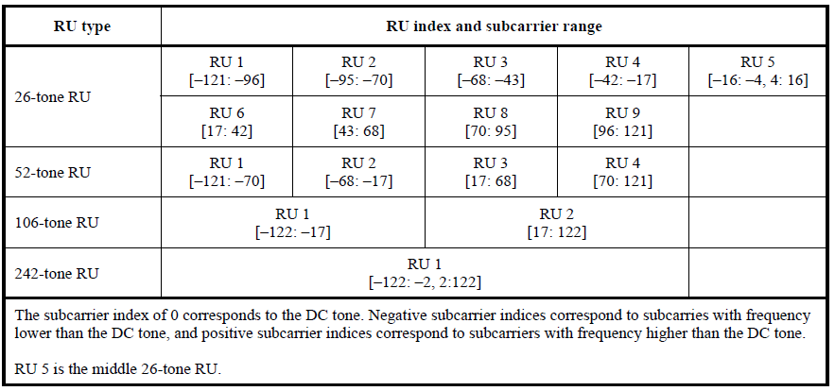
Table 27-7 in 11ax: Data and pilot Subcarrier Indices for RUs in an 20 MHz HE PPDU and in a Non-OFDMA 20 MHz HE PPDU

Slide 32
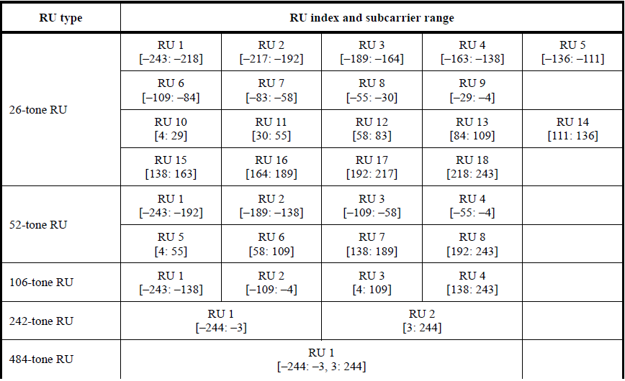
Table 27-8 in 11ax: Data and pilot Subcarrier Indices for RUs in an 40 MHz HE PPDU and in a Non-OFDMA 40 MHz HE PPDU

Slide 33
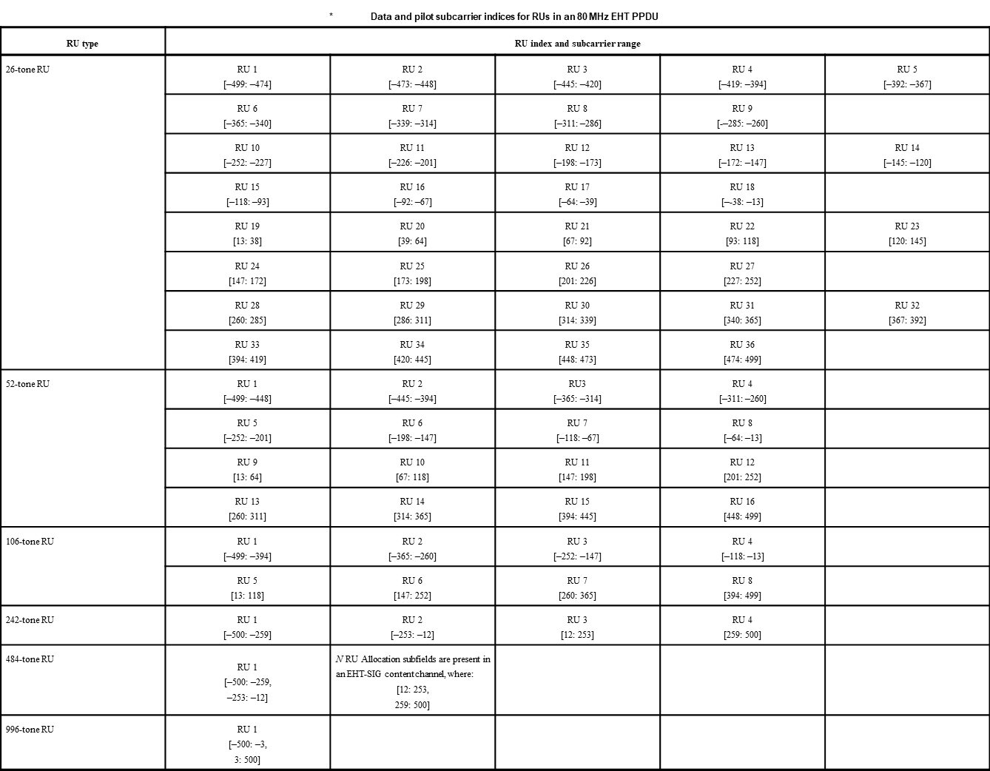
  Table 36.5-Data and pilot subcarrier indices for RUs in an 80 MHz EHT PPDU (11be D0.1)

Slide 34
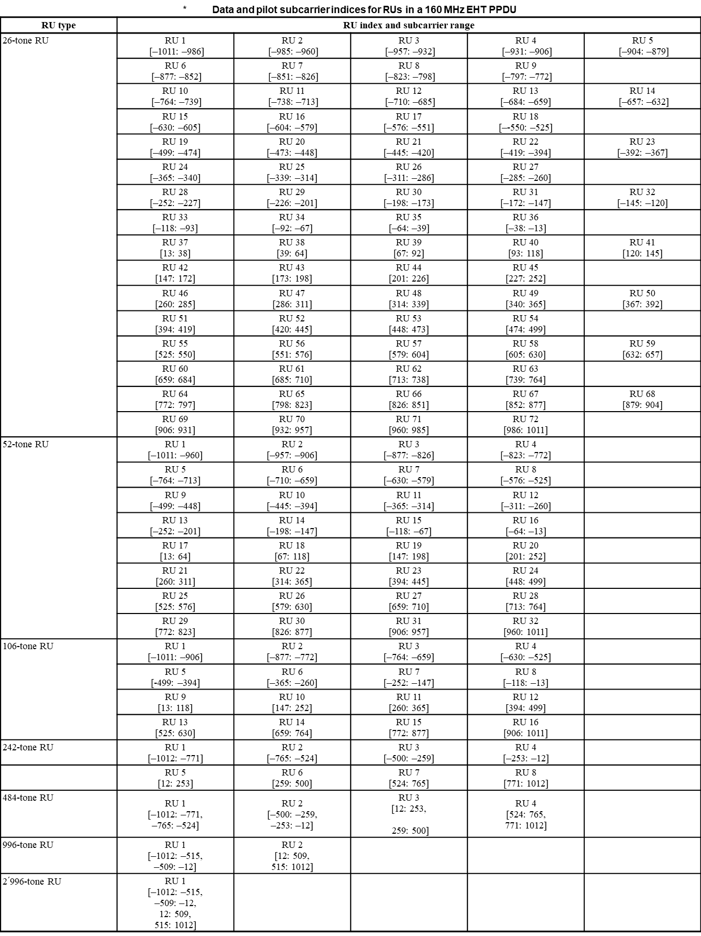
  Table 36.6-Data and pilot subcarrier indices for RUs in an 160 MHz EHT PPDU (11be D0.1)

Slide 35
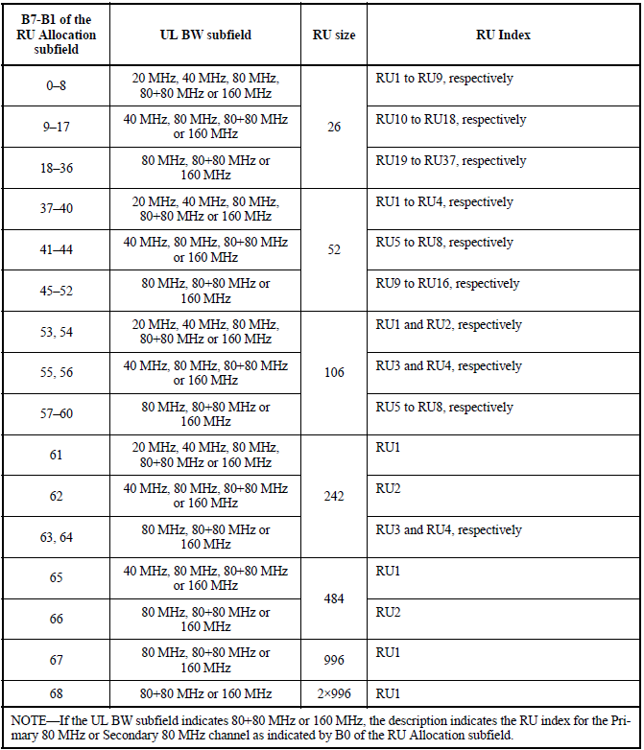
Table 9-31h in 11ax: Mapping of B7–B1 of the RU Allocation subfield

Slide 36
Reference
[1] 802.11-20/0566r23, Specification Framework for TGbe.
[2] 802.11-20/0416r0, Multi-RU Indication in Trigger Frame.
[3] 802.11-20/0413r1, Discussion on EHT Trigger based UL MU
[4] 802.11-20/1429r1, Enhanced Trigger Frame for EHT Support

Slide 37
Straw Poll #1
Do you support that the TGbe SFD shall include the following table?
  Data and pilot subcarrier indices for RUs in an 80 MHz EHT PPDU and in a non-OFDMA 80 MHz EHT PPDU (based on the modified tone plan for 11be 80MHz OFDMA (by 20/066r2))
RU type | RU index and subcarrier range
26-tone RU | RU 1 [–499: –474] | RU 2 [–473: –448] | RU 3 [–445: –420] | RU 4 [–419: –394] | RU 5 [–392: –367]
 | RU 6 [–365: –340] | RU 7 [–339: –314] | RU 8 [–311: –286] | RU 9 [–285: –260]
 | RU 10 [–252: –227] | RU 11 [–226: –201] | RU 12 [–198: –173] | RU 13 [–172: –147] | RU 14 [–145: –120]
 | RU 15 [–118: –93] | RU 16 [–92: –67] | RU 17 [–64: –39] | RU 18 [–38: –13]
 | RU 19 [13: 38] | RU 20 [39: 64] | RU 21 [67: 92] | RU 22 [93: 118] | RU 23 [120: 145]
 | RU 24 [147: 172] | RU 25 [173: 198] | RU 26 [201: 226] | RU 27 [227: 252]
 | RU 28 [260: 285] | RU 29 [286: 311] | RU 30 [314: 339] | RU 31 [340: 365] | RU 32 [367: 392]
 | RU 33 [394: 419] | RU 34 [420: 445] | RU 35 [448: 473] | RU 36 [474: 499]
52-tone RU | RU 1 [–499: –448] | RU 2 [–445: –394] | RU 3 [–365: –314] | RU 4 [–311: –260]
 | RU 5 [–252: –201] | RU 6 [–198: –147] | RU 7 [–118: –67] | RU 8 [–64: –13]
 | RU 9 [13: 64] | RU 10 [67: 118] | RU 11 [147: 198] | RU 12 [201: 252]
 | RU 13 [260: 311] | RU 14 [314: 365] | RU 15 [394: 445] | RU 16 [448: 499]
106-tone RU | RU 1 [–499: –394] | RU 2 [–365: –260] | RU 3 [–252: –147] | RU 4 [–118: –13]
 | RU 5 [13: 117] | RU 6 [147: 252] | RU 7 [260: 365] | RU 8 [394: 499]
242-tone RU | RU 1 [–500: -259] | RU 2 [-253:-12] | RU 3 [12: 253] | RU 4 [259:500]
484-tone RU | RU 1 [–500: -259, -253:-12] |  | RU 2 [12: 253, 259:500]
996-tone RU | RU 1 [–500: –3, 3: 500]
The subcarrier index of 0 corresponds to the DC tone. Negative subcarrier indices correspond to subcarriers with frequency lower than the DC tone, and positive subcarrier indices correspond to subcarriers with frequency higher than the DC tone.

Slide 38
Straw Poll #4
Do you support that the TGbe SFD shall include the following table?
  Indices for MRUs in an 80 MHz EHT PPDU and in a non-OFDMA 80MHz EHT PPDU
MRU type | MRU index | MRU combination
RU52+RU26 (Only for OFDMA) | MRU 1 | 52-tone RU 2 + 26-tone RU 5
 | MRU 2 | 52-tone RU 3 + 26-tone RU 8
 | MRU 3 | 52-tone RU 6 + 26-tone RU 11
 | MRU 4 | 52-tone RU 6 + 26-tone RU 14
 | MRU 5 | 52-tone RU 10 + 26-tone RU 23
 | MRU 6 | 52-tone RU 11 + 26-tone RU 26
 | MRU 7 | 52-tone RU 14 + 26-tone RU 29
 | MRU 8 | 52-tone RU 14 + 26-tone RU 32
RU106+RU26 (Only for OFDMA) | MRU 1 | 106-tone RU 1 + 26-tone RU 5
 | MRU 2 | 106-tone RU 4 + 26-tone RU 14
 | MRU 3 | 106-tone RU 5 + 26-tone RU 23
 | MRU 4 | 106-tone RU 8 + 26-tone RU 32
RU484+RU242 | MRU 1 | RU484+RU242; [empty-RU242 RU242 RU484]
 | MRU 2 | RU484+RU242; [RU242 empty-RU242 RU484]
 | MRU 3 | RU484+RU242; [RU484 empty-RU242 RU242]
 | MRU 4 | RU484+RU242; [RU484 RU242 empty-RU242]

Slide 39
Straw Poll #4a
Do you support that the TGbe SFD shall include the following table?
  Indices for small-size MRUs in an OFDMA 80 MHz EHT PPDU
MRU type | MRU index | MRU combination
RU52+RU26 | MRU 1 | 52-tone RU 2 + 26-tone RU 5
 | MRU 2 | 52-tone RU 3 + 26-tone RU 8
 | MRU 3 | 52-tone RU 6 + 26-tone RU 11
 | MRU 4 | 52-tone RU 6 + 26-tone RU 14
 | MRU 5 | 52-tone RU 10 + 26-tone RU 23
 | MRU 6 | 52-tone RU 11 + 26-tone RU 26
 | MRU 7 | 52-tone RU 14 + 26-tone RU 29
 | MRU 8 | 52-tone RU 14 + 26-tone RU 32
RU106+RU26 | MRU 1 | 106-tone RU 1 + 26-tone RU 5
 | MRU 2 | 106-tone RU 4 + 26-tone RU 14
 | MRU 3 | 106-tone RU 5 + 26-tone RU 23
 | MRU 4 | 106-tone RU 8 + 26-tone RU 32

Slide 40
Straw Poll #7
Do you support that EHT Trigger frame includes 9-bit RU Allocation subfield?

Slide 41
Straw Poll #8
Do you support that [X1 X0] of RU Allocation subfield for EHT Trigger frame indicates the location of channel that RU or MRU allocation applies as follows?
X0 | If the UL BW subfield indicates 160+160 (TBD) MHz or 320 MHz, X0 of the RU Allocation subfield is set to 0 to indicate that the RU allocation applies to the primary 160 MHz channel and set to 1 to indicate that the RU allocation applies to the secondary 160 MHz channel.
X1 | If the UL BW subfield indicates 160+160 (TBD) MHz or 320 MHz, X1 of the RU Allocation subfield is set to 0 to indicate that the RU allocation applies to the primary 80 MHZ or lower 80 MHz channel in 160 MHz as indicated by X0 of the RU Allocation subfield and set to 1 to indicate that the RU allocation applies to the secondary 80 MHz or higher 80 MHz channel in 160 MHz as indicated by X0 of the RU Allocation subfield. If the UL BW subfield indicates 80+80 (TBD) MHz or 160 MHz, X1 of the RU Allocation subfield is set to 0 to indicate that the RU allocation applies to the primary 80 MHz channel and set to 1 to indicate that the RU allocation applies to the secondary 80 MHz channel.

Slide 42
Straw Poll #9
Do you support that the TGbe SFD shall include the following table and text for EHT Trigger frame to define the mapping of [X8 - X2] of RU Allocation subfield?
X8-X2of RU Allocation subfield | UL BW subfield | RU size | RU Index | Entry
0-8 | 20 MHz, 40 MHz, 80 MHz, 80+80 (TBD) MHz or 160 MHz, 160+160 (TBD) MHz or 320 MHz | RU26 | RU1 to RU9, respectively | 9
9–17 | 40 MHz, 80 MHz, 80+80 (TBD) MHz or 160 MHz, 160+160 (TBD) MHz or 320 MHz |  | RU10 to RU18, respectively | 9
18–35 | 80 MHz, 80+80 (TBD) MHz or 160 MHz, 160+160 (TBD) MHz or 320 MHz |  | RU19 to RU36, respectively | 18
36–39 | 20 MHz, 40 MHz, 80 MHz, 80+80 (TBD) MHz or 160 MHz, 160+160 (TBD) MHz or 320 MHz | RU52 | RU1 to RU4, respectively | 4
40–43 | 40 MHz, 80 MHz, 80+80 (TBD) MHz or 160 MHz, 160+160 (TBD) MHz or 320 MHz |  | RU5 to RU8, respectively | 4
44–51 | 80 MHz, 80+80 (TBD) MHz or 160 MHz, 160+160 (TBD) MHz or 320 MHz |  | RU9 to RU16, respectively | 8
52, 53 | 20 MHz, 40 MHz, 80 MHz, 80+80 (TBD) MHz or 160 MHz, 160+160 (TBD) MHz or 320 MHz | RU106 | RU1 and RU2, respectively | 2
54, 55 | 40 MHz, 80 MHz, 80+80 (TBD) MHz or 160 MHz, 160+160 (TBD) MHz or 320 MHz |  | RU3 and RU4, respectively | 2
56–59 | 80 MHz, 80+80 (TBD) MHz or 160 MHz, 160+160 (TBD) MHz or 320 MHz |  | RU5 to RU8, respectively | 4
60 | 20 MHz, 40 MHz, 80 MHz, 80+80 (TBD) MHz or 160 MHz, 160+160 (TBD) MHz or 320 MHz | RU242 | RU1 | 1
61 | 40 MHz, 80 MHz, 80+80 (TBD) MHz or 160 MHz, 160+160 (TBD) MHz or 320 MHz |  | RU2 | 1
62,63 | 80 MHz, 80+80 (TBD) MHz or 160 MHz, 160+160 (TBD) MHz or 320 MHz |  | RU3 and RU4, respectively | 2
64 | 40 MHz, 80 MHz, 80+80 (TBD) MHz or 160 MHz, 160+160 (TBD) MHz or 320 MHz | 4RU84 | RU1 | 1
65 | 80 MHz, 80+80 (TBD) MHz or 160 MHz, 160+160 (TBD) MHz or 320 MHz |  | RU2 | 1
66 | 80 MHz, 80+80 (TBD) MHz or 160 MHz, 160+160 (TBD) MHz or 320 MHz | RU996 | RU1 | 1
67 | 80+80 (TBD) MHz or 160 MHz, 160+160 (TBD) MHz or 320 MHz | 2×RU996 | RU1 | 1
68 | 160+160 (TBD) MHz or 320 MHz | 4×RU996 | RU1 | 1
69-71 | 20 MHz, 40 MHz, 80 MHz, 80+80 (TBD) MHz or 160 MHz, 160+160 (TBD) MHz or 320 MHz | RU52+RU26 | MRU1 to MRU3, respectively | 3
72-74 | 40 MHz, 80 MHz, 80+80 (TBD) MHz or 160 MHz, 160+160 (TBD) MHz or 320 MHz |  | MRU4 to MRU6, respectively | 3
75, 76 | 80 MHz, 80+80 (TBD) MHz or 160 MHz, 160+160 (TBD) MHz or 320 MHz |  | MRU7 and MRU8, respectively | 2
77, 78 | 20 MHz, 40 MHz, 80 MHz, 80+80 (TBD) MHz or 160 MHz, 160+160 (TBD) MHz or 320 MHz | RU106+RU26 | MRU1 and MRU2, respectively | 2
79, 80 | 40 MHz, 80 MHz, 80+80 (TBD) MHz or 160 MHz, 160+160 (TBD) MHz or 320 MHz |  | MRU3 and MRU4, respectively | 2
81-84 | 80 MHz, 80+80 (TBD) MHz or 160 MHz, 160+160 (TBD) MHz or 320 MHz | RU484+RU242 | MRU1 to MRU4, respectively | 4
85-88 | 80+80 (TBD) MHz or 160 MHz, 160+160 (TBD) MHz or 320 MHz | RU996+RU484 | MRU1 to MRU4, respectively | 4
89-96 | 80+80 (TBD) MHz or 160 MHz, 160+160 (TBD) MHz or 320 MHz | RU996+RU484+RU242 | MRU1 to MRU8, respectively | 8
97-108 | 160+160 (TBD) MHz or 320 MHz | 2×RU996+RU484 | MRU1 to MRU12, respectively | 12
109-112 | 160+160 (TBD) MHz or 320 MHz | 3×RU996 | MRU1 to MRU4, respectively | 4
113-120 | 160+160 (TBD) MHz or 320 MHz | 3×RU996+RU484 | MRU1 to MRU8, respectively | 8

Slide 43
Straw Poll #9 (Cont’d)
  For RUs,
    If the UL BW subfield indicates 20 MHz, the mapping of the RU index to RU is defined in Table 27-7 (Data and pilot subcarrier indices for RUs in a 20 MHz HE PPDU and in a non-OFDMA 20 MHz HE PPDU) in increasing order.
    If the UL BW subfield indicates 40 MHz, the mapping of the RU index to RU is defined in Table 27-8 (Data and pilot subcarrier indices for RUs in a 40 MHz HE PPDU and in a non-OFDMA 40 MHz HE PPDU) in increasing order.
    If the UL BW subfield indicates 80 MHz, 160 MHz or 80+80 (TBD) MHz, and 320 MHz or 160+160 (TBD) MHz, the mapping of the RU index to RU is defined in Table 36-5 (Data and pilot subcarrier indices for RUs in an 80 MHz EHT PPDU) in increasing order.
    If the UL BW subfield indicates 320 MHz or 160+160 (TBD) MHz, X8–X2 of the RU Allocation subfield is set to 67 to indicate a 2×996-tone RU. A non-AP STA ignores X1 for 2×996-tone RU indication.
    If the UL BW subfield indicates 320 MHz or 160+160 (TBD) MHz, X8–X2 of the RU Allocation subfield is set to 68 to indicate a 4×996-tone RU. A non-AP STA ignores X1-X0 for 4×996-tone RU indication.
    RU index starts from the lowest frequency and continues to the highest frequency within the channel indicated by X1-X0.
  For MRUs,
    If the UL BW subfield indicates 20 MHz, the mapping of the MRU index to MRU is defined in the proposed table of “Indices for MRUs in an OFDMA 20 MHz EHT PPDU” in increasing order to indicate the combinations of 52+26 tone MRU and 106+26 tone MRU.
    If the UL BW subfield indicates 40 MHz, the mapping of the MRU index to MRU is defined in the proposed table of “Indices for MRUs in an OFDMA 40 MHz EHT PPDU” in increasing order to indicate the combinations of 52+26 tone MRU and 106+26 tone MRU.
    If the UL BW subfield indicates 80 MHz , 160 MHz or 80+80 (TBD) MHz, and 320 MHz or 160+160 (TBD) MHz, the mapping of the MRU index to MRU is defined in the proposed table of “Indices for MRUs in an 80 MHz EHT PPDU and in a non-OFDMA 80 MHz EHT PPDU” in increasing order to indicate the combinations of 52+26 tone MRU, 106+26 tone MRU, and 484+242 tone MRU.
    If the UL BW subfield indicates 160 MHz or 80+80 (TBD) MHz and 320 MHz or 160+160 (TBD) MHz, the mapping of the MRU index to MRU is defined in the proposed table of “Indices for MRUs in an 80+80 (TBD) MHz or 160MHz EHT PPDU and in a non-OFDMA 80+80 (TBD) MHz or 160MHz EHT PPDU
    ” in increasing order to indicate the combinations of 996+484 tone MRU and 996+484+242 tone MRU.
    If the UL BW subfield indicates 320 MHz or 160+160 (TBD) MHz, the mapping of the MRU index to MRU is defined in the proposed table of “Indices for MRUs in 160+160 (TBD) MHz or 320MHz EHT PPDU and in a non-OFDMA 160+160 (TBD) MHz or 320MHz EHT PPDU” in increasing order to indicate the combinations of 2×996+484 tone MRU, 3×996-tone MRU, and 3×996+484 tone MRU.
    If the UL BW subfield indicates 320 MHz or 160+160 (TBD) MHz, X8–X2 of the RU Allocation subfield is set to a value between 85 and 96 to indicate a 996+484 tone MRU or 996+484+242 tone MRU. A non-AP STA ignores X1 for 996+484 tone MRU or 996+484+242 tone MRU indication.
    If the UL BW subfield indicates 320 MHz or 160+160 MHz, X8–X2 of the RU Allocation subfield is set to a value between 97 and 120 to indicate a 2×996+484 tone MRU or 3×996-tone MRU or 3×996+484 tone MRU. A non-AP STA ignores X1-X0 for 2×996+484 tone MRU or 3×996-tone MRU or 3×996+484 tone MRU indication.
    MRU index starts from the lowest frequency and continues to the highest frequency within the channel indicated by X1-X0.

