Slide 1
RU Allocation Subfield Design for EHT Trigger Frame
Date: 2020-05-26
Authors:

Slide 2
Introduction
11be task group has approved that 11be shall allow the following PHY features [1].
320 MHz and 160+160 MHz PPDU
802.11be shall allow more than one RUs to be assigned to a single STA.
Design aspects regarding Trigger frame to support these above features have been discussed in several contributions [2][3].
In this contribution, we address the modified 9-bit RU Allocation subfield for Trigger frame so that RU allocation signaling for Trigger based UL MU transmissions can cover the supported bandwidths and multi-RU combinations.

Slide 3
EHT Trigger Frame Format
In 11ax, a Trigger frame allocates resources for and solicits one or more HE TB PPDU transmissions. The Trigger frame also carries other information required by the responding STA to send an HE TB PPDU.
Trigger frame format in 11ax
EHT Trigger frame can be designed by modifying an existing HE Trigger frame in order to allocate RU or multi-RU to STAs for UL MU transmissions in EHT.
E.g., UL BW in Common Info is expanded to support BW of 320MHz. (2 bits => 3 bits)
E.g., RU Allocation subfield in User Info field is expanded to indicate multi-RU assignment.
We focus on RU Allocation subfield design to enable trigger based UL MU in 11be to support BW of 320MHz and Multi-RU aggregation.
Frame Control | Duration | RA | TA | Common Info | User Info List | Padding | FCS

Slide 4
Structure of RU Allocation subfield for Each STA
Existing 8-bit RU Allocation subfield in User info field in Trigger frame does not allow indicating BW of 320MHz and multiple RU allocation information.
To support the larger bandwidths and multi-RU combinations, we can consider the extended 9-bit RU allocation subfield.
2 bits of [X1 X0]: Used to indicate the location of channel that RU allocation applies
7 bits of [X8 - X2]: Used to indicate RU or multi-RU assignment
RU Allocation subfield for EHT
X8 X7 X6 X5 X4 X3 X2 X1 X0

Slide 5
RU Allocation Subfield for 320 MHz BW
In 11ax, one bit (B0) in the RU Allocation subfield in Trigger frame is used to indicate the Primary 80MHz or Secondary 80MHz channel.
To cover the supported bandwidth of 320 MHz in EHT, it is preferred to use two bits, [X1 X0], to indicate the location of channel that RU or MRU allocation applies.
Example
To indicate 80MHz channel for BW of 80+80 MHz or 160MHz / 160+160 MHz or 320 MHz
To indicate 160MHz channel for BW of 160+160 MHz or 320 MHz
If the UL BW subfield indicates 160+160 MHz or 320 MHz, the description indicates the RU index for the primary 160 MHz channel or secondary 160 MHz channel as indicated by X0 of the RU Allocation subfield.
 | [X1 X0]
 | Primary 160MHz |  | Secondary 160MHz
 | Primary 80MHz | Secondary 80MHz | Lower 80MHz | Higher 80MHz
80+80 MHz and 160MHz | [x 0] | [x 1] | - | -
160+160 MHz and 320 MHz | [0 0] | [1 0] | [0 1] | [1 1]

Slide 6
Indication for Multiple RU Allocation Info
Considering the number of entries needed for multi-RU combinations, it is possible to indicate the allocated multi-RU aggregation to STAs with the reserved entries of RU Allocation subfield table for the Trigger frame in 11ax .
First, we define indices for multi-RU combinations based on data and pilot subcarrier indices for RUs.
Then, based on the defined indices for multi-RU combinations, new entries to indicate various combinations for multi-RU aggregation are added to the existing RU Allocation subfield in 11ax.
In the followings, the details of RU Allocation subfield design for indication of allocated multi-RU are described.

Slide 7
Define Indices for MRUs
Based on Table 27-7 & Table 27-8 in 11ax and Table 1 in Appendix, the location of MRUs are defined as follows.
Indices for MRUs in an 20 MHz EHT PPDU
Indices for MRUs in an 40 MHz EHT PPDU
MRU type | MRU index | MRU combination
RU52+RU26 | MRU 1 | 52-tone RU 2 + 26-tone RU 2
 | MRU 2 | 52-tone RU 3 + 26-tone RU 8
 | MRU 3 | 52-tone RU 2 + 26-tone RU 5
RU106+RU26 | MRU 1 | 106-tone RU 1 + 26-tone RU 5
 | MRU 2 | 106-tone RU 2 + 26-tone RU 5
MRU type | MRU index | MRU combination
RU52+RU26 | MRU 1 | 52-tone RU 2 + 26-tone RU 2
 | MRU 2 | 52-tone RU 3 + 26-tone RU 8
 | MRU 3 | 52-tone RU 6 + 26-tone RU 11
 | MRU 4 | 52-tone RU 7 + 26-tone RU 17
 | MRU 5 | 52-tone RU 2 + 26-tone RU 5
 | MRU 6 | 52-tone RU 6 + 26-tone RU 14
RU106+RU26 | MRU 1 | 106-tone RU 1 + 26-tone RU 5
 | MRU 2 | 106-tone RU 2 + 26-tone RU 5
 | MRU 3 | 106-tone RU 3 + 26-tone RU 14
 | MRU 4 | 106-tone RU 4 + 26-tone RU 14

Slide 8
Define Indices for MRUs (Cont’d)
The location of MRUs are defined as follows.
Indices for MRUs in an 80 MHz EHT PPDU
MRU type | MRU index | MRU combination
RU52+RU26 | MRU 1 | 52-tone RU 3 + 26-tone RU 8
 | MRU 2 | 52-tone RU 6 + 26-tone RU 11
 | MRU 3 | 52-tone RU 11 + 26-tone RU 26
 | MRU 4 | 52-tone RU 14 + 26-tone RU 29
 | MRU 5 | 52-tone RU 2 + 26-tone RU 5
 | MRU 6 | 52-tone RU 6 + 26-tone RU 14
 | MRU 7 | 52-tone RU 10 + 26-tone RU 23
 | MRU 8 | 52-tone RU 14 + 26-tone RU 32
RU106+RU26 | MRU 1 | 106-tone RU 1 + 26-tone RU 5
 | MRU 2 | 106-tone RU 4 + 26-tone RU 14
 | MRU 3 | 106-tone RU 5 + 26-tone RU 23
 | MRU 4 | 106-tone RU 8 + 26-tone RU 32
RU484+RU242 | MRU 1 | RU484+RU242; [empty-RU242 RU242 RU484]
 | MRU 2 | RU484+RU242; [RU242 empty-RU242 RU484]
 | MRU 3 | RU484+RU242; [RU484 empty-RU242 RU242]
 | MRU 4 | RU484+RU242; [RU484 RU242 empty-RU242]

Slide 9
Define Indices for MRUs (Cont’d)
The location of MRUs are defined as follows.
Indices for MRUs in 80+80 MHz or 160MHz EHT PPDU
MRU type | MRU index | MRU combination
RU996+RU484 | MRU 1 | RU996+RU484; [empty-RU484 RU484 RU996]
 | MRU 2 | RU996+RU484; [RU484 empty-RU484 RU996]
 | MRU 3 | RU996+RU484; [RU996 empty-RU484 RU484]
 | MRU 4 | RU996+RU484; [RU996 RU484 empty-RU484]
RU996+RU484+ RU242 | MRU 1 | RU996+RU484+RU242; [empty-RU242 RU242 RU484 RU996]
 | MRU 2 | RU996+RU484+RU242; [RU242 empty-RU242 RU484 RU996]
 | MRU 3 | RU996+RU484+RU242; [RU484 empty-RU242 RU242 RU996]
 | MRU 4 | RU996+RU484+RU242; [RU484 RU242 empty-RU242 RU996]
 | MRU 5 | RU996+RU484+RU242; [RU996 empty-RU242 RU242 RU484]
 | MRU 6 | RU996+RU484+RU242; [RU996 RU242 empty-RU242 RU484]
 | MRU 7 | RU996+RU484+RU242; [RU996 RU484 empty-RU242 RU242]
 | MRU 8 | RU996+RU484+RU242; [RU996 RU484 RU242 empty-RU242]

Slide 10
Define Indices for MRUs (Cont’d)
The location of MRUs are defined as follows.
Indices for MRUs in 160+160 MHz or 320MHz EHT PPDU
MRU type | MRU index | MRU combination
2×RU996+RU484 | MRU 1 | 2×RU996+RU484; [empty-RU484 RU484 RU996 RU996 empty-RU996]
 | MRU 2 | 2×RU996+RU484; [RU484 empty-RU484 RU996 RU996 empty-RU996]
 | MRU 3 | 2×RU996+RU484; [RU996 empty-RU484 RU484 RU996 empty-RU996]
 | MRU 4 | 2×RU996+RU484; [RU996 RU484 empty-RU484 RU996 empty-RU996]
 | MRU 5 | 2×RU996+RU484; [RU996 RU996 empty-RU484 RU484 empty-RU996]
 | MRU 6 | 2×RU996+RU484; [RU996 RU996 RU484 empty-RU484 empty-RU996]
 | MRU 7 | 2×RU996+RU484; [empty-RU996 empty-RU484 RU484 RU996 RU996]
 | MRU 8 | 2×RU996+RU484; [empty-RU996 RU484 empty-RU484 RU996 RU996]
 | MRU 9 | 2×RU996+RU484; [empty-RU996 RU996 empty-RU484 RU484 RU996]
 | MRU 10 | 2×RU996+RU484; [empty-RU996 RU996 RU484 empty-RU484 RU996]
 | MRU 11 | 2×RU996+RU484; [empty-RU996 RU996 RU996 empty-RU484 RU484]
 | MRU 12 | 2×RU996+RU484; [empty-RU996 RU996 RU996 RU484 empty-RU484]
3×RU996 | MRU 1 | 3×RU996; [empty-RU996 RU996 RU996 RU996]
 | MRU 2 | 3×RU996; [RU996 empty-RU996 RU996 RU996]
 | MRU 3 | 3×RU996; [RU996 RU996 empty-RU996 RU996]
 | MRU 4 | 3×RU996; [RU996 RU996 RU996 empty-RU996]
3×RU996+RU484 | MRU 1 | 3×RU996+RU484; [empty-RU484 RU484 RU996 RU996 RU996]
 | MRU 2 | 3×RU996+RU484; [RU484 empty-RU484 RU996 RU996 RU996]
 | MRU 3 | 3×RU996+RU484; [RU996 empty-RU484 RU484 RU996 RU996]
 | MRU 4 | 3×RU996+RU484; [RU996 RU484 empty-RU484 RU996 RU996]
 | MRU 5 | 3×RU996+RU484; [RU996 RU996 empty-RU484 RU484 RU996]
 | MRU 6 | 3×RU996+RU484; [RU996 RU996 RU484 empty-RU484 RU996]
 | MRU 7 | 3×RU996+RU484; [RU996 RU996 RU996 empty-RU484 RU484]
 | MRU 8 | 3×RU996+RU484; [RU996 RU996 RU996 RU484 empty-RU484]

Slide 11
X8–X2 of RU Allocation Subfield for EHT
To indicate various combinations for multi-RU aggregation, new entries are added to the existing RU Allocation subfield in 11ax based on the defined indices for multi-RU combinations.
The mapping of X8–X2 of the RU Allocation subfield for EHT is defined as follows.
X8-X2of RU Allocation subfield | UL BW subfield | RU size | RU Index | Entry
0-8 | 20 MHz, 40 MHz, 80 MHz, 80+80 MHz or 160 MHz, 160+160 MHz or 320 MHz | RU26 | RU1 to RU9, respectively | 9
9–17 | 40 MHz, 80 MHz, 80+80 MHz or 160 MHz, 160+160 MHz or 320 MHz |  | RU10 to RU18, respectively | 9
18–35 | 80 MHz, 80+80 MHz or 160 MHz, 160+160 MHz or 320 MHz |  | RU19 to RU36, respectively | 18
36–39 | 20 MHz, 40 MHz, 80 MHz, 80+80 MHz or 160 MHz, 160+160 MHz or 320 MHz | RU52 | RU1 to RU4, respectively | 4
40–43 | 40 MHz, 80 MHz, 80+80 MHz or 160 MHz, 160+160 MHz or 320 MHz |  | RU5 to RU8, respectively | 4
44–51 | 80 MHz, 80+80 MHz or 160 MHz, 160+160 MHz or 320 MHz |  | RU9 to RU16, respectively | 8
52, 53 | 20 MHz, 40 MHz, 80 MHz, 80+80 MHz or 160 MHz, 160+160 MHz or 320 MHz | RU106 | RU1 and RU2, respectively | 2
54, 55 | 40 MHz, 80 MHz, 80+80 MHz or 160 MHz, 160+160 MHz or 320 MHz |  | RU3 and RU4, respectively | 2
56–59 | 80 MHz, 80+80 MHz or 160 MHz, 160+160 MHz or 320 MHz |  | RU5 to RU8, respectively | 4
60 | 20 MHz, 40 MHz, 80 MHz, 80+80 MHz or 160 MHz, 160+160 MHz or 320 MHz | RU242 | RU1 | 1
61 | 40 MHz, 80 MHz, 80+80 MHz or 160 MHz, 160+160 MHz or 320 MHz |  | RU2 | 1
62,63 | 80 MHz, 80+80 MHz or 160 MHz, 160+160 MHz or 320 MHz |  | RU3 and RU4, respectively | 2
64 | 40 MHz, 80 MHz, 80+80 MHz or 160 MHz, 160+160 MHz or 320 MHz | RU484 | RU1 | 1
65 | 80 MHz, 80+80 MHz or 160 MHz, 160+160 MHz or 320 MHz |  | RU2 | 1
66 | 80 MHz, 80+80 MHz or 160 MHz, 160+160 MHz or 320 MHz | RU996 | RU1 | 1
67 | 80+80 MHz or 160 MHz, 160+160 MHz or 320 MHz | 2×RU996 | MRU1 | 1
68 | 160+160 MHz or 320 MHz | 4×RU996 | MRU1 | 1
69-71 | 20 MHz, 40 MHz, 80 MHz, 80+80 MHz or 160 MHz, 160+160 MHz or 320 MHz | RU52+RU26 | MRU1 to MRU3, respectively | 3
72-74 | 40 MHz, 80 MHz, 80+80 MHz or 160 MHz, 160+160 MHz or 320 MHz |  | MRU4 to MRU6, respectively | 3
75, 76 | 80 MHz, 80+80 MHz or 160 MHz, 160+160 MHz or 320 MHz |  | MRU7 and MRU8, respectively | 2
77, 78 | 20 MHz, 40 MHz, 80 MHz, 80+80 MHz or 160 MHz, 160+160 MHz or 320 MHz | RU106+RU26 | MRU1 and MRU2, respectively | 2
79, 80 | 40 MHz, 80 MHz, 80+80 MHz or 160 MHz, 160+160 MHz or 320 MHz |  | MRU3 and MRU4, respectively | 2
81-84 | 80 MHz, 80+80 MHz or 160 MHz, 160+160 MHz or 320 MHz | RU484+RU242 | MRU1 to MRU4, respectively | 4
85-88 | 80+80 MHz or 160 MHz, 160+160 MHz or 320 MHz | RU996+RU484 | MRU1 to MRU4, respectively | 4
89-96 | 80+80 MHz or 160 MHz, 160+160 MHz or 320 MHz | RU996+RU484+RU242 | MRU1 to MRU8, respectively | 8
97-108 | 160+160 MHz or 320 MHz | 2×RU996+RU484 | MRU1 to MRU12, respectively | 12
109-112 | 160+160 MHz or 320 MHz | 3×RU996 | MRU1 to MRU4, respectively | 4
113-120 | 160+160 MHz or 320 MHz | 3×RU996+RU484 | MRU1 to MRU8, respectively | 8

Slide 12
Examples of Proposed RU Allocation Subfield for EHT
Examples
UL BW=320MHz
STA1: MRU2 of 484+242 in Primary 80 MHz
STA2: RU2 of 242 in lower 80 MHz segment of Secondary 160MHz
STA 1
STA 1
484
242
242
UL BW=320MHz
Primary 80
Secondary 80
80 MHz
80MHz
STA 2
242
242
484
RU Allocation subfield | STA 1 | STA 2
X1X0 | 00 | 01
X8-X2 | 1010011 (83) | 0111101 (61)

Slide 13
Summary
In this contribution, we proposed the modified 9-bit RU Allocation subfield for Trigger frame to indicate the supported bandwidths and multi-RU combinations in EHT.

Slide 14
Straw Poll #1
Do you support that the TGbe SFD shall include the following table?
Data and pilot subcarrier indices for RUs in an 80 MHz HE PPDU and in a non-OFDMA 80 MHz HE PPDU (based on the modified tone plan for 11be 80MHz OFDMA (by 20/066r2))
RU type | RU index and subcarrier range
26-tone RU | RU 1 [–499: –474] | RU 2 [–473: –448] | RU 3 [–445: –420] | RU 4 [–419: –394] | RU 5 [–392: –367]
 | RU 6 [–365: –340] | RU 7 [–339: –314] | RU 8 [–311: –286] | RU 9 [–285: –260]
 | RU 10 [–252: –227] | RU 11 [–226: –201] | RU 12 [–198: –173] | RU 13 [–172: –147] | RU 14 [–145: –120]
 | RU 15 [–118: –93] | RU 16 [–92: –67] | RU 17 [–64: –39] | RU 18 [–38: –13]
 | RU 19 [13: 38] | RU 20 [39: 64] | RU 21 [67: 92] | RU 22 [93: 118] | RU 23 [120: 145]
 | RU 24 [147: 172] | RU 25 [173: 198] | RU 26 [201: 226] | RU 27 [227: 252]
 | RU 28 [260: 285] | RU 29 [286: 311] | RU 30 [314: 339] | RU 31 [340: 365] | RU 32 [367: 392]
 | RU 33 [394: 419] | RU 34 [420: 445] | RU 35 [448: 473] | RU 36 [474: 499]
52-tone RU | RU 1 [–499: –448] | RU 2 [–445: –394] | RU 3 [–365: –314] | RU 4 [–311: –260]
 | RU 5 [–252: –201] | RU 6 [–198: –147] | RU 7 [–118: –67] | RU 8 [–64: –13]
 | RU 9 [13: 64] | RU 10 [67: 118] | RU 11 [147: 198] | RU 12 [201: 252]
 | RU 13 [260: 311] | RU 14 [314: 365] | RU 15 [394: 445] | RU 16 [448: 499]
106-tone RU | RU 1 [–499: –394] | RU 2 [–365: –260] | RU 3 [–252: –147] | RU 4 [–118: –13]
 | RU 5 [13: 117] | RU 6 [147: 252] | RU 7 [260: 365] | RU 8 [394: 499]
242-tone RU | RU 1 [–500: -259] | RU 2 [-253:-12] | RU 3 [12: 253] | RU 4 [259:500]
484-tone RU | RU 1 [–500: -259, -253:-12] |  | RU 2 [12: 253, 259:500]
996-tone RU | RU 1 [–500: –3, 3: 500]
The subcarrier index of 0 corresponds to the DC tone. Negative subcarrier indices correspond to subcarriers with frequency lower than the DC tone, and positive subcarrier indices correspond to subcarriers with frequency higher than the DC tone.

Slide 15
Straw Poll #2
Do you support that the TGbe SFD shall include the following table?
Indices for MRUs in an 20 MHz HE PPDU
MRU type | MRU index | MRU combination
RU52+RU26 | MRU 1 | 52-tone RU 2 + 26-tone RU 2
 | MRU 2 | 52-tone RU 3 + 26-tone RU 8
 | MRU 3 | 52-tone RU 2 + 26-tone RU 5
RU106+RU26 | MRU 1 | 106-tone RU 1 + 26-tone RU 5
 | MRU 2 | 106-tone RU 2 + 26-tone RU 5

Slide 16
Straw Poll #3
Do you support that the TGbe SFD shall include the following table?
Indices for MRUs in an 40 MHz EHT PPDU
MRU type | MRU index | MRU combination
RU52+RU26 | MRU 1 | 52-tone RU 2 + 26-tone RU 2
 | MRU 2 | 52-tone RU 3 + 26-tone RU 8
 | MRU 3 | 52-tone RU 6 + 26-tone RU 11
 | MRU 4 | 52-tone RU 7 + 26-tone RU 17
 | MRU 5 | 52-tone RU 2 + 26-tone RU 5
 | MRU 6 | 52-tone RU 6 + 26-tone RU 14
RU106+RU26 | MRU 1 | 106-tone RU 1 + 26-tone RU 5
 | MRU 2 | 106-tone RU 2 + 26-tone RU 5
 | MRU 3 | 106-tone RU 3 + 26-tone RU 14
 | MRU 4 | 106-tone RU 4 + 26-tone RU 14

Slide 17
Straw Poll #4
Do you support that the TGbe SFD shall include the following table?
Indices for MRUs in an 80 MHz EHT PPDU
MRU type | MRU index | MRU combination
RU52+RU26 | MRU 1 | 52-tone RU 3 + 26-tone RU 8
 | MRU 2 | 52-tone RU 6 + 26-tone RU 11
 | MRU 3 | 52-tone RU 11 + 26-tone RU 26
 | MRU 4 | 52-tone RU 14 + 26-tone RU 29
 | MRU 5 | 52-tone RU 2 + 26-tone RU 5
 | MRU 6 | 52-tone RU 6 + 26-tone RU 14
 | MRU 7 | 52-tone RU 10 + 26-tone RU 23
 | MRU 8 | 52-tone RU 14 + 26-tone RU 32
RU106+RU26 | MRU 1 | 106-tone RU 1 + 26-tone RU 5
 | MRU 2 | 106-tone RU 4 + 26-tone RU 14
 | MRU 3 | 106-tone RU 5 + 26-tone RU 23
 | MRU 4 | 106-tone RU 8 + 26-tone RU 32
RU484+RU242 | MRU 1 | RU484+RU242; [empty-RU242 RU242 RU484]
 | MRU 2 | RU484+RU242; [RU242 empty-RU242 RU484]
 | MRU 3 | RU484+RU242; [RU484 empty-RU242 RU242]
 | MRU 4 | RU484+RU242; [RU484 RU242 empty-RU242]

Slide 18
Straw Poll #5
Do you support that the TGbe SFD shall include the following table?
Indices for MRUs in 80+80 MHz or 160MHz EHT PPDU
MRU type | MRU index | MRU combination
RU996+RU484 | MRU 1 | RU996+RU484; [empty-RU484 RU484 RU996]
 | MRU 2 | RU996+RU484; [RU484 empty-RU484 RU996]
 | MRU 3 | RU996+RU484; [RU996 empty-RU484 RU484]
 | MRU 4 | RU996+RU484; [RU996 RU484 empty-RU484]
RU996+RU484+ RU242 | MRU 1 | RU996+RU484+RU242; [empty-RU242 RU242 RU484 RU996]
 | MRU 2 | RU996+RU484+RU242; [RU242 empty-RU242 RU484 RU996]
 | MRU 3 | RU996+RU484+RU242; [RU484 empty-RU242 RU242 RU996]
 | MRU 4 | RU996+RU484+RU242; [RU484 RU242 empty-RU242 RU996]
 | MRU 5 | RU996+RU484+RU242; [RU996 empty-RU242 RU242 RU484]
 | MRU 6 | RU996+RU484+RU242; [RU996 RU242 empty-RU242 RU484]
 | MRU 7 | RU996+RU484+RU242; [RU996 RU484 empty-RU242 RU242]
 | MRU 8 | RU996+RU484+RU242; [RU996 RU484 RU242 empty-RU242]

Slide 19
Straw Poll #6
Do you support that the TGbe SFD shall include the following table?
Indices for MRUs in 160+160 MHz or 320MHz EHT PPDU
MRU type | MRU index | MRU combination
2×RU996+RU484 | MRU 1 | 2×RU996+RU484; [empty-RU484 RU484 RU996 RU996 empty-RU996]
 | MRU 2 | 2×RU996+RU484; [RU484 empty-RU484 RU996 RU996 empty-RU996]
 | MRU 3 | 2×RU996+RU484; [RU996 empty-RU484 RU484 RU996 empty-RU996]
 | MRU 4 | 2×RU996+RU484; [RU996 RU484 empty-RU484 RU996 empty-RU996]
 | MRU 5 | 2×RU996+RU484; [RU996 RU996 empty-RU484 RU484 empty-RU996]
 | MRU 6 | 2×RU996+RU484; [RU996 RU996 RU484 empty-RU484 empty-RU996]
 | MRU 7 | 2×RU996+RU484; [empty-RU996 empty-RU484 RU484 RU996 RU996]
 | MRU 8 | 2×RU996+RU484; [empty-RU996 RU484 empty-RU484 RU996 RU996]
 | MRU 9 | 2×RU996+RU484; [empty-RU996 RU996 empty-RU484 RU484 RU996]
 | MRU 10 | 2×RU996+RU484; [empty-RU996 RU996 RU484 empty-RU484 RU996]
 | MRU 11 | 2×RU996+RU484; [empty-RU996 RU996 RU996 empty-RU484 RU484]
 | MRU 12 | 2×RU996+RU484; [empty-RU996 RU996 RU996 RU484 empty-RU484]
3×RU996 | MRU 1 | 3×RU996; [empty-RU996 RU996 RU996 RU996]
 | MRU 2 | 3×RU996; [RU996 empty-RU996 RU996 RU996]
 | MRU 3 | 3×RU996; [RU996 RU996 empty-RU996 RU996]
 | MRU 4 | 3×RU996; [RU996 RU996 RU996 empty-RU996]
3×RU996+RU484 | MRU 1 | 3×RU996+RU484; [empty-RU484 RU484 RU996 RU996 RU996]
 | MRU 2 | 3×RU996+RU484; [RU484 empty-RU484 RU996 RU996 RU996]
 | MRU 3 | 3×RU996+RU484; [RU996 empty-RU484 RU484 RU996 RU996]
 | MRU 4 | 3×RU996+RU484; [RU996 RU484 empty-RU484 RU996 RU996]
 | MRU 5 | 3×RU996+RU484; [RU996 RU996 empty-RU484 RU484 RU996]
 | MRU 6 | 3×RU996+RU484; [RU996 RU996 RU484 empty-RU484 RU996]
 | MRU 7 | 3×RU996+RU484; [RU996 RU996 RU996 empty-RU484 RU484]
 | MRU 8 | 3×RU996+RU484; [RU996 RU996 RU996 RU484 empty-RU484]

Slide 20
Straw Poll #7
Do you support that EHT Trigger frame includes 9-bit RU Allocation subfield?

Slide 21
Straw Poll #8
Do you support that [X1 X0] of RU Allocation subfield indicates the location of channel that RU or MRU allocation applies as follows?
X0 | If the UL BW subfield indicates 160+160 MHz or 320 MHz, X0 of the RU Allocation subfield is set to 0 to indicate that the RU allocation applies to the primary 160 MHz channel and set to 1 to indicate that the RU allocation applies to the secondary 160 MHz channel. If the UL BW subfield indicates 80+80 MHz or 160 MHz, X0 of the RU Allocation subfield is set to 0 to indicate that the RU allocation applies to the primary 80 MHz channel and set to 1 to indicate that the RU allocation applies to the secondary 80 MHz channel.
X1 | If the UL BW subfield indicates 160+160 MHz or 320 MHz, X1 of the RU Allocation subfield is set to 0 to indicate that the RU allocation applies to the primary 80 MHZ or lower 80 MHz channel in 160 MHz as indicated by X0 of the RU Allocation subfield and set to 1 to indicate that the RU allocation applies to the secondary 80 MHz or higher 80 MHz channel in 160 MHz as indicated by X0 of the RU Allocation subfield. If the UL BW subfield indicates 80+80 MHz or 160 MHz, X1 of the RU Allocation subfield is reserved.

Slide 22
Straw Poll #9
Do you support that the TGbe SFD shall include the following table of RU Allocation subfield in Trigger frame?
X8-X2of RU Allocation subfield | UL BW subfield | RU size | RU Index | Entry
0-8 | 20 MHz, 40 MHz, 80 MHz, 80+80 MHz or 160 MHz, 160+160 MHz or 320 MHz | RU26 | RU1 to RU9, respectively | 9
9–17 | 40 MHz, 80 MHz, 80+80 MHz or 160 MHz, 160+160 MHz or 320 MHz |  | RU10 to RU18, respectively | 9
18–35 | 80 MHz, 80+80 MHz or 160 MHz, 160+160 MHz or 320 MHz |  | RU19 to RU36, respectively | 18
36–39 | 20 MHz, 40 MHz, 80 MHz, 80+80 MHz or 160 MHz, 160+160 MHz or 320 MHz | RU52 | RU1 to RU4, respectively | 4
40–43 | 40 MHz, 80 MHz, 80+80 MHz or 160 MHz, 160+160 MHz or 320 MHz |  | RU5 to RU8, respectively | 4
44–51 | 80 MHz, 80+80 MHz or 160 MHz, 160+160 MHz or 320 MHz |  | RU9 to RU16, respectively | 8
52, 53 | 20 MHz, 40 MHz, 80 MHz, 80+80 MHz or 160 MHz, 160+160 MHz or 320 MHz | RU106 | RU1 and RU2, respectively | 2
54, 55 | 40 MHz, 80 MHz, 80+80 MHz or 160 MHz, 160+160 MHz or 320 MHz |  | RU3 and RU4, respectively | 2
56–59 | 80 MHz, 80+80 MHz or 160 MHz, 160+160 MHz or 320 MHz |  | RU5 to RU8, respectively | 4
60 | 20 MHz, 40 MHz, 80 MHz, 80+80 MHz or 160 MHz, 160+160 MHz or 320 MHz | RU242 | RU1 | 1
61 | 40 MHz, 80 MHz, 80+80 MHz or 160 MHz, 160+160 MHz or 320 MHz |  | RU2 | 1
62,63 | 80 MHz, 80+80 MHz or 160 MHz, 160+160 MHz or 320 MHz |  | RU3 and RU4, respectively | 2
64 | 40 MHz, 80 MHz, 80+80 MHz or 160 MHz, 160+160 MHz or 320 MHz | 4RU84 | RU1 | 1
65 | 80 MHz, 80+80 MHz or 160 MHz, 160+160 MHz or 320 MHz |  | RU2 | 1
66 | 80 MHz, 80+80 MHz or 160 MHz, 160+160 MHz or 320 MHz | RU996 | RU1 | 1
67 | 80+80 MHz or 160 MHz, 160+160 MHz or 320 MHz | 2×RU996 | MRU1 | 1
68 | 160+160 MHz or 320 MHz | 4×RU996 | MRU1 | 1
69-71 | 20 MHz, 40 MHz, 80 MHz, 80+80 MHz or 160 MHz, 160+160 MHz or 320 MHz | RU52+RU26 | MRU1 to MRU3, respectively | 3
72-74 | 40 MHz, 80 MHz, 80+80 MHz or 160 MHz, 160+160 MHz or 320 MHz |  | MRU4 to MRU6, respectively | 3
75, 76 | 80 MHz, 80+80 MHz or 160 MHz, 160+160 MHz or 320 MHz |  | MRU7 and MRU8, respectively | 2
77, 78 | 20 MHz, 40 MHz, 80 MHz, 80+80 MHz or 160 MHz, 160+160 MHz or 320 MHz | RU106+RU26 | MRU1 and MRU2, respectively | 2
79, 80 | 40 MHz, 80 MHz, 80+80 MHz or 160 MHz, 160+160 MHz or 320 MHz |  | MRU3 and MRU4, respectively | 2
81-84 | 80 MHz, 80+80 MHz or 160 MHz, 160+160 MHz or 320 MHz | RU484+RU242 | MRU1 to MRU4, respectively | 4
85-88 | 80+80 MHz or 160 MHz, 160+160 MHz or 320 MHz | RU996+RU484 | MRU1 to MRU4, respectively | 4
89-96 | 80+80 MHz or 160 MHz, 160+160 MHz or 320 MHz | RU996+RU484+RU242 | MRU1 to MRU8, respectively | 8
97-108 | 160+160 MHz or 320 MHz | 2×RU996+RU484 | MRU1 to MRU12, respectively | 12
109-112 | 160+160 MHz or 320 MHz | 3×RU996 | MRU1 to MRU4, respectively | 4
113-120 | 160+160 MHz or 320 MHz | 3×RU996+RU484 | MRU1 to MRU8, respectively | 8

Slide 23
Appendix

Slide 24
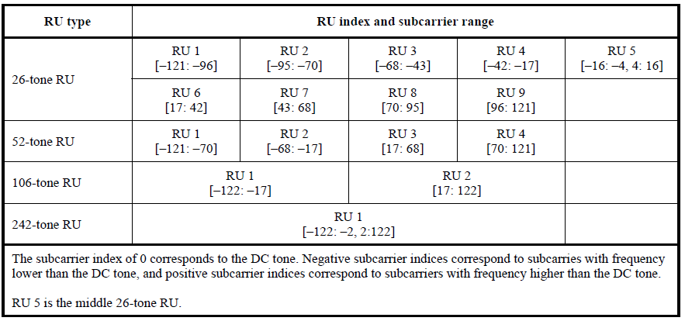
Table 27-7 in 11ax: Data and pilot Subcarrier Indices for RUs in an 20 MHz HE PPDU and in a Non-OFDMA 20 MHz HE PPDU

Slide 25
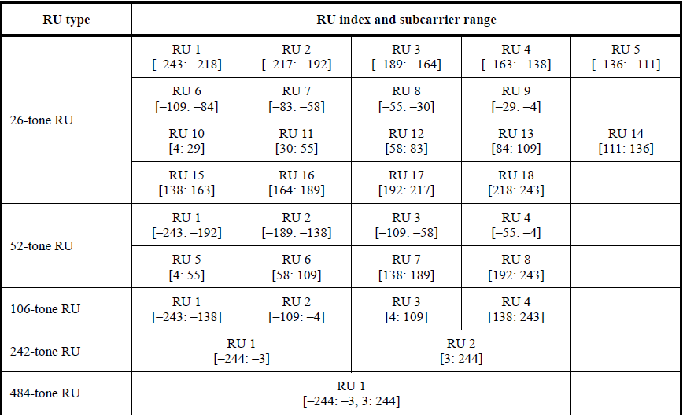
Table 27-8 in 11ax: Data and pilot Subcarrier Indices for RUs in an 40 MHz HE PPDU and in a Non-OFDMA 40 MHz HE PPDU

Slide 26
Table 1: Data and pilot Subcarrier Indices for RUs in an 80 MHz EHT PPDU and in a Non-OFDMA 80 MHz EHT PPDU
Based on the modified tone plan for 11be 80MHz OFDMA (by 20/066r2)
RU type | RU index and subcarrier range
26-tone RU | RU 1 [–499: –474] | RU 2 [–473: –448] | RU 3 [–445: –420] | RU 4 [–419: –394] | RU 5 [–392: –367]
 | RU 6 [–365: –340] | RU 7 [–339: –314] | RU 8 [–311: –286] | RU 9 [–285: –260]
 | RU 10 [–252: –227] | RU 11 [–226: –201] | RU 12 [–198: –173] | RU 13 [–172: –147] | RU 14 [–145: –120]
 | RU 15 [–118: –93] | RU 16 [–92: –67] | RU 17 [–64: –39] | RU 18 [–38: –13]
 | RU 19 [13: 38] | RU 20 [39: 64] | RU 21 [67: 92] | RU 22 [93: 118] | RU 23 [120: 145]
 | RU 24 [147: 172] | RU 25 [173: 198] | RU 26 [201: 226] | RU 27 [227: 252]
 | RU 28 [260: 285] | RU 29 [286: 311] | RU 30 [314: 339] | RU 31 [340: 365] | RU 32 [367: 392]
 | RU 33 [394: 419] | RU 34 [420: 445] | RU 35 [448: 473] | RU 36 [474: 499]
52-tone RU | RU 1 [–499: –448] | RU 2 [–445: –394] | RU 3 [–365: –314] | RU 4 [–311: –260]
 | RU 5 [–252: –201] | RU 6 [–198: –147] | RU 7 [–118: –67] | RU 8 [–64: –13]
 | RU 9 [13: 64] | RU 10 [67: 118] | RU 11 [147: 198] | RU 12 [201: 252]
 | RU 13 [260: 311] | RU 14 [314: 365] | RU 15 [394: 445] | RU 16 [448: 499]
106-tone RU | RU 1 [–499: –394] | RU 2 [–365: –260] | RU 3 [–252: –147] | RU 4 [–118: –13]
 | RU 5 [13: 117] | RU 6 [147: 252] | RU 7 [260: 365] | RU 8 [394: 499]
242-tone RU | RU 1 [–500: -259] | RU 2 [-253:-12] | RU 3 [12: 253] | RU 4 [259:500]
484-tone RU | RU 1 [–500: -259, -253:-12] |  | RU 2 [12: 253, 259:500]
996-tone RU | RU 1 [–500: –3, 3: 500]
The subcarrier index of 0 corresponds to the DC tone. Negative subcarrier indices correspond to subcarriers with frequency lower than the DC tone, and positive subcarrier indices correspond to subcarriers with frequency higher than the DC tone.

Slide 27
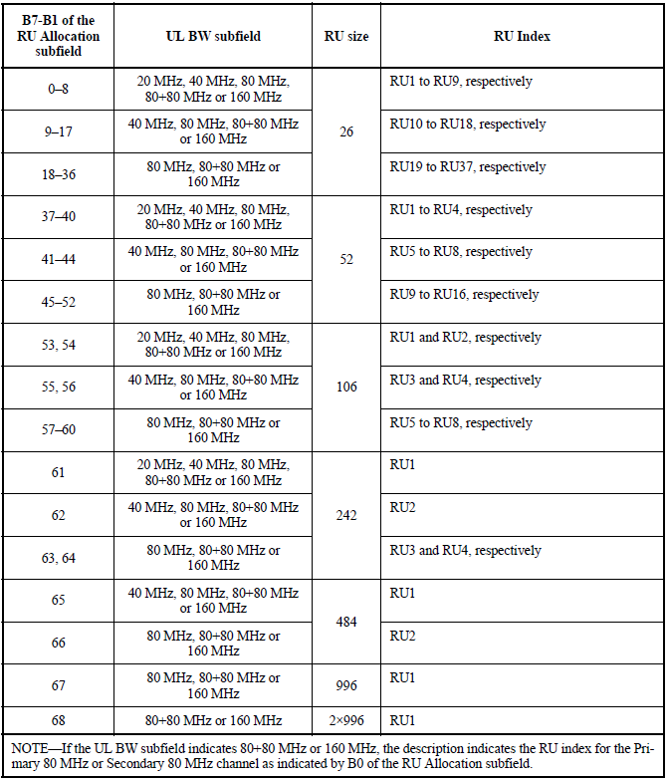
Table 9-31h in 11ax: Mapping of B7–B1 of the RU Allocation subfield

Slide 28
Reference
[1] 802.11-20/0566r23, Specification Framework for TGbe.
[2] 802.11-20/0416r0, Multi-RU Indication in Trigger Frame.
[3] 802.11-20/0413r1, Discussion on EHT Trigger based UL MU

