Slide 1
RU Allocation Subfield Design for EHT Trigger Frame
Date: 2020-05-26
Authors:

Slide 2
Introduction
11be task group has approved that 11be shall allow the following PHY features [1].
320 MHz and 160+160 MHz PPDU
240 MHz and 160+80 MHz transmission
802.11be shall allow more than one RUs to be assigned to a single STA.
Design aspects regarding Trigger frame to support these above features have been discussed in several contributions [2][3].
In this contribution, we address the modified 9-bit RU Allocation subfield for Trigger frame so that RU allocation signaling for Trigger based UL MU transmissions can cover the supported bandwidths and multi-RU combinations.

Slide 3
EHT Trigger Frame Format
In 11ax, a Trigger frame allocates resources for and solicits one or more HE TB PPDU transmissions. The Trigger frame also carries other information required by the responding STA to send an HE TB PPDU.
Trigger frame format in 11ax
EHT Trigger frame can be designed by modifying an existing HE Trigger frame in order to allocate RU or multi-RU to STAs for UL MU transmissions in EHT.
E.g., UL BW in Common Info is expanded to support BW of 240/320MHz. (2 bits => 3 bits)
E.g., RU Allocation subfield in User Info field is expanded to indicate multi-RU assignment.
We focus on RU Allocation subfield design to enable trigger based UL MU in 11be to support BW of 240/320MHz and Multi-RU aggregation.
Frame Control | Duration | RA | TA | Common Info | User Info List | Padding | FCS

Slide 4
Structure of RU Allocation subfield for Each STA
Existing 8-bit RU Allocation subfield in User info field in Trigger frame does not allow indicating BW of 240/320MHz and multiple RU allocation information.
To support the larger bandwidths and multi-RU combinations, we can consider the extended 9-bit RU allocation subfield.
2 bits of [X1 X0]: Used to indicate the location of channel that RU allocation applies
7 bits of [X8 - X2]: Used to indicate RU or multi-RU assignment
RU Allocation subfield for EHT
X8 X7 X6 X5 X4 X3 X2 X1 X0

Slide 5
RU Allocation Subfield for 240/320 MHz BW
In 11ax, one bit (B0) in the RU Allocation subfield in Trigger frame is used to indicate the Primary 80MHz or Secondary 80MHz channel.
To cover the supported bandwidths of 240/320 MHz in EHT, it is preferred to use two bits, [X1 X0], to indicate the location of channel that RU or MRU allocation applies.
Example
For BW of 160MHz and 80+80 MHz / 320 MHz and 160+160 MHz
For BW of 240MHz and 160+80 MHz
Note: For 2×RU996, 3×RU996, and RU484+RU996, 80MHz channel indicated by [X1 X0] becomes the starting 80MHz segment.
 | [X1 X0]
 | Primary 160MHz |  | Secondary 160MHz
 | Primary 80MHz | Secondary 80MHz | Lower 80MHz | Higher 80MHz
160MHz and 80+80MHz (11ax) | [x 0] | [x 1] | - | -
320 MHz and 160+160 MHz | [0 0] | [1 0] | [0 1] | [1 1]
 | [X1 X0]
 | Primary 80MHz | Other 160MHz
 |  | Lower 80MHz | Higher 80MHz
240 MHz and 160+80 MHz | [x 0] | [0 1] | [1 1]

Slide 6
Indication for Multiple RU Allocation Info
Considering the number of entries needed for multi-RU combinations, it is possible to indicate the allocated multi-RU aggregation to STAs with the reserved entries of RU Allocation subfield table for the Trigger frame in 11ax .
First, we define indices for multi-RU combinations based on data and pilot subcarrier indices for RUs.
Then, based on the defined indices for multi-RU combinations, new entries to indicate various combinations for multi-RU aggregation are added to the existing RU Allocation subfield in 11ax.
In the followings, the details of RU Allocation subfield design for indication of allocated multi-RU are described.

Slide 7
Define Indices for MRUs
Based on Table 27-7 & Table 27-8 in 11ax and Table 1 in Appendices, the location of MRUs are defined as follows.
Indices for MRUs in an 20 MHz EHT PPDU
Indices for MRUs in an 40 MHz EHT PPDU
MRU type | MRU index | MRU combination
RU52+RU26 | MRU 1 | 52-tone RU 2 + 26-tone RU 2
 | MRU 2 | 52-tone RU 3 + 26-tone RU 8
RU106+RU26 | MRU 1 | 106-tone RU 1 + 26-tone RU 5
 | MRU 2 | 106-tone RU 2 + 26-tone RU 5
MRU type | MRU index | MRU combination
RU52+RU26 | MRU 1 | 52-tone RU 2 + 26-tone RU 2
 | MRU 2 | 52-tone RU 3 + 26-tone RU 8
 | MRU 3 | 52-tone RU 6 + 26-tone RU 11
 | MRU 4 | 52-tone RU 7 + 26-tone RU 17
RU106+RU26 | MRU 1 | 106-tone RU 1 + 26-tone RU 5
 | MRU 2 | 106-tone RU 2 + 26-tone RU 5
 | MRU 3 | 106-tone RU 3 + 26-tone RU 14
 | MRU 4 | 106-tone RU 4 + 26-tone RU 14

Slide 8
Define Indices for MRUs (Cont’d)
The location of MRUs are defined as follows.
Indices for MRUs in an 80 MHz EHT PPDU
Indices for MRUs in an 160 MHz EHT PPDU
MRU type | MRU index | MRU combination
RU52+RU26 | MRU 1 | 52-tone RU 3 + 26-tone RU 8
 | MRU 2 | 52-tone RU 6 + 26-tone RU 11
 | MRU 3 | 52-tone RU 11 + 26-tone RU 26
 | MRU 4 | 52-tone RU 14 + 26-tone RU 29
RU106+RU26 | MRU 1 | 106-tone RU 1 + 26-tone RU 5
 | MRU 2 | 106-tone RU 4 + 26-tone RU 14
 | MRU 3 | 106-tone RU 5 + 26-tone RU 23
 | MRU 4 | 106-tone RU 8 + 26-tone RU 32
RU484+RU242 | MRU 1 | RU484+RU242; option 1 - First RU242 is not allocated in [RU242 RU242 RU484]
 | MRU 2 | RU484+RU242; option 2 - Second RU242 is not allocated in [RU242 RU242 RU484]
 | MRU 3 | RU484+RU242; option 3 - First RU242 is not allocated in [RU484 RU242 RU242]
 | MRU 4 | RU484+RU242; option 4 - Second RU242 is not allocated in [RU484 RU242 RU242]
MRU type | MRU index | MRU combination
RU996+RU484 | MRU 1 | RU484+RU996; option 1 - First RU484 is not allocated in [RU484 RU484 RU996]
 | MRU 2 | RU484+RU996; option 2 - Second RU484 is not allocated in [RU484 RU484 RU996]
 | MRU 3 | RU484+RU996; option 3 - First RU484 is not allocated in [RU996 RU484 RU484]
 | MRU 4 | RU484+RU996; option 4 - Second RU484 is not allocated in [RU996 RU484 RU484]

Slide 9
X8–X2 of RU Allocation Subfield for EHT
To indicate various combinations for multi-RU aggregation, new entries are added to the existing RU Allocation subfield in 11ax based on the defined indices for multi-RU combinations.
The mapping of X8–X2 of the RU Allocation subfield for EHT is defined as follows.
X8-X2of RU Allocation subfield | UL BW subfield | RU size | RU Index
0-8 | 20MHz, 40MHz, 80MHz, 80+80 or 160MHz, 160+80 or 240MHz, 160+160 or 320MHz | 26 | RU1 to RU9, respectively
9–17 | 40MHz, 80MHz, 80+80 or 160MHz, 160+80 or 240MHz, 160+160 or 320MHz |  | RU10 to RU18, respectively
18–35 | 80MHz, 80+80 or 160MHz, 160+80 or 240MHz, 160+160 or 320MHz |  | RU19 to RU36, respectively
36–39 | 20MHz, 40MHz, 80MHz, 80+80 or 160MHz, 160+80 or 240MHz, 160+160 or 320MHz | 52 | RU1 to RU4, respectively
40–43 | 40MHz, 80MHz, 80+80 or 160MHz, 160+80 or 240MHz, 160+160 or 320MHz |  | RU5 to RU8, respectively
44–51 | 80MHz, 80+80 or 160MHz, 160+80 or 240MHz, 160+160 or 320MHz |  | RU9 to RU16, respectively
52, 53 | 20MHz, 40MHz, 80MHz, 80+80 or 160MHz, 160+80 or 240MHz, 160+160 or 320MHz | 106 | RU1 and RU2, respectively
54, 55 | 40MHz, 80MHz, 80+80 or 160MHz, 160+80 or 240MHz, 160+160 or 320MHz |  | RU3 and RU4, respectively
56–59 | 80MHz, 80+80 or 160MHz, 160+80 or 240MHz, 160+160 or 320MHz |  | RU5 to RU8, respectively
60 | 20MHz, 40MHz, 80MHz, 80+80 or 160MHz, 160+80 or 240MHz, 160+160 or 320MHz | 242 | RU1
61 | 40MHz, 80MHz, 80+80 or 160MHz, 160+80 or 240MHz, 160+160 or 320MHz |  | RU2
62,63 | 80MHz, 80+80 or 160MHz, 160+80 or 240MHz, 160+160 or 320MHz |  | RU3 and RU4, respectively
64 | 40MHz, 80MHz, 80+80 or 160MHz, 160+80 or 240MHz, 160+160 or 320MHz | 484 | RU1
65 | 80MHz, 80+80 or 160MHz, 160+80 or 240MHz, 160+160 or 320MHz |  | RU2
66 | 80MHz, 80+80 or 160MHz, 160+80 or 240MHz, 160+160 or 320MHz | 996 | RU1
67 | 80+80 or 160MHz, 160+80 or 240MHz, 160+160 or 320MHz | 2×996 | RU1
68 | 160+80 or 240MHz, 160+160 or 320MHz | 3×996 | RU1
69 | 160+160 or 320MHz | 4×996 | RU1
70,71 | 20MHz, 40MHz, 80MHz, 80+80 or 160MHz, 160+80 or 240MHz, 160+160 or 320MHz | RU52+RU26 | MRU1 and MRU2, respectively
72,73 | 40MHz, 80MHz, 80+80 or 160MHz, 160+80 or 240MHz, 160+160 or 320MHz |  | MRU3 and MRU4, respectively
74,75 | 20MHz, 40MHz, 80MHz, 80+80 or 160MHz, 160+80 or 240MHz, 160+160 or 320MHz | RU106+RU26 | MRU1 and MRU2, respectively
76,77 | 40MHz, 80MHz, 80+80 or 160MHz, 160+80 or 240MHz, 160+160 or 320MHz |  | MRU3 and MRU4, respectively
78-81 | 80MHz, 80+80 or 160MHz, 160+80 or 240MHz, 160+160 or 320MHz | RU484+RU242 | MRU1 to MRU4, respectively
83-85 | 160MHz, 160+80 or 240MHz, 160+160 or 320MHz | RU996+RU484 | MRU1 to MRU4, respectively
Existing
entries
considering the modified tone plan
for 80MHz OFDMA
Newly
added entries

Slide 10
Examples of Proposed RU Allocation Subfield for EHT
Examples
UL BW=320MHz
STA1: MRU2 of 484+242 in Primary 80 MHz
STA2: RU2 of 242 in lower 80 MHz segment of Secondary 160MHz
STA 1
STA 1
484
242
242
UL BW=320MHz
Primary 80
Secondary 80
80 MHz
80MHz
STA 2
242
242
484
RU Allocation subfield | STA 1 | STA 2
X1X0 | 00 | 01
X8-X2 | 1010000 (80) | 0111101 (61)

Slide 11
Summary
In this contribution, we proposed the modified 9-bit RU Allocation subfield for Trigger frame to indicate the supported bandwidths and multi-RU combinations in EHT.

Slide 12
Straw Poll #1
Do you support that the TGbe SFD shall include the following table?
Data and pilot subcarrier indices for RUs in an 80 MHz HE PPDU and in a non-OFDMA 80 MHz HE PPDU (based on the modified tone plan for 11be 80MHz OFDMA (by 20/066r2))
RU type | RU index and subcarrier range
26-tone RU | RU 1 [–499: –474] | RU 2 [–473: –448] | RU 3 [–445: –420] | RU 4 [–419: –394] | RU 5 [–392: –367]
 | RU 6 [–365: –340] | RU 7 [–339: –314] | RU 8 [–311: –286] | RU 9 [–285: –260]
 | RU 10 [–252: –227] | RU 11 [–226: –201] | RU 12 [–198: –173] | RU 13 [–172: –147] | RU 14 [–145: –120]
 | RU 15 [–118: –93] | RU 16 [–92: –67] | RU 17 [–64: –39] | RU 18 [–38: –13]
 | RU 19 [13: 38] | RU 20 [39: 64] | RU 21 [67: 92] | RU 22 [93: 118] | RU 23 [120: 145]
 | RU 24 [147: 172] | RU 25 [173: 198] | RU 26 [201: 226] | RU 27 [227: 252]
 | RU 28 [260: 285] | RU 29 [286: 311] | RU 30 [314: 339] | RU 31 [340: 365] | RU 32 [367: 392]
 | RU 33 [394: 419] | RU 34 [420: 445] | RU 35 [448: 473] | RU 36 [474: 499]
52-tone RU | RU 1 [–499: –448] | RU 2 [–445: –394] | RU 3 [–365: –314] | RU 4 [–311: –260]
 | RU 5 [–252: –201] | RU 6 [–198: –147] | RU 7 [–118: –67] | RU 8 [–64: –13]
 | RU 9 [13: 64] | RU 10 [67: 118] | RU 11 [147: 198] | RU 12 [201: 252]
 | RU 13 [260: 311] | RU 14 [314: 365] | RU 15 [394: 445] | RU 16 [448: 499]
106-tone RU | RU 1 [–499: –394] | RU 2 [–365: –260] | RU 3 [–252: –147] | RU 4 [–118: –13]
 | RU 5 [13: 117] | RU 6 [147: 252] | RU 7 [260: 365] | RU 8 [394: 499]
242-tone RU | RU 1 [–500: -259] | RU 2 [-253:-12] | RU 3 [12: 253] | RU 4 [259:500]
484-tone RU | RU 1 [–500: -259, -253:-12] |  | RU 2 [12: 253, 259:500]
996-tone RU | RU 1 [–500: –3, 3: 500]
The subcarrier index of 0 corresponds to the DC tone. Negative subcarrier indices correspond to subcarriers with frequency lower than the DC tone, and positive subcarrier indices correspond to subcarriers with frequency higher than the DC tone.

Slide 13
Straw Poll #2
Do you support that the TGbe SFD shall include the following table?
Indices for MRUs in an 20 MHz HE PPDU
MRU type | MRU index | MRU combination
RU52+RU26 | MRU 1 | 52-tone RU 2 + 26-tone RU 2
 | MRU 2 | 52-tone RU 3 + 26-tone RU 8
RU106+RU26 | MRU 1 | 106-tone RU 1 + 26-tone RU 5
 | MRU 2 | 106-tone RU 2 + 26-tone RU 5

Slide 14
Straw Poll #3
Do you support that the TGbe SFD shall include the following table?
Indices for MRUs in an 40 MHz EHT PPDU
MRU type | MRU index | MRU combination
RU52+RU26 | MRU 1 | 52-tone RU 2 + 26-tone RU 2
 | MRU 2 | 52-tone RU 3 + 26-tone RU 8
 | MRU 3 | 52-tone RU 6 + 26-tone RU 11
 | MRU 4 | 52-tone RU 7 + 26-tone RU 17
RU106+RU26 | MRU 1 | 106-tone RU 1 + 26-tone RU 5
 | MRU 2 | 106-tone RU 2 + 26-tone RU 5
 | MRU 3 | 106-tone RU 3 + 26-tone RU 14
 | MRU 4 | 106-tone RU 4 + 26-tone RU 14

Slide 15
Straw Poll #4
Do you support that the TGbe SFD shall include the following table?
Indices for MRUs in an 80 MHz EHT PPDU
MRU type | MRU index | MRU combination
RU52+RU26 | MRU 1 | 52-tone RU 3 + 26-tone RU 8
 | MRU 2 | 52-tone RU 6 + 26-tone RU 11
 | MRU 3 | 52-tone RU 11 + 26-tone RU 26
 | MRU 4 | 52-tone RU 14 + 26-tone RU 29
RU106+RU26 | MRU 1 | 106-tone RU 1 + 26-tone RU 5
 | MRU 2 | 106-tone RU 4 + 26-tone RU 14
 | MRU 3 | 106-tone RU 5 + 26-tone RU 23
 | MRU 4 | 106-tone RU 8 + 26-tone RU 32
RU484+RU242 | MRU 1 | RU484+RU242; option 1 - First RU242 is not allocated in [RU242 RU242 RU484]
 | MRU 2 | RU484+RU242; option 2 - Second RU242 is not allocated in [RU242 RU242 RU484]
 | MRU 3 | RU484+RU242; option 3 - First RU242 is not allocated in [RU484 RU242 RU242]
 | MRU 4 | RU484+RU242; option 4 - Second RU242 is not allocated in [RU484 RU242 RU242]

Slide 16
Straw Poll #5
Do you support that EHT Trigger frame includes 9-bit RU Allocation subfield?

Slide 17
Straw Poll #6
Do you support that [X1 X0] of RU Allocation subfield indicates the location of channel that RU or MRU allocation applies as follows?
X0 | If the UL BW subfield indicates 160+160 MHz or 320 MHz, X0 of the RU Allocation subfield is set to 0 to indicate that the RU allocation applies to the primary 160 MHz channel and set to 1 to indicate that the RU allocation applies to the secondary 160 MHz channel. If the UL BW subfield indicates 160+80 MHz or 240 MHz, X0 of the RU Allocation subfield is set to 0 to indicate that the RU allocation applies to the primary 80 MHz channel and set to 1 to indicate that the RU allocation applies to the other 160 MHz channel If the UL BW subfield indicates 80+80 MHz or 160 MHz, X0 of the RU Allocation subfield is set to 0 to indicate that the RU allocation applies to the primary 80 MHz channel and set to 1 to indicate that the RU allocation applies to the secondary 80 MHz channel.
X1 | If the UL BW subfield indicates 160+160 MHz or 320 MHz, X1 of the RU Allocation subfield is set to 0 to indicate that the RU allocation applies to the lower 80 MHz channel in 160MHz as indicated by X0 of the RU Allocation subfield and set to 1 to indicate that the RU allocation applies to the higher 80 MHz channel in 160MHz as indicated by X0 of the RU Allocation subfield If the UL BW subfield indicates 160+80 MHz or 240 MHz, X1 of the RU Allocation subfield is set to 0 to indicate that the RU allocation applies to the lower 80 MHz channel in 160MHz as indicated by X0 of the RU Allocation subfield and set to 1 to indicate that the RU allocation applies to the higher 80 MHz channel in 160MHz as indicated by X0 of the RU Allocation subfield If the UL BW subfield indicates 80+80 MHz or 160 MHz, X1 of the RU Allocation subfield is reserved.
Note- For 2×RU996, 3×RU996, and RU484+RU996, 80MHz channel indicated by [X1 X0] becomes the starting 80MHz segment.

Slide 18
Straw Poll #7
Do you support that the TGbe SFD shall include the following table of RU Allocation subfield in Trigger frame?
X8–X2 of RU Allocation subfield | UL BW subfield | RU size | RU Index
0-8 | 20MHz, 40MHz, 80MHz, 80+80 or 160MHz, 160+80 or 240MHz, 160+160 or 320MHz | 26 | RU1 to RU9, respectively
9–17 | 40MHz, 80MHz, 80+80 or 160MHz, 160+80 or 240MHz, 160+160 or 320MHz |  | RU10 to RU18, respectively
18–35 | 80MHz, 80+80 or 160MHz, 160+80 or 240MHz, 160+160 or 320MHz |  | RU19 to RU36, respectively
36–39 | 20MHz, 40MHz, 80MHz, 80+80 or 160MHz, 160+80 or 240MHz, 160+160 or 320MHz | 52 | RU1 to RU4, respectively
40–43 | 40MHz, 80MHz, 80+80 or 160MHz, 160+80 or 240MHz, 160+160 or 320MHz |  | RU5 to RU8, respectively
44–51 | 80MHz, 80+80 or 160MHz, 160+80 or 240MHz, 160+160 or 320MHz |  | RU9 to RU16, respectively
52, 53 | 20MHz, 40MHz, 80MHz, 80+80 or 160MHz, 160+80 or 240MHz, 160+160 or 320MHz | 106 | RU1 and RU2, respectively
54, 55 | 40MHz, 80MHz, 80+80 or 160MHz, 160+80 or 240MHz, 160+160 or 320MHz |  | RU3 and RU4, respectively
56–59 | 80MHz, 80+80 or 160MHz, 160+80 or 240MHz, 160+160 or 320MHz |  | RU5 to RU8, respectively
60 | 20MHz, 40MHz, 80MHz, 80+80 or 160MHz, 160+80 or 240MHz, 160+160 or 320MHz | 242 | RU1
61 | 40MHz, 80MHz, 80+80 or 160MHz, 160+80 or 240MHz, 160+160 or 320MHz |  | RU2
62,63 | 80MHz, 80+80 or 160MHz, 160+80 or 240MHz, 160+160 or 320MHz |  | RU3 and RU4, respectively
64 | 40MHz, 80MHz, 80+80 or 160MHz, 160+80 or 240MHz, 160+160 or 320MHz | 484 | RU1
65 | 80MHz, 80+80 or 160MHz, 160+80 or 240MHz, 160+160 or 320MHz |  | RU2
66 | 80MHz, 80+80 or 160MHz, 160+80 or 240MHz, 160+160 or 320MHz | 996 | RU1
67 | 80+80 or 160MHz, 160+80 or 240MHz, 160+160 or 320MHz | 2×996 | RU1
68 | 160+80 or 240MHz, 160+160 or 320MHz | 3×996 | RU1
69 | 160+160 or 320MHz | 4×996 | RU1
70,71 | 20MHz, 40MHz, 80MHz, 80+80 or 160MHz, 160+80 or 240MHz, 160+160 or 320MHz | RU52+RU26 | MRU1 and MRU2, respectively
72,73 | 40MHz, 80MHz, 80+80 or 160MHz, 160+80 or 240MHz, 160+160 or 320MHz |  | MRU3 and MRU4, respectively
74,75 | 20MHz, 40MHz, 80MHz, 80+80 or 160MHz, 160+80 or 240MHz, 160+160 or 320MHz | RU106+RU26 | MRU1 and MRU2, respectively
76,77 | 40MHz, 80MHz, 80+80 or 160MHz, 160+80 or 240MHz, 160+160 or 320MHz |  | MRU3 and MRU4, respectively
78-81 | 80MHz, 80+80 or 160MHz, 160+80 or 240MHz, 160+160 or 320MHz | RU484+RU242 | MRU1 to MRU4, respectively
83-85 | 160MHz, 160+80 or 240MHz, 160+160 or 320MHz | RU996+RU494 | MRU1 to MRU4, respectively

Slide 19
Appendices

Slide 20
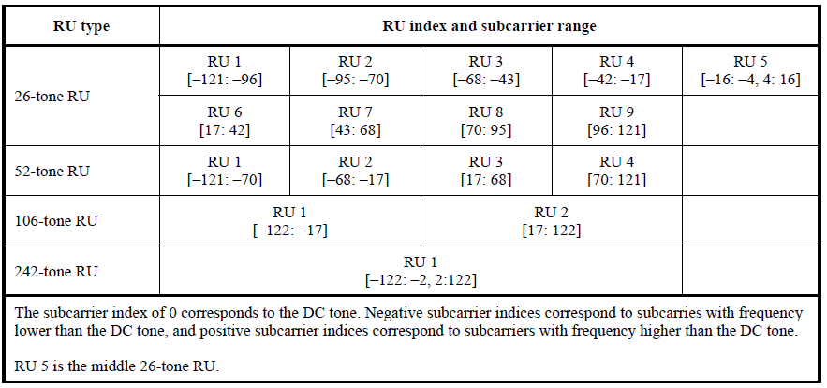
Data and pilot Subcarrier Indices for RUs in an 20 MHz HE PPDU and in a Non-OFDMA 20 MHz HE PPDU – Table 27-7 in 11ax

Slide 21
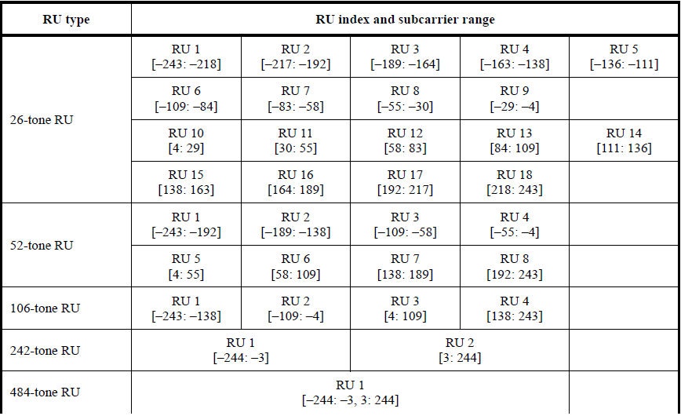
Data and pilot Subcarrier Indices for RUs in an 40 MHz HE PPDU and in a Non-OFDMA 40 MHz HE PPDU – Table 27-8 in 11ax

Slide 22
Data and pilot Subcarrier Indices for RUs in an 80 MHz HE PPDU and in a Non-OFDMA 80 MHz HE PPDU – Table 1 in Appendices
Based on the modified tone plan for 11be 80MHz OFDMA (by 20/066r2)
RU type | RU index and subcarrier range
26-tone RU | RU 1 [–499: –474] | RU 2 [–473: –448] | RU 3 [–445: –420] | RU 4 [–419: –394] | RU 5 [–392: –367]
 | RU 6 [–365: –340] | RU 7 [–339: –314] | RU 8 [–311: –286] | RU 9 [–285: –260]
 | RU 10 [–252: –227] | RU 11 [–226: –201] | RU 12 [–198: –173] | RU 13 [–172: –147] | RU 14 [–145: –120]
 | RU 15 [–118: –93] | RU 16 [–92: –67] | RU 17 [–64: –39] | RU 18 [–38: –13]
 | RU 19 [13: 38] | RU 20 [39: 64] | RU 21 [67: 92] | RU 22 [93: 118] | RU 23 [120: 145]
 | RU 24 [147: 172] | RU 25 [173: 198] | RU 26 [201: 226] | RU 27 [227: 252]
 | RU 28 [260: 285] | RU 29 [286: 311] | RU 30 [314: 339] | RU 31 [340: 365] | RU 32 [367: 392]
 | RU 33 [394: 419] | RU 34 [420: 445] | RU 35 [448: 473] | RU 36 [474: 499]
52-tone RU | RU 1 [–499: –448] | RU 2 [–445: –394] | RU 3 [–365: –314] | RU 4 [–311: –260]
 | RU 5 [–252: –201] | RU 6 [–198: –147] | RU 7 [–118: –67] | RU 8 [–64: –13]
 | RU 9 [13: 64] | RU 10 [67: 118] | RU 11 [147: 198] | RU 12 [201: 252]
 | RU 13 [260: 311] | RU 14 [314: 365] | RU 15 [394: 445] | RU 16 [448: 499]
106-tone RU | RU 1 [–499: –394] | RU 2 [–365: –260] | RU 3 [–252: –147] | RU 4 [–118: –13]
 | RU 5 [13: 117] | RU 6 [147: 252] | RU 7 [260: 365] | RU 8 [394: 499]
242-tone RU | RU 1 [–500: -259] | RU 2 [-253:-12] | RU 3 [12: 253] | RU 4 [259:500]
484-tone RU | RU 1 [–500: -259, -253:-12] |  | RU 2 [12: 253, 259:500]
996-tone RU | RU 1 [–500: –3, 3: 500]
The subcarrier index of 0 corresponds to the DC tone. Negative subcarrier indices correspond to subcarriers with frequency lower than the DC tone, and positive subcarrier indices correspond to subcarriers with frequency higher than the DC tone.

Slide 23
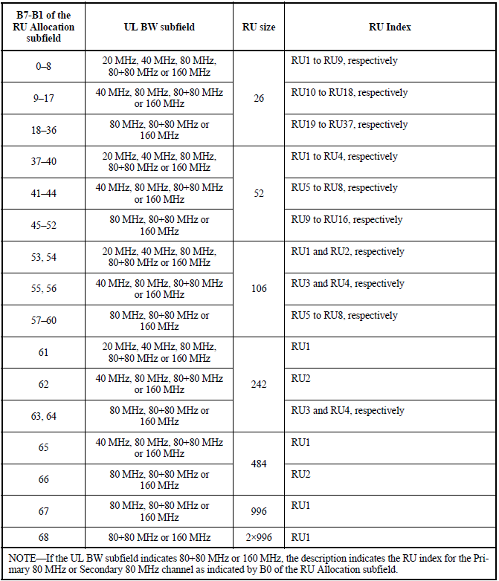
Mapping of B7–B1 of the RU Allocation subfield in 11ax (Table 9-31h)

Slide 24
Reference
[1] 802.11-20/0566r23, Specification Framework for TGbe.
[2] 802.11-20/0416r0, Multi-RU Indication in Trigger Frame.
[3] 802.11-20/0413r1, Discussion on EHT Trigger based UL MU

