Slide 1
EHT-LTF sequences considering the new tone plan

Slide 2
Introduction
I suggested EHT-LTF sequences and the following straw-polls were passed [1].
  Do you support to reuse 1/2/4x HE-LTF sequences for 1/2/4x EHT-LTF sequences in 20/40/80MHz?
  Do you support to reuse 1/2/4x HE-LTF sequences for 1/2/4x EHT-LTF sequences in 80+80/160MHz?
I add the PAPR performances of 80/160MHz LTF sequences in new tone plan as a reference in Appendix 1 and 2.
And I suggest EHT-LTF sequences for 320MHz.
  I already suggested the sequences in [1], but I’d like to re-check the performance with some changes as [2,3] and re-select the sequences if needed.
  TBD for 240MHz. That’s because we need to discuss first whether we define the LTF sequences alone or use some part of LTF sequences for 320MHz.

Slide 3
EHT-LTF sequences for 320MHz BW
The suggested 1/2/4x EHT-LTF sequences are as below.
  EHTLTF_{320MHz_1x} = {LTF_{80MHz_lower1_1x}, 23 zeros, LTF_{80MHz_upper1_1x}, 23 zeros, LTF_{80MHz_lower2_1x}, 23 zeros, LTF_{80MHz_upper2_1x}}
    LTF_{80MHz_lower1_1x} = {s(1)*LTF_{80MHz_left_1x}, 0, s(2)*LTF_{80MHz_right_1x}}
    LTF_{80MHz_upper1_1x} = {s(3)*LTF_{80MHz_left_1x}, 0, s(4)*LTF_{80MHz_right_1x}}
    LTF_{80MHz_lower2_1x} = {s(5)*LTF_{80MHz_left_1x}, 0, s(6)*LTF_{80MHz_right_1x}}
    LTF_{80MHz_upper2_1x} = {s(7)*LTF_{80MHz_left_1x}, 0, s(8)*LTF_{80MHz_right_1x}}
  EHTLTF_{320MHz_2x} = {LTF_{80MHz_lower1_2x}, 23 zeros, LTF_{80MHz_upper1_2x}, 23 zeros, LTF_{80MHz_lower2_2x}, 23 zeros, LTF_{80MHz_upper2_2x}}
    LTF_{80MHz_lower1_2x} = {q(1)*LTF_{80MHz_part1_2x}, q(2)*LTF_{80MHz_part2_2x}, q(3)*LTF_{80MHz_part3_2x}, q(4)*LTF_{80MHz_part4_2x}, q(5)*LTF_{80MHz_part5_2x}}
    LTF_{80MHz_upper1_2x} = {q(6)*LTF_{80MHz_part1_2x}, q(7)*LTF_{80MHz_part2_2x}, q(8)*LTF_{80MHz_part3_2x}, q(9)*LTF_{80MHz_part4_2x}, q(10)*LTF_{80MHz_part5_2x}}
    LTF_{80MHz_lower2_2x} = {q(11)*LTF_{80MHz_part1_2x}, q(12)*LTF_{80MHz_part2_2x}, q(13)*LTF_{80MHz_part3_2x}, q(14)*LTF_{80MHz_part4_2x}, q(15)*LTF_{80MHz_part5_2x}}
    LTF_{80MHz_upper2_2x} = {q(16)*LTF_{80MHz_part1_2x}, q(17)*LTF_{80MHz_part2_2x}, q(18)*LTF_{80MHz_part3_2x}, q(19)*LTF_{80MHz_part4_2x}, q(20)*LTF_{80MHz_part5_2x}}
  EHTLTF_{320MHz_4x} = {LTF_{80MHz_lower1_4x}, 23 zeros, LTF_{80MHz_upper1_4x}, 23 zeros, LTF_{80MHz_lower2_4x}, 23 zeros, LTF_{80MHz_upper2_4x}}
    LTF_{80MHz_lower1_4x} = {n(1)*LTF_{80MHz_left_4x}, 0, n(2)*LTF_{80MHz_right_4x}}
    LTF_{80MHz_upper1_4x} = {n(3)*LTF_{80MHz_left_4x}, 0, n(4)*LTF_{80MHz_right_4x}}
    LTF_{80MHz_lower2_4x} = {n(5)*LTF_{80MHz_left_4x}, 0, n(6)*LTF_{80MHz_right_4x}}
    LTF_{80MHz_upper2_4x} = {n(7)*LTF_{80MHz_left_4x}, 0, n(8)*LTF_{80MHz_right_4x}}
The sequences are made by changing the signs of each 80MHz_left/right in 1/4x HE-LTF sequences and 80MHz_part1/2/3/4/5 in 2x HE LTF sequence, and picked with PAPR performance in all (M-)RU and punctured cases.

Slide 4
Simulation Assumption
The best sequences are changed which RUs are considered. Here, I consider the below (M)RUs in 320MHz.
  26/52/106/26+52/26+106, 242/484/996/2*996/4*996/3*996/ 3*996+484/ 484+996 in a continuous 160MHz, (2*996+484)
  I add most of all (M)RU cases in OFDMA or non-OFDMA.
All simulation in this contribution is based on 4x sampling with 1stream.
Under the situation, the s, q, n for best sequences are as below. There are two options whether (2*996+484)RU are considered or not. The MRU is considered if 240MHz LTF is defined as a part of 320MHz LTF.
  s(1)~s(8) for 1x LTF = [1 -1 1 1 -1 -1 -1 -1] or [1 -1 -1 -1 1 1 1 1]
  q(1)~q(20) for 2x LTF = [1 1 1 1 1 1 1 -1 -1 -1 -1 -1 1 -1 -1 -1 -1 1 1 1] or [1 1 -1 -1 -1 -1 -1 -1 -1 -1 1 1 1 1 1 1 1 1 1 1]
  n(1)~n(8) for 4x LTF = [1 1 -1 -1 -1 -1 1 1] or [1 1 -1 1 1 1 1 -1]
The performance of under 996RU has similar with 80/160MHz. So I show the PAPRs of the suggested LTF sequences in Large RUs (equal or larger than 996RU). See the next page.

Slide 5
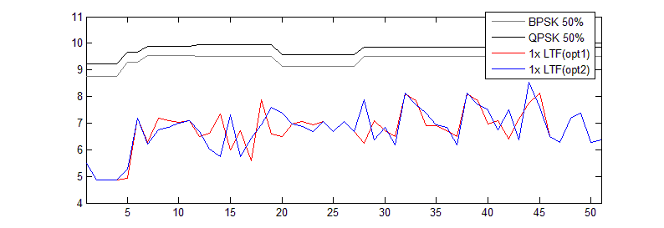
PAPR performance (1/2)
PAPRs in the indices of X-axis
  1~4: 996RUs, 5~6: 2*996RUs, 7: 4*996RU, 8~11: 3*996RUs
  12~19: (3*996+484)RUs, 20~27: (996+484)RUs, 28~51: (2*996+484)RUs
Option 1 of 1/2/4x LTF is to minimize the worst PAPR in all (M)RU cases and, option2 is to minimize the worst PAPR in (M)RU cases except (2*996+484) case.
1x LTF
  All PAPRs are under the data’s. And there’s no big difference of PAPRs between two options.
(2*996+484) RUs

Slide 6
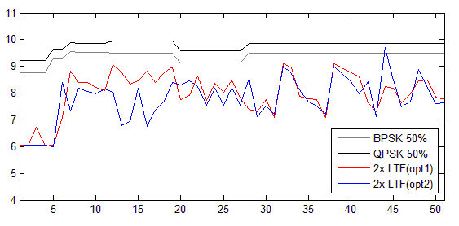
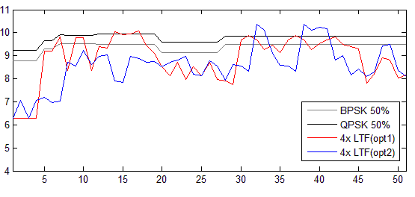
PAPR performance (2/2)
2x LTF
  All PAPRs of option 1 are under the data’s.
  Option 2 has a highest PAPR in (2*996+484)RUs, but except that, it shows slightly lower PAPR than option1.
4x LTF
  Any combinations based on HE-LTF can’t put all PAPRs under 50% data’s.
  Option1 has minimum value of worst PAPR in all (M)RU cases.
  Option2’s PAPRs are mostly lower than option 1 except (2*996+484)RUs.
[NOTE] It has the similar trend in non-continuous 160+160MHz. Refer Appendix 3.

Slide 7
Conclusion
In this contribution, I suggest a unified sequence for each 1, 2 and 4x EHT-LTF of 320MHz and checked the PAPR performance considering the new tone plan.
The sequences are made by reusing the existing LTF sequences for easy implementation.
Based on the method, I suggest two options in each 1/2/4x LTF, and the best sequence can be changed whether 2*996+484 is included or not in 320MHz.

Slide 8
Reference
[1] IEEE802.11-20/0608r0, “Consideration on EHT-LTF”
[2] IEEE802.11-20/667r1, “Small RU Combinations”
[3] IEEE802.11-20/0608r2, “80MHz OFDMA Tone Plan”

Slide 9
Straw poll 1
Do you support to use a unified sequence for each 1/2/4x EHT-LTF in non-OFDMA and OFDMA transmission of 320MHz and 160+160MHz BW PPDU?
  Y/N/Abs

Slide 10
Straw poll 2
Do you support to make EHT-LTF sequences by reusing HE-LTF sequences as below in 320MHz BW PPDU of 11be?
  80MHz_left/right in 1x and 4x HE-LTF sequence, respectively
  80MHz_part1/2/3/4/5 in 2x HE LTF sequence
  The coefficient of the sequences are changed in 11be.
  Y/N/Abs

Slide 11
Straw poll 3
Which one do you support to be used for EHT-LTF sequences in 240MHz and 160+80MHz BW PPDU?
  Option1: some parts of EHT-LTF sequences of 320MHz
  Option2: other sequences for 240MHz and 160+80MHz specific
  Y/N/Abs

Slide 12
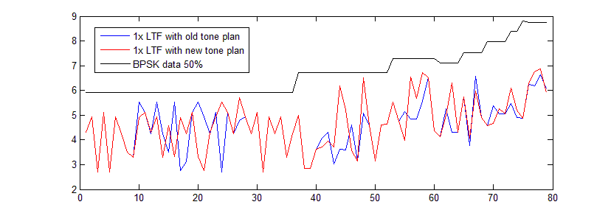
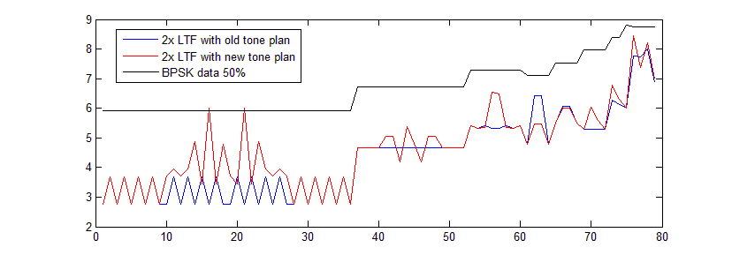
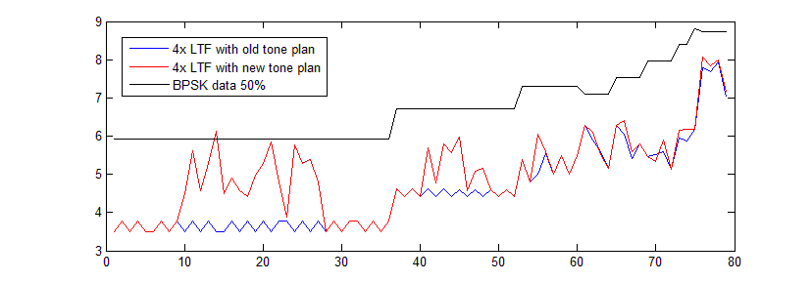
Appendix 1. PAPRs of LTF in 80MHz
PAPRs in the indices of X-axis.
  1~36: 26-tone RUs
  37~52: 52-tone RUs
  53~60: 106-tone RUs
  61~64: 26+52-tone RUs
  65~68: 26+106-tone RUs
  69~72: 242-tone RUs
  73~74: 484-tone RUs
  75: 996-tone RUs
  76~78: 484+242-tone RUs
    I omits the center 26 RU of old tone plan to match the indices of old and new tone plan.
PAPRs in the new tone plan are shown a little higher than with old tone plan in some cases, but most LTF sequences have lower PAPRs than 50% data except in one or two 26 RUs. But the PAPR is around 6dB and it seems to have no problem.

Slide 13
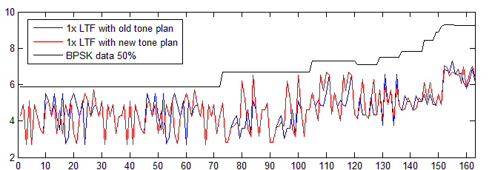
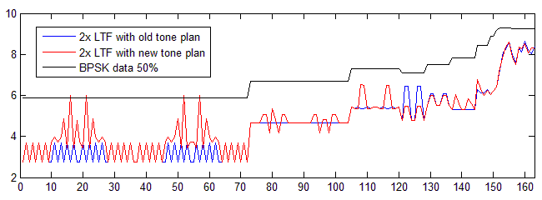
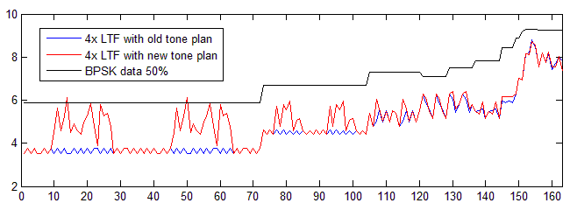
Appendix 2. PAPRs of LTF in 160MHz
PAPRs in the indices of X-axis.
  1~72: 26-tone RUs
  73~104: 52-tone RUs
  105~120: 106-tone RUs
  121~128: 26+52-tone RUs
  129~136: 26+106-tone RUs
  137~144: 242-tone RUs
  145~148: 484-tone RUs
  149~150: 996-tone RUs
  151: 2*996 RU
  152~155: 484+996 RUs
  156~163: 242+484+996-tone RUs
    I omits the center 26 RU of old tone plan to match the indices of old and new tone plan.
It has similar trend with LTF in 80MHz.

Slide 14
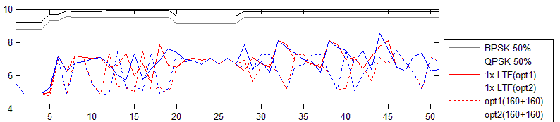
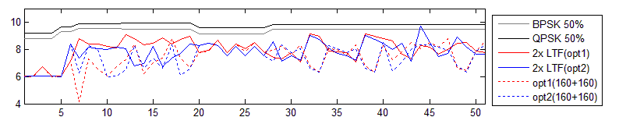
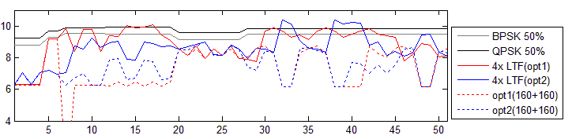
Appendix 3. PAPRs in 160+160 BW
There are no 2*996+484RUs in 160+160MHz.
PAPRs in 160+160MHz are not higher than in 320MHz.

