Slide 1
EHT-LTF sequences considering the new tone plan

Slide 2
Introduction
I suggested EHT-LTF sequences and the following straw-polls were passed [1].
Do you support to reuse 1/2/4x HE-LTF sequences for 1/2/4x EHT-LTF sequences in 20/40/80MHz?
Do you support to reuse 1/2/4x HE-LTF sequences for 1/2/4x EHT-LTF sequences in 80+80/160MHz?
I add the PAPR performances of 80/160MHz LTF sequences in new tone plan as a reference in Appendix 1 and 2.
And I suggest EHT-LTF sequences for 240/320MHz.
I already suggested the sequences in [1], but I’d like to re-check the performance with some changes as [2,3] and re-select the sequences if needed.
All simulation in this contribution is based on 4x sampling with 1stream.

Slide 3
EHT-LTF for 240/320MHz bandwidth (1/2)
26+106 RU is newly added and the possible (M)RUs in 240/320MHz are as below.
In 240MHz: 26/52/106/26+52/26+106, 242/484/996/3*996/2*996/2*996+484/ 996+484 in a continuous 160MHz
In 320MHz: 26/52/106/26+52/26+106, 242/484/996/2*996/4*996/3*996/ 3*996+484/ 484+996 in a continuous 160MHz
The suggested 1/2/4x EHT-LTF sequences in 240MHz
EHTLTF_{240MHz_1x} = {LTF_{80MHz_lower_1x}, 23 zeros, LTF_{80MHz_middle_1x}, 23 zeros, LTF_{80MHz_upper_1x}}
LTF_{80MHz_lower_1x} = {LTF_{80MHz_left_1x}, 0, LTF_{80MHz_right_1x}}
LTF_{80MHz_middle_1x} = {LTF_{80MHz_left_1x}, 0, (-)LTF_{80MHz_right_1x}}
LTF_{80MHz_upper_1x} = {(-)LTF_{80MHz_left_1x}, 0, (-)LTF_{80MHz_right_1x}}
EHTLTF_{240MHz_2x} = {LTF_{80MHz_lower_2x}, 23 zeros, LTF_{80MHz_middle_2x}, 23 zeros, LTF_{80MHz_upper_2x}}
LTF_{80MHz_lower_2x} = {LTF_{80MHz_part1_2x}, LTF_{80MHz_part2_2x}, LTF_{80MHz_part3_2x}, LTF_{80MHz_part4_2x}, LTF_{80MHz_part5_2x}}
LTF_{80MHz_middle_2x} = {LTF_{80MHz_part1_2x}, LTF_{80MHz_part2_2x}, (-)LTF_{80MHz_part3_2x}, (-)LTF_{80MHz_part4_2x}, (-)LTF_{80MHz_part5_2x}}
LTF_{80MHz_upper_2x} = {(-)LTF_{80MHz_part1_2x}, (-)LTF_{80MHz_part2_2x}, (-)LTF_{80MHz_part3_2x}, (-)LTF_{80MHz_part4_2x}, (-)LTF_{80MHz_part5_2x} }
EHTLTF_{240MHz_4x} = {LTF_{80MHz_lower_4x}, 23 zeros, LTF_{80MHz_middle_4x}, 23 zeros, LTF_{80MHz_upper_4x}}
LTF_{80MHz_lower_4x} = {LTF_{80MHz_left_4x}, 0, LTF_{80MHz_right_4x}}
LTF_{80MHz_middle_4x} = {LTF_{80MHz_left_4x}, 0, (-)LTF_{80MHz_right_4x}}
LTF_{80MHz_upper_4x} = {(-)LTF_{80MHz_left_4x}, 0, (-)LTF_{80MHz_right_4x}}

Slide 4
EHT-LTF for 240/320MHz bandwidth (2/2)
The suggested 1/2/4x EHT-LTF sequences in 320MHz
EHTLTF_{320MHz_1x} = {LTF_{80MHz_lower1_1x}, 23 zeros, LTF_{80MHz_upper1_1x}, 23 zeros, LTF_{80MHz_lower2_1x}, 23 zeros, LTF_{80MHz_upper2_1x}}
LTF_{80MHz_lower1_1x} = {LTF_{80MHz_left_1x}, 0, LTF_{80MHz_right_1x}}
LTF_{80MHz_upper1_1x} = {(-)LTF_{80MHz_left_1x}, 0, (-)LTF_{80MHz_right_1x}}
LTF_{80MHz_lower2_1x} = {(-)LTF_{80MHz_left_1x}, 0, LTF_{80MHz_right_1x}}
LTF_{80MHz_upper2_1x} = {(-)LTF_{80MHz_left_1x}, 0, LTF_{80MHz_right_1x}}
EHTLTF_{320MHz_2x} = {LTF_{80MHz_lower1_2x}, 23 zeros, LTF_{80MHz_upper1_2x}, 23 zeros, LTF_{80MHz_lower2_2x}, 23 zeros, LTF_{80MHz_upper2_2x}}
LTF_{80MHz_lower1_2x} = {LTF_{80MHz_part1_2x}, LTF_{80MHz_part2_2x}, (-)LTF_{80MHz_part3_2x}, (-)LTF_{80MHz_part4_2x}, (-)LTF_{80MHz_part5_2x}}
LTF_{80MHz_upper1_2x} = {(-)LTF_{80MHz_part1_2x}, (-)LTF_{80MHz_part2_2x}, (-)LTF_{80MHz_part3_2x}, (-)LTF_{80MHz_part4_2x}, (-)LTF_{80MHz_part5_2x}}
LTF_{80MHz_lower2_2x} = {LTF_{80MHz_part1_2x}, LTF_{80MHz_part2_2x}, LTF_{80MHz_part3_2x}, LTF_{80MHz_part4_2x}, LTF_{80MHz_part5_2x}}
LTF_{80MHz_upper2_2x} = {LTF_{80MHz_part1_2x}, LTF_{80MHz_part2_2x}, LTF_{80MHz_part3_2x}, LTF_{80MHz_part4_2x}, LTF_{80MHz_part5_2x}}
EHTLTF_{320MHz_4x} = {LTF_{80MHz_lower1_4x}, 23 zeros, LTF_{80MHz_upper1_4x}, 23 zeros, LTF_{80MHz_lower2_4x}, 23 zeros, LTF_{80MHz_upper2_4x}}
LTF_{80MHz_lower1_4x} = {LTF_{80MHz_left_4x}, 0, LTF_{80MHz_right_4x}}
LTF_{80MHz_upper1_4x} = {(-)LTF_{80MHz_left_4x}, 0, LTF_{80MHz_right_4x}}
LTF_{80MHz_lower2_4x} = {LTF_{80MHz_left_4x}, 0, LTF_{80MHz_right_4x}}
LTF_{80MHz_upper2_4x} = {LTF_{80MHz_left_4x}, 0, (-)LTF_{80MHz_right_4x}}
The sequences are made by changing the signs of each 80MHz_left/right in 1/4x HE-LTF sequences and 80MHz_part1/2/3/4/5 in 2x HE LTF sequence, and picked with PAPR performance in all (M-)RU and punctured cases.

Slide 5
PAPRs in (M)RUs of 240MHz
Indices in X-axis
1~108: 26RUs (36*3)
109~156: 52RUs (16*3)
157~180: 106RUs (8*3)
181~192: 26+52RUs (4*3)
193~204: 26+106RUs (4*3)
205~216: 242RUs (4*3)
217~222: 484RUs (2*3)
223~225: 996RUs (3)
226: 3*996RUs (1)
227~229: 2*996RUs (3)
230~235: 2*996+484RUs (6)
236~243: 996+484RUs (8)
1/2/4x LTF
All PAPRs of LTF are lower than the data’s except in some 26RUs of 2/4x LTF due to tone shift.
The worst PAPRs are 7.87/8.93/ 9.16dB in non-continuous 2*996 RU (for non-OFDMA) in 1/2/4x LTF.

Slide 6
PAPRs in (M)RUs of 320MHz
Indices in X-axis
1~144: 26RUs (36*4)
145~208: 52RUs (16*4)
209~240: 106RUs (8*4)
241~256: 26+52RUs (4*4)
257~272: 26+106RUs (4*4)
273~288: 242RUs (4*4)
289~296: 484RUs (2*4)
297~300: 996RUs (4)
301~302: 2*996RUs (2)
303: 4*996RUs (1)
304~307: 3*996RUs (4)
308~315: 3*996+484RUs (8)
316~323: 996+484RUs (8)
1/2/4x LTF
All PAPRs of LTF are lower than the data PAPRs except in some 26RUs in 2/4x LTF due to tone shift.
The worst PAPRs are 7.73/8.46dB in 2*996RU of 1/2x LTF and 9.22dB in 3*996RU.

Slide 7
Summary
Most of all LTFs have lower PAPRs than 50% values of BPSK data.
In small (M)RU, PAPRs in a few 26 RUs are slightly higher because of tone shifting by new tone plan, but it’s around 6dB and it seems okay.
In large (M)RU, LTFs show somewhat high PAPRs around 8~9dB in some cases of 2/4x LTF as the below table, and the situation is also shown in 80/160MHz.
The sequences are generated by minimizing the worst PAPR among the sequences based on HE-LTF. And there are a few points over 9dB PAPRs in large MRU of 4x LTF. But it’s in the PAPR of 50% BPSK and it may be acceptable.
[NOTE] The PAPRs for non-continuous 160+80MHz and 160+160MHz are in Appendix 3. There’s no big difference.
 | Worst PAPRs (1/2/4x)
80MHz | 6.71dB (106RU)/ 8.46(484+242RU)/ 8.07 (484+242RU)
160MHz | 7.05/ 8.58/ 8.73dB (484+996 RU)
240MHz | 7.87/8.93/9.16dB (2*996RU)
320MHz | 7.73(2*996RU)/8.46dB (2*996RU)/ 9.22dB (3*996 RU)

Slide 8
Conclusion
In this contribution, I suggest 1/2/4x LTF sequences in 240 and 320MHz and checked the PAPR performance considering the new tone plan.
The sequences are made by reusing the existing LTF sequences for easy implementation. And the trend of PAPRs is similar with the one in 80/160MHz. Therefore they can be used as EHT-LTF sequences in 240/320MHz.

Slide 9
Reference
[1] IEEE802.11-20/0608r0, “Consideration on EHT-LTF”
[2] IEEE802.11-20/667r1, “Small RU Combinations”
[3] IEEE802.11-20/0608r2, “80MHz OFDMA Tone Plan”

Slide 10
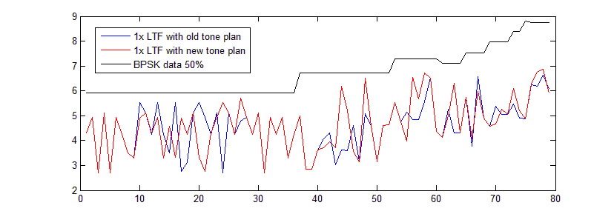
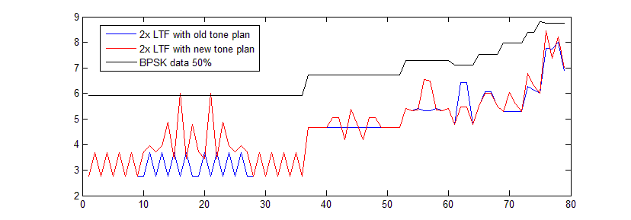
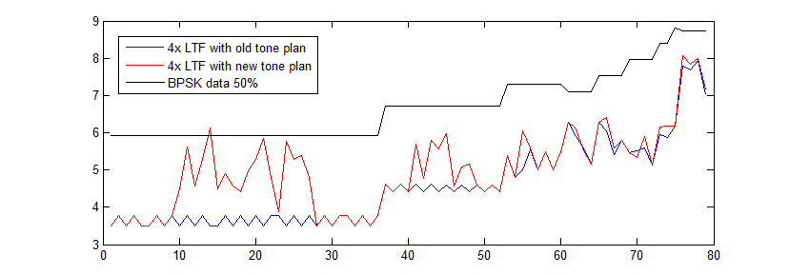
Appendix 1. PAPRs of LTF in 80MHz
I plotted all the PAPRs sequentially with the below RU lists for the comparison between PAPRs with old tone plan and new tone plan.
RUs: 26/ 52/ 106/ 26+52/ 26+106, 242/ 484/ 996/ 484+242
Index 1~36 in X-axis is shown the PAPRs of each 26 RU, and index 37~52 is shown the PAPR of each 52 RU, etc. And, I omits the center 26 RU of old tone plan to match the indices of old and new tone plan.
PAPRs with new tone plan are shown a little higher than with old tone plan in some cases, but most LTF sequences have lower PAPRs than 50% data except in one or two 26 RUs. But the PAPR is around 6dB and it seems to have no problem.

Slide 11
Appendix 2. PAPRs of LTF in 160MHz
In 160MHz, the PAPRs of LTF in 26/ 52/ 106/ 26+52/ 26+106, 242/ 484/ 996/ 2*996/ 484+996/ 242+484+996 RUs are as below.
It has similar trend with LTF in 80MHz.

Slide 12
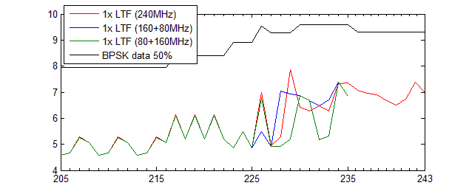
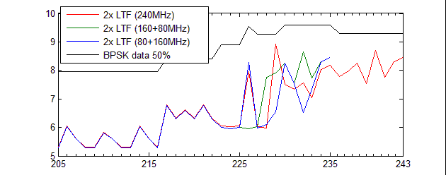
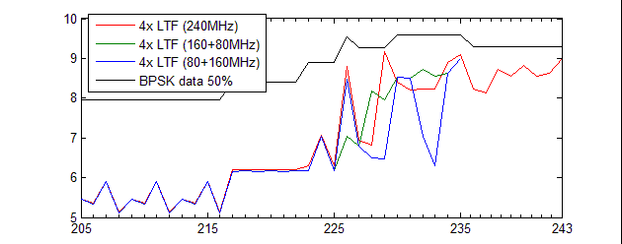
Appendix 3. PAPRs in non-continuous BW
There are PAPRs of Large (M)RUs
Because it shows the same PAPR with continuous 240/320MHz in Small (M)RUs.
Only two 2*996 RUs are included and 2*996+484 RUs are omitted in non-continuous 160+80MHz.

Slide 13
Straw poll 1
Do you support to use a unified sequence for each 1/2/4x EHT-LTF in non-OFDMA and OFDMA transmission of 320MHz and 160+160MHz?
Y/N/Abs

Slide 14
Straw poll 2
Do you support to use a unified sequence for each 1/2/4x EHT-LTF in non-OFDMA and OFDMA transmission of 240MHz and 160+80MHz?
Y/N/Abs

Slide 15
Straw poll 3
Do you support to make EHT-LTF sequences by reusing HE-LTF sequences of 80/160MHz in each 240 and 320MHz?
Y/N/Abs

Slide 16
Straw poll 4
Do you support to use the below 1/2/4x EHT-LTF sequences in 320MHz and 160+160MHz?
EHTLTF_{320MHz_1x} = {LTF_{80MHz_lower1_1x}, 23 zeros, LTF_{80MHz_upper1_1x}, 23 zeros, LTF_{80MHz_lower2_1x}, 23 zeros, LTF_{80MHz_upper2_1x}}
LTF_{80MHz_lower1_1x} = {LTF_{80MHz_left_1x}, 0, LTF_{80MHz_right_1x}}
LTF_{80MHz_upper1_1x} = {(-)LTF_{80MHz_left_1x}, 0, (-)LTF_{80MHz_right_1x}}
LTF_{80MHz_lower2_1x} = {(-)LTF_{80MHz_left_1x}, 0, LTF_{80MHz_right_1x}}
LTF_{80MHz_upper2_1x} = {(-)LTF_{80MHz_left_1x}, 0, LTF_{80MHz_right_1x}}
EHTLTF_{320MHz_2x} = {LTF_{80MHz_lower1_2x}, 23 zeros, LTF_{80MHz_upper1_2x}, 23 zeros, LTF_{80MHz_lower2_2x}, 23 zeros, LTF_{80MHz_upper2_2x}}
LTF_{80MHz_lower1_2x} = {LTF_{80MHz_part1_2x}, LTF_{80MHz_part2_2x}, (-)LTF_{80MHz_part3_2x}, (-)LTF_{80MHz_part4_2x}, (-)LTF_{80MHz_part5_2x}}
LTF_{80MHz_upper1_2x} = {(-)LTF_{80MHz_part1_2x}, (-)LTF_{80MHz_part2_2x}, (-)LTF_{80MHz_part3_2x}, (-)LTF_{80MHz_part4_2x}, (-)LTF_{80MHz_part5_2x}}
LTF_{80MHz_lower2_2x} = {LTF_{80MHz_part1_2x}, LTF_{80MHz_part2_2x}, LTF_{80MHz_part3_2x}, LTF_{80MHz_part4_2x}, LTF_{80MHz_part5_2x}}
LTF_{80MHz_upper2_2x} = {LTF_{80MHz_part1_2x}, LTF_{80MHz_part2_2x}, LTF_{80MHz_part3_2x}, LTF_{80MHz_part4_2x}, LTF_{80MHz_part5_2x}}
EHTLTF_{320MHz_4x} = {LTF_{80MHz_lower1_4x}, 23 zeros, LTF_{80MHz_upper1_4x}, 23 zeros, LTF_{80MHz_lower2_4x}, 23 zeros, LTF_{80MHz_upper2_4x}}
LTF_{80MHz_lower1_4x} = {LTF_{80MHz_left_4x}, 0, LTF_{80MHz_right_4x}}
LTF_{80MHz_upper1_4x} = {(-)LTF_{80MHz_left_4x}, 0, LTF_{80MHz_right_4x}}
LTF_{80MHz_lower2_4x} = {LTF_{80MHz_left_4x}, 0, LTF_{80MHz_right_4x}}
LTF_{80MHz_upper2_4x} = {LTF_{80MHz_left_4x}, 0, (-)LTF_{80MHz_right_4x}}
Y/N/Abs

Slide 17
Straw poll 5
Do you support to use the below 1/2/4x EHT-LTF sequences in 240MHz and 160+80MHz?
EHTLTF_{240MHz_1x} = {LTF_{80MHz_lower_1x}, 23 zeros, LTF_{80MHz_middle_1x}, 23 zeros, LTF_{80MHz_upper_1x}}
LTF_{80MHz_lower_1x} = {LTF_{80MHz_left_1x}, 0, LTF_{80MHz_right_1x}}
LTF_{80MHz_middle_1x} = {LTF_{80MHz_left_1x}, 0, (-)LTF_{80MHz_right_1x}}
LTF_{80MHz_upper_1x} = {(-)LTF_{80MHz_left_1x}, 0, (-)LTF_{80MHz_right_1x}}
EHTLTF_{240MHz_2x} = {LTF_{80MHz_lower_2x}, 23 zeros, LTF_{80MHz_middle_2x}, 23 zeros, LTF_{80MHz_upper_2x}}
LTF_{80MHz_lower_2x} = {LTF_{80MHz_part1_2x}, LTF_{80MHz_part2_2x}, LTF_{80MHz_part3_2x}, LTF_{80MHz_part4_2x}, LTF_{80MHz_part5_2x}}
LTF_{80MHz_middle_2x} = {LTF_{80MHz_part1_2x}, LTF_{80MHz_part2_2x}, (-)LTF_{80MHz_part3_2x}, (-)LTF_{80MHz_part4_2x}, (-)LTF_{80MHz_part5_2x}}
LTF_{80MHz_upper_2x} = {(-)LTF_{80MHz_part1_2x}, (-)LTF_{80MHz_part2_2x}, (-)LTF_{80MHz_part3_2x}, (-)LTF_{80MHz_part4_2x}, (-)LTF_{80MHz_part5_2x}}
EHTLTF_{240MHz_4x} = {LTF_{80MHz_lower_4x}, 23 zeros, LTF_{80MHz_middle_4x}, 23 zeros, LTF_{80MHz_upper_4x}}
LTF_{80MHz_lower_4x} = {LTF_{80MHz_left_4x}, 0, LTF_{80MHz_right_4x}}
LTF_{80MHz_middle_4x} = {LTF_{80MHz_left_4x}, 0, (-)LTF_{80MHz_right_4x}}
LTF_{80MHz_upper_4x} = {(-)LTF_{80MHz_left_4x}, 0, (-)LTF_{80MHz_right_4x}}
Y/N/Abs

