Slide 1
Triggered P2P transmissions follow up
Date: 2020-06-08
Authors:

Slide 2
Abstract
Propose a simple/low-complexity Triggered P2P scheme to be used for 11be R1.

Slide 3
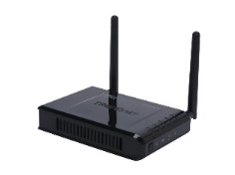


Introduction
Direct Link transmission => A Direct Link Scheduled (“DLS”) STA communicates directly with another Direct Link Peer STA (“DLP”).
Benefits of Direct Link (“DiL”) transmission [1] :
  high throughput because lower number of transmissions
  low latency due to one hop communication.
Use-case of interest:
  Miracast streaming from laptop to monitor.
  VR applications
  Wireless file transfer from phone to printer.
AP
DiL-A
TXOP
DLS STA
SIFS
Data
DLP STA
SIFS
Ack
Slide 3

Slide 4
Trigger based DiL sequence benefits
A DiL transmission sequence initiated by a TF transmission has following benefits.
  Increases the chances of either AP or the DiL STA wins a TXOP for DiL transmissions when both contend simultaneously.
  Better medium management at AP as it can serve more than just one DiL STA in a TXOP.
Submission 1117r1 (appendix) mentions some inefficiency of QTP to support Direct link:
  Legacy STA not prevented from channel access.
  AP is not aware of actual resource requests at STA during the QTP period. The initial configuration of schedules may be stale => medium inefficiency.

Slide 5
Possible Topologies
Case 1
ESS
Case 2
AP in the ceiling
of an office
AP in the ceiling
of an office
DLP
STA
(wireless monitor)
DLS
STA (laptop)
DLS
STA (laptop)
DLP
STA
(wireless monitor)
Both STAs associated
to same AP.
[Optional]
Another AP in the
ESS
Only one STA associated
to the Triggering AP.
: AP
: Non-AP STA
Notes:
Case 3 is same as general Multi-AP.

Slide 6
Principle
P2P traffic is triggered by the AP for a “Single-User style” PPDU :
  AP can share a part of the TXOP to the P2P traffic.
  P2P traffic uses a “P2P RU” = n x 20MHZ covering all the operating band for that period of time.
  Dedicated signaling (may be a 1 bit) to signal “P2P RU”.
TXOP owned by the AP
TF for P2P
AP
Allocated time
STA1
P2P PPDU
SU PPDU
(N x 20MHz)
STA2
ACK 2→1
SIFS
SIFS

Slide 7
Example in cascading sequence
TXOP
MU cascading sequence
HE MU PPDU /TRS or TF
Multi STA Block Ack
TF for P2P
AP
Allocated time
STA1
P2P PPDU
STA2
ACK 2→1
UL Length
SU PPDU
(N x 20MHz)
STA3
HE TB PPDU
STA4
HE TB PPDU
SIFS
SIFS
SIFS
SIFS
SIFS

Slide 8
Summary
Discussed challenges with Triggered P2P operation.
Proposed a simple solution for R1

Slide 9
Straw Poll #1
Do you support that 11be defines a procedure for an AP to share a part of the obtained TXOP for peer-to-peer (STA-to-STA) frame exchanges by signaling in a trigger frame, a TBD field specifying the allocated time for the peer to peer communication, and a P2P RU allocated to a non-AP STA associated to the AP ?
Note #1: This is an R1 feature.
Note #2: Type of trigger frame is TBD
Results: Y/N/A

Slide 10
Reference
[1]. 11-18-1481-01: Technology for EHT
[2] 11-20-0871-00-be-simplified-p2p-release1
[3]. 11-19-1117-00: Coordinated OFDMA Operation
[4]. 11-20-0095-02: Triggered P2P transmissions
[5]- 11-18-2009-06-0rta-rta-report-draft

Slide 11
Backup slides

Slide 12
Triggered P2P Transmissions follow up
No Change in the direct link setup/teardown procedure.
Triggered P2P feature should be controlled by a capability (both at AP or STA level).
A non-AP STA can signal the need for P2P transmission thanks to Tspec or BSR (exact signaling is TBD).
P2P traffic is triggered by the AP for a “Single-User style” PPDU :
  AP can share a part of the TXOP to the P2P traffic
    The AP provides resource to the source P2P station that is associated with it.
    TF May be included in a cascading mechanism.
  P2P traffic uses a “P2P RU” = n x 20MHZ covering all the operating band for that period of time.
  Simple signaling (typically 1 bit) to signal “P2P RU”.
  P2P traffic uses its own preamble on its distinct channel :
    AP does not need to provide all trigger transmission parameters (e.g. MCS)
    No synchronization requirement (even for Ack part)
  PPDU format is TBD (e.g. SU or MU PPDU format can be envisaged)

Slide 13
1117r1: Direct Link issues with 11ax amendments
Direct link provides high “interferences” to the AP
  Direct link traffic carries large amount of data
    Large video transmission for VR, or video streaming.
  Direct link traffic often requires low latency thus frequently accesses the medium.
    Interactive applications (VR, visio conferences, etc.)
Direct link cannot be efficiently scheduled by an AP today
  AP cannot trigger the sending of direct link data, so fine scheduling is not possible.
    Direct link only relies on EDCA.
    Multi User OFDMA doesn’t support Direct link traffic.
  Quiet time period mechanism is not incentive enough
    Every station with direct link traffic will contend on the same period.
    Even if this period has been negotiated by a STA, the quiet time period is open for all direct link stations
    Other stations with uplink data may also contend during this period (Quiet time period is just intended to give a better priority of medium access for direct link traffic).
    No specific protection against legacy stations.

Slide 14
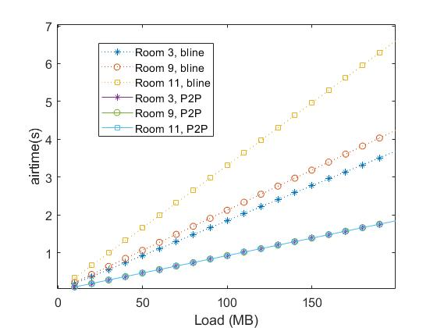
Motivation
P2P communication can significantly reduce the load on the BSS and simultaneously the latency by a one-hop communication.
About 70% reduction in
latency/airtime possible in
the two floor home scenario
by using P2P communication
among users in the same room.

Slide 15
Example in cascading sequence 2/2
TXOP
MU cascading sequence
HE MU PPDU / TRS or TF
HE MU PPDU /TRS or TF
AP
Multi STA Block Ack
Allocated Time
STA1
P2P PPDU
STA2
ACK 2→1
UL Length
SU PPDU
(N x 20MHz)
STA3
HE TB PPDU
STA4
HE TB PPDU
SIFS
SIFS
SIFS
SIFS
SIFS

