Slide 1
STR Capability Report
Date: 2020-04-10
Authors:
Name | Affiliations | Address | Phone | Email
Pooya Monajemi | Cisco |  |  | pmonajem@cisco.com
Brian Hart |  |  |  | brianh@cisco.com
Notes:
September 2012

Slide 2
Motivation
11be Introduces both STR and non-STR modes of operation for non-AP MLDs [1]
Operating in STR mode is preferable when possible
  STA enjoys freedom in contending
  Inefficiencies in power/spectrum from non-STR modes
  Complex scheduling required for non-STR operation
AP selects operating channels for each link
  Needs prior knowledge of required frequency separation for devices to operate in STR
    Factors local to STA may impact STR-capability, but minimum requirement is valuable to know
  A posteriori signaling by STAs (after switching channels) does not address the issue
Options have been discussed in the past, for example [2]

Slide 3


STR Operation Factors
Self interference from Tx PSD leaking into Rx Bandwidth
Resulting SIR depends on
  Frequency Separation
  Transmit power
  Receive signal strength
  PSD sideband characteristics
A constant frequency separation requirement is inadequate
  Especially given that AP’s TX power, AP's edge of cell target RSSI and client's actual RSSI are all varying.
P
TX PSD
$$∆P$$
RX PSD
$$Δf$$
f

Slide 4



Defining A Reference Point
We can define a reference point where STR operation is satisfactory
Reference Parameters:
  ΔP_{ref}
  Δf_{ref}
  α : Tx sideband slope
    (As seen by receiver)
P
TX PSD
$${∆P}_{ref}$$
RX PSD
$$α^{⊿}$$
$${Δf}_{ref}$$
f

Slide 5


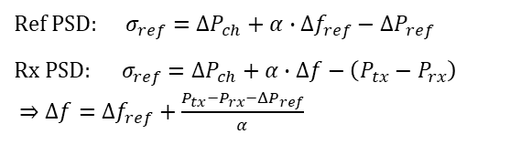
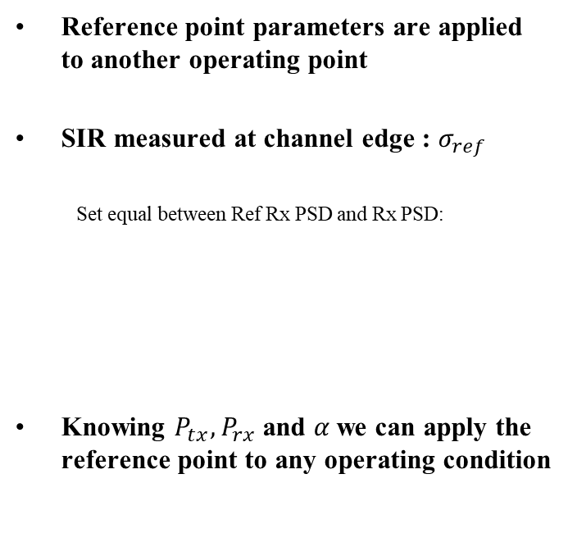






Applying The Reference Point
Reference point parameters are applied to another operating point
SIR measured at channel edge : $σ_{ref}$
  Set equal between Ref Rx PSD and Rx PSD:
Knowing $P_{tx}, P_{rx}$ and $α$we can apply the reference point to any operating condition
P
$$P_{tx}$$
TX PSD
$${∆P}_{ref}$$
$${∆P}_{ch}$$
Ref. Rx PSD
$$Ref PSD: σ_{ref}={ΔP}_{ch}+α∙{Δf}_{ref}−{ΔP}_{ref}$$
$Rx PSD:$ $σ_{ref}={ΔP}_{ch}+α∙Δf−\left(P_{tx}−P_{rx}\right)$
$⇒Δf={Δf}_{ref}+\frac{P_{tx}−P_{rx}−{ΔP}_{ref}}{α}$
$$α^{⊿}$$
$$σ_{ref}$$
$$P_{rx}$$
RX PSD
$$σ_{ref}$$
$${∆f}_{ref}$$
f
$$Δf$$

Slide 6


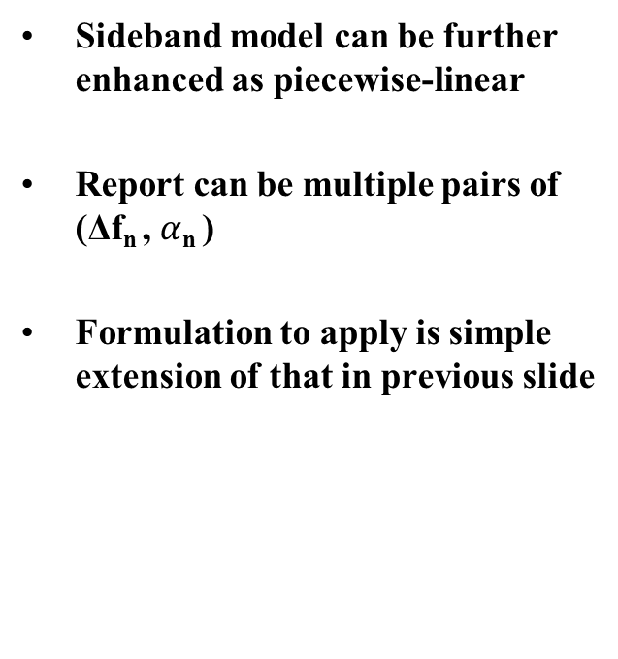



Piecewise Linear Model
Sideband model can be further enhanced as piecewise-linear
Report can be multiple pairs of ($\text{Δ}\text{f}\text{n}$, $α$_{n} )
Formulation to apply is simple extension of that in previous slide
P
TX PSD
RX PSD
$${α_{1}}^{⊿}$$
$${α_{2}}^{⊿}$$
$${α_{3}}^{⊿}$$
$${Δf}_{1}$$
$${Δf}_{2}$$
f

Slide 7
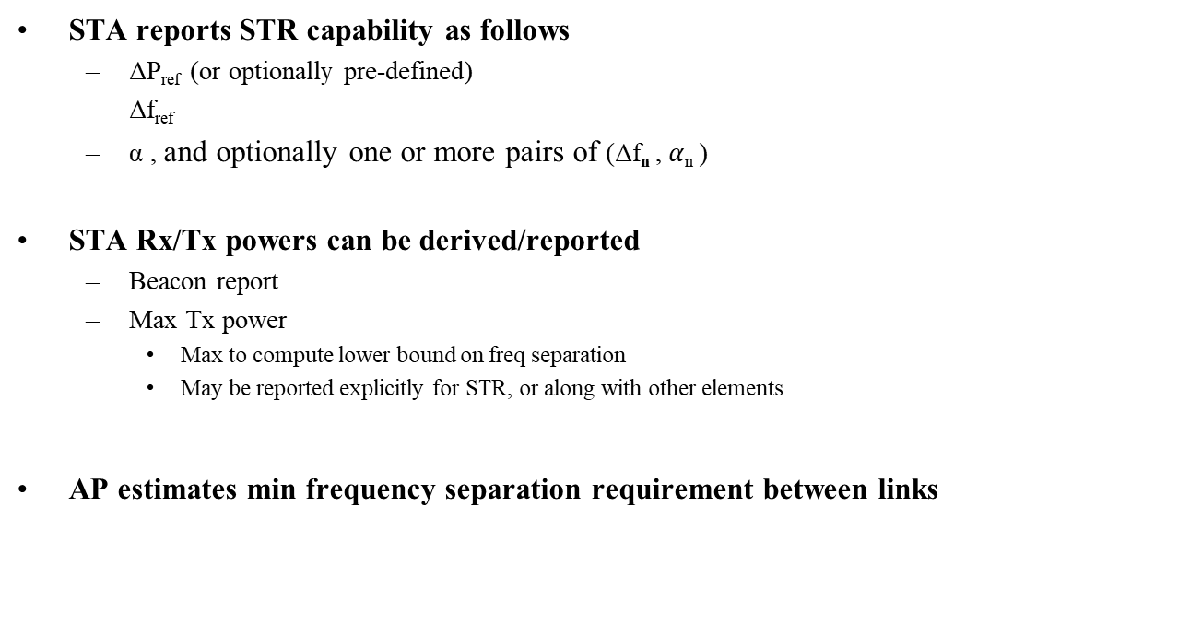
Proposed Scheme
STA reports STR capability as follows
  ΔP_{ref} (or optionally pre-defined)
  Δf_{ref}
  α , and optionally one or more pairs of ($\text{Δ}\text{f}\text{n}$, $α$_{n} )
STA Rx/Tx powers can be derived/reported
  Beacon report
  Max Tx power
    Max to compute lower bound on freq separation
    May be reported explicitly for STR, or along with other elements
AP estimates min frequency separation requirement between links

Slide 8
Other Considerations
No obligation enforced on non-AP STA
  It is understandable that other factors may impact the STR capability of the STA
  The capability report is generally seen as a method to help the AP with the estimation and channel selection. We do not envisage enforcement of the reported capabilities on the STAs.
A piecewise-linear characterization may be insufficient across bands
  The capability report can be provided separately for each band or specified frequency range
  Alternatively, the worst-performing frequency range may be reported
Narrow band transmissions/receptions
  A narrow band transmission may impact the SINR at receiver differently from a full channel width transmission
    For simplicity, we can consider only full channel transmissions (AP reported BW)
    Impact of narrow band cases may be limited and fixed by adding margins
  A narrow band reception will have improved SINR compared to full channel width one.
    The AP can apply heuristics to approximately deduce this the improvement

Slide 9
Conclusions
We described the need for an AP to be able to predict STR capability of STAs wrt frequency separation
  The capability is also dependent on Tx/Rx powers
We suggest a scheme for STA to report its capability in a compact form that can be extended to any operating condition

Slide 10
SP1
Do you agree to introduce an STR capability reporting scheme as described in slide 7?

Slide 11
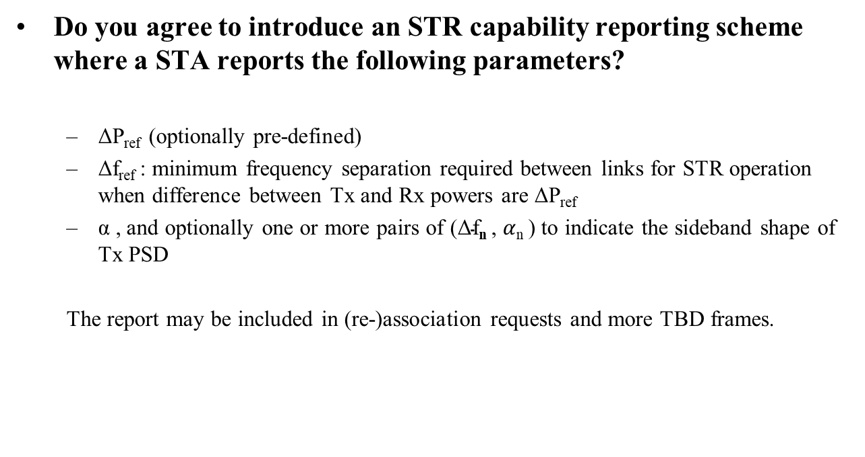
SP2
Do you agree to introduce an STR capability reporting scheme where a STA reports the following parameters?
  ΔP_{ref} (optionally pre-defined)
  Δf_{ref} : minimum frequency separation required between links for STR operation when difference between Tx and Rx powers are ΔP_{ref}
  α , and optionally one or more pairs of ($\text{Δ}\text{f}\text{n}$, $α$_{n} ) to indicate the sideband shape of Tx PSD
  The report may be included in (re-)association requests and more TBD frames.

Slide 12
References
[1] 11be SFD
[2] 11-19/1550r1 Simultaneous Tx/Rx Capability indication for multi-link operation

