Slide 1
On TBD segment parser and tone interleaver for specific MRU
Date: 2020-04-28
Authors:
Name | Affiliations | Address | Phone | Email
Jianhan Liu | Mediatek | 2840 Junction Ave. San Jose, CA, 95134 |  | jianhan.liu@mediatek.com
Shengquan Hu
Thomas Pare

Slide 2
Progress made on MRU transmissions
The following straw polls have been passed [1]:
  Do you support joint interleaving for RU and aggregated RU size <=80 MHz?
  Do you agree with the following LDPC tone mapper scheme for multi-RU aggregation in 11be?
    For aggregated RUs and PPDU BW larger than 80MHz, separate LDPC tone mapper is applied in each 80MHz segment.
  Do you agree that 11be uses 80MHz segment parser with proportional round robin (PRR) scheme?

Slide 3

Progress made on MRU transmissions (cont.’s)
Do you agree that 11be uses 80HMz segment parser with the following parameters for proportional round robin scheme?
RU Aggregation | Nsd_total | Proportional Ratio (m1:m2:m3:m4) | Leftover bits (per symbol)
484+996 | 1448 | 1s:2s | 44*Nbpscs on ru996
484+2*996 | 2428 | 1s:2s:2s | 44*Nbpscs on ru996
484+3*996 | 3408 | 1s:2s:2s:2s | 44*Nbpscs on ru996
2*996 | 1960 | 1s:1s | 0
3*996 | 2940 | 1s:1s:1s | 0
4*996 | 3920 | 1s:1s:1s:1s | 0
Where:

Slide 4
Progress made on MRU transmissions (cont.’s)
Do you agree the same proportional round robin is applied to left-over bits?
  The same ratios are used in the entire segment parsing process except the ratios of those already filled segment becomes 0.
To 1st RU
To 2nd RU
Leftover bits

Slide 5
TBDs on MRU transmissions
There is only one mode of MRU is TBD, which is how to transmit MRU including (242+484).
In the passed SP, (242+484) is transmitted using a joint tone interleaver with DTM=18.
In [3], a new segment parser is proposed for (242+484)+996 as follows:
RU Parser
Constellation
Mapper
LDPC Mapper
. . .
Constellation
Mapper
LDPC Mapper
Stream Parser
RU Parser
Constellation
Mapper
LDPC Mapper
  Let us name the method proposed in [3] as the separate tone interleave scheme and name the method proposed in [4] as the joint tone interleave scheme

Slide 6
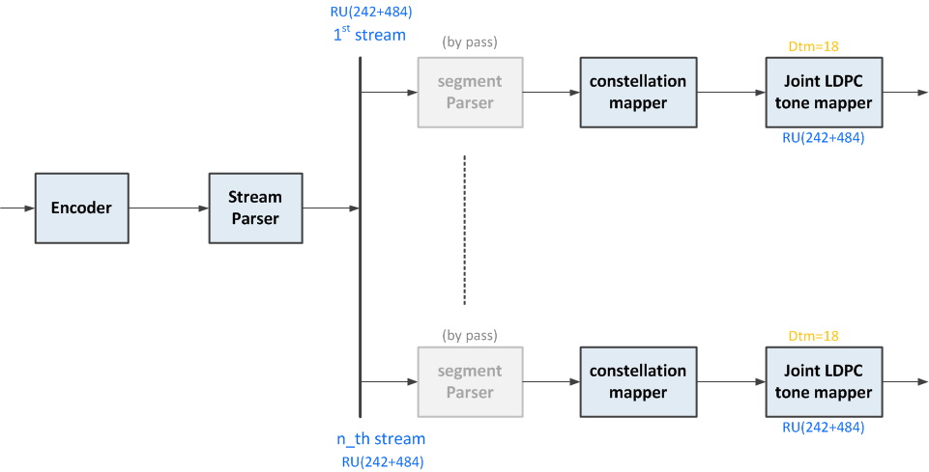
M-RU (242+484): Joint Interleave Scheme
Note:
No parsing required since M-RU contained within 80MHz segment
Nss Interleavers (minimum (constellation+tone mappers required)

Slide 7
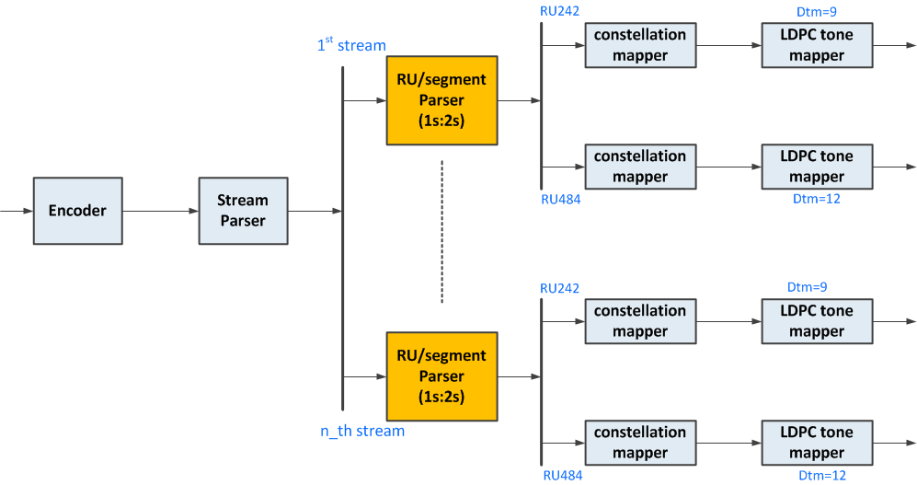
M-RU (242+484): Separate Interleave Scheme
Added complexity required:
  Nss RU/segment parsing stages
  Nss Interleavers (constellation+tone mappers)

Slide 8
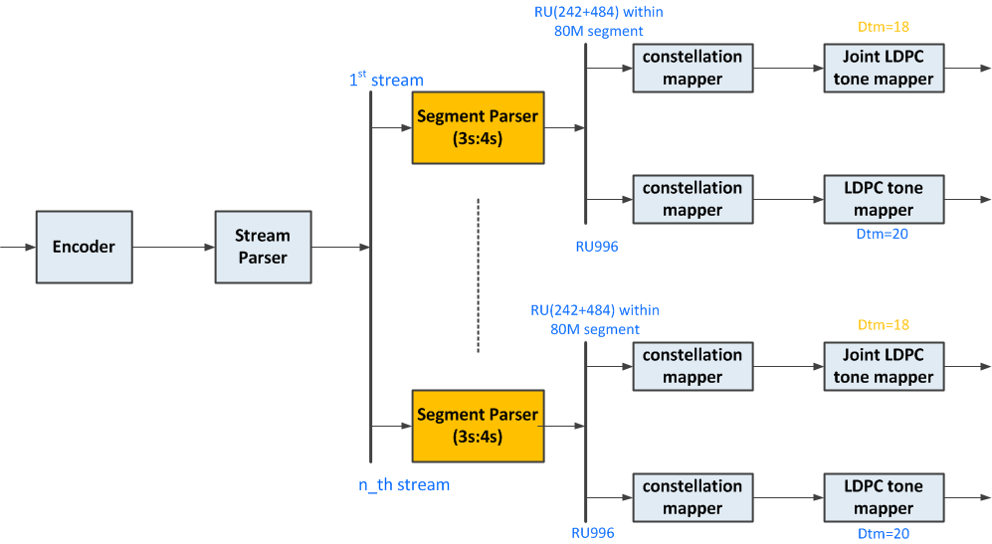
M-RU (242+484)+996: Joint Interleave Scheme

Slide 9
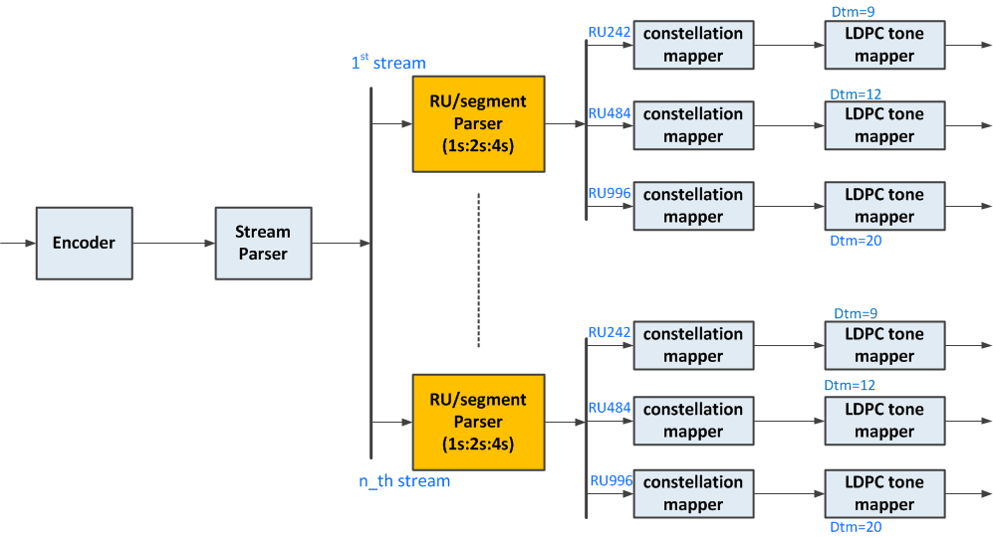
M-RU (242+484)+996: Separate Interleave Scheme

Slide 10
Comparison Between Two Schemes
Note the separate tone interleave scheme for (242+484) contradicts the passed SP “joint interleaving for RU and aggregated RU size <=80 MHz”
    Overthrowing the passed SPs without a strong technical reason is difficult. It is not the way to make progress.
The separate tone interleave scheme for (242+484) does not follow the tradition of per-80MHz joint tone interleave used since 11ac/11ax and currently 11be.
    An exception for just (242+484) just increases hardware complexity and implementation complexity; For example, 4 users OFDMA with (242+484) for each user in each 80MHz segment,
      Separate tone interleave scheme: (4 PRR parser+8 Tone interleavers) x Nss
      Joint tone interleave: (4 Tone interleavers) x Nss
    Note the separate tone interleave scheme for (242+484)+996 requires transmit architecture change.

Slide 11
Performance comparisons
Simulation results shows there is no gain by using separate interleave scheme for (242+484).
  In some cases, separate interleave scheme performs worse than Join interleave scheme.

Slide 12
Simulations: M-RU(242+484), MCS7, 4x2, D-NLOS

Slide 13
Simulations: M-RU(242+484), MCS9, 2x1, B-LOS

Slide 14
Simulations: M-RU(242+484)+996, MCS7, 2x1, B-LOS

Slide 15
Simulations: M-RU(242+484)+996, MCS7, 4x2, D-NLOS

Slide 16
Simulation Results: RU(242+484)+996, MCS7, 4x2, BF on, B-LOS

Slide 17
References
[1] “Compendium of straw polls and potential changes to the Specification Framework Document”, Edward Au, IEEE 802.11-20/0566r0.
[2] “Segment Parser and Tone Interleaver for 11be”, IEEE 802.11-20/0440r1, Jianhan Liu, etc.
[3] “New Parser Discussion in 11be”, IEEE 802.11-20/0604r2, Dandan Liang, etc.
[4] “Updates on RU/Segment Parser and Tone Mapper for 11be”, IEEE 802.11-20/0579r3, Jianhan Liu, etc.

Slide 18
Straw Poll #1
Do you agree that 11be uses 80HMz segment parser with the following parameters for (242+484)+996?
RU Aggregation | Nsd_total | Proportional Ratio (m1:m2:m3:m4) | Leftover bits (per symbol)
(242+484)+996 | 1682 | 3s:4s | 44*Nbpscs on ru996
Where:

