Slide 1
EHT-SIG Compression Format
Date: 2020-05-12
Authors:
Name | Affiliations | Address | Phone | email
Ross Jian Yu | Huawei |  |  | ross.yujian@huawei.com
Mengshi Hu | Huawei
Ming Gan | Huawei

Slide 2
Recap – 11ax SIG compression
In 11ax, a compression mode of HE-SIG-B is introduced, there is no common field in HE-SIG-B for compression mode.
In HE-SIG-A, there exist HE-SIG-B Compression field and Number Of HE-SIG-B Symbols Or MU-MIMO Users Field. When the HE-SIG-B compression field indicates 1, Number Of HE-SIG-B Symbols Or MU-MIMO Users Field indicates the number of MU-MIMO users and is set to the number of MU-MIMO users minus 1.
In 11ax, for compression mode, the exact number of OFDM symbols in the HE-SIG-B field is calculated based on the number of User fields in the HE-SIG-B content Channel.

Slide 3
Recap – 11be SIG compression
In [1], two compression modes are proposed for 11be:
  Compression mode 1: Used for Full BW SU or Full BW MU-MIMO; RU allocation info in the common field is omitted
  Compression mode 2: Used for Punctured SU or Punctured MU-MIMO; RU allocation info in the common field is replaced by a punctured channel info with granularity of 20MHz

Slide 4
Three modes of EHT-SIG
The following three modes are considered for EHT-SIG:
  Non-compressed mode (for OFDMA case): RU allocation subfields only, and the number of RU allocation subfields is equal to N, and N can be defined as in 11ax
  Compressed mode 1 (punctured non-OFDMA case): there is no RU allocation subfield, only one preamble puncture subfield or only one special RU allocation subfield, which contains entries for large MRU combinations. People may have different preference regarding terminology.
  Compressed mode 2 (non-punctured non-OFDMA case): no RU allocation subfields/preamble puncture indication. This mode can also be seen as a special mode of compressed mode 1, where within the puncture indication/special RU allocation subfield, it indicates RU types of no puncture, e.g., 2*996, 3*996, 4*996.
There should exist indication in U-SIG differentiating:
  Non-compression Mode, Compression Mode 1 and Compression Mode 2
  Non-compression Mode and Compression Mode
Under the above assumptions, we further discuss the alignment issues regarding compression mode.

Slide 5
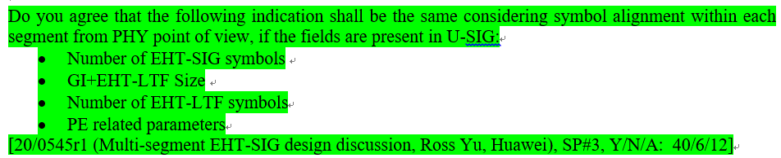
Alignment Requirement for MS-EHT-SIG
In 11be, considering multi-segment EHT-SIG or A-PPDU structure [2,3], EHT-SIG needs to be aligned between each segments. The group has the following SPs in green [4,6] and this requirement is also mentioned in [2]:

Slide 6
Alignment issues of compression mode
If 11be follows 11ax, the number of EHT-SIG symbols is reinterpreted as the number of MU-MIMO users for a non-OFDMA transmission, then the exact number of OFDM symbols in the EHT-SIG field is calculated based on the number of User fields in the EHT-SIG content Channel:
  For sub-PPDU-2 with 2 users full MU-MIMO, in each CC, there only exists 1 user field with CRC and tail. Assuming 38 bits, and also assume 4 bits U-SIG overflow info, with MCS 0, then there will be 2 EHT-SIG symbols for sub-PPDU-2.
The above method cannot indicate the exact number of EHT-SIG symbols after padding.
Hence, compression mode cannot be applied (also mentioned in [2]). Or we can say with MS-EHT-SIG or A-PPDU structure, compression mode can be seldom applied in EHT PPDU.
Aggregated PPDU
Sub-PPDU-3 (non-compression mode with 8 EHT-SIG symbols)
80MHz
Sub-PPDU-2 (2 users, full BW MU-MIMO), need to padding to 8 EHT-SIG symbols
80MHz
Sub-PPDU-1 (non-compression mode with 8 EHT-SIG symbols)
160MHz

Slide 7
Simple solution to enable compression mode
If the number of EHT-SIG symbols is always used to indicate number of EHT-SIG symbols and not reinterpreted as anything else. Then the issue is solved.
  Enable alignment all the time
For the number of MU-MIMO users field (up to 4 bits), it is indicated in the common field of the EHT-SIG instead.
  May be only needed for compression mode, can also be merged to preamble puncture indication
  The cost of maximum 4 bits saves the overhead of one or multiple RU allocation subfields (8/9/10 bits multiplies by N)

Slide 8
Extending applicable scenario of compression mode
Level 0: if 11be follows 11ax, then compression mode can seldom be applied.
  Can only be applied if no alignment is needed, usually non-OFDMA transmission across the whole BW.
Level 1: By the previous simple solution, compression mode can be further applied if the transmission is non-OFDMA within a sub-PPDU.

Slide 9
Extending applicable scenario of compression mode
Level 2: Below we introduce a more flexible scenario for compression mode. The compression mode can be applied if the transmission of the STAs of one parking segment is non-OFDMA, then the compression mode can be applied.
  Data of STA1-6 is OFDMA, whilst data of STA3-6 is non-OFDMA.
  Can be implementation specific and transparent to STAs if level 1 is supported.
Preamble puncture indication will indicate
xx11 1111
in segment 2.

Slide 10
Bitwidth for the number of EHT-SIG symbols field
In 11ax, the bitwidth for the number of HE-SIG-B symbols is 4. And it is proved not enough for 11ax if the HE-SIG-B-MCS field is set to 0, 1, 2, or 3 regardless of the value of the HE-SIG-B DCM field, or the HESIG-B-MCS field is set to 4 and the HE-SIG-B DCM field is set to 1 [5].
  With 16 HE-SIG-B symbols, only up to 24 users can be scheduled in one OFDMA PPDU no matter how large the bandwidth of OFDMA PPDU is if SIG B uses MCS 0
In 11be, the bandwidth is even larger, and the number of scheduled users can be even larger. So it is proposed to have 5 bits for the number of EHT-SIG symbols field.
  Can support up to 32 number of EHT-SIG symbols, about 48 users with MCS0.

Slide 11
Summary
We discuss the alignment issue of compression mode in 11be under the scenario of MS-EHT-SIG.
A simple solution would be that the number of EHT-SIG symbols field always exist in a PPDU transmitted to multiple users.
We then further discuss extending applicable scenario of compression mode.

Slide 12
Straw Poll #1
Do you agree that the bitwidth of number of EHT-SIG symbols field is 5 if it exists in U-SIG?

Slide 13
Straw Poll #2
Do you agree that the number of EHT-SIG symbols field always exist in a PPDU transmitted to multiple users?
  The filed is not reinterpreted as the number of MU-MIMO users

Slide 14
References
[1] https://mentor.ieee.org/802.11/dcn/20/11-20-0049-02-00be-ppdu-types-and-u-sig-content.pptx, Sammer Vermani, Qualcomm
[2] https://mentor.ieee.org/802.11/dcn/20/11-20-0693-00-00be-aggregated-ppdu-for-large-bw.pptx, Rui Cao, NXP
[3] https://mentor.ieee.org/802.11/dcn/20/11-20-0674-00-00be-forward-compatible-ofdma.pptx, Xiaogang Chen, Intel
[4] https://mentor.ieee.org/802.11/dcn/20/11-20-0545-01-00be-multi-segment-eht-sig-design-discussion.pptx, Ross Jian Yu, Huawei
[5] https://mentor.ieee.org/802.11/dcn/18/11-18-0541-01-00ax-fix-the-issue-on-number-of-he-sig-b-symbols.pptx, Ming Gan, Huawei
[6] https://mentor.ieee.org/802.11/dcn/20/11-20-0566-18-00be-compendium-of-straw-polls-and-potential-changes-to-the-specification-framework-document.docx, Edward Au, Huawei

Slide 15
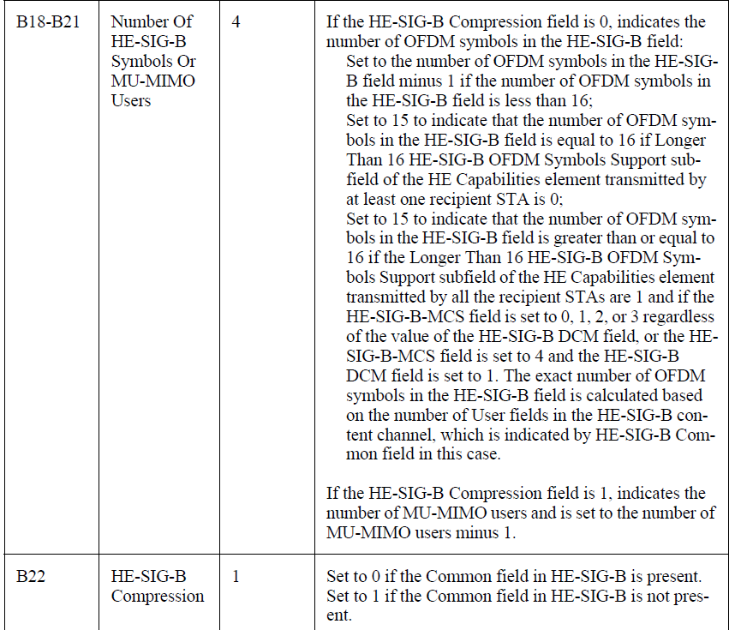
Appendix: Number of HE-SIG-B Symbols Or MU-MIMO User field and HE-SIG-B Compression Field

Slide 16
Appendix: Example without compression mode

