Slide 1
EHT-SIG Compression Format
Date: 2020-05-12
Authors:
Name | Affiliations | Address | Phone | email
Ross Jian Yu | Huawei |  |  | ross.yujian@huawei.com
Mengshi Hu | Huawei
Ming Gan | Huawei

Slide 2
Recap – 11ax SIG compression
In 11ax, a compression mode of HE-SIG-B is introduced, there is no common field in HE-SIG-B for compression mode.
In HE-SIG-A, there exist HE-SIG-B Compression field and Number Of HE-SIG-B Symbols Or MU-MIMO Users Field. When the HE-SIG-B compression field indicates 1, Number Of HE-SIG-B Symbols Or MU-MIMO Users Field indicates the number of MU-MIMO users and is set to the number of MU-MIMO users minus 1.
In 11ax, for compression mode, the exact number of OFDM symbols in the HE-SIG-B field is calculated based on the number of User fields in the HE-SIG-B content Channel.

Slide 3
Recap – 11be SIG compression
In [1], two compression modes are proposed for 11be:
  Compression mode 1: Used for Full BW SU or Full BW MU-MIMO; RU allocation info in the common field is omitted
  Compression mode 2: Used for Punctured SU or Punctured MU-MIMO; RU allocation info in the common field is replaced by a punctured channel info with granularity of 20MHz

Slide 4
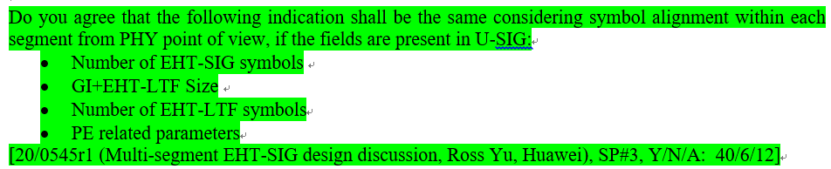
Alignment Requirement for MS-EHT-SIG
In 11be, considering multi-segment EHT-SIG or A-PPDU structure [2,3], EHT-SIG needs to be aligned between each segments. The group has the following SPs in green [4,6] and this requirement is also mentioned in [2]:

Slide 5
Alignment issues of compression mode
If 11be follows 11ax, the number of EHT-SIG symbols is reinterpreted as the number of MU-MIMO users for a non-OFDMA transmission, then the exact number of OFDM symbols in the EHT-SIG field is calculated based on the number of User fields in the EHT-SIG content Channel:
  For sub-PPDU-2 with 2 users full MU-MIMO, in each CC, there only exists 1 user field with CRC and tail. Assuming 38 bits, and also assume 4 bits U-SIG overflow info, with MCS 0, then there will be 2 EHT-SIG symbols for sub-PPDU-2.
The above method cannot indicate the exact number of EHT-SIG symbols after padding.
Hence, compression mode cannot be applied (also mentioned in [2]). Or we can say with MS-EHT-SIG or A-PPDU structure, compression mode can be seldom applied in EHT PPDU.
Aggregated PPDU
Sub-PPDU-3 (non-compression mode with 8 EHT-SIG symbols)
80MHz
Sub-PPDU-2 (2 users, full BW MU-MIMO), need to padding to 8 EHT-SIG symbols
80MHz
Sub-PPDU-1 (non-compression mode with 8 EHT-SIG symbols)
160MHz

Slide 6
Simple solution to enable compression mode
If the number of EHT-SIG symbols is always used to indicate number of EHT-SIG symbols and not reinterpreted as anything else. Then the issue is solved.
  Enable alignment all the time
For the number of MU-MIMO users field (up to 4 bits), it is indicated in the common field of the EHT-SIG instead.
  May be only needed for compression mode, can also be merged to preamble puncture indication
  The cost of maximum 4 bits saves the overhead of one or multiple RU allocation subfields (8/9/10 bits multiplies by N)

Slide 7
Extending applicable scenario of compression mode
Level 0: if 11be follows 11ax, then compression mode can seldom be applied.
  Can only be applied if no alignment is needed, usually non-OFDMA transmission across the whole BW.
Level 1: By the previous simple solution, compression mode can be further applied if the transmission is non-OFDMA within a sub-PPDU.

Slide 8
Extending applicable scenario of compression mode
Level 2: Below we introduce a more flexible scenario for compression mode. The compression mode can be applied if the transmission of the STAs of one parking segment is non-OFDMA, then the compression mode can be applied.
  Data of STA1-6 is OFDMA, whilst data of STA3-6 is non-OFDMA.
  Can be implementation specific and transparent to STAs if level 1 is supported.
Preamble puncture indication will indicate
xx11 1111
in segment 2.

Slide 9
Bitwidth for the number of EHT-SIG symbols field
In 11ax, the bitwidth for the number of HE-SIG-B symbols is 4. And it is proved not enough for 11ax if the HE-SIG-B-MCS field is set to 0, 1, 2, or 3 regardless of the value of the HE-SIG-B DCM field, or the HESIG-B-MCS field is set to 4 and the HE-SIG-B DCM field is set to 1 [5].
  With 16 HE-SIG-B symbols, only up to 24 users can be scheduled in one OFDMA PPDU no matter how large the bandwidth of OFDMA PPDU is if SIG B uses MCS 0
In 11be, the bandwidth is even larger, and the number of scheduled users can be even larger. So it is proposed to have 5 bits for the number of EHT-SIG symbols field.
  Can support up to 32 number of EHT-SIG symbols, about 48 users with MCS0.

Slide 10
Summary
We discuss the alignment issue of compression mode in 11be under the scenario of MS-EHT-SIG.
A simple solution would be that the number of EHT-SIG symbols field always exist in a PPDU transmitted to multiple users.
We then further discuss extending applicable scenario of compression mode.

Slide 11
Straw Poll #1
Do you agree that the bitwidth of number of EHT-SIG symbols field is 5 if it exists in U-SIG?

Slide 12
Straw Poll #2
Do you agree that the number of EHT-SIG symbols field always exist in a PPDU transmitted to multiple users?
  The filed is not reinterpreted as the number of MU-MIMO users

Slide 13
References
[1] https://mentor.ieee.org/802.11/dcn/20/11-20-0049-02-00be-ppdu-types-and-u-sig-content.pptx, Sammer Vermani, Qualcomm
[2] https://mentor.ieee.org/802.11/dcn/20/11-20-0693-00-00be-aggregated-ppdu-for-large-bw.pptx, Rui Cao, NXP
[3] https://mentor.ieee.org/802.11/dcn/20/11-20-0674-00-00be-forward-compatible-ofdma.pptx, Xiaogang Chen, Intel
[4] https://mentor.ieee.org/802.11/dcn/20/11-20-0545-01-00be-multi-segment-eht-sig-design-discussion.pptx, Ross Jian Yu, Huawei
[5] https://mentor.ieee.org/802.11/dcn/18/11-18-0541-01-00ax-fix-the-issue-on-number-of-he-sig-b-symbols.pptx, Ming Gan, Huawei
[6] https://mentor.ieee.org/802.11/dcn/20/11-20-0566-18-00be-compendium-of-straw-polls-and-potential-changes-to-the-specification-framework-document.docx, Edward Au, Huawei

Slide 14
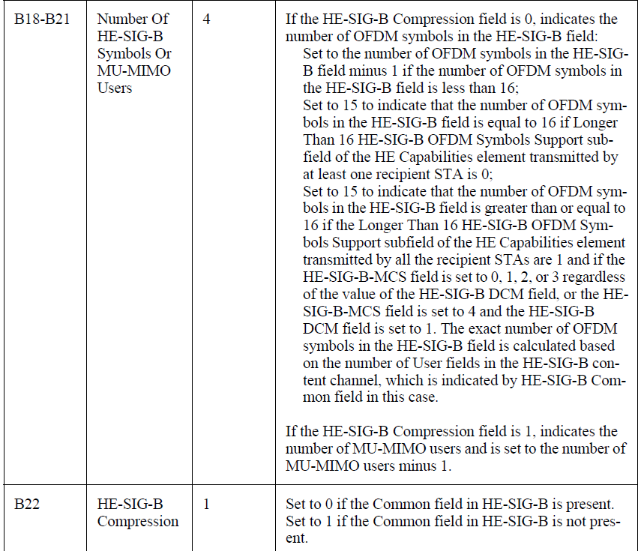
Appendix: Number of HE-SIG-B Symbols Or MU-MIMO User field and HE-SIG-B Compression Field

Slide 15
Appendix: Example without compression mode

