Slide 1
BCC Interleaver Parameters for Multiple RU
Date: 2020-05-13
Authors:
Name | Affiliation | Address | Phone | Email
Ross Jian Yu | Huawei Technologies | F3-6A, Huawei Base, Bantian, Shenzhen |  | ross.yujian@huawei.com
Junghoon Suh
Yan Xin
Ming Gan

Slide 2
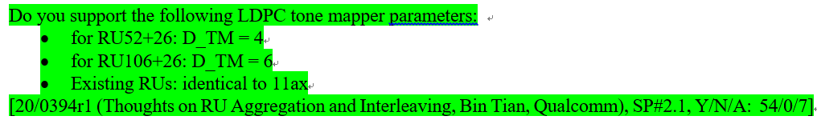
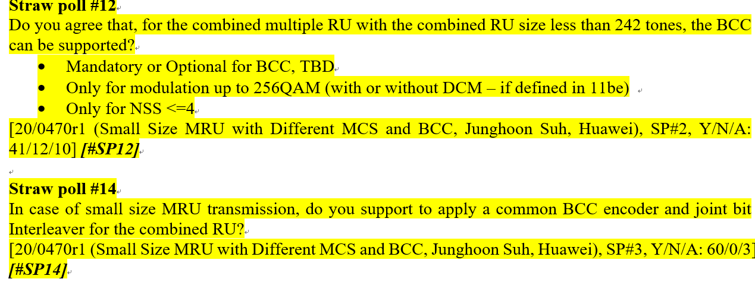
Background
We have the following passed SPs regarding LDPC tone mapper parameters [1]:
We also have the following passed SPs regarding BCC interleaving:

Slide 3
Background
Same interleaver structure as 11n/11ac/11ax, i.e., 3 permutations characterized by three parameters Ncol, Nrow and Nrot.
The exact BCC parameters regarding RU52+26 and RU106+26 interleavers have not been decided.
The following parameters are proposed in [2]:
In this proposal, we show our analysis and proposed BCC parameters. We focus on the case without DCM as for now.

Slide 4
BCC Parameters for RU78/132
First of all, different groups of Ncol and Nrow are compared with a given Nrot:
The simulation settings are as follows:
  BCC, 5000 frames, ChD
  Opt1: 4Tx3Rx, 3SS, MCS5 (64-QAM, R=2/3)
  Opt2: 4Tx2Rx, 1SS, MCS9 (256-QAM, R=5/6)
  Opt3: 4Tx2Rx, 1SS, MCS7 (64-QAM, R=5/6)
RU78 | Case 1 | Case 2 | Case 3
Nsd | 72
Ncol | 18 | 24 | 12
Nrow | 4*Nbpscs | 3*Nbpscs | 6*Nbpscs
RU132 | Case 1 | Case 2
Nsd | 126
Ncol | 18 | 21
Nrow | 7*Nbpscs | 6*Nbpscs

Slide 5
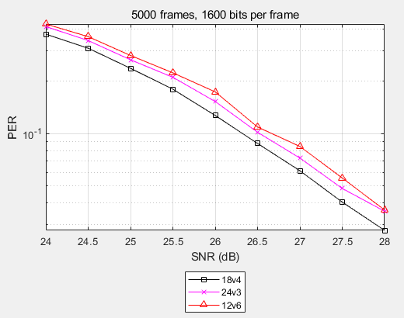
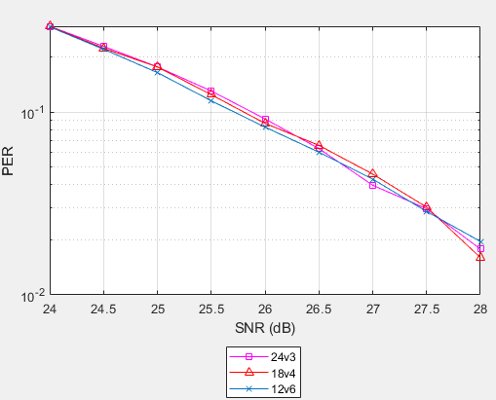
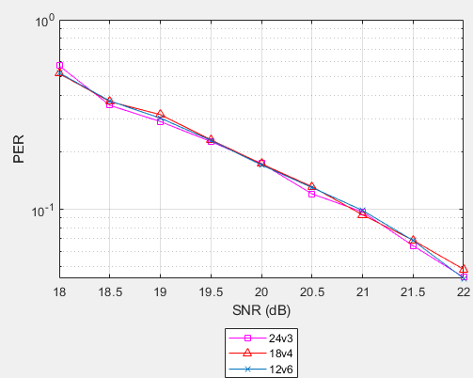
Simulation results for RU78
The simulation results are shown as follows:
  Opt1: 4Tx3Rx, 3SS, MCS5 (64-QAM, R=2/3)
  Opt2: 4Tx2Rx, 1SS, MCS9 (256-QAM, R=5/6)
  Opt3: 4Tx2Rx, 1SS, MCS9 (64-QAM, R=5/6)
18v4 gets the best performance for RU 78
Three curves show similar performance.
Three curves show similar performance.
Note that a v b means: Ncol v Nrow/Nbpscs

Slide 6
Simulation results for RU78
Then under Opt1 (same simulation settings as slide 4), different Nrot is simulated, and the required SNR at 10% PER is shown as follows:
Didn’t show big difference on the required SNR with different NROT.
Don’t have strong opinion. Maybe simply follow 11ac 80Mhz when Nss<=4: Nrot=floor(Nsd/4)=18.
Nrot | 11 | 13 | 15 | 17 | 18 | 19 | 21 | 29
SNR | 26.35 | 26.28 | 26.38 | 26.25 | 26.31 | 26.24 | 26.27 | 26.25

Slide 7
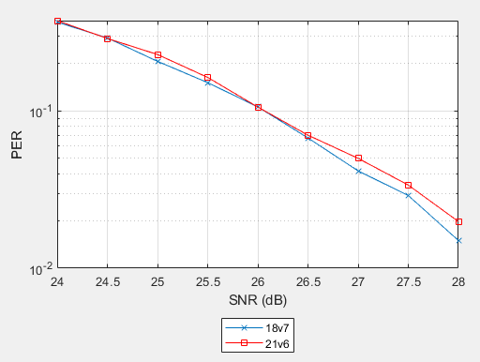
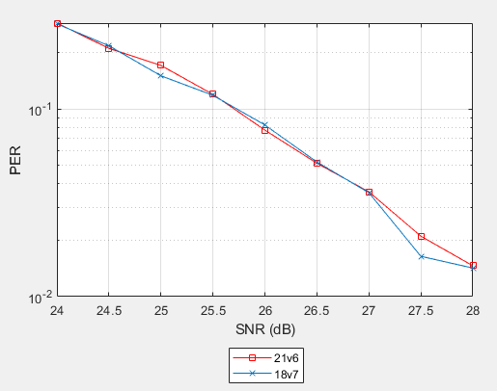
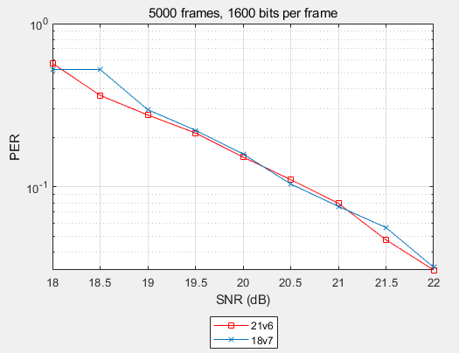
Simulation results for RU132
The simulation results are shown as follows:
For Nrot, also don’t have strong opinion. Maybe Nrot=floor(Nsd/4)=31.
  Opt1: 4Tx3Rx, 3SS, MCS5 (64-QAM, R=2/3)
  Opt2: 4Tx2Rx, 1SS, MCS9 (256-QAM, R=5/6)
  Opt3: 4Tx2Rx, 1SS, MCS9 (64-QAM, R=5/6)
Show similar performance at 10% PER, 18v7 is a little bit better
Show similar performance
Show similar performance

Slide 8
Summary
We have shown our analysis on different sets of Ncol and Nrow for RU78 and RU132 respectively. We identify 18v4 and 18v7 proposed in [2] are good candidates.
For Nrot, there is no strong preference. Can either reuse existing Nrot as proposed in [2] or simply follow 11ac 80Mhz rule: Nrot = floor(Nsd/4), and will be 18 and 31 for RU78 and RU 132 respectively.
May further evaluate DCM case in the future.
RU78 | Parameters
Nsd | 72
Ncol | 18
Nrow | 4*Nbpscs
RU132 | Parameters
Nsd | 126
Ncol | 18
Nrow | 7*Nbpscs

Slide 9
Straw Poll 1
Do you support the following BCC interleaver parameters for RU78:
  Note: the parameters are for w/o DCM case
RU78 | Parameters
Nsd | 72
Ncol | 18
Nrow | 4*Nbpscs

Slide 10
Straw Poll 2
Do you support the following BCC interleaver parameters for RU132:
  Note: the parameters are for w/o DCM case
RU132 | Parameters
Nsd | 126
Ncol | 18
Nrow | 7*Nbpscs

Slide 11
Straw Poll 3
Do you support the following BCC interleaver parameters for RU78:
  Note: the parameters are for w/o DCM case
RU78 | Parameters
Nrot | 18

Slide 12
Straw Poll 4
Do you support the following BCC interleaver parameters for RU132:
  Note: the parameters are for w/o DCM case
RU132 | Parameters
Nrot | 31

Slide 13
Reference
[1] https://mentor.ieee.org/802.11/dcn/20/11-20-0566-18-00be-compendium-of-straw-polls-and-potential-changes-to-the-specification-framework-document.docx, Edward Au, Huawei
[2] https://mentor.ieee.org/802.11/dcn/20/11-20-0495-01-00be-discussions-on-multi-ru-aggregation.pptx, Tianyu Wu, Apple
[3] https://mentor.ieee.org/802.11/dcn/10/11-10-0548-02-00ac-80mhz-transmission-flow.ppt, Hongyuan Zhang, Marvel

Slide 14
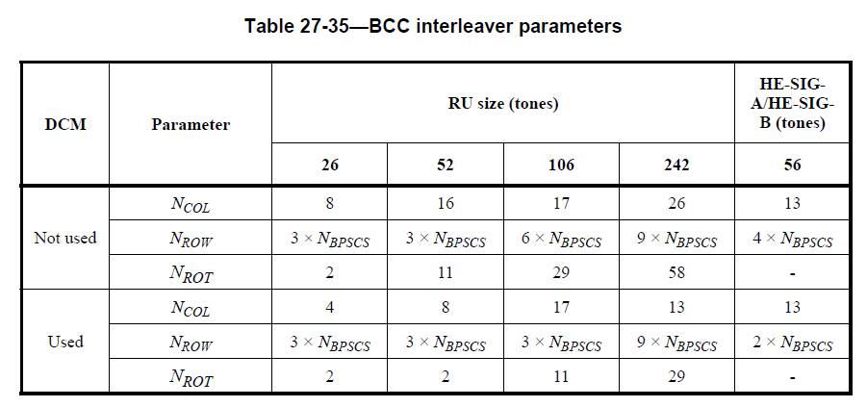
Appendix: BCC interleaver parameters in 11ax

