Slide 1
Operation with Non-STR AP
Date: 2020-05-15
Authors:

Slide 2
Abstract
In this submission, we focus on the Soft AP use case in which the Soft AP is instantiated by a Non-STR STA MLD. The general rules are discussed to operate such a BSS with Non-STR AP MLD.

Slide 3
Assumption
The Non-STR AP MLD needs to service legacy STAs
The Non-STR AP MLD may not support certain operations
  Ex: MU, TWT, etc.
The Non-STR AP MLD performs independent EDCA on all links
  The same applies to a Non-STR STA MLD, when communicating with the Non-STR AP MLD
* Non-STR AP MLD is also called Soft AP MLD in this submission

Slide 4
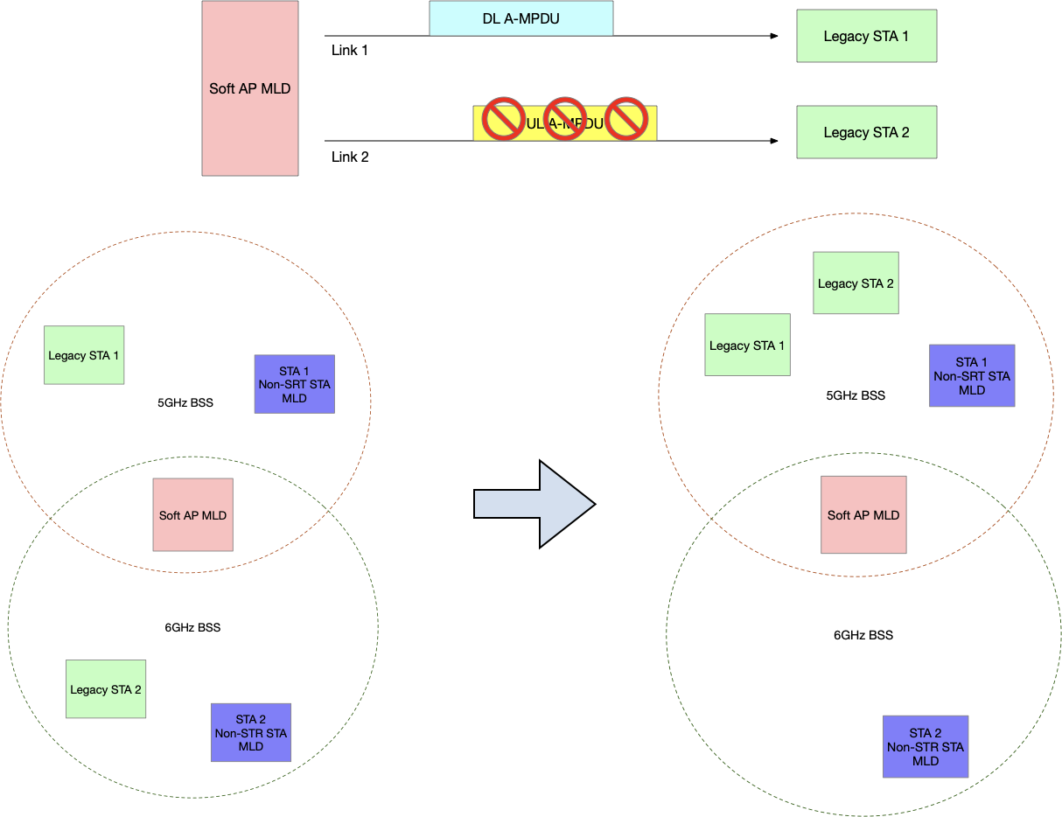
Communicating with Legacy STAs

Slide 5
Defining the Basic Link for Legacy STAs
Basic Link Set: every pair of links in this set has sufficient isolation between each other. In other words, STR is a satisfying operation mode. The links in this set are called basic links
  Ex: {2.4GHz Link, 5GHz Link} or {2.4GHz Link, 6GHz Link}
Conditional Link: a link that does not have sufficient isolation from some basic link(s)
  Ex: if {2.4GHz Link, 5GHz Link} is the basic link set, 6GHz Link is a conditional link corresponding to 5GHz Link

Slide 6
How to Serve the Legacy STAs
Based on the definition, a Soft AP MLD shall communicate with legacy STAs only on basic links
Additionally, EHT STAs shall not initiate authentication and association on conditional links

Slide 7
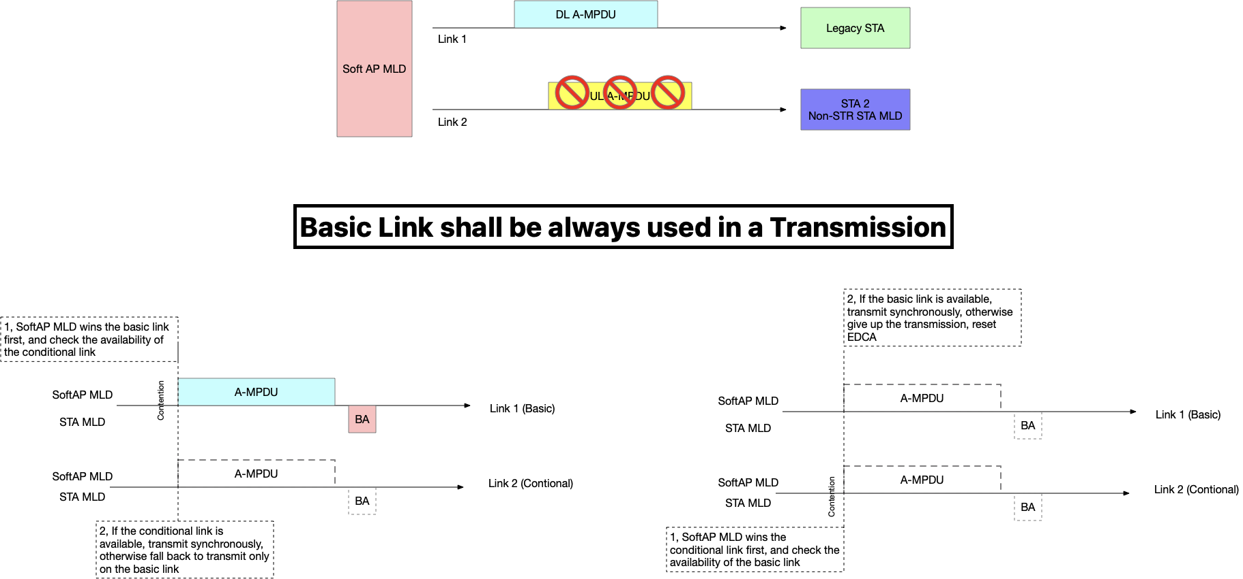
Non-STR STA on a Conditional Link

Slide 8
Rules at TX side
The channel access between a Non-STR MLD pair can reuse certain UL channel access methods between a Non-STR STA MLD and an STR AP MLD with the following additional requirement
  If a conditional link wins channel access, while the corresponding basic link(s) does NOT meet channel access requirement, the channel access shall be aborted on all related links
    The transmitter using a conditional link shall always include the corresponding basic link(s) in any transmission
If the transmitter transmits on both a conditional link and its corresponding basic link(s), it shall align the starting and ending of the PPDUs transmitted on all these links
Notes:
If a conditional link has two corresponding basic links, and any usage of conditional link shall include all the links in between basic links. Highly doubtable this will happen…

Slide 9
Other Rules
The Soft AP MLD may transmit to different STAs on different links
  Ex: transmit to a legacy STA on a basic link, meanwhile transmit to a 11be STA on a conditional link
Multicast frames shall be only transmitted on the basic links
For a STA MLD, Power Save on a basic link implies Power Save on the corresponding conditional link, but not vice versa
A Soft AP MLD may dynamically turn on/off a conditional link, e.g., to save power

Slide 10
References
[1] 11-19-1547-05-00be-multi-link-operation-and-channel-access-discussion
[2] 111-19-1574-03-00be-multi-link-auxiliary-link

Slide 11
Straw Poll 1
Do you agree to define mechanisms to support the operation of a Non-STR AP MLD in R1?

