Slide 1
Multi-link Setup clarifications
Date: 2020-05-11
Authors:
Name | Company | Address | Phone | Email
Rojan Chitrakar | Panasonic Corporation | 202 Bedok South Avenue 1, #02-11 Singapore 469332 |  | rojan.chitrakar@sg.panasonic.com
Lei Huang
Yanyi Ding
Yoshio Urabe

Slide 2
Introduction
Some points related to Multi-link setup captured in the SFD:
802.11be defines a multi-link setup signalling exchange executed over one link initiated by a non-AP MLD with an AP MLD as follows:
Capability for one or more links can be exchanged during the multi-link setup.
The AP MLD serves as the interface to the DS for the non-AP MLD after successful multi-link setup
A new element will be defined as a container to advertise and exchange capability information for multi-link setup.
In this contribution, we seek to clarify how the links are selected for setup during the Multi-link Setup procedure.

Slide 3
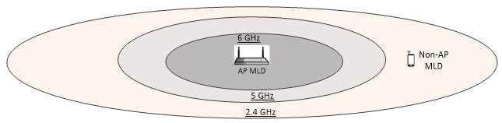
Link conditions
The condition of different links between a non-AP MLD and an AP MLD may be different:
A non-AP MLD may be within range of the AP MLD in a link in a lower frequency band (e.g. 2.4 GHz band), but it may be out of range in the other links that are in higher frequency bands (e.g. 5 GHz or 6 GHz).
Even if a non-AP MLD is in range in all the supported links, the non-AP MLD may choose not to setup certain links (e.g. due to co-existence interference due to Bluetooth in the 2.4 GHz band etc.).
The different links may also have mutual restrictions e.g. a common radio is shared between 5 GHz and 6 GHz link and therefore can operate on only one of the two links at any time.

Slide 4
Legacy Association
In legacy (i.e. single link) case, the setup frames (e.g. Association Request/Response frames) are exchanged on the same channel (link) that is being setup. Further, both AP and non-AP STA may have also gauged the condition of the link even prior to initiating the setup request, e.g. through Beacon frames, Probe frames etc.
Non-AP STAs can choose not to initiate association with an AP on a channel that is not good for the STA, while an AP may also reject association requests from non-AP STAs that experience poor channel conditions on the BSS operating channel.

Slide 5
Multi-link Setup: Terminology
For ease of discussion, we borrow the terminology used in [2] to differentiate the link on which the ML Setup frames are exchanged and the rest of the links:
  Transmitted link: Link on which the ML Setup frames are exchanged.
  Non-transmitted link: The other links included in the ML Setup.
Since Multi-link Setup for multiple links is performed on a single link, AP MLD may not have visibility on the quality of the non-transmitted links.

Slide 6
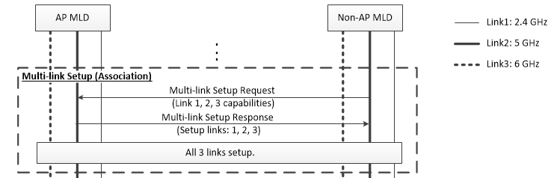
Multi-link Setup clarifications
Does a non-AP MLD include the capability information of ALL the links that it supports in the Multi-link Setup Request?
  Or capability information are included only for the links that the non-AP MLD actually requests to setup?
Does the AP MLD setup or reject all requested links together?
  Or can it selectively reject the setup requests on some links?

Slide 7
Multi-link Setup Request: Option-1
Multi-link Setup Request only includes information (e.g. capabilities, MAC address) of the STA/links that are requested for setup. Information of links that are not requested for setup is not included. E.g. Information of link1 & link2 are included, but information of link 3 is not included.
  The transmitted link is always considered requested for setup.
Multi-link Setup
Request
Link 1 Information
Link 2 Information
Inclusion of a STA/link’s information in the Multi-link Setup Request implicitly indicates that the STA/link is requested for setup.
Notes:
Less signaling overhead, but also less flexible.

Slide 8
Multi-link Setup Request: Option-2
Multi-link Setup Request includes information (at least capability) of all the STA/links that are supported (including information of links that are not requested for setup). In addition, non-AP MLD explicitly indicates which links are requested for setup (e.g. using a Request bit in the Link Information, or a Request Bitmap etc.). E.g. link1 & link2 are requested, but link 3 is not requested.
  The transmitted link may be omitted from the request for setup
Multi-link Setup
Request
Link 1 Information
Link 2 Information
Link 3 Information
Requested Links: 1, 2
The STA/link that is requested for setup is explicitly indicated in the Multi-link Setup Request.
Notes:
More signaling overhead, but more flexible.

Slide 9
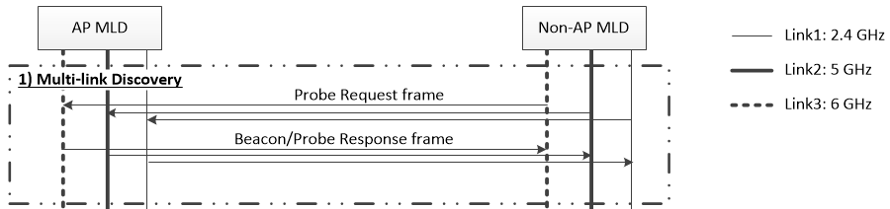
Link Quality information
In addition, Multi-link Setup Request may also include an indicator of the link quality as part of the link information to help the AP MLD to decide whether or not to accept the setup request of non-transmitted links. For example, link quality may represent the RSSI of the Beacon/Probe Response frames received by the STAs of the non-AP MLD on each link during the discovery phase. If the non-AP MLD knows the Transmit power used for the Beacon/Probe Response frames, Path Loss information may be used as link quality instead of RSSI.
Multi-link Setup
Request
Link 1 Information
Link Quality
…

Slide 10
Multi-link Setup Response
An AP MLD takes the link quality of a link in account when deciding whether or not to allow setup of a requested link. AP MLD may selectively disallow setup of links with low link quality and only allow setup of links with acceptable link quality.
Multi-link Setup Response only includes information (e.g. Link ID, AID, capabilities, Operation parameters etc.) of the links that are setup. Information of links that are not setup is not included.
E.g. Information of link 2 & link 3 are included, but information of link 1 is not included even though links 1,2 & 3 were requested => link 2 & link 3 are setup.
Multi-link Setup
Response
ML Setup Status = SUCCESS
Link 2 Information: Link ID, AID, capabilities, Operation parameters…
Link 3 Information: Link ID, AID, Operation parameters…

Slide 11
Multi-link Setup: An Example
Non-AP MLD requests setup of links 1, 2 & 3 by sending the Multi-link Setup Request over Link 3 and also includes the link quality of all 3 links.
AP MLD finds the link quality of link 1 to be below its acceptable range and only allows the setup of links 2 & 3.

Slide 12
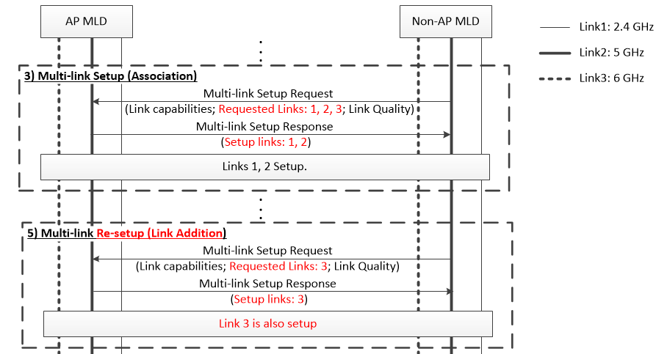
Multi-link Re-setup
Non-AP MLD and AP MLD may negotiate the setup of additional links by performing a re-setup without needing to tear down existing Multi-link Setup, e.g. when the non-AP MLD gets in range of the AP MLD in an unsetup link.

Slide 13
Conclusion
We discussed how the links for Multi-link setup may be requested and responded. We prefer the links to be setup to be implicitly indicated by inclusion of the link information in the ML setup frames.
We also proposed that non-AP MLD includes information of link quality of non-transmitted links in the Multi-link setup request to help the AP MLD to decide whether or not to accept the setup request of non-transmitted links.

Slide 14
Reference
[1] 20/0566r18 - Compendium of straw polls and potential changes to the Specification Framework Document
[2] 20/030r4 - Multi-link Association Follow Up (Guogang Huang)
[3] 20/0387r0 - Multi-link Setup Follow Up II (Po-kai)

Slide 15
Straw Poll 1
In the Multi-link Setup Request, which option do you prefer for a non-AP MLD to indicate that a link is requested for setup:
  Option 1: Implicitly by including information of the link in the Multi-link Setup Request.
  Option 2: Using explicit signaling (e.g. a Request bit in the Link Information)
  Option 1 / Option 2 / Others / Abstain

Slide 16
Straw Poll 2
Do you support to add to the 11be SFD:
  An AP MLD indicates that a link has been setup as part of a Multi-link Setup by including information of the link in the Multi-link Setup Response.
  Y/N/A

Slide 17
Straw Poll 3
Do you support to add to the 11be SFD:
  A non-AP MLD should indicate, in the Multi-link Setup Request, the link quality of each link that is requested for setup, aside from the link in which the Multi-link Setup is negotiated.
  NOTE – Definition of link quality is TBD.
  Y/N/A

Slide 18
Straw Poll 4
Do you support to add to the 11be SFD:
  A non-AP MLD and an AP MLD may negotiate the setup of additional links without tearing down existing Multi-link Setup.
  Y/N/A

