Slide 1
RTS/CTS frames in 11be
Date: 2020-03-20
Authors:

Slide 2
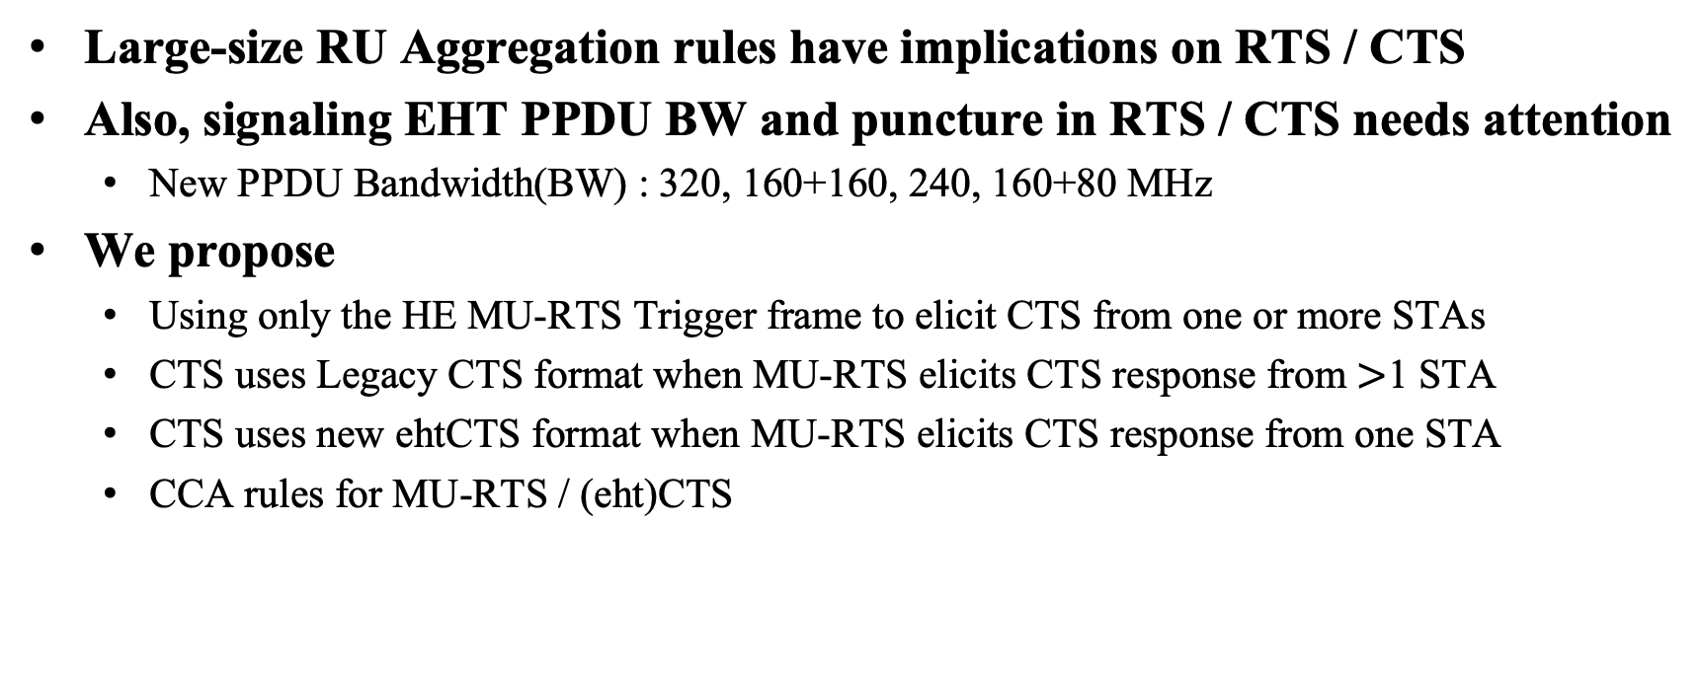
Abstract
Large-size RU Aggregation rules have implications on RTS / CTS
Also, signaling EHT PPDU BW and puncture in RTS / CTS needs attention
  New PPDU Bandwidth(BW) : 320, 160+160, 240, 160+80 MHz
We propose
  Using only the HE MU-RTS Trigger frame to elicit CTS from one or more STAs
  CTS uses Legacy CTS format when MU-RTS elicits CTS response from $>$1 STA
  CTS uses new ehtCTS format when MU-RTS elicits CTS response from one STA
  CCA rules for MU-RTS / (eht)CTS

Slide 3
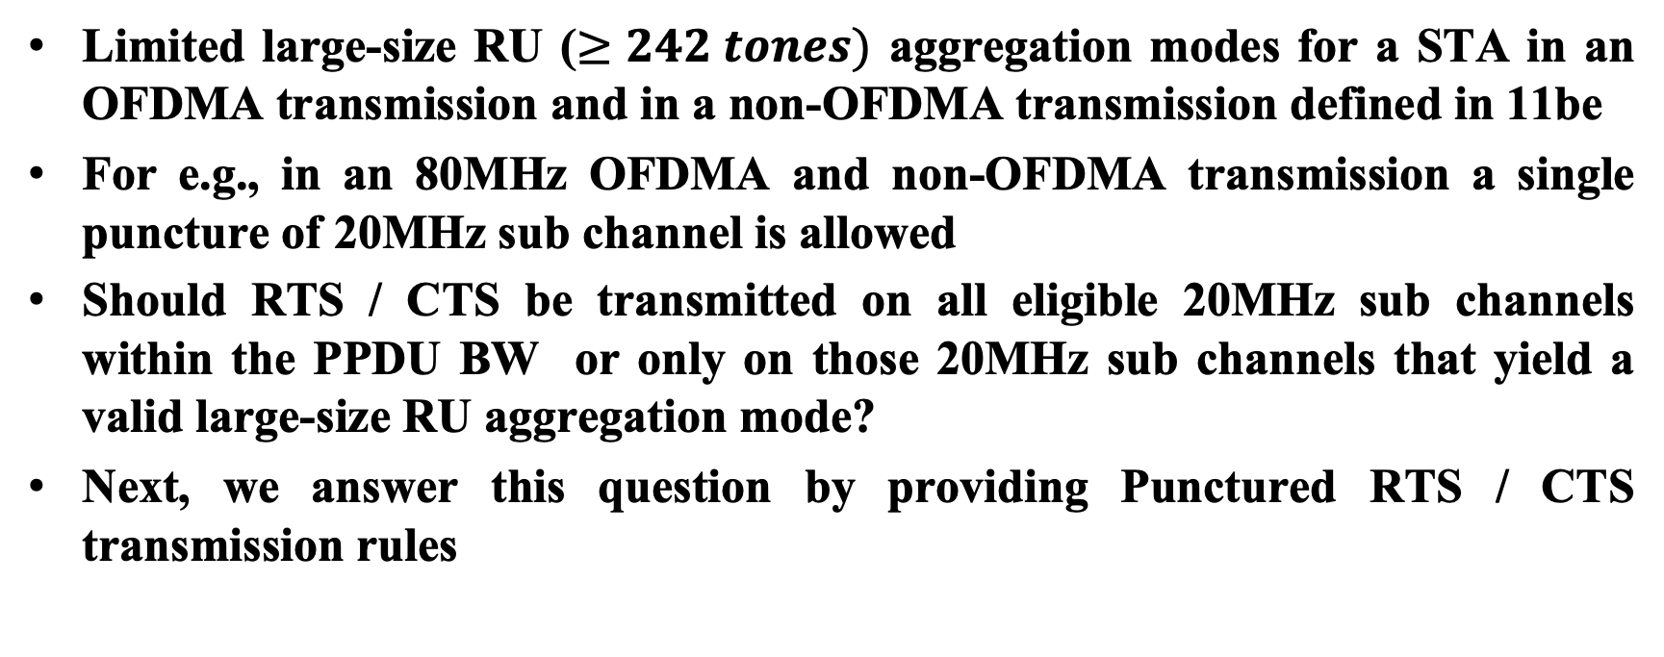
Large-size RU Aggregation Rules Implications on RTS / CTS
Limited large-size RU ($≥242 tones)$ aggregation modes for a STA in an OFDMA transmission and in a non-OFDMA transmission defined in 11be
For e.g., in an 80MHz OFDMA and non-OFDMA transmission a single puncture of 20MHz sub channel is allowed
Should RTS / CTS be transmitted on all eligible 20MHz sub channels within the PPDU BW or only on those 20MHz sub channels that yield a valid large-size RU aggregation mode?
Next, we answer this question by providing Punctured RTS / CTS transmission rules

Slide 4
Punctured RTS Transmission Rules
Option 1 (Preferred)
RTS transmitted only on 20MHz sub channels that have CCA Idle and that yield a valid large-size RU aggregation mode
  Avoids unnecessary medium reservation
Option 2
RTS transmitted on all 20MHz sub channels that have CCA Idle
  May result in unnecessary medium reservation
  May accommodate cases such as CTS is returned on 80/160MHz BW, wherein 20MHz puncturing is allowed
Options illustrated through an example of 320MHz PPDU
Min. puncture of 40MHz in 320MHz PPDU [2]

Slide 5
Punctured CTS Transmission Rules
Option 1 (Preferred)
CTS transmitted on all 20MHz sub channels on which RTS was received and that have CCA Idle
  Simplicity of CTS transmission logic
Option 2
CTS transmitted only on 20 MHz sub channels on which RTS was received and that have CCA Idle and that yield a valid large-size RU aggregation mode
Next, BW and Puncture signaling in RTS/CTS
Options illustrated through an example of 320MHz PPDU
Min. puncture of 40MHz in 320MHz PPDU [2]

Slide 6
EHT PPDU BW and Puncture Indication in RTS / CTS
Possible approaches include
Extending BW Signaling TA method
  Cons: feasibility issue due to lack of bits available for repurposing
Define new EHT RTS / new EHT CTS frame format [1]
  Cons: HE devices cannot reset NAV set by an EHT RTS
Reuse HE MU-RTS Trigger frame
  Pros: HE devices can reset NAV set by a MU-RTS, i.e., MU-RTS + no CTS + no Data => clear NAV
Next is detailed description of 3

Slide 7
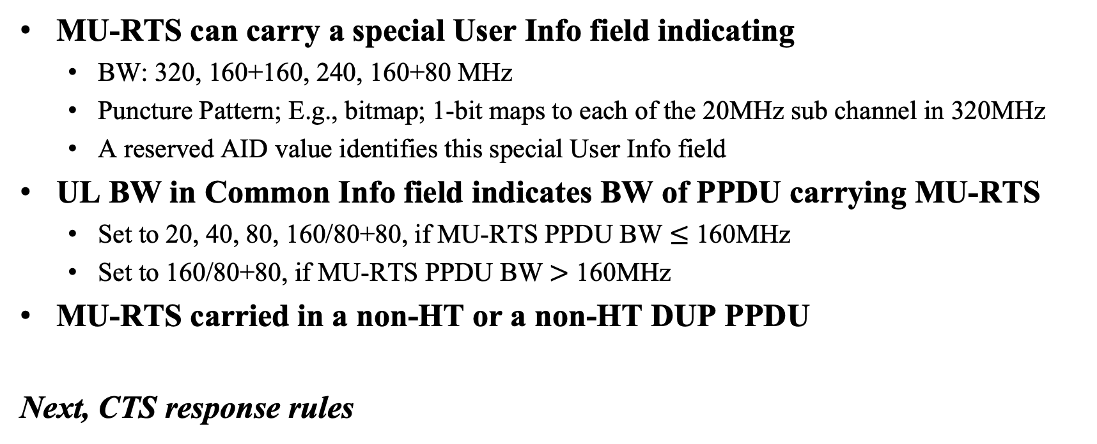
BW & Puncture Indication in HE MU-RTS by EHT STA
MU-RTS can carry a special User Info field indicating
  BW: 320, 160+160, 240, 160+80 MHz
  Puncture Pattern; E.g., bitmap; 1-bit maps to each of the 20MHz sub channel in 320MHz
  A reserved AID value identifies this special User Info field
UL BW in Common Info field indicates BW of PPDU carrying MU-RTS
  Set to 20, 40, 80, 160/80+80, if MU-RTS PPDU BW $≤$ 160MHz
  Set to 160/80+80, if MU-RTS PPDU BW $>$ 160MHz
MU-RTS carried in a non-HT or a non-HT DUP PPDU
Next, CTS response rules

Slide 8
CTS Frame Response to MU-RTS Trigger Frame
CTS uses Legacy CTS frame format when MU-RTS indicates that this MU-RTS is eliciting response from more than one STA
  CTS’s don’t indicate reserved BW because CTS’s transmitted by STAs must be identical
CTS uses a new ehtCTS frame format when MU-RTS indicates that this MU-RTS is eliciting response from one STA
  ehtCTS indicates reserved BW allowing any STA to determine reserved BW by receiving ehtCTS on at least primary 20MHz channel
(eht)CTS carried in non-HT or non-HT DUP PPDU
One bit in the Common Info field on the MU-RTS indicates to the STA, which CTS frame format to use in response to the MU-RTS
  E.g., repurpose a bit from UL HE-SIG-A2 Reserved
Next, ehtCTS frame format

Slide 9
An example of ehtCTS Frame Format
ehtCTS frame format builds upon legacy CTS
chBitmap indicates the 20MHz sub channel on which ehtCTS is transmitted
Next, AID value setting in MU-RTS

Slide 10
AID Setting in User Info field of MU-RTS Trigger Frame
MU-RTS Trigger frame transmission by an 11be AP and non-AP STA
In MU-RTS transmitted by an AP the AID value is set to the AID of the non-AP STA that is being triggered for CTS response
In MU-RTS transmitted by a non-AP STA the AID value is set to the AID of the non-AP STA that is transmitting the MU-RTS
  Or, AID value set to 0 (reserved) or some other pre-defined value
Next CCA rules for (eht)CTS

Slide 11
CCA Rules for (eht)CTS frame response to MU-RTS
Carry over HE CCA Rules for CTS frame response to MU-RTS to EHT
Combination of virtual Carrier Sense (CS) and ED-based CCA during SIFS after MU-RTS Trigger frame used to determine medium state on non punctured 20MHz sub channels
  Only non-primary channels are punctured
If MU-RTS is eliciting response from more than one STA
  CTS transmitted by a STA only when all the 20MHz sub channels contained in the allocated RU that are CCA Idle (Option 1 from Slide-5)
If MU-RTS is eliciting response from one STA
  ehtCTS transmitted by a STA on the primary 20MHz channel and on any other 20MHz sub channels contained in the allocated RU that are CCA Idle (Option 1 from Slide-5)

Slide 12
An example MU-RTS and CTS frame exchange
MU-RTS is transmitted on 160MHz carried in non-HT DUP PPDU
MU-RTS requests non-AP STA1 to transmit CTS response in non-HT PPDU on P80 and non-AP STA2 to transmit CTS response in non-HT DUP PPDU on 160MHz
No transmission in puncture zones

Slide 13
Summary
We describe punctured RTS / CTS transmission rules as a result of limited large-size RU aggregation modes in 11be
We propose using only the HE MU-RTS Trigger frame to elicit CTS from one or more STAs
  Preserves the property that HE devices can reset NAV set by a MU-RTS
MU-RTS signals if it is eliciting CTS response from 1 or more than 1 STA
  CTS uses Legacy CTS format when MU-RTS elicits CTS response from > 1 STA
  CTS uses new ehtCTS format when MU-RTS elicits CTS response from one STA
CCA rules for MU-RTS / (eht)CTS

Slide 14
References
[1] 11-19-2125-00-00be-EHT-RTS-and-CTS-procedure
[2] 11-19-1262-08-00be-specification-framework-for-tgbe

Slide 15
Backup

Slide 16
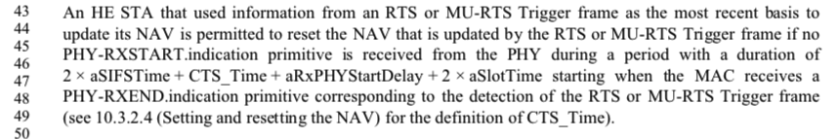
NAV Reset Rule for (MU)RTS/CTS [802.11ax D6.0, P/L:319/43]

Slide 17
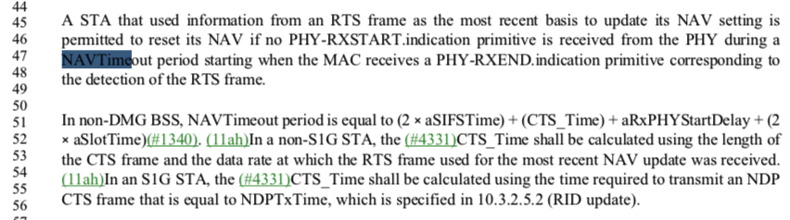
NAV Reset Rule RTS/CTS [802.11 REVmd3.1, P/L:1734/45]

