Slide 1
Indication of Multi-link Information:
Follow-up
Date: 2020-05-11
Authors:
Name | Affiliation | Address | Phone | Email
Insun Jang | LG Electronics | 19, Yangjae-daero 11gil, Seocho-gu, Seoul 137-130, Korea |  | insun.jang@lge.com
Jinsoo Choi |  |  |  | js.choi@lge.com
Jeongki Kim |  |  |  | jeongki.kim@lge.com
Taewon Song |  |  |  | taewon.song@lge.com
Namyeong Kim |  |  |  | namyeong.kim@lge.com

Slide 2
Introduction
We have agreed with many parts for multi-link (ML) discovery and setup [1], e.g.,
  Single ML Setup on a link
  Providing partial (basic) or complete information of links through RNR and/or ML element during ML discovery and setup
  Reusing existing frames (e.g., Probe Req./Rep., Beacon, Association Req./Rep.)
In this contribution, we first clarify the set of links and then discuss the indication of ML information to enable ML setup

Slide 3

Clarification on Set of Links
Set of Supported links
  Set of links AP MLD supports
Set of Setup links
  Set of links Non-AP MLD setups with AP MLD
    Non-AP MLD may not need to setup with some APs of AP MLD (e.g., not capable, bad quality)
Set of Enabled links* [1]
  Set of links Non-AP MLD actually operates (exchanges frames) with AP MLD
    All setup STAs of non-AP MLD may not be able to operate on all of setup links at a time due to Number of STAs
*A link, that is setup as part of a multi-link setup, is defined as Enabled if that link can be used for frame exchange and at least one TID is mapped to that link

Slide 4
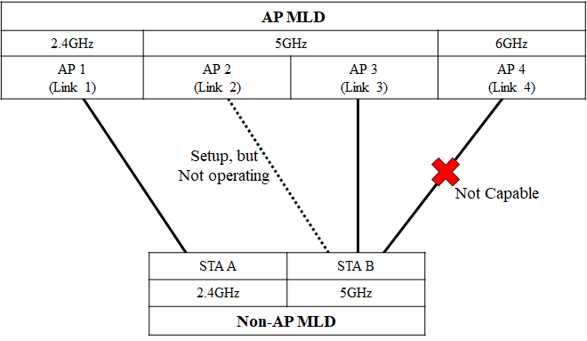
Example
Set of Supported links : {Link 1, 2, 3, 4}
Set of Setup links: {Link 1, 2, 3}
Set of Enabled links: {Link 1, 3}

Slide 5
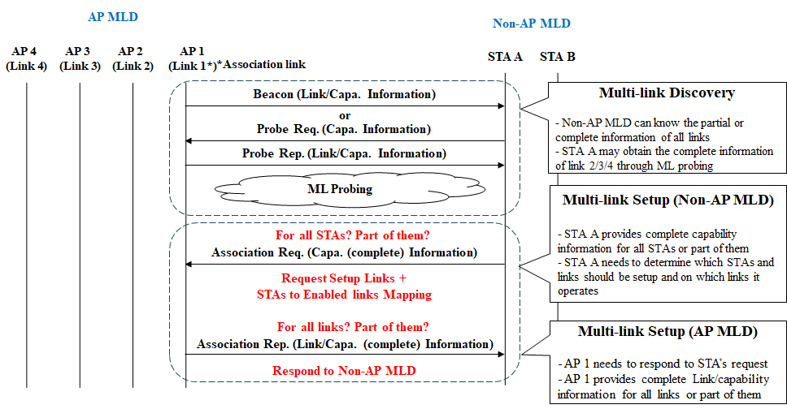
ML Discovery and Setup
NOTE: Authentication procedure is omitted

Slide 6
Association Request for MLD
In the MLD context, an STA of non-AP MLD would transmit the following information in addition to existing IEs
  1) Complete information of other STAs of non-AP MLD in ML Element
  2) Set of (Preferred) links to be ML Setup
  3) STA-to-Enabled link Mapping
    Which STA will be operating on which link
  2), 3) may be included in ML Element
Complete information of other STAs of non-AP MLD in ML IE
  Option 1 (Explicit): indicates the complete information of All of other STAs (regardless of setup) + Indication
  Option 2 (Implicit) : indicates the complete information of other STAs Only to be setup => Preferred option due to the signaling overhead
STA-to-Enabled link Mapping
  TID-to-link mapping can indicate enabled links; however, doesn’t indicate that which non-AP STA will be operating on which link after ML setup
    If we can know the mapping implicitly, may not need to indicate it in Assoc. Request

Slide 7
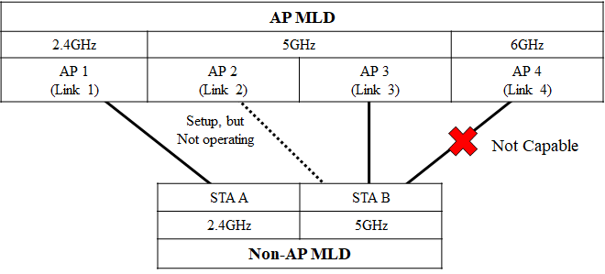
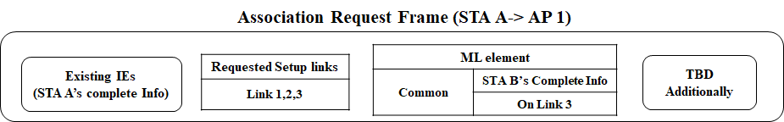
Association Request for MLD: Example

Slide 8
Association Response for MLD
An AP of AP MLD receiving would transmit the complete information of Setup links in addition to existing IEs if the AP MLD accepts the Association Request
  The complete information of other APs of AP MLD in ML element
  According to Status Code, additional information (e.g., modifications to setup) may be included
  In MLD context, some status codes may be newly defined
Complete information of other APs of AP MLD in ML Element
  Option 1 (Explicit): The information could be for All APs (regardless of setup) + Indication
  Option 2 (Implicit) : The information could be for Only APs to be setup
  We prefer Option 2 since Option 1 has higher signaling overhead

Slide 9
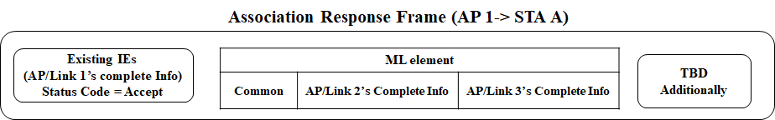
Association Response for MLD: Example

Slide 10
Summary
In this contribution, we clarified the set of links, i.e., Set of Supported links, Set of Setup links, and Set of Enabled links
Also, we discussed the indication of ML information to enable ML setup. Specifically,
  In ML Association Request frame, the following information can be included
    Complete information of other STAs of non-AP MLD only to be setup in ML Element
    Set of (Preferred) links to be ML Setup
    STA-to-Enabled link Mapping
  In ML Association Response frame, the following information can be included, when an AP MLD accepts the association request of a non-AP MLD
    Complete information of other APs of AP MLD only to be setup in ML element

Slide 11
SP #1
Do you support to add to the 11be SFD in R1 that a non-AP MLD may initiate multi-link setup with an AP MLD to setup more than one link with subset of APs affiliated with the AP MLD?
Y/N/A

Slide 12
SP #2
Do you support that an AP MLD may not be setup with all STAs of non-AP MLD during ML setup?
Y/N/A

Slide 13
SP #3
Do you support that a non-AP MLD includes the complete information of reported STAs only requested for setup in multi-link element included in Association Request frame during multi-link setup?
Y/N/A

Slide 14
SP #4
Do you agree to include the additional information that a non-AP MLD requests in its Association Request frame during multi-link (ML) setup, as described below?
  Set of (Preferred) APs to be ML Setup
  STA-to-Enabled link Mapping that means which non-AP STA will be operating on which link after ML setup
  The signaling is TBD
Y/N/A

Slide 15
SP #5
Do you support that when an AP MLD accepts the association request of a non-AP MLD, the AP MLD provides the complete information of reported APs a non-AP MLD requests for setup in multi-link element included in Association Response frame during multi-link setup?
Y/N/A

Slide 16
References
[1] 802.11-19/1262r11 Specification Framework for TGbe

Slide 17
Related Motions #1
802.11be defines a directional-based TID-to-link mapping mechanism among the setup links of a MLD.
  By default, after the multi-link setup, all TIDs are mapped to all setup links.
  The multi-link setup may include the TID-to-link mapping negotiation.
    TID-to-link mapping can have the same or different link-set for each TID unless a non-AP MLD indicates that it requires to use the same link-set for all TIDs during the multi-link setup phase
    NOTE – Such indication method by the non-AP MLD is TBD (implicit or explicit).
The TID-to-link mapping can be updated after multi-link setup through a negotiation, which can be initiated by any MLD.
  Format TBD
  NOTE – When the responding MLD cannot accept the update, it can reject the TID-to-link mapping update
At any point in time, a TID shall always be mapped to at least one link that is set up, unless admission control is used

Slide 18
Related Motions #2
A link, that is setup as part of a multi-link setup, is defined as Enabled if that link can be used for frame exchange and at least one TID is mapped to that link
If a TID is mapped in UL to a set of enabled links for a non-AP MLD, then the non-AP MLD can use any link within this set of enabled links to transmit data frames from that TID.
If a TID is mapped in DL to a set of enabled links for a non-AP MLD, then:
  The non-AP MLD can retrieve buffered BUs corresponding to that TID on any links within this set of enabled links.
  The AP MLD can use any link within this set of enabled links to transmit data frames from that TID, subject to existing restrictions for transmissions of frames that apply to those enabled links.
  An example of restriction is if the STA is in doze state.

