Slide 1
Indication of Multi-link Information: Follow-up
Date: 2020-05-11
Authors:
Name | Affiliation | Address | Phone | Email
Insun Jang | LG Electronics | 19, Yangjae-daero 11gil, Seocho-gu, Seoul 137-130, Korea |  | insun.jang@lge.com
Jinsoo Choi |  |  |  | js.choi@lge.com
Jeongki Kim |  |  |  | jeongki.kim@lge.com
Taewon Song |  |  |  | taewon.song@lge.com
Namyeong Kim |  |  |  | namyeong.kim@lge.com

Slide 2
Introduction
We have agreed with many parts for multi-link (ML) discovery and setup [1], e.g.,
Single ML Setup on a link
Providing partial or complete information of links through RNR and/or ML element during ML discovery and setup
Reusing existing frames (e.g., Probe Req./Rep., Beacon, Association Req./Rep.)
In this contribution, we first clarify the set of links and then discuss the indication of ML information to enable ML setup

Slide 3
Clarification on Set of Links
Set of Supported links
Set of links AP MLD supports
Set of Setup links
Set of links Non-AP MLD setups with AP MLD
Non-AP MLD may not need to setup with some APs of AP MLD (e.g., not capable)
Set of Enabled links* [1]
Set of links Non-AP MLD actually operates (exchanges frames) with AP MLD
All STAs of non-AP MLD may not be able to operate on all of setup links at a time due to Number of STAs
*A link, that is setup as part of a multi-link setup, is defined as Enabled if that link can be used for frame exchange and at least one TID is mapped to that link

Slide 4
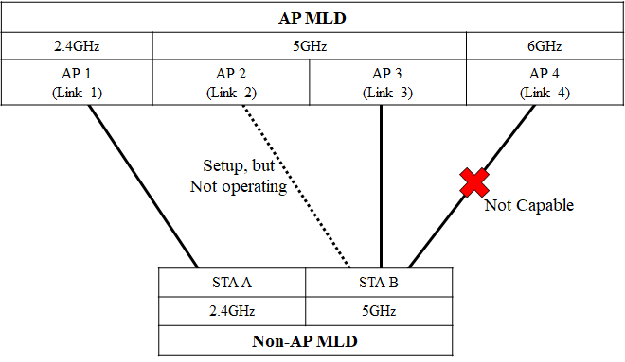
Example
Set of Supported links (AP MLD): {Link 1, 2, 3, 4}
Set of Setup links: {Link 1, 2, 3}
Set of Enabled links: {Link 1, 3}

Slide 5
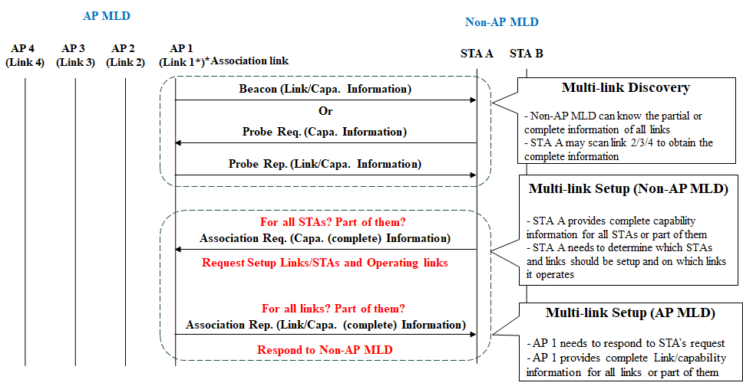
ML Discovery and Setup

Slide 6
ML Association Request
In the MLD context, an STA of non-AP MLD would transmit the following information in addition to existing IEs
The complete information of STAs of non-AP MLD
The information could be MLD-level + capabilities per STA
The information could be for All STAs (regardless of setup) or Only STAs to be setup
Request ML Setup including several information
The Information for Requesting ML Setup
Set of (Preferred) links for ML Setup
Set of non-AP STAs for ML Setup
Which STA will be operating on which link, i.e., Mapping Set of non-AP STAs for ML Setup onto links in the set of links for ML setup

Slide 7
ML Association Request: Example
The Information for Requesting ML Setup
Complete Information of STA A and STA B
Set of (Preferred) Setup links: {Link (AP) 1, Link (AP) 2, Link (AP) 3}
STAs to be Setup: {STA A, STA B}
Which STA will be operating on which link: {STA A <-> AP 1, STA B <-> AP 3}

Slide 8
ML Association Response
An AP of AP MLD receiving an association request from a non-AP MLD would transmit the complete information of Setup links in addition to existing IEs with Status Code = SUCCESS
The complete information of APs of AP MLD
The information could be MLD-level + Operation parameters/Capabilities per link
The Information for Responding ML Setup (assuming status code = SUCCESS)
The complete Information of APs of AP MLD to be setup

Slide 9
ML Association Response: Example
The Information for Responding ML Setup
Complete Information of Link 1, Link 2, and Link 3

Slide 10
Summary
In this contribution, we clarified the set of links, i.e., Set of Supported links, Set of Setup links, and Set of Enabled links
Also, we discussed the indication of ML information to enable ML setup. Specifically,
In ML Association Request frame, the following information can be included
The complete information of STAs only to be setup
Set of (Preferred) links for ML Setup
Set of non-AP STAs for ML Setup
Which STA will be operating on which link, i.e., Mapping Set of non-AP STAs for ML Setup onto links in the set of links for ML setup
In ML Association Response frame, the following information can be included, when an AP MLD accepts the association request of a non-AP MLD
The complete information of links a non-AP MLD requests for setup

Slide 11
SP #1
Do you support that a non-AP MLD may not be setup with all links of AP MLD during ML setup?
Y/N/A

Slide 12
SP #2
Do you support that an AP MLD may not be setup with all STAs of non-AP MLD during ML setup?
Y/N/A

Slide 13
SP #3
Do you support that non-AP MLD provides the complete information of STAs only to be setup in Association Request frame during multi-link setup?
Y/N/A

Slide 14
SP #4
Do you agree to include the information that a non-AP MLD requests in its Association Request frame during multi-link (ML) setup, as described below?
Set of (Preferred) links for ML Setup
Set of non-AP STAs for ML Setup
Which STA will be operating on which link, i.e., Mapping Set of non-AP STAs for ML Setup onto links in the set of links for ML setup
The signaling is TBD
Y/N/A

Slide 15
SP #5
Do you support that when an AP MLD accepts the association request of a non-AP MLD, the AP MLD provides the complete information of links a non-AP MLD requests for setup in Association Response frame during multi-link setup?
Y/N/A

Slide 16
References
[1] 802.11-19/1262r11 Specification Framework for TGbe

Slide 17
Related Motions
802.11be defines a directional-based TID-to-link mapping mechanism among the setup links of a MLD.
By default, after the multi-link setup, all TIDs are mapped to all setup links.
The multi-link setup may include the TID-to-link mapping negotiation.
TID-to-link mapping can have the same or different link-set for each TID unless a non-AP MLD indicates that it requires to use the same link-set for all TIDs during the multi-link setup phase
NOTE – Such indication method by the non-AP MLD is TBD (implicit or explicit).
The TID-to-link mapping can be updated after multi-link setup through a negotiation, which can be initiated by any MLD.
Format TBD
NOTE – When the responding MLD cannot accept the update, it can reject the TID-to-link mapping update
At any point in time, a TID shall always be mapped to at least one link that is set up, unless admission control is used

Slide 18
Related Motions
A link, that is setup as part of a multi-link setup, is defined as Enabled if that link can be used for frame exchange and at least one TID is mapped to that link
If a TID is mapped in UL to a set of enabled links for a non-AP MLD, then the non-AP MLD can use any link within this set of enabled links to transmit data frames from that TID.
If a TID is mapped in DL to a set of enabled links for a non-AP MLD, then:
The non-AP MLD can retrieve buffered BUs corresponding to that TID on any links within this set of enabled links.
The AP MLD can use any link within this set of enabled links to transmit data frames from that TID, subject to existing restrictions for transmissions of frames that apply to those enabled links.
An example of restriction is if the STA is in doze state.

