Slide 1
Non-AP MLD Initiated Aggregation: Opportunity in TXOP
Date: 2020-07-13
Authors:
Name | Affiliation | Address | Phone | Email
Insun Jang | LG Electronics | 19, Yangjae-daero 11gil, Seocho-gu, Seoul 137-130, Korea |  | insun.jang@lge.com
Jinsoo Choi |  |  |  | js.choi@lge.com
Jeongki Kim |  |  |  | jeongki.kim@lge.com
Taewon Song |  |  |  | taewon.song@lge.com
Namyeong Kim |  |  |  | namyeong.kim@lge.com

Slide 2
Introduction
Many contributions [1]-[8] have addressed how to transmit UL PPDUs on multiple links simultaneously for non-STR non-AP MLD
In this contribution, we discuss another method for a constrained non-AP MLD to aggregate links during TXOP(s)
It can follow an existing EDCA rules with an additional rule

Slide 3
UL Aggregation of Non-STR Non-AP MLD
Basically, UL aggregation means aligning starting times and ending times of PPDUs that are sent simultaneously on multiple links
Several Scenarios
No Aggregation: It may provide opportunities of power saving [9]
When gaining a channel access
After gaining a channel access, i.e., during TXOP (focus)

Slide 4
Observation on TXOP with Non-STR
On Link 2 At TX Phase on link 1
In most cases, back-off counter (BC) wouldn’t decrease due to strong in-device (self) interference
It always may set the channel state to BUSY, which cannot decrease BC
On Link 2 At RX Phase* on link 1
BC can decrease by following existing EDCA rules without the inference
NAVSyncDelay could be also considered
If BC = 0, STA 2 cannot transmit a PPDU during RX phase on link 1
How can we handle operations on Link 2 at each phase?

Slide 5
Possible Options During TXOP
Option 1: Defer Channel Access (Not decrease BC) during TXOP
It is simple and can have an opportunity to save power during the TXOP [9]
However, it can lose an opportunity to transmit frames
Option 2: Performs Channel Access during TXOP
It just follows the existing EDCA rules
During RX phase, if BC = 0?

Slide 6
If BC = 0 During RX Phase
Option 2-1: Re-pick BC (Not transmit anything)
It can avoid non-STR issue
However, it can lose an opportunity to transmit frames
Option 2-2: Defer during a certain time and Gains a channel access, i.e., transmit a PPDU by aligning it with the PPDU transmitted on TXOP link
Normally, it can have an opportunity to transmit frames
It needs an additional simple rule
We may allow both options in spec

Slide 7
Focusing on Option 2-2
A Proposed Rule
During a TXOP of an STA of a non-STR non-AP MLD, when another STA of the MLD gains a channel access, the another STA may defer and can transmit a PPDU simultaneously with the next PPDU of STA if medium is IDLE
Medium sensing duration is the interval of TBD (e.g., PIFS, aSlotTime) immediately preceding the start of next PPDU duration
Starting and Ending times of the PPDUs are aligned with TBD margin
The STA needs to know the length and starting and ending times of a PPDU to be transmitted by other STA(s)

Slide 8
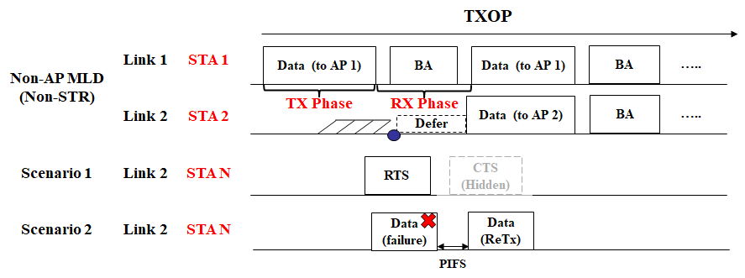
Discussion on Sensing Duration
Some scenarios
During PIFS or less than PIFS (e.g., SIFS, aSlotTime), STA 2 may not be able to detect any frames, e.g., STA 2 will recognize channel is IDLE
We think it would be good to perform CCA during “Whole time” for reliability (at the expense of efficiency)

Slide 9
Summary
We observed TXOP with non-STR
As a result, we can allow an UL aggregation with a slight change of existing rules
Specifically, we proposed a rule,
During a TXOP of an STA of a non-STR non-AP MLD, when another STA of the MLD gains a channel access, the another STA may defer and can transmit a PPDU simultaneously with the next PPDU of STA if medium is IDLE
Medium sensing duration is the interval of TBD immediately preceding the start of next PPDU duration
For example, the interval can be time elapsed from BC = 0 until the start of next PPDU or PIFS
Starting and Ending times of the PPDUs are aligned with TBD margin

Slide 10
SP #1
Do you agree that 11be shall define mechanism(s) for enabling a non-AP MLD with constraints to transmit PPDUs simultaneously on multiple links by aligning starting times and ending times of the PPDUs?
NOTE: The differences between starting or ending times have the value of more than 0
Y/N/A

Slide 11
SP #2
Do you agree that 11be shall define the following operation for non-STR
During a TXOP of an STA of a non-STR non-AP MLD, when another STA of the MLD gains a channel access, the another STA may defer and can transmit a PPDU simultaneously with the next PPDU of STA if medium is IDLE
Medium sensing duration is the interval of TBD immediately preceding the start of next PPDU duration
For example, the interval can be time elapsed from BC = 0 until the start of next PPDU or PIFS
Starting and Ending times of the PPDUs are aligned with TBD margin
Y/N/A

Slide 12
Appendix: BA Duration in 11be
Duration of RX Phase
Expected Time: 2 SIFS * + Compressed BA duration
Assuming Data rate 7.3Mbps (MCS 0, 1x1 SS, 20MHz in 11ax)
Case 1: 256 bitmap => 93.4us
Case 2: 512 bitmap => 128.4us
Case 3: 1024 bitmap => 198.6us

Slide 13
Back-up: UL Aggregation (Non-STR) [2]
Basically, UL aggregation means aligning start/end of UL PPDUs that are sent simultaneously on multiple links
The initiator of transmission is non-STR non-AP MLD
Non-AP Initiated Aggregation (e.g., Truncation of BC [1]-[5], [8])
AP-assisted Aggregation [2], [6], [7]
Example: Request and Response for Aggregation [1]

Slide 14
References
[1] 802.11-19/1144r6 Channel Access for Multi-link Operation
[2] 802.11-20/0414r4 Method for Handling Constrained MLD
[3] 802.11-20/0026r7 MLO: Sync PPDUs
[4] 802.11-20/0275r2 MLO: Need for sync PPDUs
[5] 802.11-20/0487r5 Multiple Link Operation Follow Up
[6] 802.11-20/0081r3 MLO-Synch-Transmission
[7] 802.11-20/0291r1 MLO a-synchronize and synchronize operation discussions
[8] 802.11-20/0577r0 RTS and CTS Procedure in Synchronous Multi-link Operation
[9] 802.11-20/0037r1 Power Saving Considering Non-AP without STR Capability

