Slide 1
EHT SST Operation
Date: 2020-07-20
Authors:

Slide 2
160 MHz operating STA in EHT 320 MHz BSS
For efficient frequency utilization of EHT 320 MHz BSS,
A 160 MHz operating STA should be able to operate in either the primary 160 MHz channel or the secondary 160 MHz channel within the BSS bandwidth.

Slide 3
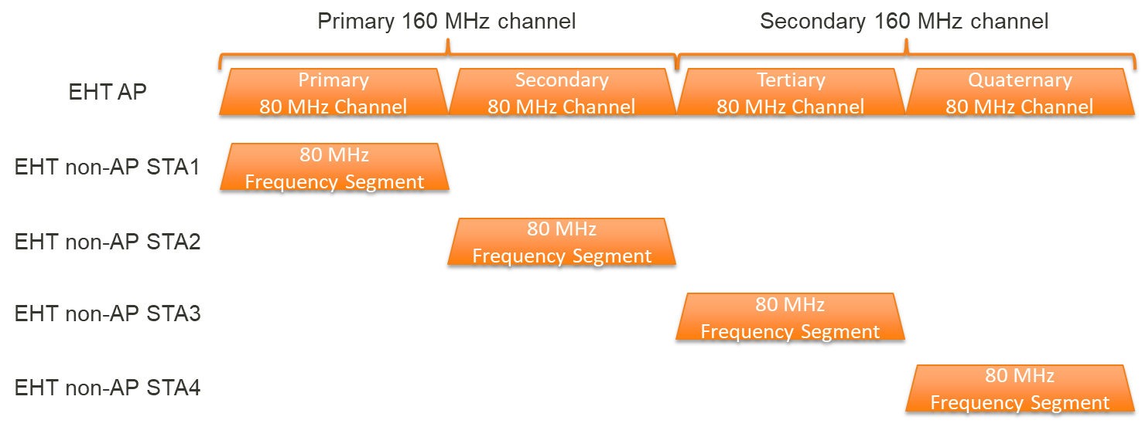
80 MHz or 20 MHz operating STA in EHT 320 MHz BSS
For efficient frequency utilization of EHT 320 MHz BSS,
An 80 MHz or a 20 MHz operating STA should be able to operate in any 80 MHz or 20 MHz channel within the BSS bandwidth.

Slide 4
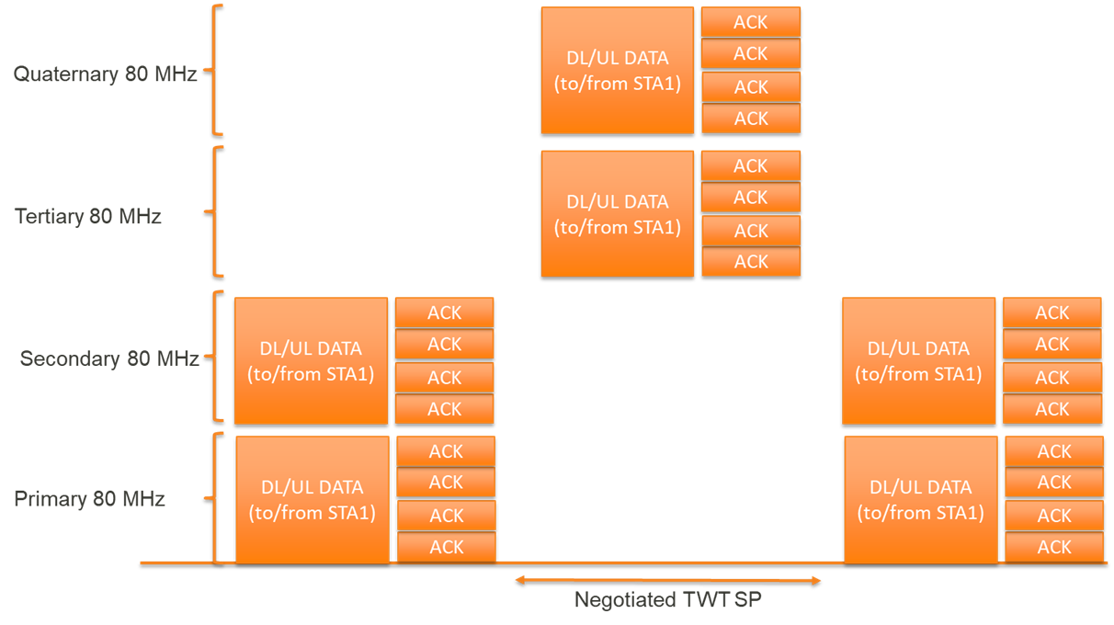
EHT SST Operation for 160 MHz operating STA
An EHT SST AP and an EHT SST non-AP STA where the positions of the first 80 MHz frequency segment and the second 80 MHz frequency segment of the EHT SST non-AP STA are switched to the negotiated positions during a negotiated TWT SP.

Slide 5
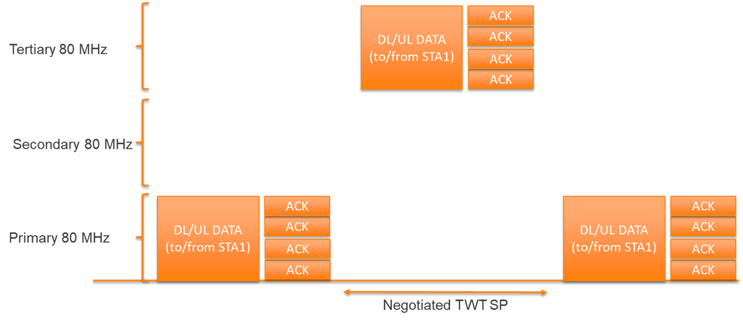
EHT SST Operation for 80 MHz or 20 MHz operating STA
An EHT SST AP and an EHT SST non-AP STA where the position of the 80 MHz or 20 MHz frequency segment of the EHT SST non-AP STA is switched to the negotiated position during a negotiated TWT SP.

Slide 6
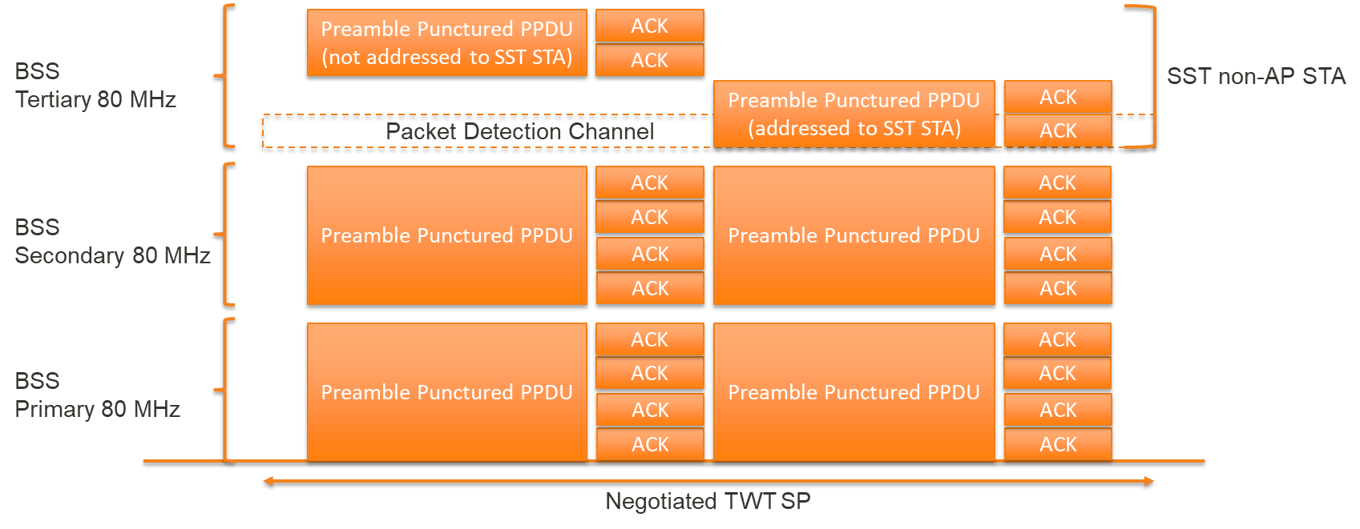
Packet Detection Channel in EHT SST Operation
When an EHT SST AP transmits a preamble punctured PPDU addressed to an EHT SST non-AP STA during the TWT SP, the EHT SST AP shall ensure that the punctured channel of that PPDU does not cover a 20 MHz channel on which the EHT SST non-AP STA performs a packet detection (i.e., the packet detection channel).

Slide 7
Conclusion
In this contribution, we have discussed an EHT SST operation to support a 20 MHz operating STA, a 80 MHz operating STA, and a 160 MHz operating STA in an EHT 320 MHz BSS.

Slide 8
Straw Poll 1
Do you support to extend SST mechanism so that an 80MHz/160 MHz (20MHz TBD) operating STA can operate in the secondary 160 MHz channel in R2?
Yes/No/Abstain/No Answer: 40/2/25/36 (Passed)

Slide 9
Straw Poll 2
Do you support that an EHT SST non-AP STA has a 20MHz packet detection channel which can’t be punctured in the PPDU addressed to the EHT SST non-AP STA during the TWT SP?
NOTE- Determination mechanism of the 20MHz packet detection channel is TBD.
Deferred.

