Slide 1
EHT SST Operation
Date: 2020-06-11
Authors:

Slide 2
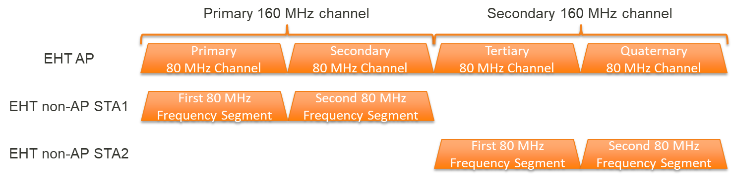
160 MHz operating STA in EHT 320 MHz BSS
For efficient frequency utilization of EHT 320 MHz BSS,
  A 160 MHz operating STA should be able to operate in either the primary 160 MHz channel or the secondary 160 MHz channel within the BSS bandwidth.

Slide 3
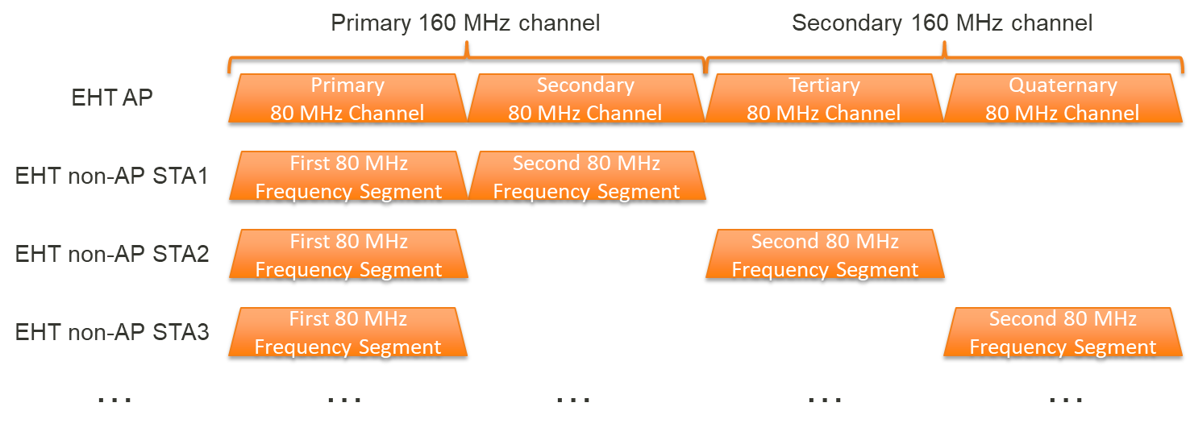
80+80 MHz operating STA in EHT 320 MHz BSS
For efficient frequency utilization of EHT 320 MHz BSS,
  An 80+80 MHz operating STA should be able to operate in any combination of two 80 MHz channels within the BSS bandwidth.

Slide 4
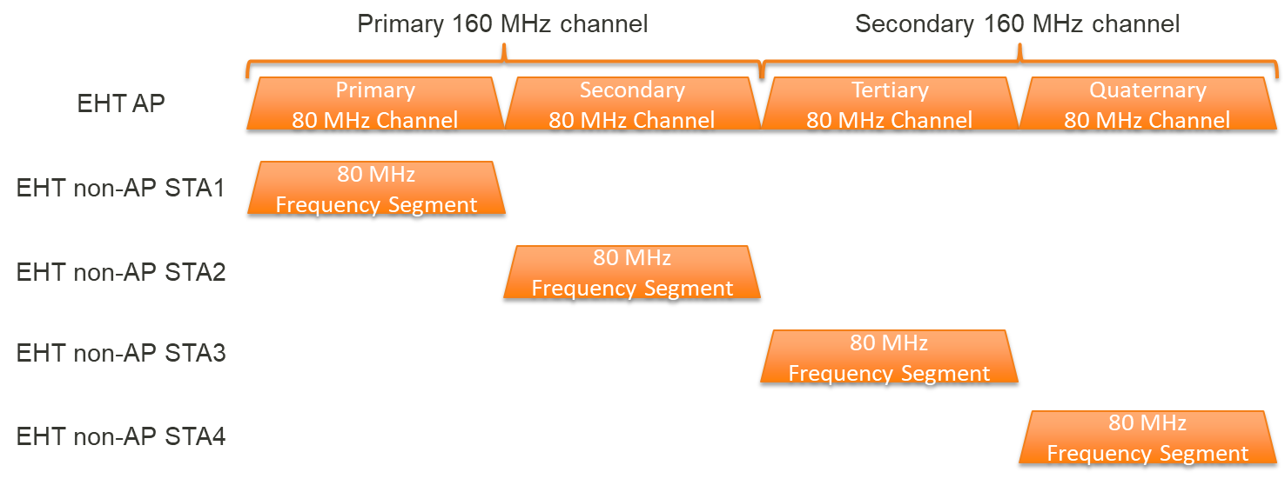
80 MHz or 20 MHz operating STA in EHT 320 MHz BSS
For efficient frequency utilization of EHT 320 MHz BSS,
  An 80 MHz or a 20 MHz operating STA should be able to operate in any 80 MHz or 20 MHz channel within the BSS bandwidth.

Slide 5
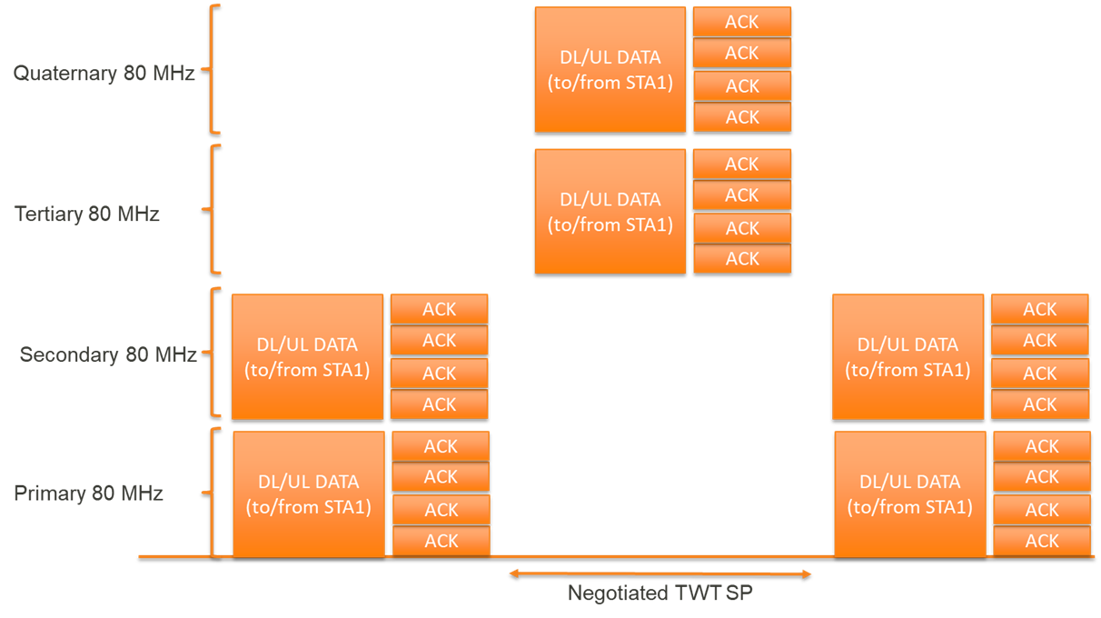
EHT SST Operation for 160 MHz operating STA
An EHT SST AP and an EHT SST non-AP STA where the positions of the first 80 MHz frequency segment and the second 80 MHz frequency segment of the EHT SST non-AP STA are switched to the negotiated positions during a negotiated TWT SP.

Slide 6
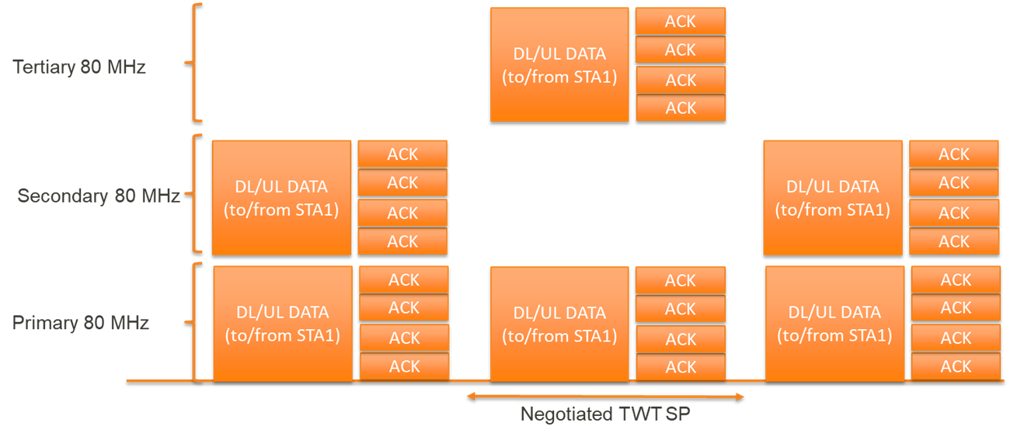
EHT SST Operation for 80+80 MHz operating STA
An EHT SST AP and an EHT SST non-AP STA where the positions of the first 80 MHz frequency segment and the second 80 MHz frequency segment of the EHT SST non-AP STA are switched to the negotiated positions during a negotiated TWT SP.

Slide 7
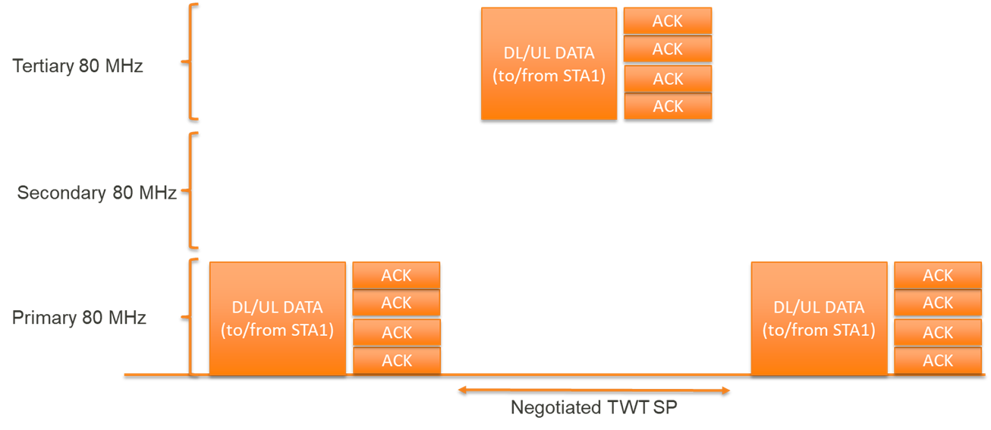
EHT SST Operation for 80 MHz or 20 MHz operating STA
An EHT SST AP and an EHT SST non-AP STA where the position of the 80 MHz or 20 MHz frequency segment of the EHT SST non-AP STA is switched to the negotiated position during a negotiated TWT SP.

Slide 8
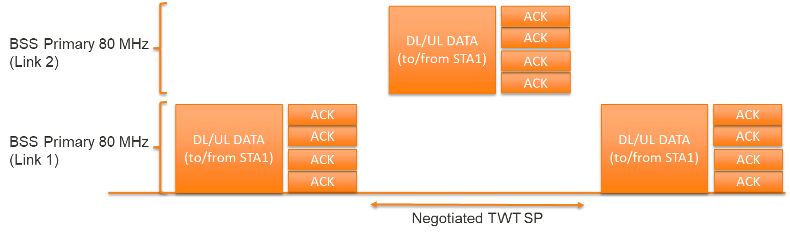
EHT SST Operation across links
An EHT SST AP in an AP MLD and an EHT SST non-AP STA in a single radio non-AP MLD where the positions of the 160 MHz, 80 MHz, or 20 MHz frequency segment of the EHT SST non-AP STA in the single radio non-AP MLD are switched to the negotiated positions in another link during a negotiated TWT SP.

Slide 9
Conclusion
In this contribution, we have discussed an EHT SST operation to support a 20 MHz operating STA, a 80 MHz operating STA, a 80+80 MHz operating STA, and a 160 MHz operating STA in an EHT 320 MHz BSS.

Slide 10
Straw Poll 1
Do you support that an EHT SST STA may set up EHT SST operation by negotiating a trigger-enabled TWT as defined in 26.8.2 (Individual TWT agreements) except that:
  A 160 MHz operating STA can operate in either the primary 160 MHz channel or the secondary 160 MHz channel within the BSS bandwidth belonging to a current link or a different link if it is associated with the MLD AP.
  An 80+80 MHz operating STA can operate in any combination of two 80 MHz channels within the BSS bandwidth belonging to a current link or a different link if it is associated with the MLD AP.
  An 80 MHz or a 20 MHz operating STA can operate in any 80 MHz or 20 MHz channel within the BSS bandwidth belonging to a current link or a different link if it is associated with the MLD AP.

Slide 11
Straw Poll 2
Do you support that an EHT SST AP specifies a packet detection channel of an EHT SST non-AP STA to support a reception of a preamble punctured PPDU during the negotiated trigger-enabled TWT SPs?

Slide 12
Backup

Slide 13
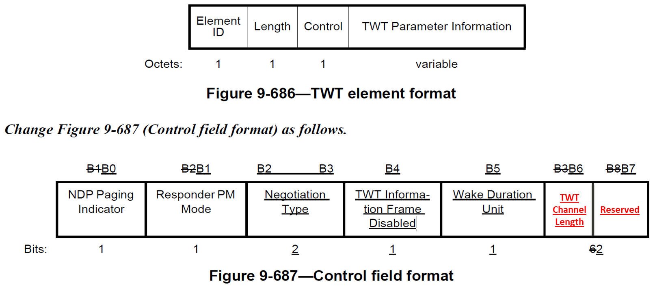
EHT subchannel selective transmission

Slide 14
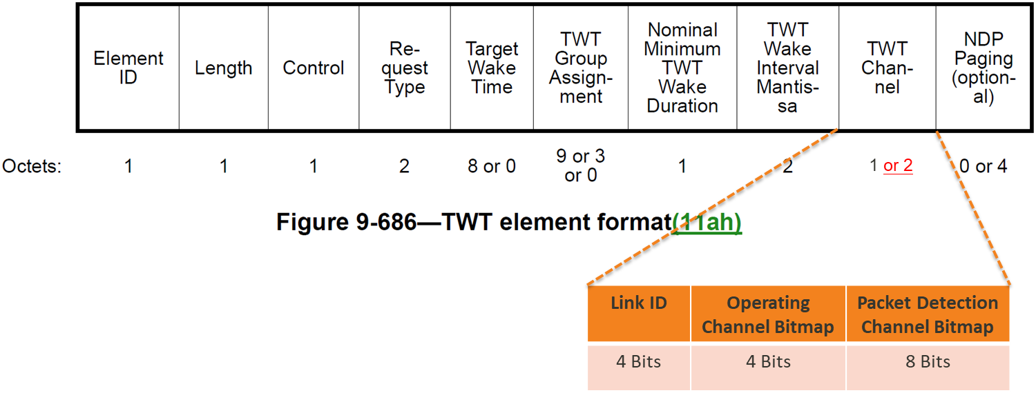
EHT subchannel selective transmission
The Length of the TWT Channel field in the TWT Parameter Set field is determined by the TWT Channel Length subfield in the Control field in the TWT element.

Slide 15
EHT subchannel selective transmission
The TWT Channel Length subfield in the Control field in the TWT element indicates the length of the TWT Channel field.
The TWT Channel Length subfield is set to 0 if the length of the TWT Channel field is 1 byte and is set to 1 if the length of the TWT Channel field is 2 byte.
A non-EHT STA sets the TWT Channel Length subfield to 0.

Slide 16
EHT subchannel selective transmission
An EHT SST STA may set up EHT SST operation by negotiating a trigger-enabled TWT as defined in 26.8.2 (Individual TWT agreements) except that:
  When the TWT Channel Length subfield is equal to 1, each bit in the Operating Channel Bitmap subfield in the TWT Channel field corresponds to a 80 MHz channel.
    The TWT response shall have an Operating Channel Bitmap subfield in a TWT Channel field with up to one bit set to 1 to indicate the 80 MHz frequency segment that will contain the RU allocations addressed to the EHT SST non-AP STA that is either a 20 MHz operating STA or a 80 MHz operating STA.
      An operating channel of a 20 MHz operation STA is determined within the 80 MHz frequency segment by the Packet Detection Channel Bitmap subfield.

Slide 17
EHT subchannel selective transmission
An EHT SST STA may set up EHT SST operation by negotiating a trigger-enabled TWT as defined in 26.8.2 (Individual TWT agreements) except that:
    The TWT response shall have an Operating Channel Bitmap subfield in a TWT Channel field with up to two bits set to 1 to indicate two contiguous or non-contiguous 80 MHz frequency segments containing the RU allocations addressed to the EHT SST non-AP STA that is a 80+80 MHz operating STA.
    The TWT response shall have an Operating Channel Bitmap subfield in a TWT Channel field with all bits of up to one of Bits B0-B1 and Bits B2-B3 set to 1 to indicate whether the primary 160 MHz channel or the secondary 160 MHz channel contains the RU allocations addressed to the EHT SST non-AP STA that is a 160 MHz operating STA.

Slide 18
EHT subchannel selective transmission
The Packet Detection Channel Bitmap subfield in the TWT Channel field indicates the position of the packet detection channel of the EHT SST STA during the negotiated trigger-enabled TWT SPs.
  When the TWT Channel Length subfield is equal to 1,
    The TWT response shall have N^{th} bit in a Packet Detection Channel Bitmap subfield in a TWT Channel field set to 1.
      The EHT SST STA performs the packet detection on the N^{th} 20 MHz channel in the operating bandwidth indicated by the Operating Channel Bitmap subfield in the TWT Channel field.
    The TWT Request can indicate one or more channels as the preferred packet detection channels.
    The TWT Response can indicate multiple channels as the packet detection channels.

Slide 19
EHT subchannel selective transmission
An EHT SST non-AP STA in a single radio non-AP MLD may set up EHT multi-link SST operation in another link by negotiating a trigger-enabled TWT as defined in 26.8.2 (Individual TWT agreements) except that:
  When the TWT Channel Length subfield is equal to 1,
    The TWT response shall have a Link ID subfield in a TWT Channel field to indicate the link that the operating bandwidth indicated by the Operating Channel Bitmap subfield in the TWT Channel field is applied during negotiated trigger-enabled TWT SPs.
    The TWT Request can indicate the preferred link through a Link ID subfield in a TWT Channel field.

