Slide 1
BQR for 320MHz
Date: 2020-05-01
Authors:
Name | Affiliations | Address | Phone | Email
Yunbo Li | Huawei | Shenzhen, China |  | liyunbo@Huawei.com
Yiqing Li
Yuchen Guo
Ming Gan
Guogang Huang
Yifan Zhou
Notes:
September 2012

Slide 2
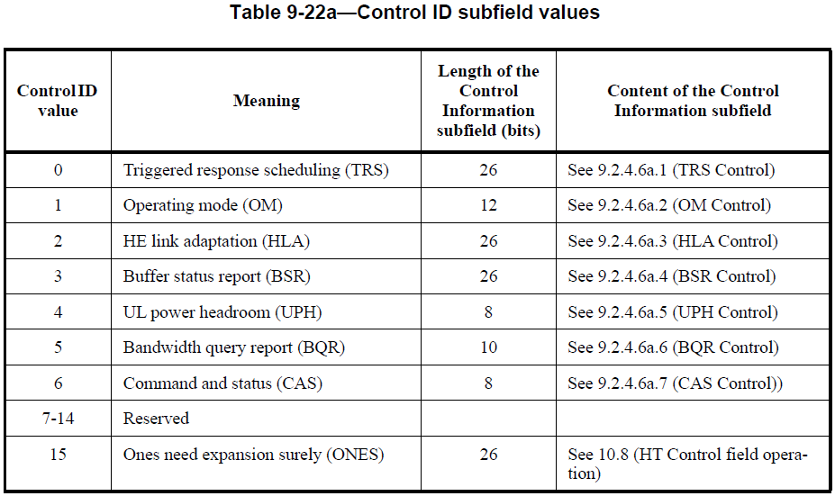
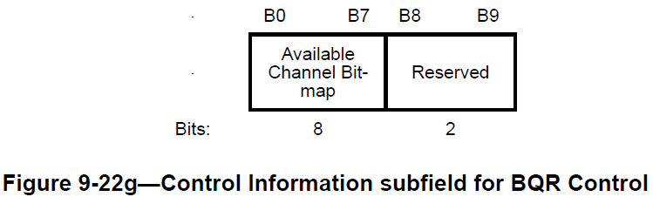
Motivation
BQR Control subfield contains the bandwidth query report (BQR) used for bandwidth query report operation to assist HE MU transmission;
The available channel bitmap is 8 bits, each bit corresponding to a 20MHz subchannel, so it can indicate up to 160MHz;
The largest bandwidth in 11be is 320MHz, how to indicate 320MHz in BQR needs to be discussed.

Slide 3
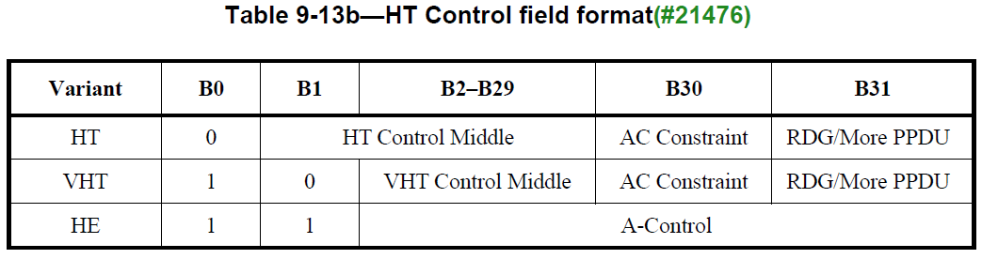
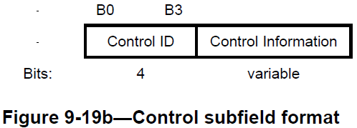
Proposed Solution
The length of A-control in HE variant HT control field is 30 bits;
BQR control subfield is 14 bits, which is 4 bits control ID and 10 bits of control information of BQR control;
A-control subfield has enough space to carry two BQR control subfields. Since one BQR control subfield can indicate 160MHz, we can use these two BQR control subfield to indicate 320MHz.

Slide 4
Proposed Solution
When two BQR controls are carried in a A-control subfield, use below indication for 320MHz operating channel
  The 1st BQR Control subfield is used to indicate the lower 160MHz, the 2nd BQR Control subfield is used to indicate the higher 160MHz;
A-control subfield
BQR control 1
BQR control 2
Reserved
Bits: 14 14 2

Slide 5
Proposed Solution
There are two reserved bits in BQR Control, they can be used to further reduced the signaling overhead;
The solution is just to carry one BQR Control in A-Control to indicate one of 160MHz in 320MHz channel, the available channels in the other 160MHz are indicated by the two reserved bits
  Because just 2 reserved bits available, only some particular cases can be indicated;
  E.g. the other 160MHz is all busy or all idle;
1st reserved bit indicates which 160MHz the Available Channel Bitmap indicates for
  0 indicates the lower 160MHz, 1 indicates the higher 160MHz
2nd reserved bit is used to indicate the channel status of the other 160MHz
  0 means all 20MHz subchannels in the other 160MHz are busy;
  1 means all 20MHz subchannels in the other 160MHz are idle.
Bits: 4 8 2
Control ID=5
(BQR)
Available Channel Bitmap
Reserved
BQR Control
This Channel Segment
Status of the other Channel Segment

Slide 6
Conclusion
Current BQR control only can support up to 160MHz, it can not meet the requirement of 320MHz indication in EHT;
A simple solution to indicate 320MHz channel availability is proposed
  Carry two BQR control subfields in A-control field
The two reserved bits can be used to indicate the channel availability of the other 160MHz in some case to further save overhead
  E.g. the other 160MHz is all idle, or all busy.

Slide 7
Straw Poll 1
Do you support to indicate the channel availability of 320MHz channel by carrying two BQR Control subfields in A-control subfield?

Slide 8
Straw Poll 2
Do you support below indication when two BQR Control subfields are carried in A-Control subfield?
  The 1st BQR Control is used to indicate the lower 160MHz, the 2nd BQR Control is used to indicate the higher 160MHz

Slide 9
Straw Poll 3
Do you support to use the two reserved bits in BQR Control subfields as below when only one BQR control appears in A-control subfield?
  The 1st reserved bit indicates which 160MHz the Available Channel Bitmap subfield indicates for;
    0 indicates the lower 160MHz, 1 indicates the higher 160MHz
  The 2nd reserved bit is used to indicate the channel status of the other 160MHz
    0 indicates the other 160MHz all busy, 1 indicates the other 160MHz all idle

