Slide 1
BQR for 320MHz
Date: 2020-05-01
Authors:
Name | Affiliations | Address | Phone | Email
Yunbo Li | Huawei | Shenzhen, China |  | liyunbo@Huawei.com
Yiqing Li
Yuchen Guo
Ming Gan
Guogang Huang
Yifan Zhou
Notes:
September 2012

Slide 2
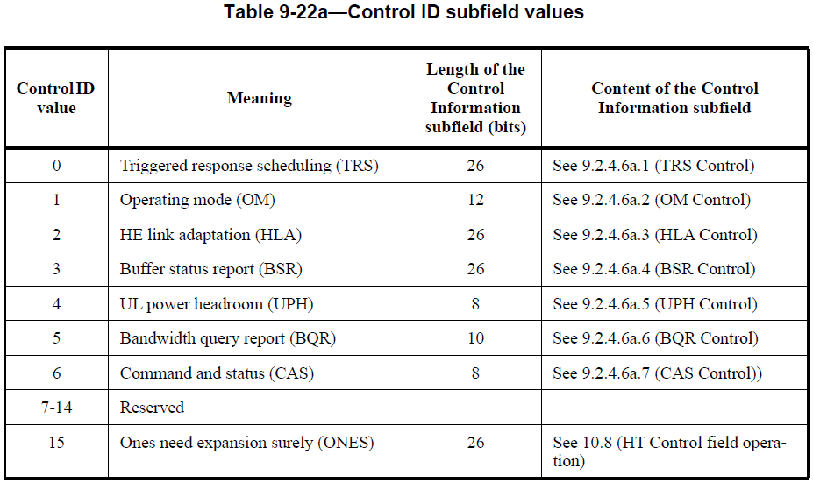
Motivation
BQR Control subfield contains the bandwidth query report (BQR) used for bandwidth query report operation to assist HE MU transmission;
The available channel bitmap is 8 bits, each bit corresponding to a 20MHz subchannel, so it can indicate up to 160MHz;
The largest bandwidth in 11be is 320MHz, BQR can not indicate 320MHz.

Slide 3
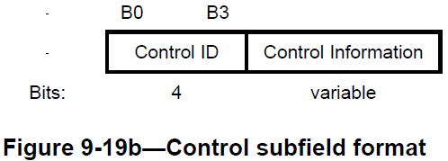
Proposed Solution
The length of A-control in HE variant HT control field is 30 bits;
BQR control subfield is 14 bits, which is 4 bits control ID and 10 bits of control information of BQR control;
Two BQR control subfields can be carried in the A-control subfield. Each BQR can indicate 160MHz, so two BQRs can totally indicate 320MHz.

Slide 4
Proposed Solution
When two BQR controls are carried in a A-control subfield, use below indication for 320MHz operating channel
The 1st BQR Control subfield to indicate lower 160MHz, the 2nd BQR Control subfield to indicate higher 160MHz;
A-control subfield
BQR control 1
BQR control 2
Reserved
Bits: 14 14 2

Slide 5
Proposed Solution
There are two reserved bits in BQR Control, they can be used to further reduced the signaling overhead;
Only one BQR Control is carried in A-Control to indicate one 160MHz channel, the available channels in the other 160MHz are indicated by two reserved bits
Because only 2 bits available, just some particular cases can be indicated.
E.g. one of the two 160MHz is all available
1st reserved bit indicates which 160MHz the Available Channel Bitmap indicate for
0 means lower 160MHz, 1 means higher 160MHz
2nd reserved bit is used to indicate the channel status of the other 160MHz
0 means all 20MHz subchannels in the other 160MHz are busy;
1 means all 20MHz subchannels in the other 160MHz are idle.
Bits: 4 8 2
Control ID=5
(BQR)
Available Channel Bitmap
Reserved
BQR Control
This Channel Segment
Status of the other Channel Segment

Slide 6
Conclusion
Current BQR control only can support up to 160MHz, it can not meet the requirement of 320MHz indication in EHT;
A simple solution to indicate 320MHz channel availability is proposed
Carry two BQR control subfields in A-control field
The two reserved bits can be used to indicate the channel availability of another 160MHz in some case to save overhead
E.g. the other 160MHz is all idle, or all busy.

Slide 7
Straw Poll 1
Do you support to indicate the channel availability of 320MHz channel by carrying two BQR Control subfields in A-control subfield?

Slide 8
Straw Poll 2
Do you support below indication when two BQR Control subfields are carried in A-Control subfield?
The 1st BQR Control to indicate lower 160MHz, the 2nd BQR Control to indicate higher 160MHz

Slide 9
Straw Poll 3
Do you support to use the two reserved bits in BQR Control subfields as below?
1st reserved bit indicates which 160MHz the Available Channel Bitmap subfield indicate for;
2nd reserved bit is used to indicate the channel status of the other 160MHz

