Slide 1
Attacks to Fully Random QPSK Sounding Signal
Date: 2020-05-05

Slide 2
Introduction
.
In some attack mode, it is assumed that the attacker has a ISI-free channel to the sounding transmitter.
Under this assumption, the existing 8PSK-Golay secure sounding signal is vulnerable under brute force computational attacks and therefore fully random QPSK was proposed for secure ranging [1].
In this contribution, we will show that the fully random QPSK is vulnerable and better protection is needed for future proof.

Slide 3
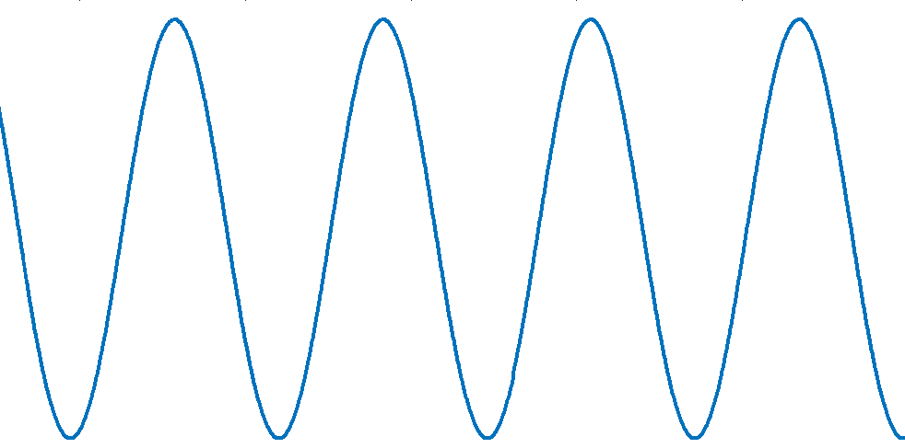
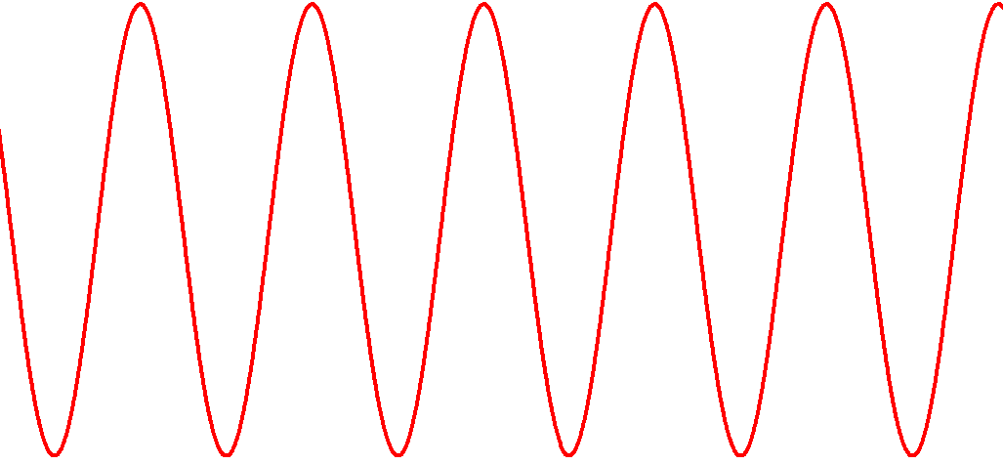
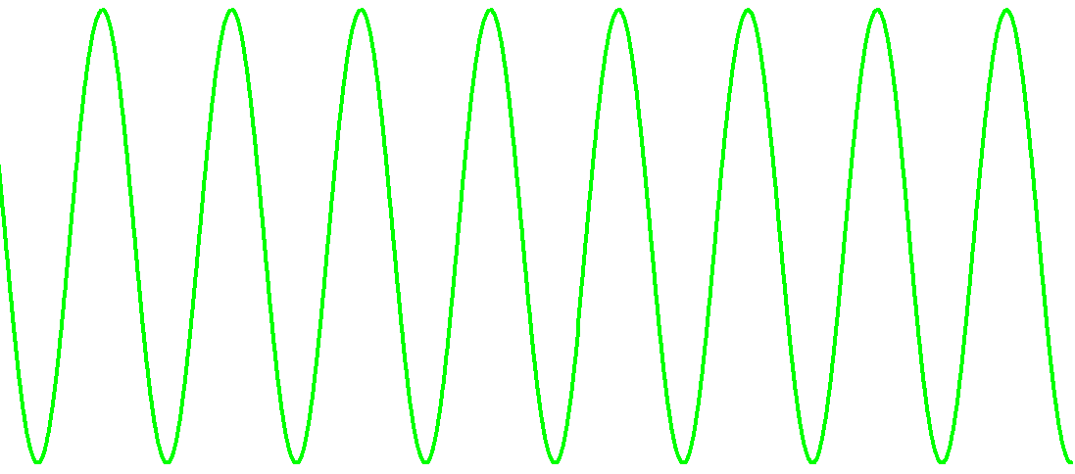
Observation Window
Attacker observes the beginning portion and detects the phases of the sinusoids for generating shifted attack signals
…
Observation window
Attack window
Slide 3

Slide 4
Windowed FFT (1/2)
Time-domain window is applied to weight the input signal and then FFT is performed on the weighted signal

Slide 5
Windowed FFT (2/2)
The longer the window in time, the fewer the significant taps in frequency

Slide 6
Windowing in Time, ICI in Frequency
The time-domain windowing introduces inter-carrier interferences in frequency domain

Slide 7
Attack to QPSK Sounding Signal
Assuming an ISI-free channel, attacker can detect the QPSK symbols using Viterbi equalizer in frequency domain and then generate attack signals
  A Hamming window is applied to the beginning portion of the sounding signal in time domain
  The windowed signal is converted into frequency domain, whose spectrum is simply the convolution of Hamming spectrum and the independent QPSK symbols
  Detecting the QPSK symbols is a classical equalization problem for ISI channels, which can be solved by Viterbi equalizer optimally

Slide 8
Viterbi Equalizer
Almost the same as the Viterbi algorithm for convolutional code decoding except the operations are now in complex domain
Each combination of the previous 4 symbols represents one of 2⁸ states in the memory
Current input symbol
S_{n}
S_{n-1}
S_{n-2}
S_{n-3}
S_{n-4}
w₁
w₂
w₃
w₀
w₄
Significant taps in Hamming spectrum
+
noise
r_{n}
Observed output symbol

Slide 9
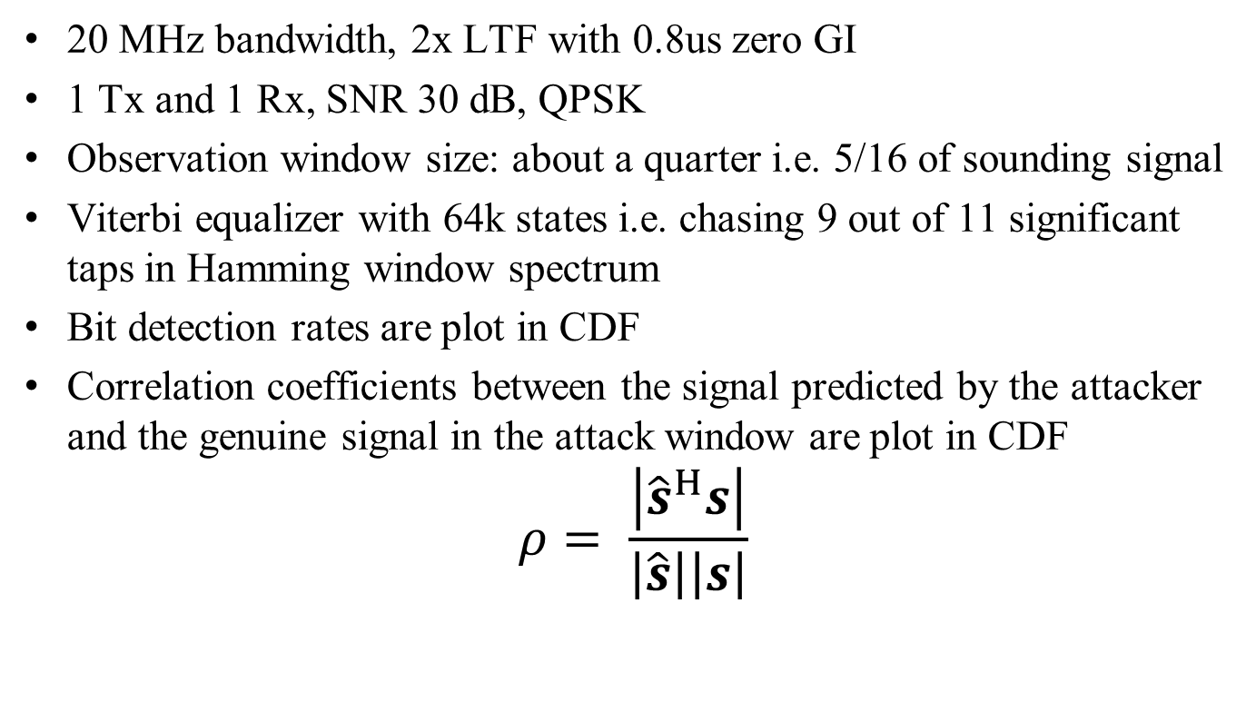
Simulation Settings
20 MHz bandwidth, 2x LTF with 0.8us zero GI
1 Tx and 1 Rx, SNR 30 dB, QPSK
Observation window size: about a quarter i.e. 5/16 of sounding signal
Viterbi equalizer with 64k states i.e. chasing 9 out of 11 significant taps in Hamming window spectrum
Bit detection rates are plot in CDF
Correlation coefficients between the signal predicted by the attacker and the genuine signal in the attack window are plot in CDF
$$ρ= \frac{\left|{\hat{s}}^{H}s\right|}{\left|\hat{s}\right|\left|s\right|}$$

Slide 10
Bit detection rate
> 0.97 for ¼ cases

Slide 11
Correlation Coefficient
> 0.94 for ¼ cases

Slide 12
Remarks
Assuming ISI-free channels and observing about ¼ of the sounding, the attacker can know >94% of the remaining
The complexity is low
  Only 64k Viterbi states. Using 64M states, the observation window reduces down to 1/8 of the sounding
  Lower complexity detectors e.g. decision-feedback and LMMSE equalizers exist
Since the security relies on ICI in frequency domain, which only mixes the adjacent encryption bits, the attacker can detected the bits sequentially with a low complexity
Better protection is needed for future proof

Slide 13
Conclusions
Under the assumption of ISI-free channels, QPSK fully random sounding signal can be broken with low complexities

Slide 14
References
[1] Tianyu Wu, et al., IEEE 802.11-20/0375r1, Mar. 2020

Slide 15
Backup Slides

