Slide 1
Considerations on the Scrambler design for 11be
Date: 2020-04-28
Name | Affiliation | Address | Phone | Email
Chenchen LIU | Huawei |  |  | liuchenchen1@huawei.com
Dandan Liang
Ross Jian Yu
Ming Gan

Slide 2
Abstract
In this contribution, we discuss and propose the scrambler for 11be.

Slide 3
Outline
Recap of the current scrambler in 802.11;
Problem of periodic source signal for larger BW;
Scrambler design principles
Pros vs Cons for a Higher order Scrambler;
Proposed solution
References.

Slide 4
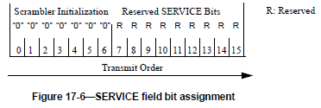

Recap of the current scrambler in 802.11[1]
$$G\left(X\right)=X^{7}+X^{4}+1$$
00001110 11110010 11001001 00000010 00100110 00101110 10110110 00001100 11010100 11100111 10110100 00101010 11111010 01010001 10111000 1111111, when the all 1s initial state is used
The scrambler repeats every 127 bits;
The phase of the scramble sequence produced is determined by the initial state of the scrambler
The receiver needs to know the initial state of the scrambler for producing the identical sequence to descramble the data.

Slide 5
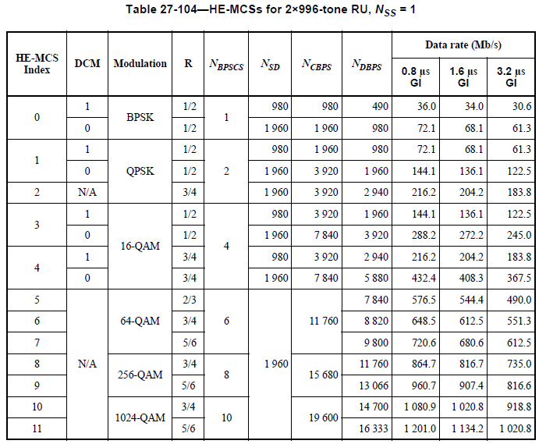
Problem of periodic source signal for larger BW
To avoid the high PAPR problem, the repetition is not expected within one OFDM symbol
There can be hundreds of repetition within one OFDM symbol with scramble sequence of period of 127(16333/127)
320MHz and 4096QAM are the main features in 11be, therefore a higher degree(maybe≥17) scrambler is required.

Slide 6
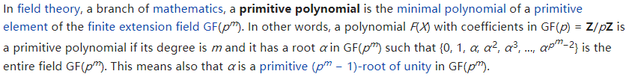
Scrambler design principles
The generator polynomial should be primitive [2]
To make it simple, the primitive polynomial with the least non-zero term is preferred(minimum number of terms 3)
Considering the reversal property, there is always a dual scrambler design
The initialize bits can be reduced(already done in 11ac)
A full list of scrambler satisfying the first two constrains within degree range from 8 to 32 is given in the following slides(without considering the dual)

Slide 7

















Scrambler design principles
Degree 9:
Degree 10:
Degree 11:
Degree 15:
Degree 17:
Degree 18:
Degree 20:
Degree 21:
Degree 22:
Degree 23:
Degree 25:
Degree 29:
Degree 31:
S$\left(x\right)=x^{9}+x^{5}+1$
S$\left(x\right)=x^{10}+x^{7}+1$
S$\left(x\right)=x^{11}+x^{9}+1$
S$\left(x\right)=x^{15}+x^{14}+1;$
S$\left(x\right)=x^{15}+x^{11}+1;$
S$\left(x\right)=x^{15}+x^{8}+1$
S$\left(x\right)=x^{17}+x^{14}+1;$
S$\left(x\right)=x^{17}+x^{12}+1;$
S$\left(x\right)=x^{17}+x^{11}+1$
S$\left(x\right)=x^{18}+x^{11}+1$
S$\left(x\right)=x^{20}+x^{17}+1$
S$\left(x\right)=x^{21}+x^{19}+1$
S$\left(x\right)=x^{22}+x^{21}+1$
S$\left(x\right)=x^{23}+x^{18}+1$
S$\left(x\right)=x^{25}+x^{22}+1$
S$\left(x\right)=x^{29}+x^{27}+1$
S$\left(x\right)=x^{31}+x^{28}+1$

Slide 8
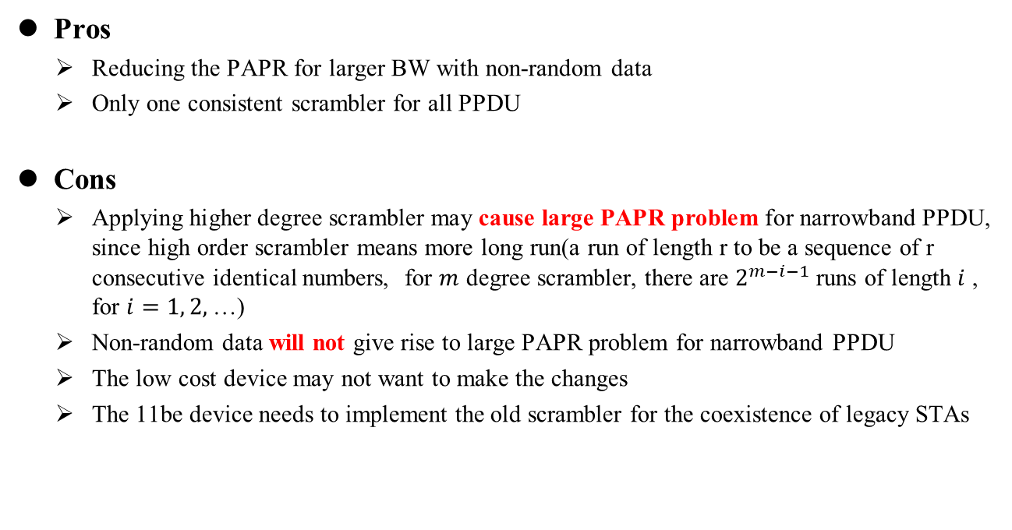
Pros vs Cons for Higher order Scrambler
Pros
  Reducing the PAPR for larger BW with non-random data
  Only one consistent scrambler for all PPDU
Cons
  Applying higher degree scrambler may cause large PAPR problem for narrowband PPDU, since high order scrambler means more long run(a run of length r to be a sequence of r consecutive identical numbers, for $m$ degree scrambler, there are $2^{m−i−1}$ runs of length $i$ , for $i=1, 2,$…)
  Non-random data will not give rise to large PAPR problem for narrowband PPDU
  The low cost device may not want to make the changes
  The 11be device needs to implement the old scrambler for the coexistence of legacy STAs

Slide 9



Simulations
Simulation Assumptions:
  RU Size: 106, 242, 484, 996;
  MCS: 0, 1SS;
  LDPC;
  All zeros data
  Scrambler of order 7, 11, 15 with the following generator polynomial
S$\left(x\right)=x^{7}+x^{4}+1$
S$\left(x\right)=x^{11}+x^{9}+1$
S$\left(x\right)=x^{15}+x^{14}+1$

Slide 10
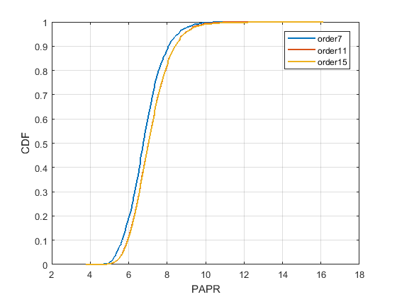
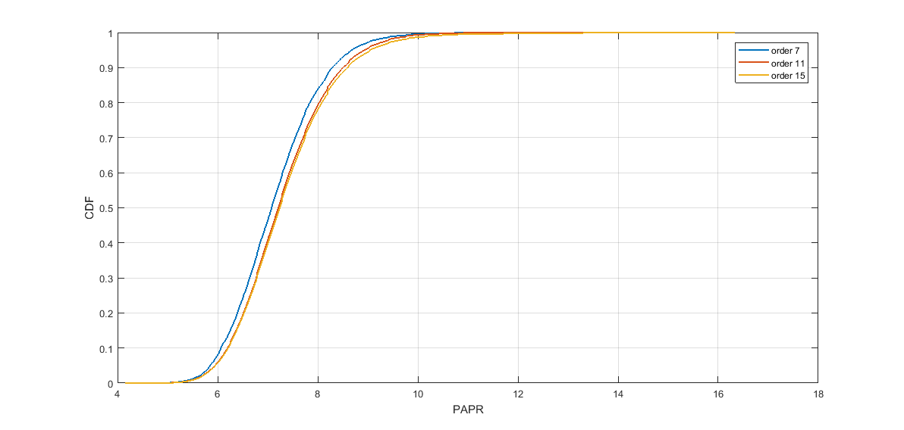
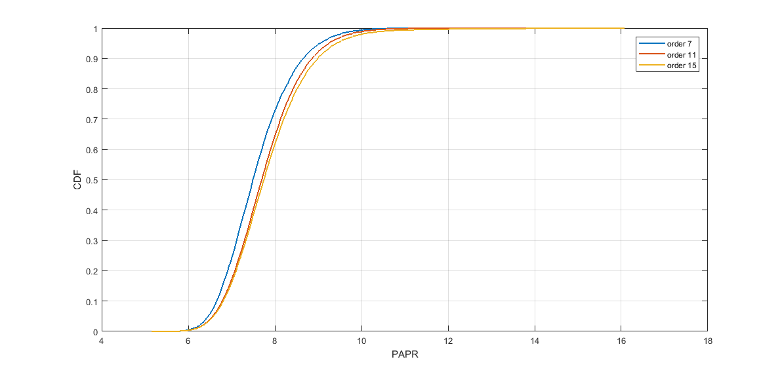
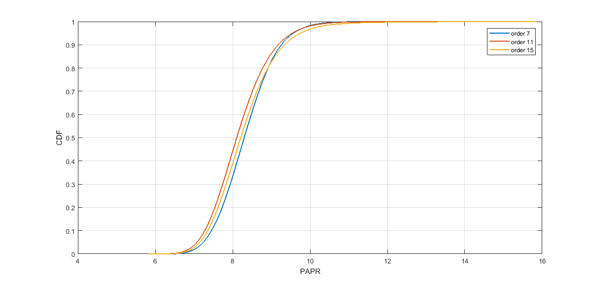
Simulation Results
RU106
RU242
RU484
RU996

Slide 11
Simulation Results
From the simulation results, it can be observed that
  High degree scrambler will increase the PAPR for small RU size.
  The CDF of high degree scrambler has a longer tail, i.e. some of the packet may suffer from very large PAPR which lead to the failure of transmition.
  The higher degree scrambler can have work well when RU size >=996.

Slide 12

Proposed Solution: Adaptive Scrambler
[3] proposed the scrambler with , while we propose to use an adaptive scrambler with respect to the RU size and MCS.
S$\left(x\right)=x^{11}+x^{9}+1$
e.g.
For RU size size(or combined RU size ) <996, the original scrambler is used.
For RU size(or combined RU size ) between 996 to 2*996, the 11 degree scrambler used (can also use 15 degree scrambler instead to make it simple)
For RU size(or combined RU size )>2*996, 15 degree scrambler is used
The low order scrambler can reuse the hardware resource of high order scrambler
The transmitter determines which scrambler will be used base on the RU size and MCS
  RU size for UL MU PPDU, BW for SU PPDU, TBD for DL MU PPDU, TBD for Puncture
With this adaptive scrambler, the low-cost device does not need to implement the high order scrambler

Slide 13
Summary
In this contribution, considering the backward compatibility and reducing PAPR,
we propose the adaptive scrambler for 11be and different BW can apply
Scrambler of different degree.

Slide 14
SP
Do you agree to use higher degree scrambler only for user with large RU size and high MCS in EHT PPDU?
  The exact high degree scrambler is TBD
  The condition when the high degree scrambler should be used is TBD

Slide 15
References
[1] IEEE P802.11-REVmdTM/D3.0
[2] https://en.wikipedia.org/wiki/Primitive_polynomial_(field_theory)
[3]11-20-0563-00-00be-eht-ppdu-scrambler
[4] 11-10-1281-01-00ac-bw-and-static-dynamic-indication-within-legacy
[5] 15-09-0727-00-0007-scrambler-and-fec-for-vlc

Slide 16
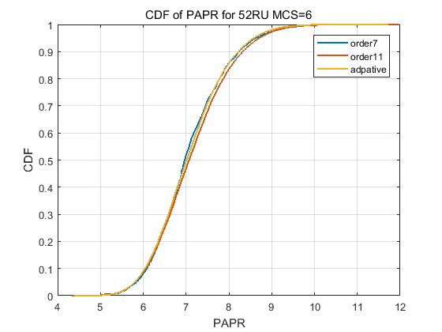
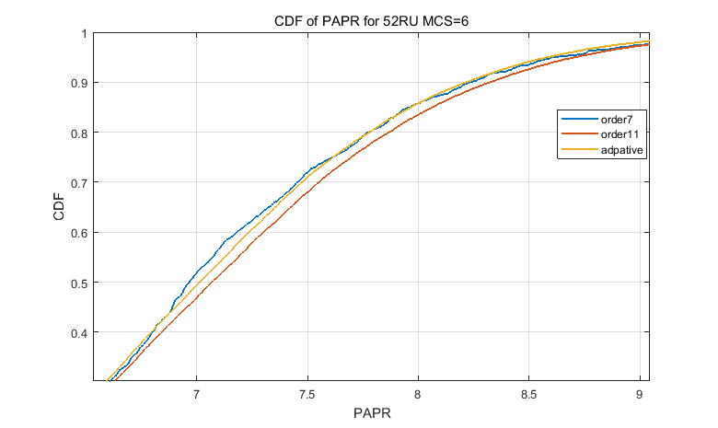
Backup

Slide 17
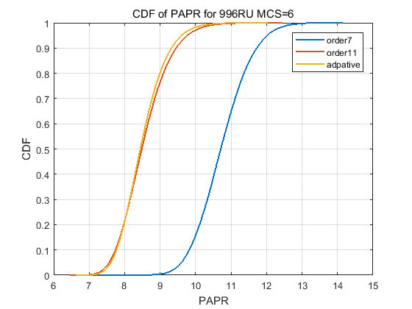
Backup
Adaptive scrambler
is 12 order

Slide 18
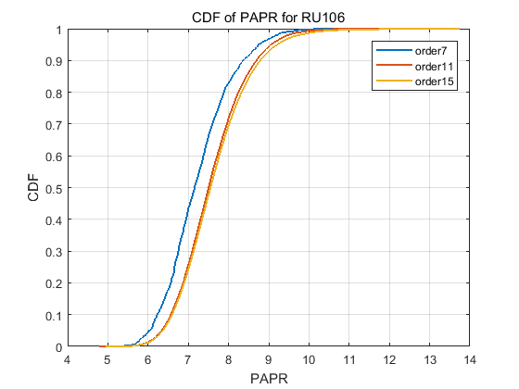
backup
MCS=4,

Slide 19

$N_{DBPS}$ for 1ss
 | 0 | 1 | 2 | 3 | 4 | 5 | 6 | 7 | 8 | 9 | 10 | 11
26-tone RU | 6/12 | 12/24 | 36 | 24/48 | 36/72 | 96 | 108 | 120 | 144 | 160 | 180 | 200
52-tone RU | 12/24 | 24/48 | 72 | 48/96 | 72/144 | 192 | 216 | 240 | 288 | 320 | 360 | 400
106-tone RU | 25/51 | 51/102 | 153 | 102/204 | 153/306 | 408 | 459 | 510 | 612 | 680 | 765 | 850
242-tone RU | 58/117 | 117/234 | 351 | 234/468 | 351/702 | 936 | 1053 | 1170 | 1404 | 1560 | 1755 | 1950
484-tone RU | 117/234 | 234/468 | 702 | 468/936 | 702/1404 | 1872 | 2106 | 2340 | 2808 | 3120 | 3510 | 3900
996-tone RU | 245/490 | 490/980 | 1470 | 980/1960 | 1470/2940 | 3920 | 4410 | 4900 | 5880 | 6533 | 7350 | 8166
2*996-tone RU | 490/980 | 980/1960 | 2940 | 1960/3920 | 2940/5880 | 7840 | 8820 | 9800 | 11760 | 13066 | 14700 | 16333

