Slide 1
Midamble design
Date: 2020-04-29
Authors:

Slide 2
Abstract
The TGbd group has agreed to investigate techniques to suppress discrete spectrum components in PPDUs with midambles [1]
This contribution describes and evaluates a technique based on midamble randomization
It is proposed to include midamble randomization in the design of 802.11bd PPDUs

Slide 3
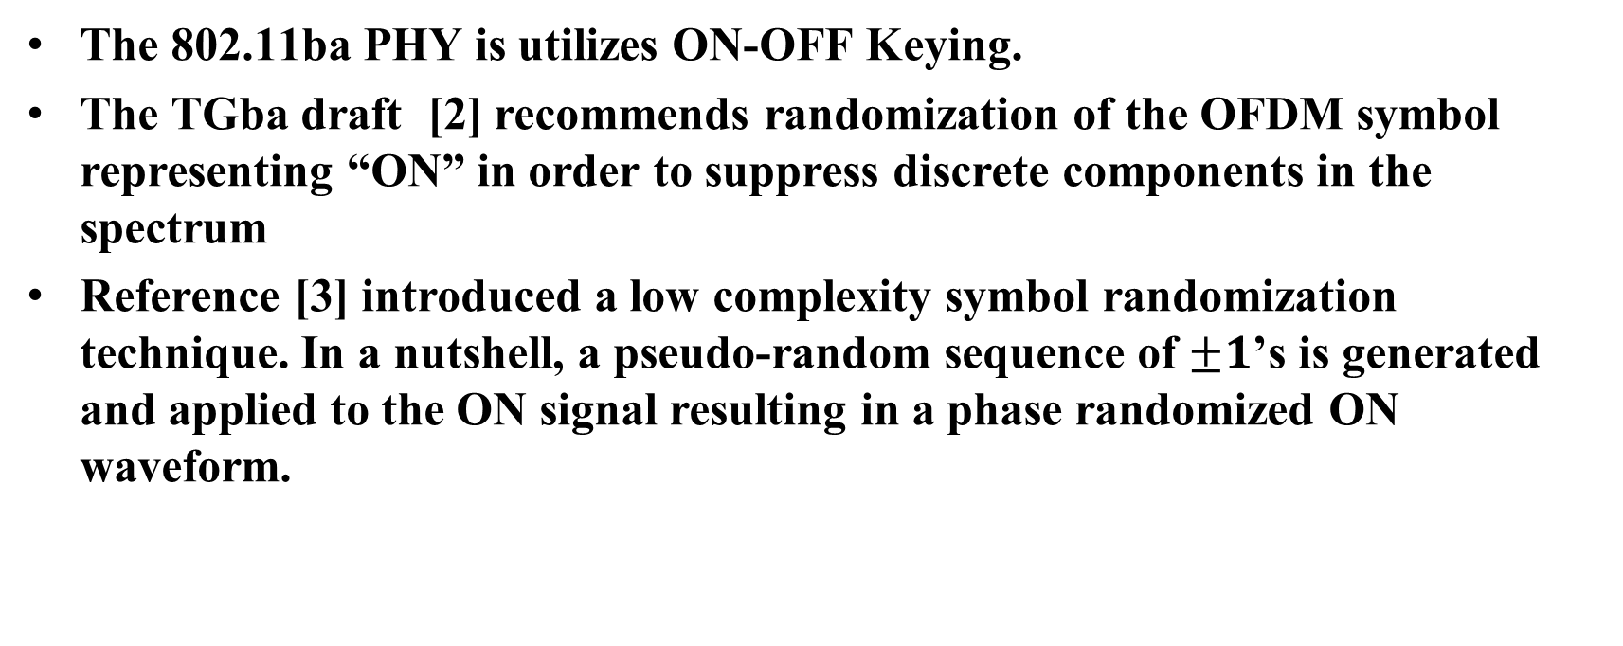
Recap – symbol randomization in 802.11ba
The 802.11ba PHY is utilizes ON-OFF Keying.
The TGba draft [2] recommends randomization of the OFDM symbol representing “ON” in order to suppress discrete components in the spectrum
Reference [3] introduced a low complexity symbol randomization technique. In a nutshell, a pseudo-random sequence of $±1$’s is generated and applied to the ON signal resulting in a phase randomized ON waveform.

Slide 4

Midamble Randomization in TGbd
It is proposed to utilize a method similar to that adopted by 802.11ba, consisting of generating a pseudo-random sequence of $±1$’s and multiplying each midamble by one of these values
Suppose that a PN sequence $\left(p_{n}\right)$ consisting of $±1$has been generated. In the case of SISO PPDUs, the midambles are randomized as shown below

Slide 5

Midamble Randomization in TGbd - MIMO PPDU
In case of MIMO PPDUs there are two alternatives
Option 1: different pseudo-random sequences are applied to the LTFs in a midamble
  The same phase shift $p_{n}$must be applied to both layers

Slide 6

Midamble Randomization in TGbd - MIMO PPDU
Option 2: the same pseudo-random sequence is applied to all LTFs in a midamble.
  The same phase shift $p_{n}$must be applied to both MIMO layers

Slide 7
Remarks
The Appendix contains a theoretical demonstration that midamble randomization suppresses the discrete spectrum components.
In the MIMO case, randomization of the phase could destroy the orthogonality property of the P matrix, which is necessary for channel estimation.
The procedures suggested in slides 5 and 6 preserve the orthogonality of the P matrix because they are equivalent to multiplying zero, one or two columns of the P matrix by -1. These operations preserve the orthogonality of the P matrix.

Slide 8
Generation of the PN sequence
Option 1: use the sequence defined in (17-25) of IEEE 802.11-2016. This is the sequence used to control the polarity of the pilot subcarriers. This sequence consists of 127 values and can be extended cyclically to any length
Option 2: generate a PN sequence by means of the LFSR described in Section 20.3.9 of IEEE 802.11-2016. If the shift register is initialized with ones then the same PN sequence as in option 1 above is obtained
Option 3: other PN generator

Slide 9
Transmitter and Receiver processing
The complexity of the transmitter processing is low. The phase shift can be applied to the midamble LTFs in either time or frequency domains.
Receiver processing also has low complexity, as it is the reverse of the transmit processing, and may also be performed in time or frequency domains.

Slide 10

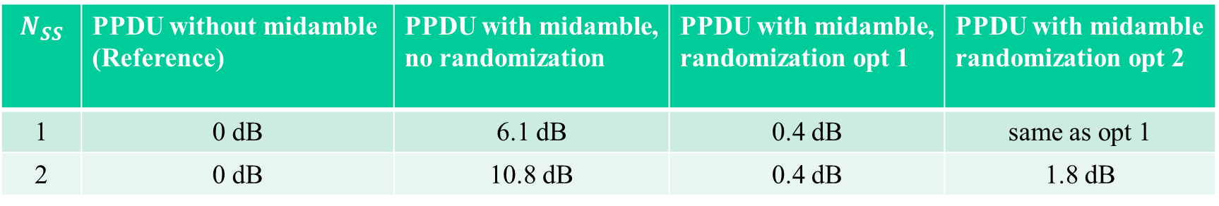
Simulation results
The PN sequence has been generated according to option 1 in slide 7.
Preamble periodicity $N_{MA}=4$ (worst case scenario)
Resolution bandwidth 3 kHz (worst case scenario)
PPDU bandwidth 10 MHz
No LTF compression
Maximum power over sliding 3 kHz window relative to PPDU with random data
$$N_{SS}$$ | PPDU without midamble (Reference) | PPDU with midamble, no randomization | PPDU with midamble, randomization opt 1 | PPDU with midamble randomization opt 2
1 | 0 dB | 6.1 dB | 0.4 dB | same as opt 1
2 | 0 dB | 10.8 dB | 0.4 dB | 1.8 dB

Slide 11
Summary
A low complexity technique to randomize the midambles has been described and it has been shown that it is effective in suppressing discrete components in the PSD
It is proposed to introduce this midamble randomization procedure in TGbd
Several implementation options were presented, having minor differences.

Slide 12
Straw poll 1
Do you agree that the midamble design should include a randomization procedure as described in slides 4 (SISO PPDU) and 5/6 (MIMO PPDU)?
Y:
N:
A:

Slide 13
Straw poll 2
Which method to randomize MIMO PPDUs do you prefer?
Opt 1 in slide 5 (possibly different PN applied to the LTFs in one midamble)
Opt 2 in slide 6 (same PN applied to all LTFs in the midamble)

Slide 14
Straw poll 3
Which method to generate the PN sequence do you prefer?
Option 1 in slide 8
Option 2 in slide 8
Some other method

Slide 15
References
[1] M. López and L. Wilhelmsson “Remark on PPDUs with midambles”, IEEE 802.11-20/0476r1 https://mentor.ieee.org/802.11/dcn/20/11-20-0476-01-00bd-remark-on-ppdus-with-midambles.pptx
[2] Draft standard 802.11ba D6.0
[3] S. Shellhammer et al. “WUR Power Spectral Density”, IEEE 802.11-18/0824r1, https://mentor.ieee.org/802.11/dcn/18/11-18-0824-01-00ba-wur-power-spectral-density.pptx

Slide 16
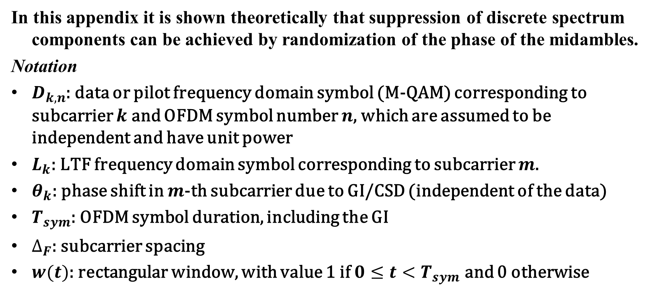
Appendix
In this appendix it is shown theoretically that suppression of discrete spectrum components can be achieved by randomization of the phase of the midambles.
Notation
$D_{k,n}$: data or pilot frequency domain symbol (M-QAM) corresponding to subcarrier $k$ and OFDM symbol number $n$, which are assumed to be independent and have unit power
$L_{k}$: LTF frequency domain symbol corresponding to subcarrier $m$.
$θ_{k}$: phase shift in $m$-th subcarrier due to GI/CSD (independent of the data)
$T_{sym}$: OFDM symbol duration, including the GI
$∆_{F}$: subcarrier spacing
$w(t)$: rectangular window, with value 1 if $0≤t<T_{sym}$ and 0 otherwise

Slide 17
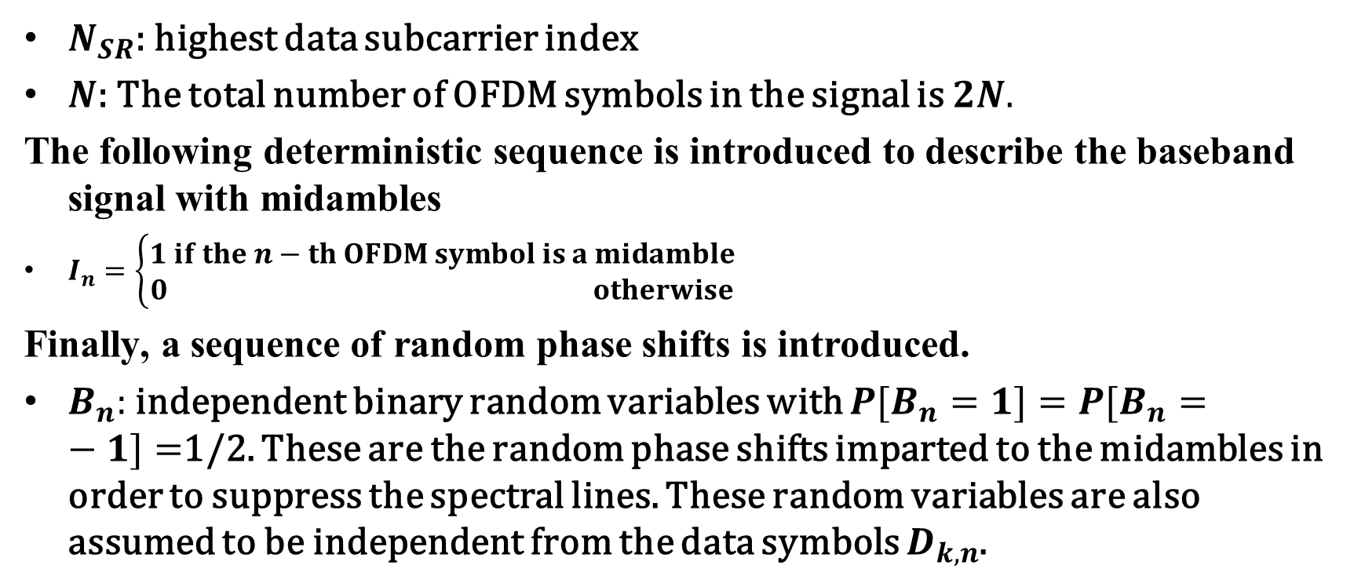
Appendix
$N_{SR}$: highest data subcarrier index
$N$: The total number of OFDM symbols in the signal is $2N.$
The following deterministic sequence is introduced to describe the baseband signal with midambles
$I_{n}=\left\{\begin{matrix}1 if the n−th OFDM symbol is a midamble \\ 0 otherwise\end{matrix}\right.$
Finally, a sequence of random phase shifts is introduced.
$B_{n}:$ independent binary random variables with ${P[B}_{n}=1]={P[B}_{n}=−1]=$1/2. These are the random phase shifts imparted to the midambles in order to suppress the spectral lines. These random variables are also assumed to be independent from the data symbols $D_{k,n}$.

Slide 18
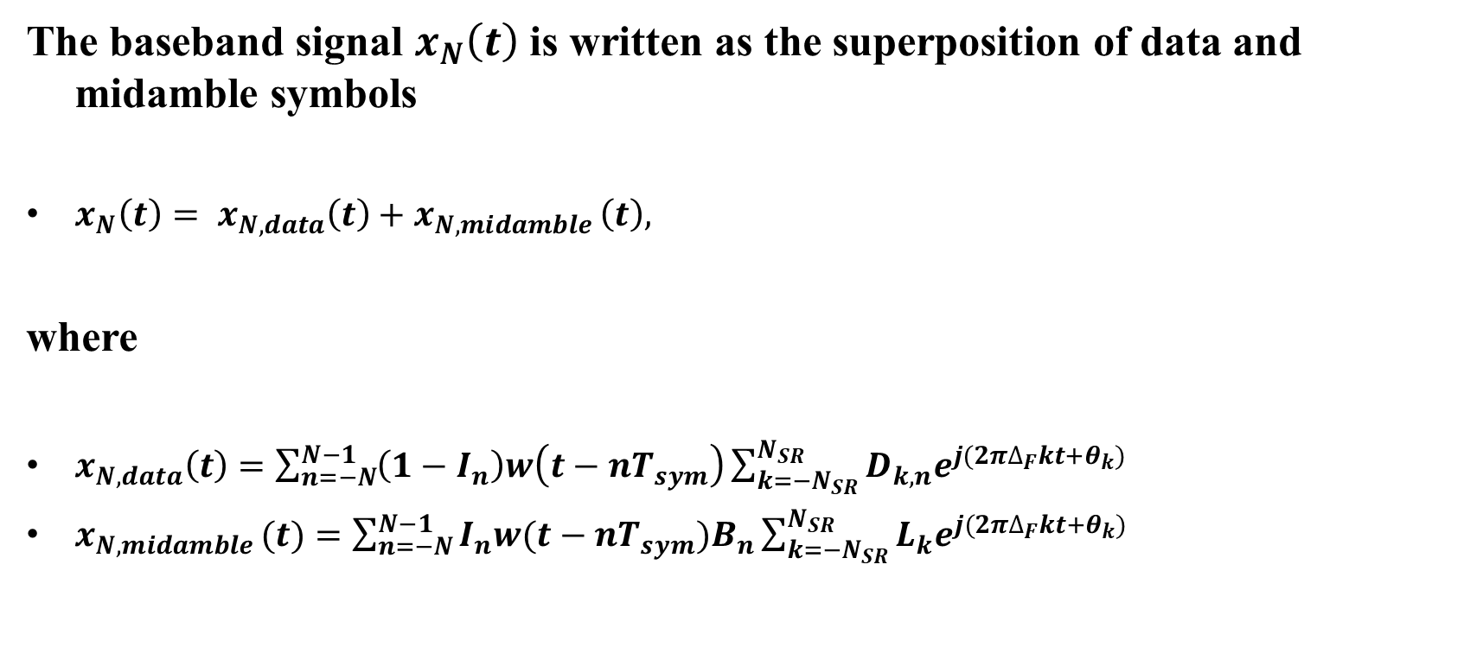
Appendix
The baseband signal $x_{N}\left(t\right)$ is written as the superposition of data and midamble symbols
$x_{N}\left(t\right)= x_{N,data}\left(t\right)+x_{N,midamble }\left(t\right),$
where
$x_{N,data}\left(t\right)=\sum_{n=−N}^{N−1}{\left(1−I_{n}\right)w\left(t−nT_{sym}\right)\sum_{k={−N}_{SR}}^{N_{SR}}{D_{k,n}e^{j{(2π∆_{F}kt+θ}_{k})}}}$
$x_{N,midamble }(t)=\sum_{n=−N}^{N−1}{I_{n}w(t−nT_{sym})B_{n}\sum_{k={−N}_{SR}}^{N_{SR}}{L_{k}e^{j{(2π∆_{F}kt+θ}_{k})}}}$

Slide 19
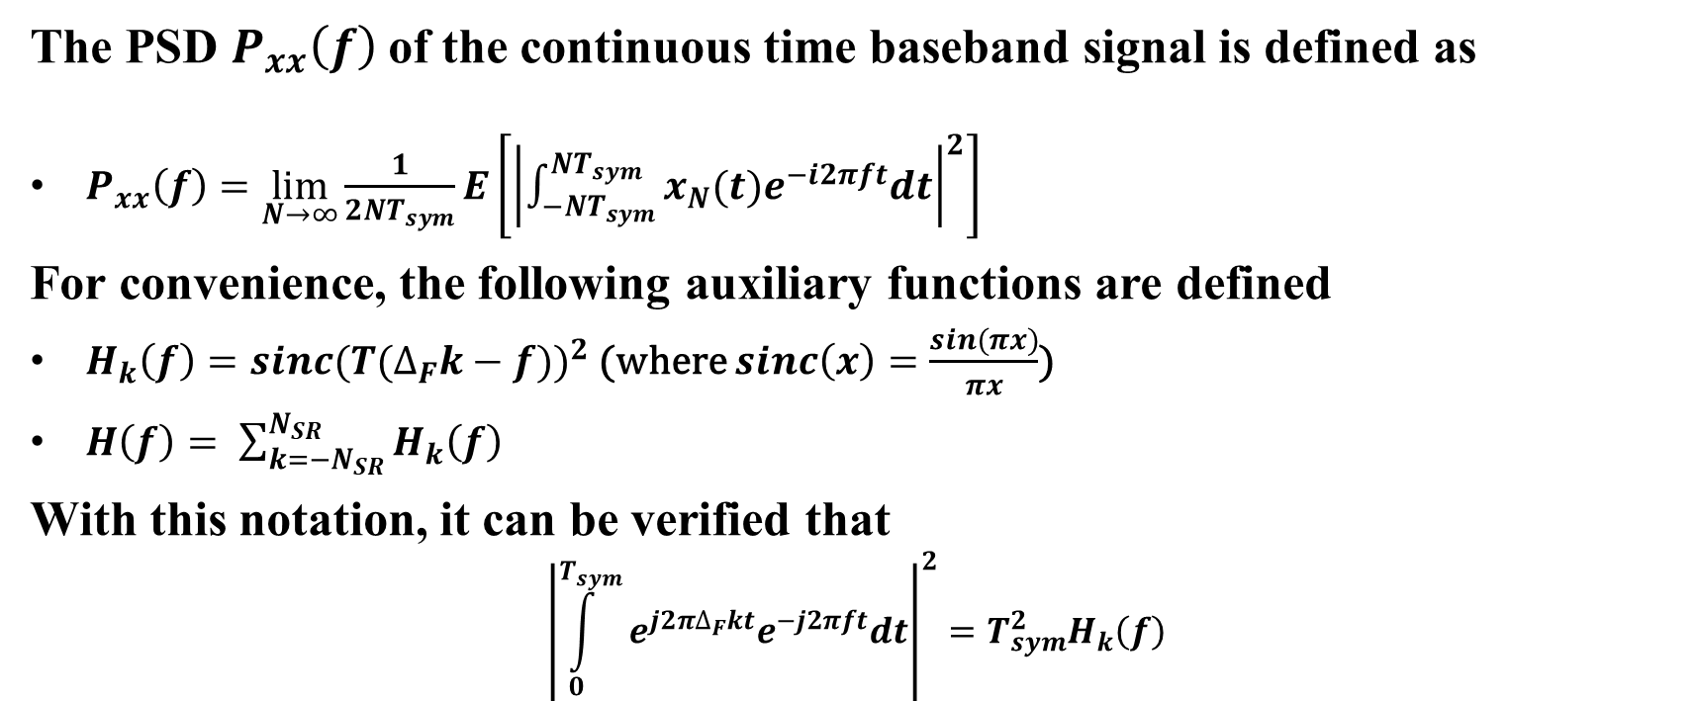
Appendix
The PSD $P_{xx}\left(f\right)$of the continuous time baseband signal is defined as
$P_{xx}\left(f\right)=\lim_{N→∞}{\frac{1}{2NT_{sym}}E\left[{\left|\int_{−NT_{sym}}^{NT_{sym}}{x_{N}(t)e^{−i2πft}dt}\right|}^{2}\right]}$
For convenience, the following auxiliary functions are defined
$H_{k}\left(f\right)={sinc(T(∆_{F}k−f))}^{2}$ (where $sinc\left(x\right)=\frac{sin(πx)}{πx}$)
$H\left(f\right)= \sum_{k={−N}_{SR}}^{N_{SR}}{H_{k}\left(f\right)}$
With this notation, it can be verified that
$${\left|\int_{0}^{T_{sym}}{e^{j2π∆_{F}kt}e^{−j2πft}dt}\right|}^{2}=T_{sym}^{2}H_{k}\left(f\right)$$

Slide 20
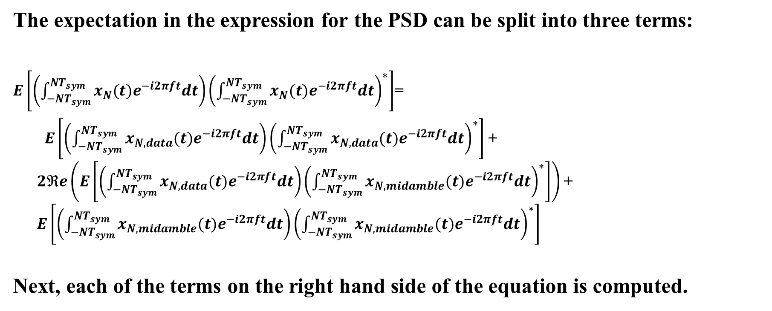
Appendix
The expectation in the expression for the PSD can be split into three terms:
$E\left[\left(\int_{−NT_{sym}}^{NT_{sym}}{x_{N}(t)e^{−i2πft}dt}\right){\left(\int_{−NT_{sym}}^{NT_{sym}}{x_{N}(t)e^{−i2πft}dt}\right)}^{∗}\right]$=
$E\left[\left(\int_{−NT_{sym}}^{NT_{sym}}{x_{N,data}(t)e^{−i2πft}dt}\right){\left(\int_{−NT_{sym}}^{NT_{sym}}{x_{N,data}(t)e^{−i2πft}dt}\right)}^{∗}\right]$ + $2ℜe\left(E\left[\left(\int_{−NT_{sym}}^{NT_{sym}}{x_{N,data}(t)e^{−i2πft}dt}\right){\left(\int_{−NT_{sym}}^{NT_{sym}}{x_{N,midamble}(t)e^{−i2πft}dt}\right)}^{∗}\right]\right)$ + $E\left[\left(\int_{−NT_{sym}}^{NT_{sym}}{x_{N,midamble}(t)e^{−i2πft}dt}\right){\left(\int_{−NT_{sym}}^{NT_{sym}}{x_{N,midamble}(t)e^{−i2πft}dt}\right)}^{∗}\right]$
Next, each of the terms on the right hand side of the equation is computed.

Slide 21
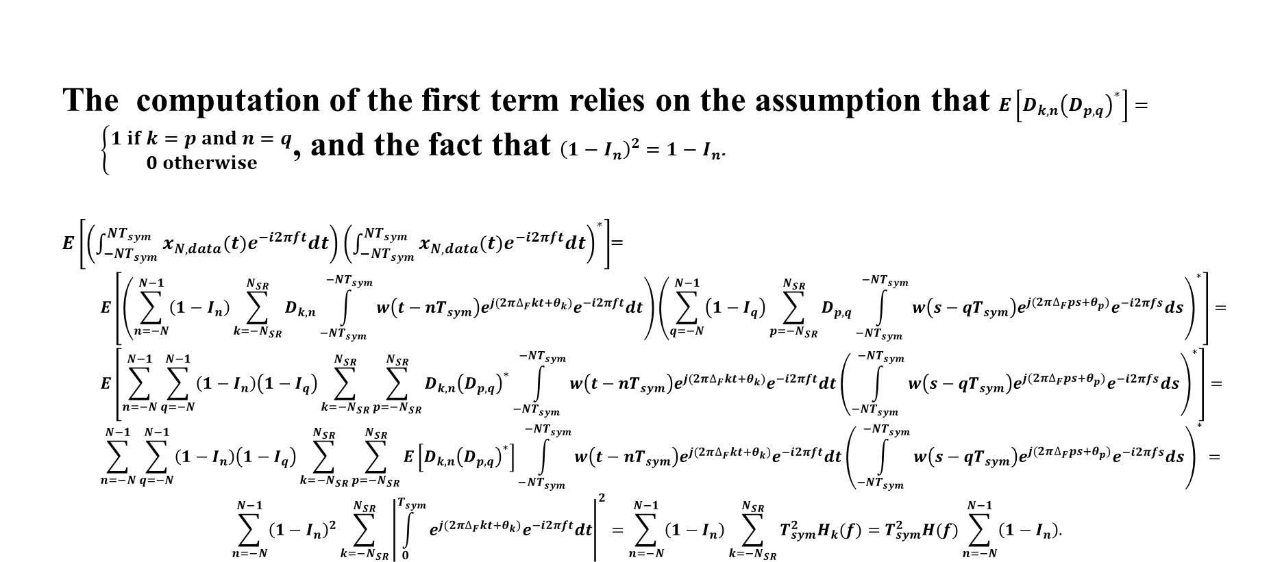
Appendix
The computation of the first term relies on the assumption that $E\left[D_{k,n}{\left(D_{p,q}\right)}^{∗}\right]=\left\{\begin{matrix}1 if k=p and n=q \\ 0 otherwise\end{matrix}\right.$, and the fact that ${\left(1−I_{n}\right)}^{2}=1−I_{n}$.
$E\left[\left(\int_{−NT_{sym}}^{NT_{sym}}{x_{N,data}(t)e^{−i2πft}dt}\right){\left(\int_{−NT_{sym}}^{NT_{sym}}{x_{N, data}(t)e^{−i2πft}dt}\right)}^{∗}\right]$=
$$E\left[\left(\sum_{n=−N}^{N−1}{\left(1−I_{n}\right)\sum_{k={−N}_{SR}}^{N_{SR}}{D_{k,n}\int_{−NT_{sym}}^{−NT_{sym}}{w\left(t−nT_{sym}\right)e^{j{(2π∆_{F}kt+θ}_{k})}e^{−i2πft}dt}}}\right){\left(\sum_{q=−N}^{N−1}{\left(1−I_{q}\right)\sum_{p={−N}_{SR}}^{N_{SR}}{D_{p,q}\int_{−NT_{sym}}^{−NT_{sym}}{w\left(s−qT_{sym}\right)e^{j{(2π∆_{F}ps+θ}_{p})}e^{−i2πfs}ds}}}\right)}^{∗}\right]=$$
$$E\left[\sum_{n=−N}^{N−1}{\sum_{q=−N}^{N−1}{\left(1−I_{n}\right)\left(1−I_{q}\right)\sum_{k={−N}_{SR}}^{N_{SR}}{\sum_{p={−N}_{SR}}^{N_{SR}}{D_{k,n}{\left(D_{p,q}\right)}^{∗}}\int_{−NT_{sym}}^{−NT_{sym}}{w\left(t−nT_{sym}\right)e^{j{(2π∆_{F}kt+θ}_{k})}e^{−i2πft}dt}}}}{\left(\int_{−NT_{sym}}^{−NT_{sym}}{w\left(s−qT_{sym}\right)e^{j{(2π∆_{F}ps+θ}_{p})}e^{−i2πfs}ds}\right)}^{∗}\right]=$$
$$\sum_{n=−N}^{N−1}{\sum_{q=−N}^{N−1}{\left(1−I_{n}\right)\left(1−I_{q}\right)\sum_{k={−N}_{SR}}^{N_{SR}}{\sum_{p={−N}_{SR}}^{N_{SR}}{E\left[D_{k,n}{\left(D_{p,q}\right)}^{∗}\right]}\int_{−NT_{sym}}^{−NT_{sym}}{w\left(t−nT_{sym}\right)e^{j{(2π∆_{F}kt+θ}_{k})}e^{−i2πft}dt}}}}{\left(\int_{−NT_{sym}}^{−NT_{sym}}{w\left(s−qT_{sym}\right)e^{j{(2π∆_{F}ps+θ}_{p})}e^{−i2πfs}ds}\right)}^{∗}=$$
$$\sum_{n=−N}^{N−1}{{\left(1−I_{n}\right)}^{2}\sum_{k={−N}_{SR}}^{N_{SR}}{{\left|\int_{0}^{T_{sym}}{e^{j{(2π∆_{F}kt+θ}_{k})}e^{−i2πft}dt}\right|}^{2}}}=\sum_{n=−N}^{N−1}{\left(1−I_{n}\right)\sum_{k={−N}_{SR}}^{N_{SR}}{T_{sym}^{2}H_{k}(f)}=T_{sym}^{2}H(f)\sum_{n=−N}^{N−1}{\left(1−I_{n}\right).}}$$

Slide 22
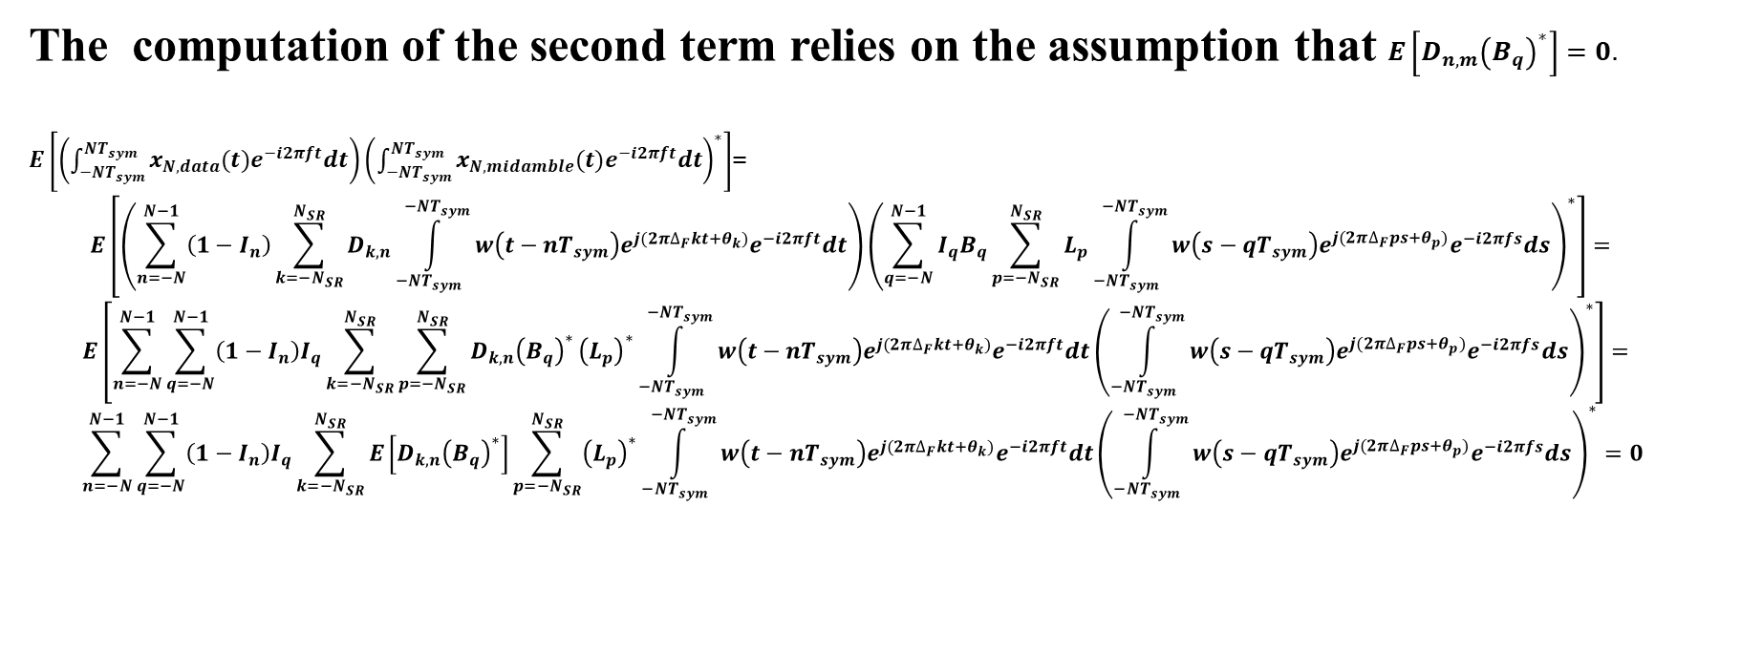
Appendix
The computation of the second term relies on the assumption that $E\left[D_{n,m}{\left(B_{q}\right)}^{∗}\right]=0.$
$E\left[\left(\int_{−NT_{sym}}^{NT_{sym}}{x_{N,data}(t)e^{−i2πft}dt}\right){\left(\int_{−NT_{sym}}^{NT_{sym}}{x_{N, midamble}(t)e^{−i2πft}dt}\right)}^{∗}\right]$=
$$E\left[\left(\sum_{n=−N}^{N−1}{\left(1−I_{n}\right)\sum_{k={−N}_{SR}}^{N_{SR}}{D_{k,n}\int_{−NT_{sym}}^{−NT_{sym}}{w\left(t−nT_{sym}\right)e^{j{(2π∆_{F}kt+θ}_{k})}e^{−i2πft}dt}}}\right){\left(\sum_{q=−N}^{N−1}{I_{q}B_{q}\sum_{p={−N}_{SR}}^{N_{SR}}{L_{p}\int_{−NT_{sym}}^{−NT_{sym}}{w\left(s−qT_{sym}\right)e^{j{(2π∆_{F}ps+θ}_{p})}e^{−i2πfs}ds}}}\right)}^{∗}\right]=$$
$$E\left[\sum_{n=−N}^{N−1}{\sum_{q=−N}^{N−1}{\left(1−I_{n}\right)I_{q}\sum_{k={−N}_{SR}}^{N_{SR}}{\sum_{p={−N}_{SR}}^{N_{SR}}{D_{k,n}{\left(B_{q}\right)}^{∗}}{\left(L_{p}\right)}^{∗}\int_{−NT_{sym}}^{−NT_{sym}}{w\left(t−nT_{sym}\right)e^{j{(2π∆_{F}kt+θ}_{k})}e^{−i2πft}dt}}}}{\left(\int_{−NT_{sym}}^{−NT_{sym}}{w\left(s−qT_{sym}\right)e^{j{(2π∆_{F}ps+θ}_{p})}e^{−i2πfs}ds}\right)}^{∗}\right]=$$
$$\sum_{n=−N}^{N−1}{\sum_{q=−N}^{N−1}{\left(1−I_{n}\right)I_{q}\sum_{k={−N}_{SR}}^{N_{SR}}{E\left[D_{k,n}{\left(B_{q}\right)}^{∗}\right]\sum_{p={−N}_{SR}}^{N_{SR}}{{\left(L_{p}\right)}^{∗}}\int_{−NT_{sym}}^{−NT_{sym}}{w\left(t−nT_{sym}\right)e^{j{(2π∆_{F}kt+θ}_{k})}e^{−i2πft}dt}}}}{\left(\int_{−NT_{sym}}^{−NT_{sym}}{w\left(s−qT_{sym}\right)e^{j{(2π∆_{F}ps+θ}_{p})}e^{−i2πfs}ds}\right)}^{∗}=0$$

Slide 23
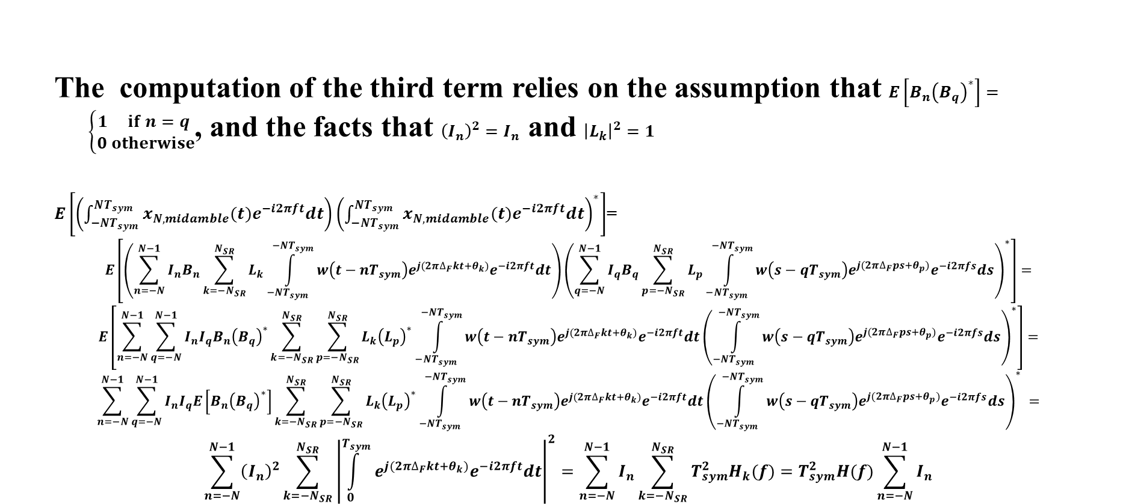
Appendix
The computation of the third term relies on the assumption that $E\left[B_{n}{\left(B_{q}\right)}^{∗}\right]=\left\{\begin{matrix}1 if n=q \\ 0 otherwise\end{matrix}\right.$, and the facts that ${\left(I_{n}\right)}^{2}=I_{n}$ and ${\left|L_{k}\right|}^{2}=1$
$E\left[\left(\int_{−NT_{sym}}^{NT_{sym}}{x_{N,midamble}(t)e^{−i2πft}dt}\right){\left(\int_{−NT_{sym}}^{NT_{sym}}{x_{N, midamble}(t)e^{−i2πft}dt}\right)}^{∗}\right]$=
$$E\left[\left(\sum_{n=−N}^{N−1}{I_{n}B_{n}\sum_{k={−N}_{SR}}^{N_{SR}}{L_{k}\int_{−NT_{sym}}^{−NT_{sym}}{w\left(t−nT_{sym}\right)e^{j{(2π∆_{F}kt+θ}_{k})}e^{−i2πft}dt}}}\right){\left(\sum_{q=−N}^{N−1}{I_{q}B_{q}\sum_{p={−N}_{SR}}^{N_{SR}}{L_{p}\int_{−NT_{sym}}^{−NT_{sym}}{w\left(s−qT_{sym}\right)e^{j{(2π∆_{F}ps+θ}_{p})}e^{−i2πfs}ds}}}\right)}^{∗}\right]=$$
$$E\left[\sum_{n=−N}^{N−1}{\sum_{q=−N}^{N−1}{I_{n}I_{q}B_{n}{\left(B_{q}\right)}^{∗}\sum_{k={−N}_{SR}}^{N_{SR}}{\sum_{p={−N}_{SR}}^{N_{SR}}{L_{k}{\left(L_{p}\right)}^{∗}\int_{−NT_{sym}}^{−NT_{sym}}{w\left(t−nT_{sym}\right)e^{j{(2π∆_{F}kt+θ}_{k})}e^{−i2πft}dt}}}}}{\left(\int_{−NT_{sym}}^{−NT_{sym}}{w\left(s−qT_{sym}\right)e^{j{(2π∆_{F}ps+θ}_{p})}e^{−i2πfs}ds}\right)}^{∗}\right]=$$
$$\sum_{n=−N}^{N−1}{\sum_{q=−N}^{N−1}{I_{n}I_{q}E\left[{B_{n}\left(B_{q}\right)}^{∗}\right]\sum_{k={−N}_{SR}}^{N_{SR}}{\sum_{p={−N}_{SR}}^{N_{SR}}{L_{k}{\left(L_{p}\right)}^{∗}\int_{−NT_{sym}}^{−NT_{sym}}{w\left(t−nT_{sym}\right)e^{j{(2π∆_{F}kt+θ}_{k})}e^{−i2πft}dt}}}}}{\left(\int_{−NT_{sym}}^{−NT_{sym}}{w\left(s−qT_{sym}\right)e^{j{(2π∆_{F}ps+θ}_{p})}e^{−i2πfs}ds}\right)}^{∗} =$$
$$\sum_{n=−N}^{N−1}{{\left(I_{n}\right)}^{2}\sum_{k={−N}_{SR}}^{N_{SR}}{{\left|\int_{0}^{T_{sym}}{e^{j{(2π∆_{F}kt+θ}_{k})}e^{−i2πft}dt}\right|}^{2}}}=\sum_{n=−N}^{N−1}{I_{n}\sum_{k={−N}_{SR}}^{N_{SR}}{T_{sym}^{2}H_{k}(f)}=T_{sym}^{2}H(f)\sum_{n=−N}^{N−1}{I_{n}}}$$

Slide 24
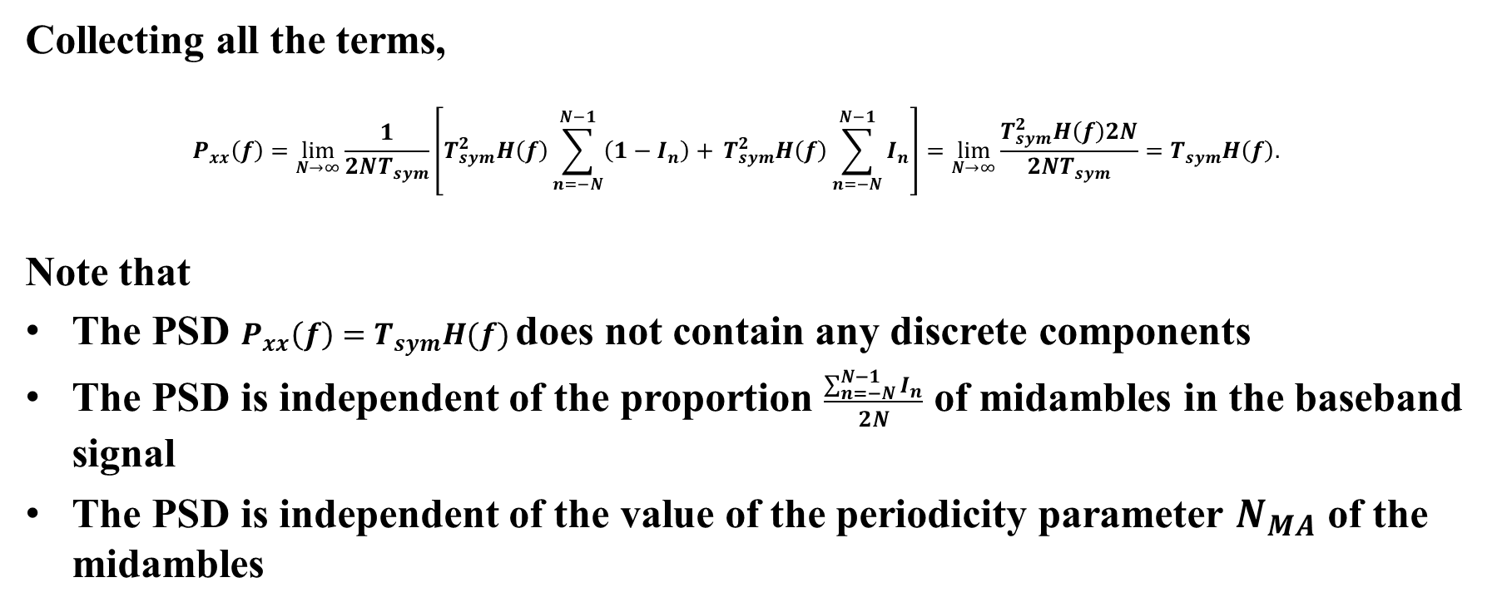
Appendix
Collecting all the terms,
$$P_{xx}\left(f\right)=\lim_{N→∞}{\frac{1}{2NT_{sym}}\left[T_{sym}^{2}H\left(f\right)\sum_{n=−N}^{N−1}{\left(1−I_{n}\right)+ }T_{sym}^{2}H\left(f\right)\sum_{n=−N}^{N−1}{I_{n}}\right]}=\lim_{N→∞}\frac{T_{sym}^{2}H\left(f\right)2N}{2NT_{sym}}=T_{sym}H\left(f\right).$$
Note that
The PSD $P_{xx}\left(f\right)=T_{sym}H(f)$ does not contain any discrete components
The PSD is independent of the proportion $\frac{\sum_{n=−N}^{N−1}{I_{n}}}{2N}$ of midambles in the baseband signal
The PSD is independent of the value of the periodicity parameter $N_{MA}$ of the midambles

