Slide 1
Multiple BSSID Support in Multi-Link Operation
Date: 2020-05-11
Authors:

Slide 2
Recap: Multiple MLDs for a set of links [1]

Slide 3
Multiple AP MLDs Configuration
If the Multiple BSSID Set is configured on more than one link, the multiple AP MLDs can be served on the single physical device.
But, since the Multiple BSSID Set is independently configured on each link,
  The maximum number of BSSIDs in the Multiple BSSID Set can be different.
  The Link on which the Multiple BSSID Set is not configured has single BSSID.

Slide 4
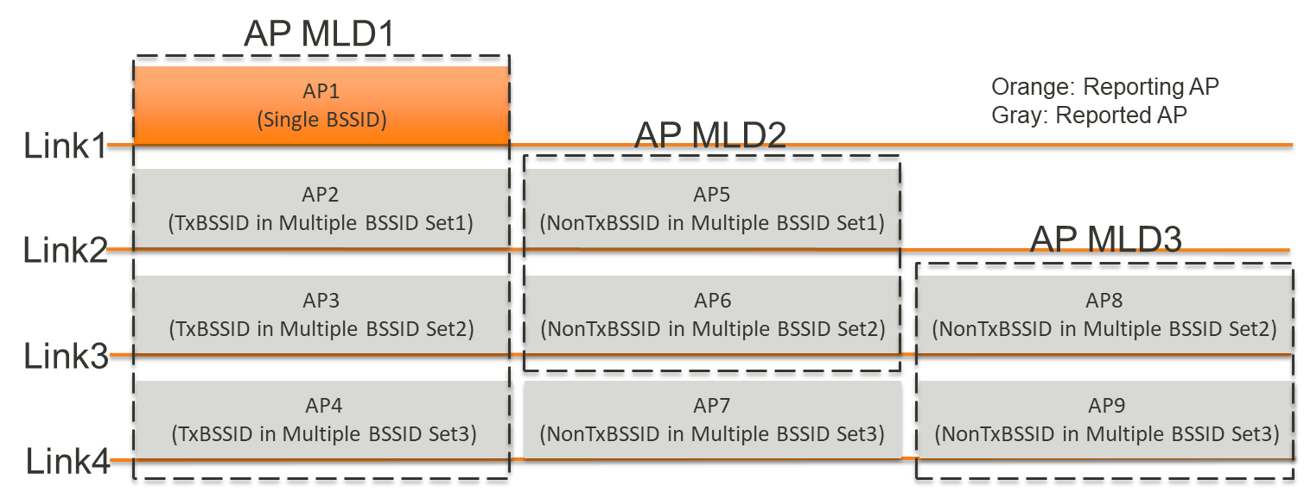
Multiple AP MLDs Configuration
The reporting AP (i.e., AP1) does not configure the Multiple BSSID Set.
  The Multiple BSSID IE is not present in the Beacon or Probe Response frames.

Slide 5
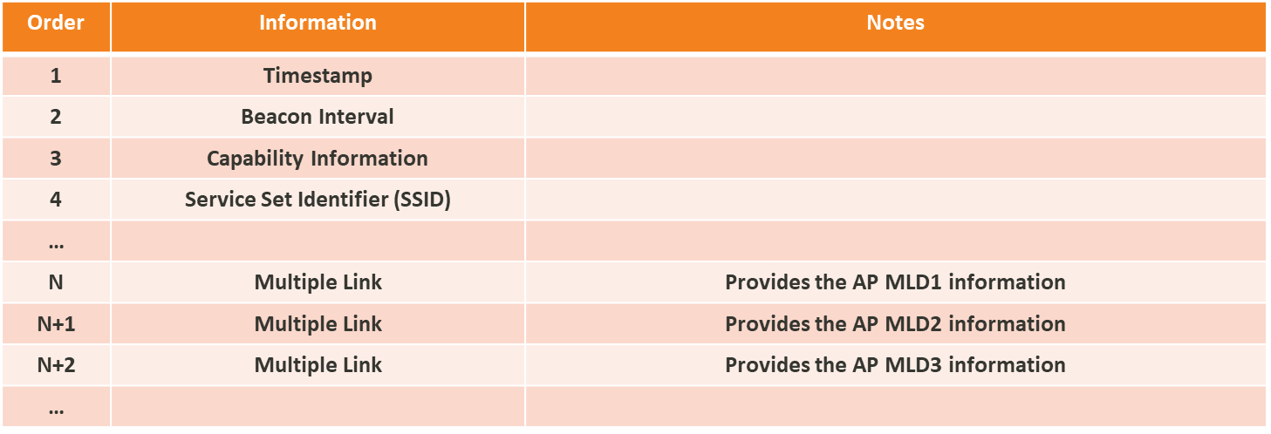
Multiple AP MLDs Configuration
The reporting AP carries in the Beacon or Probe Response frames one or more Multiple Link IEs that provide the information of the reported APs information associated with each AP MLD.

Slide 6
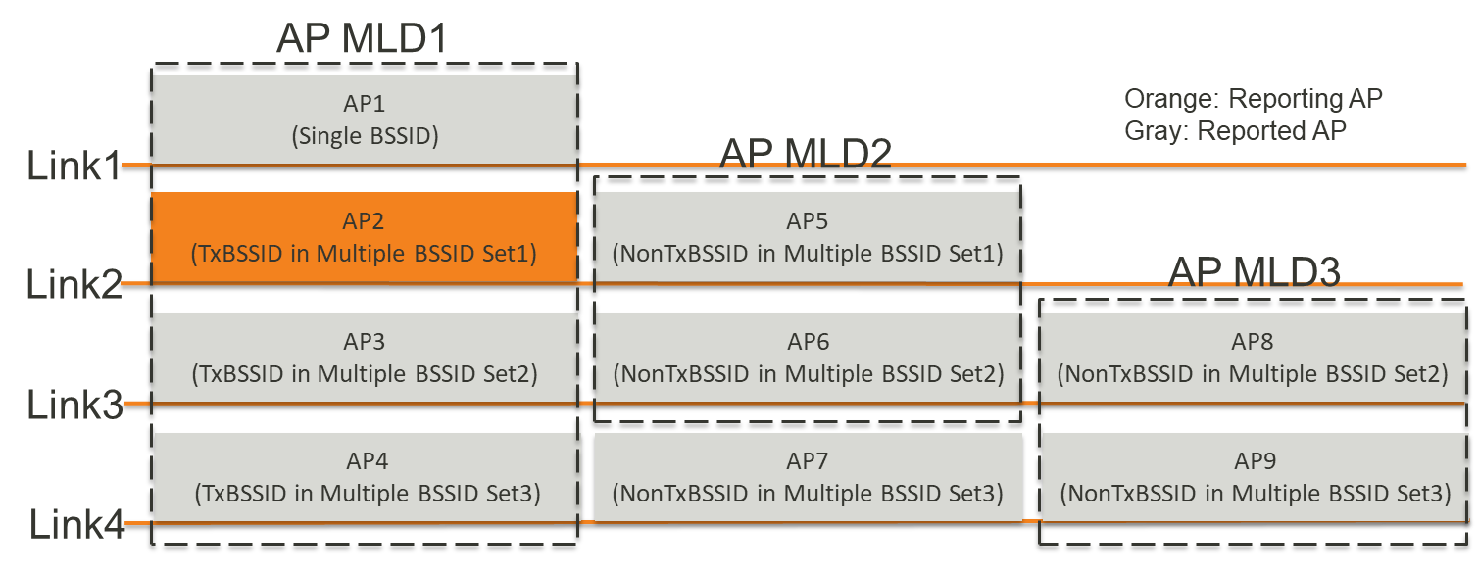
Multiple AP MLDs Configuration
The reporting AP (i.e., AP2) has configured the Multiple BSSID Set but the maximum number of BSSIDs is smaller than that of other link (i.e., Link 3 and Link 4).

Slide 7
Multiple AP MLDs Configuration
In such case, the Multiple BSSID IE is present in the Beacon or Probe Response frames but it can’t provide the AP MLD information (i.e., AP MLD3) which is not covered by the Multiple BSSID Set.
In consequence, the reporting AP should carry in the Beacon or Probe Response frames one or more Multiple Link IEs.

Slide 8
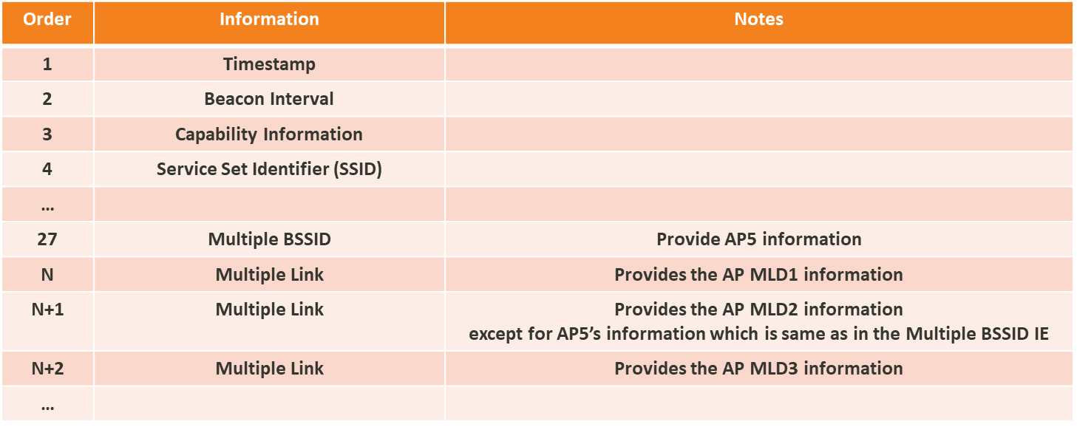
Multiple AP MLDs Configuration
But, the Multiple Link IE should exclude the duplicated information of the AP (i.e., AP5) which is provided by the Multiple BSSID IE.

Slide 9
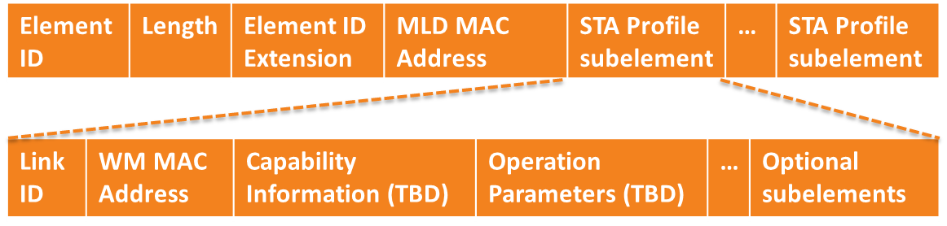
Multiple Link IE
The Multiple Link IE has the MLD information and one or more STA profile subelements.
  The MLD information includes at least the MLD MAC address.
  The STA profile subelement includes at least the Link ID, the WM MAC address, the capabilities and operation parameters, and the Optional subelements.
    The WM MAC address is present when the non-AP MLD transmits the Multiple Link IE. But, it may not be present when the AP MLD transmits the Multiple Link IE

Slide 10
Conclusion
In this contribution, we have discussed how to configure the multiple AP MLDs.
In order to support more general multiple link and multiple BSSIDs environment, the MLD configuration should be designed independent on the Multiple BSSID Set.

Slide 11
References
[1] https://mentor.ieee.org/802.11/dcn/20/11-20-0358-00-00be-multi-bssid-operation-with-mlo.pptx

Slide 12
Straw Poll 1
Do you support that the reporting AP may carry in the Beacon or Probe Response frame a ML element of an AP MLD that has no affiliated AP in the reporting link?

