Slide 1
Group addressed frame transmission in constrained multi-link operation follow-up
Date: 2020-07-04
Authors:

Slide 2
Recap: Constrained Multi-Link Device (MLD)
A constrained MLD is a MLD with which in-device coexistence (IDC) interference occurs when more than one STA within the MLD simultaneously transmits and receives frames on multiple links.
  When simultaneous Tx and Rx occur on 2.4 GHz band and 5 GHz links, the IDC interference is probably negligible.
  But, the IDC interference caused by simultaneous Tx and Rx on 5 GHz band and 6 GHz band links may be significantly worse depending on some implementation factors such as RF filter performance.

Slide 3
Motivation
It is necessary that a constrained MLD avoids simultaneously transmitting and receiving frames on multiple links.
This contribution discusses a group addressed frame transmission and reception for a constrained MLD.

Slide 4
Group addressed frame transmission in constrained multi-link operation
An AP MLD should not cause a STA affiliated to a non-STR non-AP MLD to transmit an MPDU that overlaps with group addressed frames in a constrained link if another STA affiliated to the same non-STR non-AP MLD is expected to be receiving group addressed frames.

Slide 5
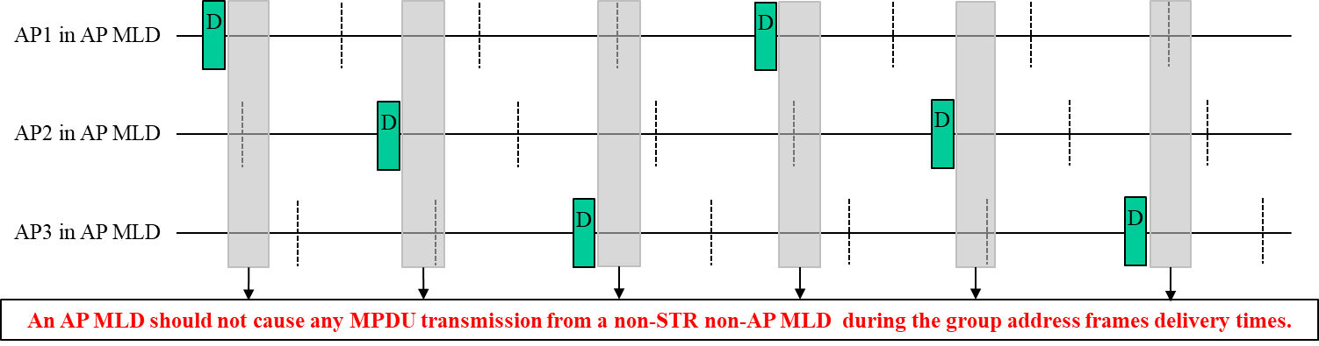
Group addressed frame transmission in constrained multi-link operation
An AP MLD considers that all other STAs affiliated to the same non-STR non-AP MLD may be scheduled to be receiving group addressed frame.
The AP MLD should not schedule any MPDU soliciting a control response frame to the non-STR non-AP MLD during the group address frames delivery times of all APs.

Slide 6
Group addressed frame transmission in constrained multi-link operation
However, if the non-STR non-AP MLD indicates to the AP MLD the STA affiliated to the non-STR non-AP MLD which is scheduled to be receiving group addressed frames,
the AP MLD should not schedule MPDUs to other STAs affiliated to the same non-STR non-AP MLD only during the group address frames delivery times associated with the indicated STA.

Slide 7
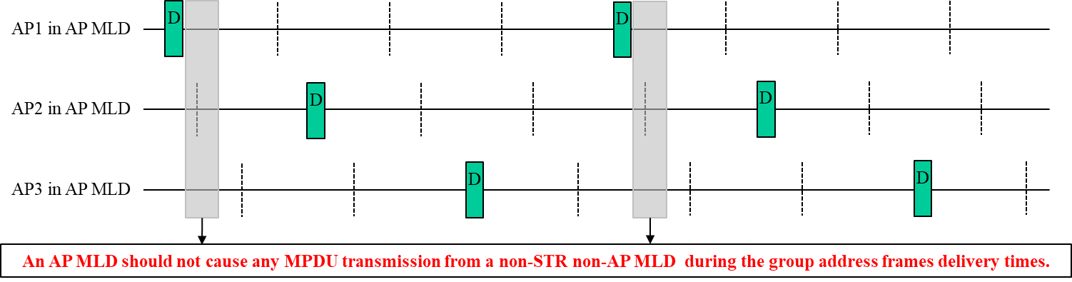
Group addressed frame transmission in constrained multi-link operation
For example, when the non-STR non-AP MLD indicates to the AP MLD that the STA1 associated with the AP1 which is scheduled to be receiving group addressed frames, the AP MLD should not schedule MPDUs to the non-STR non-AP MLD only during the group address frames delivery times of the AP1.

Slide 8
Group addressed frame reception in constrained multi-link operation
Group addressed frame reception in IEEE 802.11
  When dot11SSPNInterfaceActivated is false, the group addressed message shall be distributed into the BSS. Unless the MPDU is delivered via DMS, the STA originating the message receives the message as a group addressed message (prior to any filtering). Therefore, a STA shall filter out group addressed messages that contain their address as the source address. When dot11SSPNInterfaceActivated is false, group addressed MSDUs shall be propagated throughout the ESS.

Slide 9
Group addressed frame reception in constrained multi-link operation
Multi-link group address frame reception
  A STA1 in a STA MLD sends a group addressed MSDU to an AP1 in its associated AP MLD.
  The AP1 and AP2 in the AP MLD broadcasts the group addressed MSDU.
  In such case, the STA1 and STA2 in the STA MLD may receive the group addressed MSDU broadcasted by the AP1 and AP2 respectively.
  Because the group addressed MSDUs received on the STA1 and the STA2 is same as in initially sent by the STA1, both the STA1 and STA2 have to filter out the received group addressed MSDUs.

Slide 10
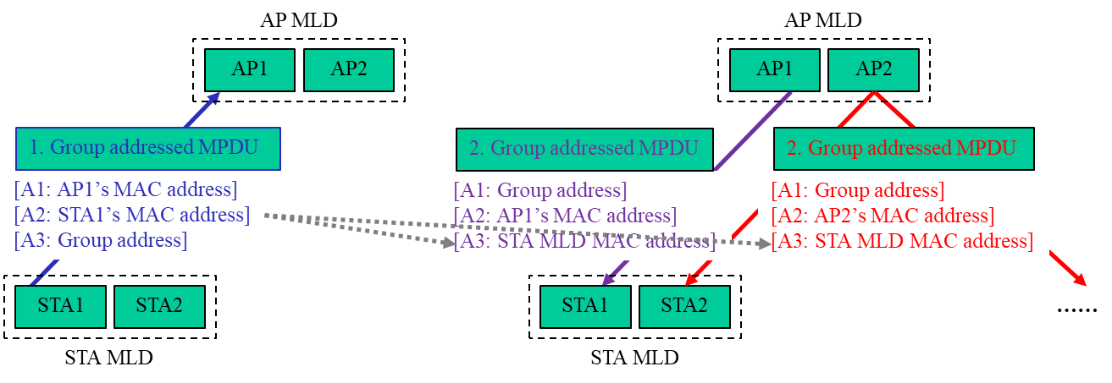
Group addressed frame reception in constrained multi-link operation
Multi-link group address frame reception
  An AP MLD that broadcasts the group addressed MPDU received from a non-AP MLD shall set the SA field of the broadcast group addressed MPDU to the MLD MAC address of the non-AP MLD.
  A non-AP MLD filters out the group addressed MPDU with the SA field set to the MLD MAC address of the non-AP MLD.

Slide 11
Conclusion
For a reliable group addressed frame transmission to a constrained MLD,
  The constrained non-AP MLD needs to configure to the AP MLD the link(s) on which it is listening the group addressed frame.
  The AP MLD should not schedule to the non-AP MLD a frame exchange sequence which overlaps with the group addressed frame of the configured link(s).

Slide 12
Straw Poll 1
Do you support the following group addressed frames delivery mechanism?
  An AP MLD should not cause a STA affiliated to a non-STR non-AP MLD to transmit an MPDU that overlaps with group addressed frames in a constrained link if another STA affiliated to the same non-STR non-AP MLD is expected to be receiving group addressed frames.
  A non-STR non-AP MLD may indicate to the AP MLD with which it has performed Multi-link setup the STA affiliated to the non-STR non-AP MLD which is scheduled to be receiving group addressed frames; otherwise an AP MLD considers that all other STAs affiliated to the same non-STR non-AP MLD may be scheduled to be receiving group addressed frame.

Slide 13
Straw Poll 2
Do you support the following loopback prevention mechanism of the group address frame in the MLO?
  An AP MLD that broadcasts the group addressed MPDU received from a non-AP MLD with which it has done multi-link setup shall set the SA field of the broadcast group addressed MPDU to the MLD MAC address of the non-AP MLD.
  A non-AP MLD filters out the group addressed MPDU with the SA field set to the MLD MAC address of the non-AP MLD.

