Slide 1
MLD Transition
Date: 2020-04-18
Authors:
Name | Affiliations | Address | Phone | Email
Po-Kai Huang | Intel
Ouzieli Ido
Ouzieli Ido
Robert Stacey
Laurent Cariou
Bravo Daniel
Arik Klein
Ofer Schreiber
Alexander Danny
Notes:
September 2012

Slide 2
Background
Current spec define BSS transition as follows:
  BSS-transition: This type is defined as a STA movement from one BSS in one ESS to another BSS within the same ESS.
  Fast BSS transition: A fast BSS transition is a BSS transition that establishes the state necessary for data connectivity before the reassociation rather than after the reassociation.
  An ESS is the union of the infrastructure BSSs with the same SSID connected by a DS.
The goal of this presentation is to expand above concept to MLD

Slide 3
Illustration
ESS
AP 1
AP 2
AP 3
Multi-link (re)setup
association
(re)association
BSS transition
BSS transition
Non-AP
Non-AP
Non-AP
Enhancement
BSS transition
ESS
AP MLD 1
AP MLD 2
MLD transition
AP 1.1
AP 1.2
AP 2.1
AP 2.2
AP 3
Multi-link setup
MLD transition
MLD transition
Non-AP 1.1
Non-AP 1.2
Non-AP 1.1
Non-AP 1.2
Non-AP
Non-AP MLD 1
Non-AP MLD 1

Slide 4
MLD transition
Define AP MLD in an ESS as follows:
  An AP MLD is in one ESS if the SSID of the AP MLD is the same as the SSID of the ESS.
Define MLD transition as follows:
  A non-AP MLD movement from having multi-link setup with one AP MLD in one ESS to having multi-link setup with another AP MLD within the same ESS.
  A non-AP MLD movement from having multi-link setup with one AP MLD in one ESS to become a non-AP STA having association with another AP within the same ESS.
  A non-AP STA movement from a non-AP STA having association with one AP in one ESS to become a non-AP MLD having multi-link setup with another AP MLD with the same ESS.
Define fast MLD transition as follows:
  A MLD transition that establishes the state necessary for data connectivity before the multi-link resetup or reassociation rather than after the multi-link resetup or reassociation.

Slide 5
Change Required for MLD Transition
Between two AP MLDs, multi-link resetup takes care of the design
Between AP MLD and legacy AP, need to have non-AP MLD MAC address same as the non-AP STA MAC address connects to the BSS of the legacy AP.
  Essentially, we have DS mapping changes from (AP MLD 2, Non-AP MLD1) to (AP3, non-AP 1)
  MAC address of Non-AP MLD1 equal to MAC address of non-AP 1 provides roaming behavior with relation of two connections
  If MAC address of Non-AP MLD1 is not equal to MAC address of non-AP 1, then the two connections are viewed as independent connections in the current spec
AP MLD 2
ESS
(AP MLD 2, non-AP MLD1)
Multi-link (re)setup
AP 2.1
AP 2.2
AP 3
DS mapping
Same MAC address
(re)association
MLD transition
(AP 3, non-AP 1)
Non-AP 1.1
Non-AP 1.2
Non-AP 1
Non-AP MLD 1 MAC address is the same as the non-AP 1 MAC address.
Non-AP MLD 1

Slide 6
Change for fast MLD Transition
We think that the current fast BSS transition signaling (FT) can be reused and expanded to fast MLD transition, we will focus on the following to illustrate the design
  FT initial mobility domain operation in an RSN
  over-the-air FT operation in an RSN

Slide 7
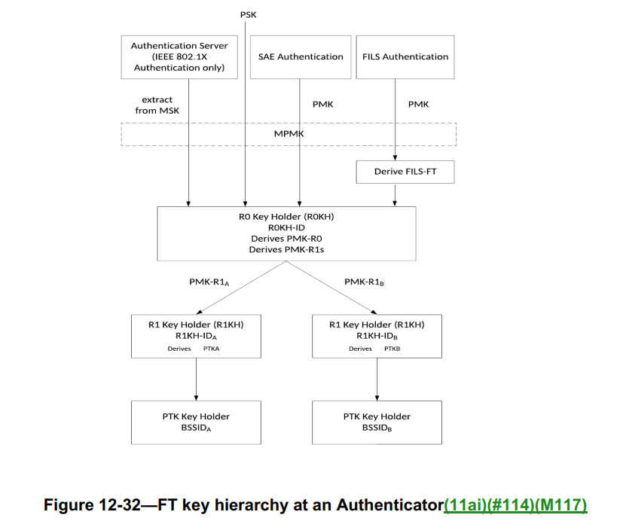
First Step: Extend FT Key Hierarchy to MLD
FT initial mobility domain
AP MLD
R0KH
R1KH
PMK-R0
PMK-R1
PTK
FT initial mobility domain AP MLD
FT initial mobility domain
Non-AP MLD
S0KH
S1KH
Target AP MLD
Target AP MLD
R1KH
PTK
Non-AP MLD
S1KH

Slide 8
Proposed Spec Change
For a non-AP MLD and an AP MLD in a FT initial mobility domain operation, use non-AP MLD address as S1KH-ID and S0KH-ID and AP MLD address as R1KH-ID.
For a non-AP MLD and a target AP MLD in an over-the-air FT operation, use non-AP MLD address as S1KH-ID and AP MLD address as R1KH-ID.

Slide 9
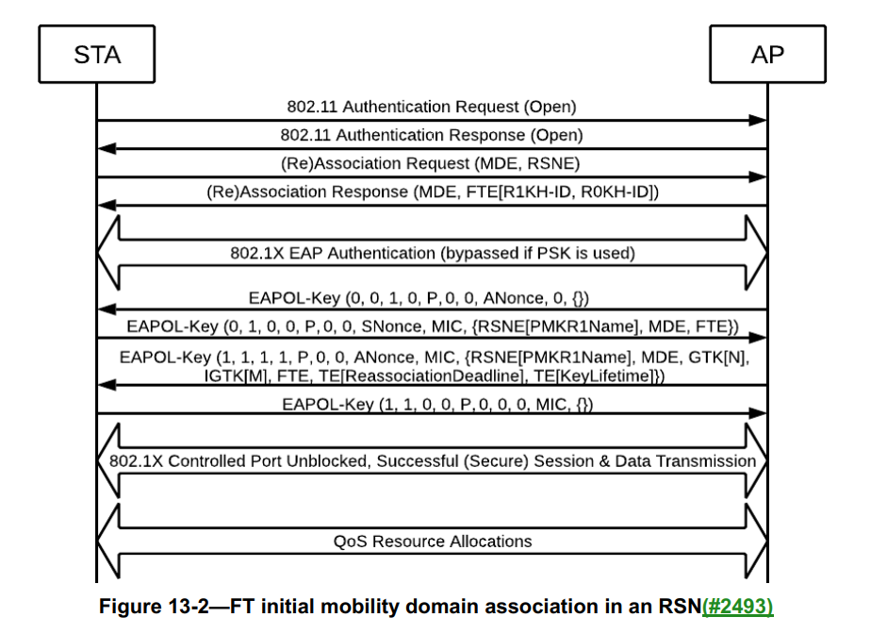
Second Step: Change for FT initial mobility domain Setup in an RSN Sequence
Need non-AP MLD address and AP MLD address to calculate PMKID, PTK, PTKName
  MLD address can be exchanged in Authentication request/response and association request/response
Delivery GTK, IGTK, BIGTK in different links in FT 4-way handshake
Non-AP MLD
AP MLD
Multi-link
Element
Multi-link
Element
R0KH:
PMK-R0
PMK-R0 Name
PMK-R1
S0KH
S1KH
R1KH: PMK-R1
PTK
Need to provide GTK/IGTK/BIGTK of different links here.

Slide 10
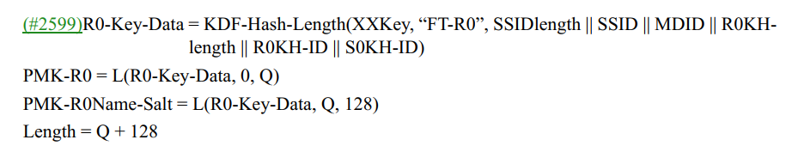
Computation of PMK-R0, PMK-R0Name, and PMK-R1
Non-AP MLD address
AP MLD address
Non-AP MLD address

Slide 11
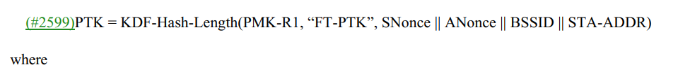
Computation of PMKR1Name, PMKID, PTK, PTKName
AP MLD address
Non-AP MLD address
AP MLD address
Non-AP MLD address
Non-AP MLD address
AP MLD address

Slide 12
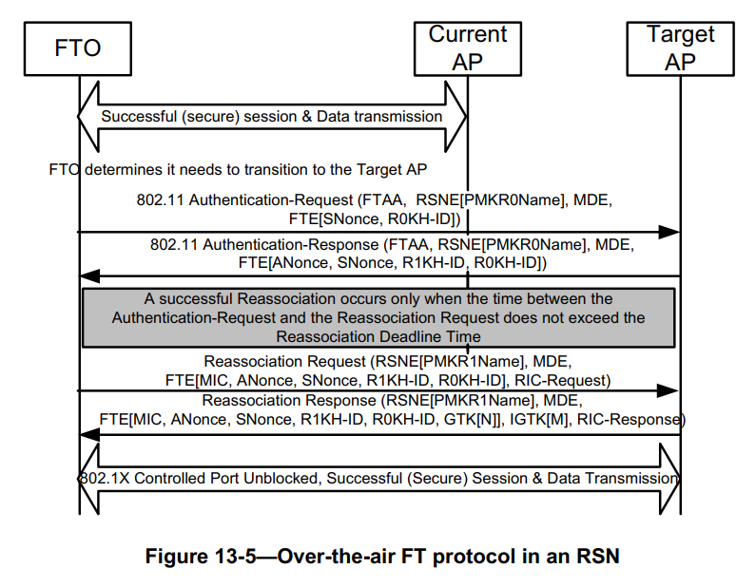
Third Step: Change for over-the-air FT protocol authentication in an RSN
Need non-AP MLD address and AP MLD address to calculate PMKID, PTK, PTKName
  MLD address can be exchanged in Authentication request/response and association request/response
Deliver GTK/IGTK/BIGTK in FTE
Current AP MLD
Target AP MLD
R1KH:
PMKR1Name
-------------------
PTK
PTKName
Multi-link
Element (short)
PTK
PTKName
Multi-link
Element
Need to provide GTK/IGTK/BIGTK of different links here.

Slide 13
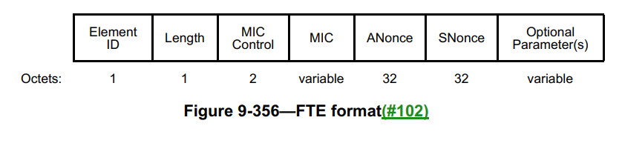
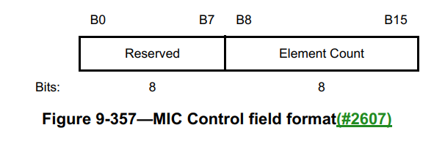
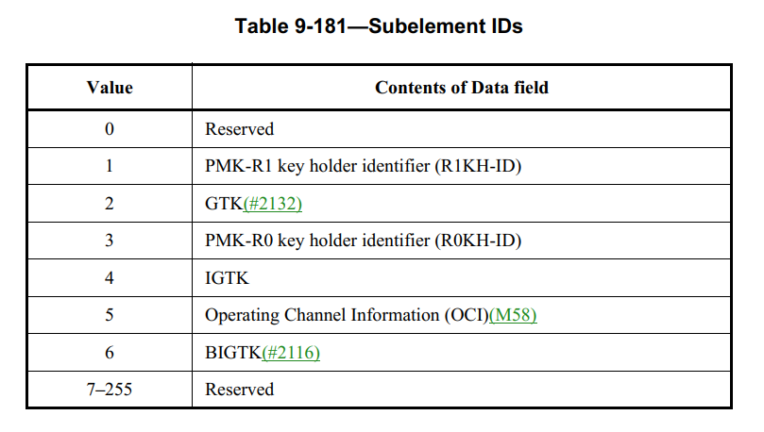
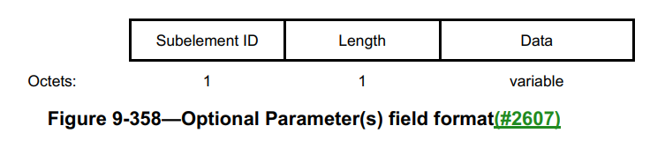
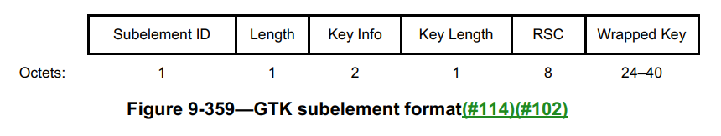
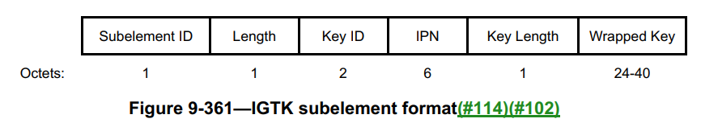
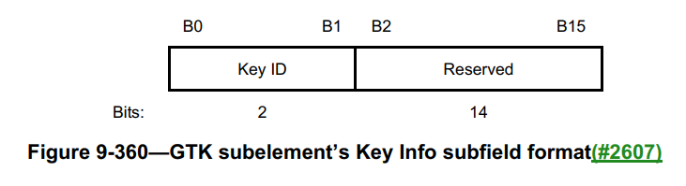
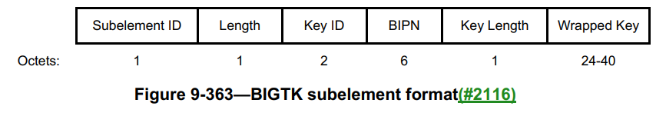
FTE
Have multiple multi-link GTK/IGTK/BIGTK subelement

Slide 14
Extension to other procedures
Following similar design philosophy, we can extend MLD transition to the following:
  Over-the-DS FT protocol
    Clarify STA Address field in FT action frame is the MLD address if roaming to an AP MLD
    Clarify Target AP address field in FT action frame is the AP MLD address if roaming to an AP MLD
  FILS authentication
    Clarify this is done between two MLDs
    Deliver GTK/IGTK/BIGTK of different links in a Key Delivery element of (Re)Association response frame.

Slide 15
Conclusion
We discuss how to expand BSS transition concept to MLD transition in this presentation
We demonstrate that by considering the transition in MLD level and use MLD MAC address, all the existing FT signaling can be reused with the additional multi-link information
For MLD transition involves a legacy AP and a AP MLD, the non-AP MLD that has multi-link (re)setup with the AP MLD has non-AP MLD MAC address equal to MAC address of the non-AP STA that has (re)association with the legacy AP

Slide 16
Straw Poll #1
Do you support the following?
  After a successful multi-link (re)setup between a non-AP MLD and an AP MLD, the non-AP MLD is in associated state and is (re)associated with the AP MLD, and the non-AP MLD to the AP MLD mapping is provided to the DS by the AP MLD
    For each setup link, the corresponding non-AP STA affiliated with the non-AP MLD is in the same associated state as the non-AP MLD and is associated with the corresponding AP affiliated with the AP MLD, without providing the corresponding non-AP STA to the corresponding AP mapping to the DS, and enables the functionalities between a non-AP STA and its associated AP unless the functionalities have been extended to MLD level and specified otherwise.
  After a successful multi-link tear down between a non-AP MLD and an AP MLD, the non-AP MLD is in unassociated state and is disassociated with the AP MLD
    All the non-AP STAs affiliated with the non-AP MLD are in the unassociated state
  NOTE - A non-AP MLD needs to perform successful multi-link (re)setup with AP MLD before the non-AP MLD is allowed to send/receive MSDU(s) via the AP MLD to the DS

Slide 17
Straw Poll #2
Do you support to add the following in 11be SFD in R1:
Define ML transition* as follows:
  A non-AP MLD movement from being associated with one AP MLD in one ESS to be reassociated with another AP MLD within the same ESS.
  A non-AP MLD movement from being associated with one AP MLD in one ESS to become a non-AP STA that is reassociated with an AP within the same ESS.
  A non-AP STA movement from being associated with one AP in one ESS to become a non-AP MLD that is reassociated with an AP MLD with the same ESS.
Define fast ML transition* as follows:
  A ML transition* that establishes the state necessary for data connectivity before the reassociation rather than after the reassociation.
Note* – the name can be changed

Slide 18
Straw Poll #3
Do you support to reuse existing frame exchange of over-the-air fast BSS transition (FT) for fast ML transition in R1?

Slide 19
Straw Poll #4
Do you support the following in R1?
  For a non-AP MLD and an AP MLD in a FT initial mobility domain operation, use non-AP MLD address as S1KH-ID and S0KH-ID and AP MLD address as R1KH-ID. Use AP MLD address and non-AP MLD address to compute PMKID, PTK, and PTKName
  For a non-AP MLD and a target AP MLD in an over-the-air FT operation, use non-AP MLD address as S1KH-ID and AP MLD address as R1KH-ID. Use AP MLD address and non-AP MLD address to compute PMKID, PTK, and PTKName

Slide 20
Straw Poll #5
Do you support the following in R1?
  For a non-AP MLD and an AP MLD in a FT initial mobility domain operation, deliver different GTK/IGTK/BIGTK of different setup links in one FT 4-way handshake
  For a non-AP MLD and a target AP MLD in an over-the-air FT operation, deliver different GTK/IGTK/BIGTK of different setup links in FTE of reassociation response of the over-the-air FT protocol

Slide 21
Straw Poll #6
Do you support that in R1, for an ML transition between a legacy AP and an AP MLD, the non-AP MLD MAC address used by the non-AP MLD for (re)associaiton with the AP MLD shall be equal to the MAC address of the non-AP STA used for (re)association with the legacy AP?
  Note: Tear down of previous association and have a new association is not an ML transition

