Slide 1
80MHz OFDMA Tone Plan
Date: 2020-04-27
Authors:
Name | Affiliations | Address | Phone | email
Ron Porat | Broadcom |  |  | ron.porat@broadcom.com
Teja Bavirisetti | Broadcom
Karim Toussi | Broadcom

Slide 2
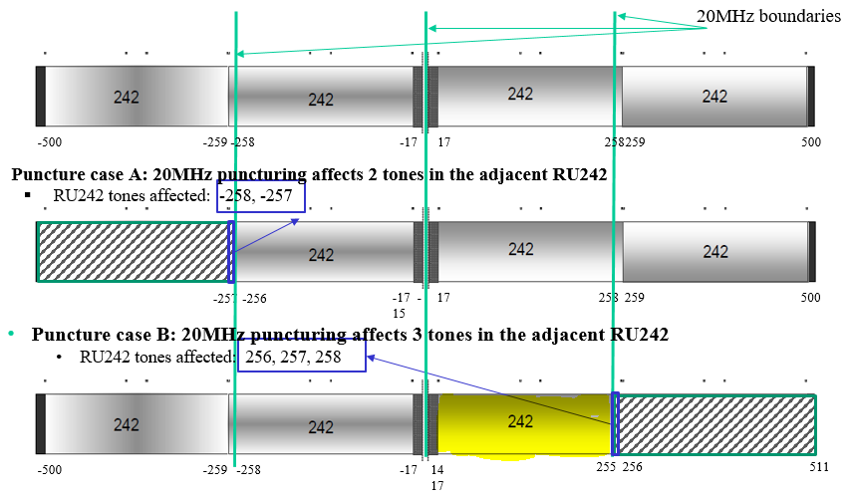
Abstract
The problems of the 11ax OFDMA 80MHz tone plan are well known and presented previously in [1] – inner 242RU tones (and smaller RU at the edge) fall inside the adjacent 20MHz boundary
We propose a very simple modification to the tone plan to solve the issues without the need for any re-design of current RUs (as suggested in [1])

Slide 3
Re-cap of Issues
Meeting spectral masks for punctured 20MHz. In particular we have investigated the requirements for meeting the new ETSI spectral masks that apply to both DL and UL
Meeting spectral masks in UL OFDMA - this was not even considered in 11ax
20-only or 20-operating devices decoding small RUs at the edge of the inner 20MHz or an inner 242RU
Requirement for ED in two 20MHz for TB PPDU RU that fall on the edge of an inner 20MHz. This is different from the behavior in DL-OFDMA → would like UL OFDMA ED to be similar to DL OFDMA which requires ED only in the utilized 20MHz subband

Slide 4
Cont.
Center 26RU in 80MHz -
We find that we don’t use it in DL OFDMA, easier for the scheduler to consider RUs in the four 20MHz subbands
It also requires checking ED in both 20MHz bands in TB PPDU which is highly inconvenient.
In addition in 11ax we already puncture it out any time we puncture the inner 20MHz which means the OFDMA design changes between puncturing and not puncturing which is undesirable
Prefer unified one 80MHz OFDMA plan for all cases

Slide 5
An Example Simulation Result
ETSI masks require meeting a -20dBr point at 1MHz away from the 20MHz channel boundary. ETSI uses 1MHz RBW which makes it more difficult to meet than IEEE requirement that uses 100KHz RBW.
For first 1MHz region can use 99% OBW criterion but -20dBr point is the bottleneck
Typical filters used in spectrum analyzers will capture the desired signal energy (1MHz is only 3dB BW) and will require puncturing of the signal to meet -20dBr point.
We have done many simulations with various configurations, channels and rates and provide here an example for the performance of an inner 242RU with the required puncturing needed to meet the spectral mask in the adjacent outer punctured 20MHz channel

Slide 6
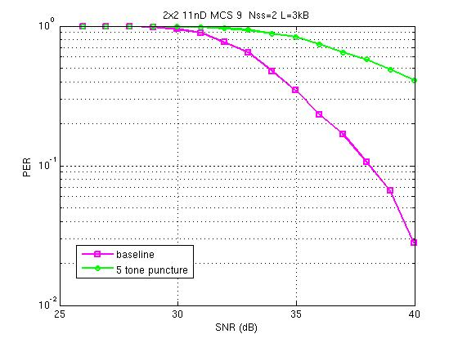
Cont.
In this particular example the loss is too high for the 242RU to be used in this configuration.

Slide 7
Proposal for 80MHz OFDMA Tone Plan
Make 80MHz OFDMA tone plan an exact duplicate of the 40MHz OFDMA plan by shifting the 40MHz plan by +/-20MHz to be centered around each 40MHz
This is in the same spirit of making 160, 240 and 320MHz exact duplicate of the 80MHz tone plan
Reminder: 40 MHz tone plan location [-244:-3 3:244]
Proposed 80MHz OFDMA plan: {-256+ [-244:-3 3:244] , 256+ [-244:-3 3:244] } =
[-500:-259, -253:-12, 12:253, 259:500]
Essentially only the red portions and the smaller RU under are shifted relative to 11ax
The 484RU is similarly changed to have 5 empty tones in the middle
80MHz OFDMA = 40MHz DUP , Table 27-8 in 11ax D6 right/left shifted by 256 tones

Slide 8
Cont.
Notes:
The 80MHz OFDMA design applies to any RU<996 for all modes of transmission, SU, DL MU, TB PPDU, with and without puncturing
Non-OFDMA full BW 80MHz segment uses 996RU design
Any punctured 80MHz segment uses the OFDMA tone plan
For each 80MHz segment in 160MHz, 240MHz or 320MHz: if it’s punctured or used for OFDMA the 80MHz OFDMA tone plan is used, if it’s used for non-OFDMA and non-punctured the 996RU tone plan is used

Slide 9
Summary
Proposed an 80MHz OFDMA tone plan to solve the issues of the 11ax 80MHz tone plan without requiring new RU design
The new tone plan requires very minor modification to the 11ax tone plan and ensures better performance and consistency in puncturing and non-puncturing cases.

Slide 10
References
[1] 19/1340r3 Revisiting the 20/40/80 MHz Tone Plan

Slide 11
Straw Poll 1
Do you support the following tone plan for 11be 80MHz OFDMA?
80MHz OFDMA = 40MHz DUP ,Table 27-8 in 11ax D6 right/left shifted by 256 tones
Notes:
The 80MHz OFDMA design applies to any RU<996 for all modes of transmission, SU, DL MU, TB PPDU, with and without puncturing
Non-OFDMA full BW 80MHz segment uses 996RU design
Any punctured 80MHz segment uses the OFDMA tone plan
For each 80MHz segment in 160MHz, 240MHz or 320MHz: if it’s punctured or used for OFDMA the 80MHz OFDMA tone plan is used, if it’s used for non-OFDMA and non-punctured the 996RU tone plan is used

