Slide 1
TDM Multilink Operation
Date: 2020-03-16
Authors:
Name | Affiliations | Address | Phone | Email
Shubhodeep Adhikari | Broadcom |  |  | shubhodeep.adhikari@broadcom.com
Sindhu Verma |  |  |  | sindhu.verma@broadcom.com
Matthew Fischer |  |  |  | matthew.fischer@broadcom.com
Vinko Erceg |  |  |  | vinko.erceg@broadcom.com

Slide 2
Introduction
This presentation discusses scenarios, methods and benefits of a TDM multilink operation instead of conventional multilink.
TDM multilink operation is especially suitable for non-AP STAs
A similar scheme has been discussed in “IEEE 802.11-20/0562r2 Enhanced multi-link single radio operation”

Slide 3
Multi-link and TDM Multi-link
Multi-Link (ML) is a capability where a AP or non-AP can transmit/receive on multiple links.
ML has two variations
  Simultaneous Transmit/Receive (STR): where a device can simultaneously receive/perform CCA on one link while transmitting on the other link.
  Non-Simultaneous Transmit/Receive(non-STR): where a device cannot do the above. Such devices may however be able to simultaneously receive on both links or transmit on both links.
It is expected that APs will be STR while most non-APs will be non-STR. This is because STR requires 2 or more radios with sufficient isolation.
This implies that the realistic performance upper-bound of ML in 11be will be achieved in a network consisting of STR APs connected to non-STR non-APs.
However, such a network still requires non-APs to have multiple radios in order to perform conventional non-STR ML operation (i.e. simultaneous receive or simultaneous transmit capability)
TDM ML is a feature that allows non-APs to attain the performance of non-STR ML without multiple transmit/receive capable radios in 5G/6G.

Slide 4
TDM Multi-link operation
Time Division Multiplexed Multi-Link (TDM ML) is a variation of Multi-link that does not require a non-AP to have two or more transmit/receive capable radios.
Transmission of DL/UL data is limited to one link at a time, with multiple links being used for such transmissions in a TDM manner within the multilink framework.
The link on which transmission of DL/UL data occurs at a given time is referred to as the “operating link” for that time.
In addition to DL/UL data transmission, a “listen” activity is defined where the non-AP monitors one or more links for the start of such a DL/UL transmission. The start can be through an RTS/MU-RTS. The “listen” activity may be supported concurrently on multiple links.
TDM ML operation involves the following:
  Conditions for switching the operating link
  Indication of the new operating link
  Capability and other parameter negotiation for both links depending on the transmitter/receiver capability

Slide 5
Conditions for switching the operating link (1)
The current “operating” link for data transmission (DL/UL) can be chosen by the AP or by the non-AP. The operating link can be chosen based on one or more of the following conditions:
Condition 1 (Dynamic):
  The operating link can be whichever wins channel access earlier
  Also, the AP/non-AP can exchange data for a given TXOP on one link and subsequently exchange data on another TXOP on a different link, based on channel access success on the different links.
Condition 2 (Semi-static):
  Measurements by AP or/and non-AP (through background scanning, etc).
  Operating link can be switched from a “worse” to a “better” one, based on channel quality parameters (estimated data rate, observed error, load balancing, interference etc).

Slide 6
Conditions for switching the operating link (2)
Example 1:
AP sends an RTS or MU-RTS on the better link or the one on which it wins channel access earlier, provided the single radio non-AP can listen on both links
The non-AP responds with a CTS on the chosen link.
Transmission may continue on the chosen link for the current TXOP or may switch to another link.
Example 2
AP may win a TXOP on link1 and exchange data with a single radio non-AP.
Subsequently AP may win a TXOP on link2 even before the end of the TXOP on link1.
AP indicates to STA on link1 to expect DL/UL data on link2 as a part of the TXOP on link2.

Slide 7
Indication of the new operating link
The new operating link for DL/UL can be set using one of the following methods (each method involves a different receiver capability at the non-AP):
Method 1: Explicit indication on the current link
This is the only method possible when the non-AP is capable of listen on only one link at a time
Protocol needs to support indicating a delay to switch links, after which DL/UL can occur on a new link.
Method 2: Implicit indication on the new link
This method can be used if the non-AP supports concurrent listen for the start of initial control message on both links
Optionally the protocol needs to support a delay after which DL/UL data transfer can occur on any link after the start of initial control message.

Slide 8
Capability and other parameter negotiation
The following parameters and capabilities need to be negotiated (in addition to what are necessary for a conventional multi-link framework):
Transmit/Receive/Listen capability of the non-AP
  If listen is supported concurrently on only one link or more than one link
  Optionally a delay for a link to become the operating link upon receiving the initial control message.

Slide 9
Summary of simulation results for TDM ML with listening on 2 links:
80+80 MHz TDM ML vs single link for Best Effort:
  90% BE latency of 80+80 TDM ML is about 50% (140ms) lower than single link.
  If only a single node does 80+80 TDM ML, the 90% BE latency is 60% (170ms) lower than single link. Such a node improves latency without harming the performance of non TDM ML single link nodes.
  80+80 TDM ML matches performance of non-STR ML
80+20 MHz TDM MLvs. 80+80 MHz TDM ML vs Single Link for Best Effort:
  80+20 TDM ML is better than Single link 80% of the time. However, the degradation 20% of the time is only due to the asymmetry in the bandwidth of the links and will also be observed in case of non-STR ML.
  90% BE latency for 80+80 TDM ML is 95% (65ms) lower than 80+20 TDM ML and 85% (25ms) lower than single link.
  80+80 TDM ML matches performance of non-STR (Simultaneous Transmit Receive) ML
80+20 MHz TDM ML vs Single link for Voice:
  90% VO latency for 80+20 TDM ML is about 50% lower in 60% load and 20% lower in 30% load.
80+20 MHz TDM ML vs. Single link for Best Effort:
  90% BE latency for 80+20 TDM ML is about 60% (12ms) lower for 5 Mbps, 30% (6ms) lower for 20 Mbps, worse for 50 Mbps and much worse for 100 Mbps.
  However the degradation for higher loads is only due to the asymmetry in the bandwidth of the links and will also be observed in case of non-STR ML.

Slide 10
Simulation configuration
Variable number of nodes (A node means a transmitter-receiver pair. Multiple nodes are independent BSSs contending for the channel)
Variable number of flows per node
All nodes have the same PHY data rate : ~570Mbps in 5G/80MHz and ~143Mbps in 5G/20MHz (assuming MCS11, NSS1)
No hidden nodes.
In ML mode:
  A flow in a node can use any channel that the node is operating on (akin to Low MAC split)
  On any 80 MHz link, it is assumed that the primary channels are aligned. It is also assumed that PIFS-based multi-channel access is used (i.e. full CCA on primary channel and PIFS CCA on the others) Hence, channel access success implies the acquisition of the entire 80 MHz bandwidth of the link.
For TDM ML, listening operation is on both the links
Maximum aggregation of 64.
RTS/CTS at the beginning of each TXOP
BE packet size:1500 bytes; VO packet size:256 bytes
AC_VO: AIFSN=1, CWmin=3, CWmax=7 ;AC_BE: AIFSN=3, CWmin=15, CWmax=63
10-20 iterations and 5 seconds for each iteration.

Slide 11
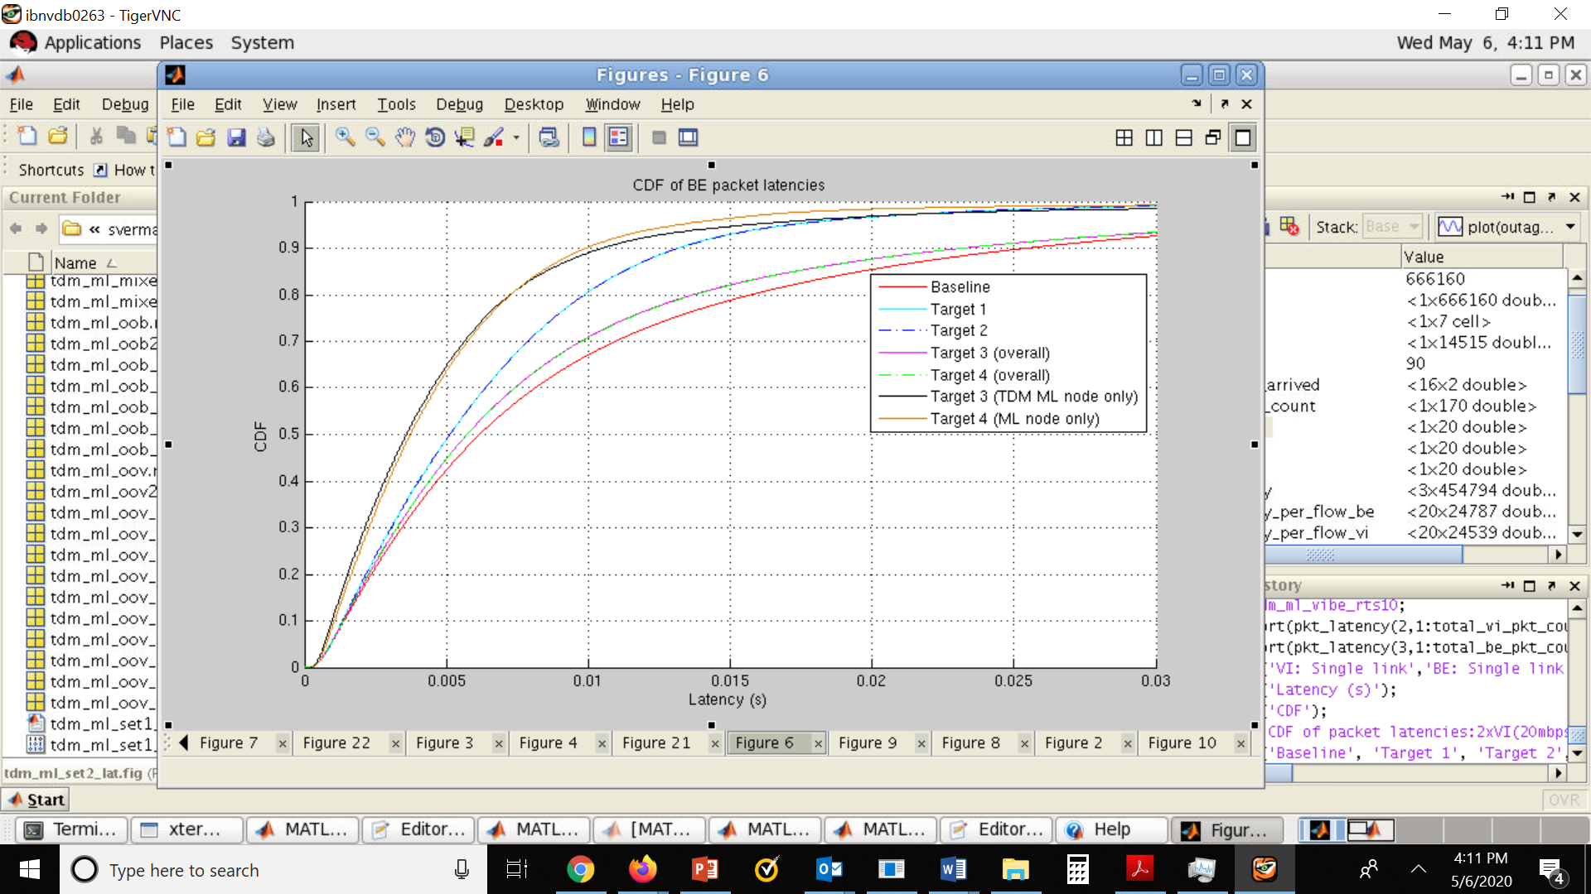
Simulation Results (1)
80+80 MHz TDM ML vs single link for Best Effort
16 nodes. 20mbps x 2 BE flows per node
Baseline: All nodes single-link, 8 each on link1 and link2
Target 1: All nodes TDM multilink, link1: 80 MHz, link2: 80 MHz
Target 2: All nodes non-STR multilink, link 1: 80 MHz, link2: 80 MHz (non-STR multilink is modeled by enabling STR multilink but modeling leakage from one link to the other).
Target 3: Only 1 node TDM multilink with link1: 80 MHz, link2: 80 MHz; 7 nodes on 1st 80 MHz link, other 8 nodes on 2nd 80 MHz link
Target 4: Only 1 node non-STR multilink with link 1: 80 MHz, link2: 80 MHz, 7 on 1st 80 MHz link, other 8 on 2nd 80 MHz link.
Observation:
The 90% BE latency of 80+80 TDM ML is about 50% (140ms) lower than single link.
If only a single node does 80+80 TDM ML, the 90% BE latency is 60% (170ms) lower than single link. Note that such a node improves latency without harming the performance of non TDM ML single link nodes.
80+80 TDM ML matches performance of non-STR ML

Slide 12
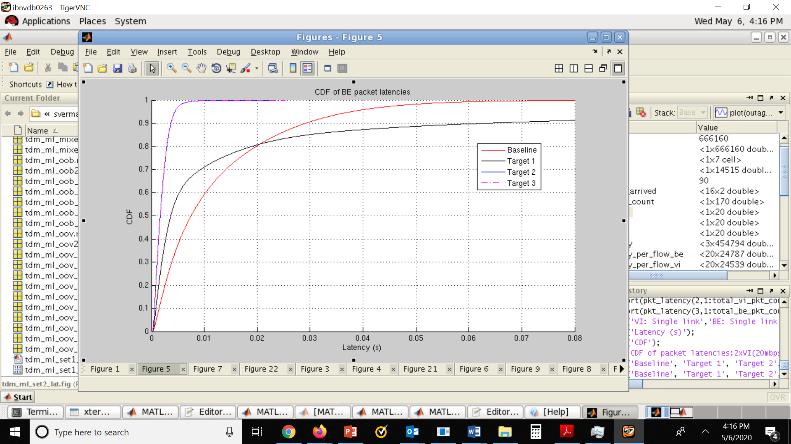
Simulation Results (2)
80+20 MHz TDM ML vs. 80+80 MHz TDM ML vs Single Link for Best Effort
8 nodes. 20mbps x 2 BE flows per node.
Baseline: All nodes single-link on a single 80 MHz link
Target 1: All nodes TDM multilink, link 1: 80 MHz, link2: 20 MHz
Target 2: All nodes TDM multilink, link 1: 80 MHz, link2: 80 MHz
Target 3: All nodes have non-STR multilink, link 1: 80 MHz, link2: 80 MHz (non-STR multilink is modeled by enabling STR multilink but modeling leakage from one link to the other).
Observation:
80+20 TDM ML is better than Single link 80% of the time
The 90% BE latency for 80+80 TDM ML is 95% (65ms) lower than 80+20 TDM ML and 85% (25ms) lower than single link.
80+80 TDM ML matches performance of non-STR (Simultaneous Transmit Receive) ML
Packet latency CDF over all nodes

Slide 13
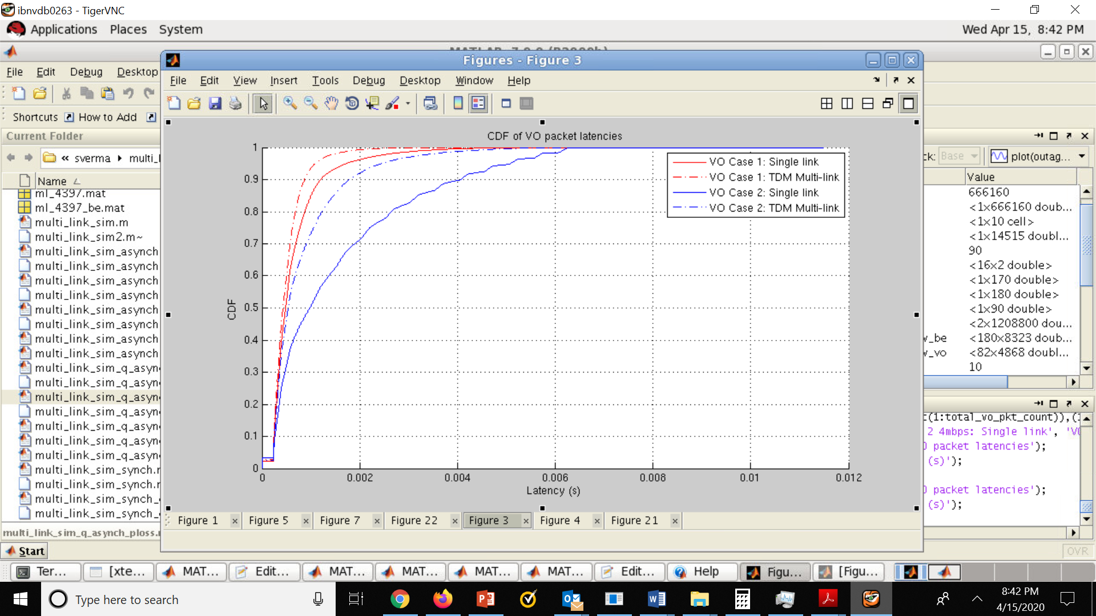
Simulation Results (3)
80+20 MHz TDM ML vs single link for Voice
Case 1: 17 nodes; 16 nodes have BE at 20 mbps x 1 BE flow per node. 1 node has 1 VO flow at 4 mbps. Achieves 30% network load.
Baseline: All single link (80 MHz). 9 nodes (including VO) on 1st 80MHz, 8 nodes on the 2nd 80MHz
Target: Only the VO node does TDM ML (80+20 MHz) while others continue doing single-link
Case 2: Same as case 1, with the difference that there are 2 BE flows per node to achieve 60% network load
Observation: The 90% VO latency for 80+20 TDM ML is about 50% lower in 60% load and 20% lower in 30% load.
Packet latency CDF of the VO node below

Slide 14
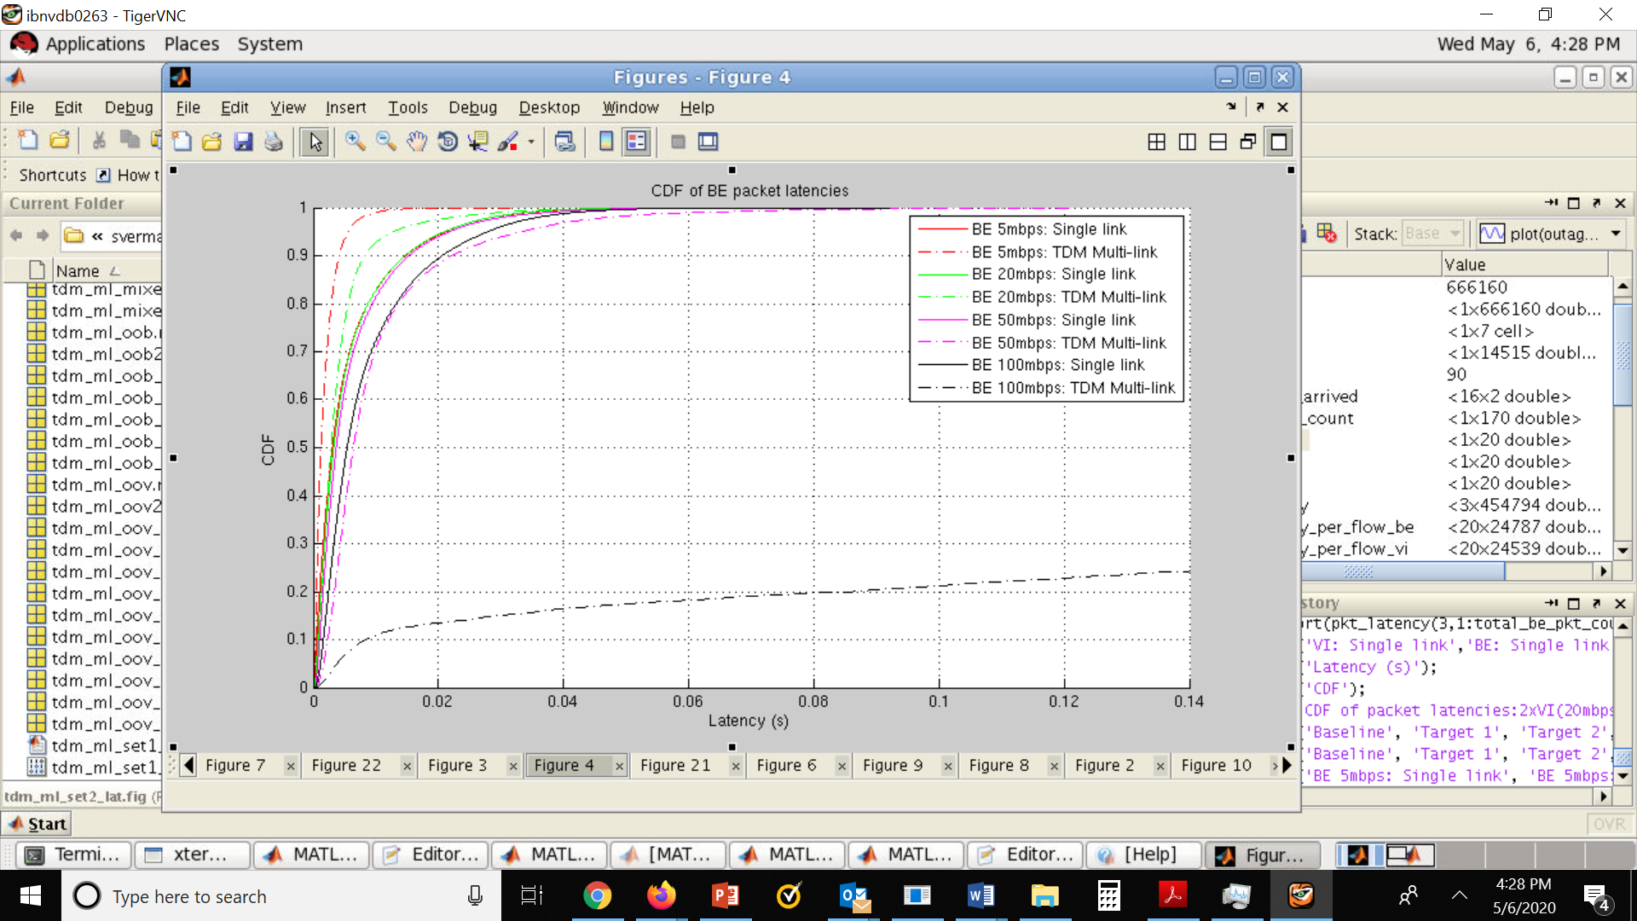
Simulation Results (4)
80+20 MHz TDM ML vs. single link for Best Effort
17 nodes; 16 nodes have BE 20 mbps x 1 BE flow per node. 1 special node has 1 BE flow at 5/10/20/50/100 mbps,
Baseline: All single link (80 MHz), 9 nodes (including the special node) on 1st 80MHz, 8 nodes on the 2nd 80MHz
Target: Only the special node does TDM ML (80+20 MHz) while others continue doing single-link
Observation: The 90% BE latency for 80+20 TDM ML is about 60% (12ms) lower for 5 Mbps, 30% (6ms) lower for 20 Mbps, worse for 50 Mbps and much worse for 100 Mbps.
Packet latency CDF of the special BE node below

Slide 15
Additional requirements at the non-AP and AP due to TDM ML
Non-AP
  Basic premise: “Listen” operation on one or more links which includes CCA as well as receiving initial control messages (e.g., RTS/MU-RTS)
  Switching of the capability to transmit or receive data/management frames from one link to the other based on initial control messages.
AP
  Selection of only 1 link if multiple links win channel access together.
  Transmitting RTS/MU-RTS to the TDM ML non-AP on only one link at a time.
  Note that this is anyway required when the AP is transmitting to a conventional non-STR non-AP, for example in the following cases:
    To ensure time alignment in case channel access is not obtained at the same time on both the links
    Even if channel access is obtained on both links at the same time, there is a single PPDU to transmit or one link is sufficient to transmit all the data and is significantly better than the others, etc)

Slide 16
Conclusions
TDM ML is a useful approach for non-APs that:
  Cannot support simultaneous data transfer on more than one link.
  Fallback to a single radio chain for conserving power.
TDM ML provides better performance than single link. The better performance of TDM ML over single link for throughput and latency are due to the following:
  Selection of the best instantaneous operating link.
  Higher channel access success by utilizing a higher capability STR AP to perform parallel channel access on different links and switching a single-radio non-AP to the TXOPs won by the AP on these different links.
  Performance gain can be explained as in any selection diversity schemes.
The performance of TDM ML matches the performance of conventional ML non-STR non-APs
TDM ML requires low standardization effort, since most of the effort will be rolled up as part of ML standardization.

Slide 17
Straw Poll 1
Do you support the concept of the multi-link operation for an enhanced single-link non-AP MLD that is defined as follows for R1
An MLD that can: 1) transmit or receive data/management frames to another MLD on a single link, and 2) listening on one or more links.
  The “listening” operation includes CCA as well as receiving initial control messages (e.g., RTS/MU-RTS)
  Link switch delay may be indicated by the non-AP MLD
Y/N/A

Slide 18
Straw Poll 2
Do you agree to define limitations for the first frame of a frame exchange sequence when a transmission occurs to a TDM/Single-radio MLD?
The limitations are: spatial stream, MCS, PPDU type, frame type, accounting for link switch delay
Note: Example: only 1 spatial stream, up to MCS 3, transmitted in non-HT PPDU, only supports RTS/MU-RTS
Y/N/A

Slide 19
Straw Poll 3
Do you agree to defining Capability/parameter exchange to enable the above TDM/Single-radio MLD operation and limitations? The exact method is TBD.
Y/N/A

