Slide 1
Consideration on EHT-LTF sequences

Slide 2
Introduction
In 11be SFD, the followings are defined.[1]
802.11be shall include 1/2/4x EHT-LTF.
The 802.11be amendment shall support a preamble puncture mechanism for an EHT PPDU transmitted to a single STA/multiple STAs. Preamble puncturing resolution is 20MHz.
802.11be shall allow more than one RUs to be assigned to a single STA.
Here, we checked that HE-LTF sequences can be reused for EHT-LTF in 20/40/80/160/80+80MHz including the puncturing or large-RU combination cases.
We compared the performance of the LTF PAPRs and data PAPRs.
And we investigated EHT-LTF sequences for 240/320MHz bandwidth based on HE-LTF sequences and also showed the PAPRs in comparison of Data’s PAPRs.

Slide 3
EHT-LTF for ≤160MHz bandwidth
1/2/4x HE-LTF sequences had low PAPRs in all RUs of 11ax (See [2, 3]). But if we reuse the sequences in 11be, we also need to check the PAPRs in small/large RU combinations and puncturing cases[1].
Therefore I showed the PAPRs in each BW including the RU cases:
In 20MHz
26/ 52/ 106/ 52+26/ 106+26/ 242
In 40MHz
Small RUs: 26/ 52/ 106/ 26+52/ 106+26
Large RUs: 242/ 484
In 80MHz
Small RUs: 26/ 52/ 106/ 26+52
Large RUs: 242/ 484/ 996/ 484+242
In 160MHz
Small RUs: 26/ 52/ 106/ 26+52
Large RUs: 242/ 484/ 996/ 2*996/ 484+996/ 242+484+996

Slide 4
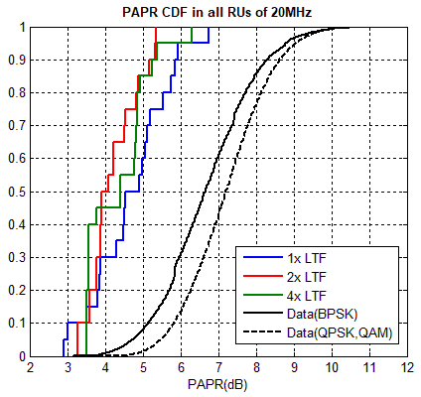
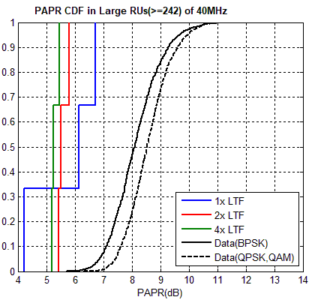
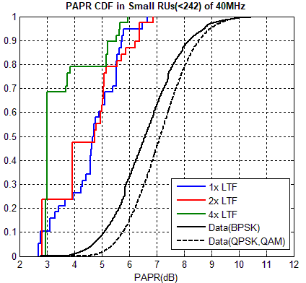
EHT-LTF for 20/40MHz bandwidth (1/2)
There are the results of PAPR CDFs in 20/40MHz.
It’s based on 1 stream, 4 times up-sampling. (it applied in all simulation.)
In 20MHz, we made a graph including all RUs. But over 20MHz, we made two graphs with Small RUs and Large RUs to show the details.
Most PAPRs of 1/2/4x HE-LTF are lower than median data’s PAPRs except some PAPRs in Small RUs. So we showed the detail PAPRs per RU in the next slide for analysis.

Slide 5
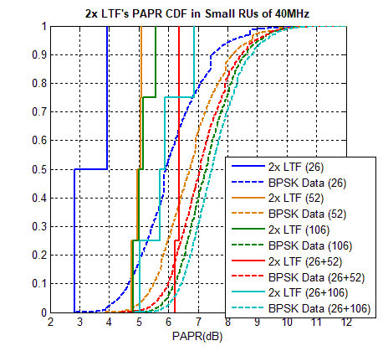
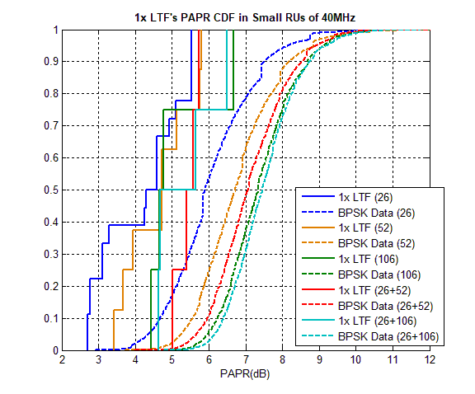
EHT-LTF for 20/40MHz bandwidth (2/2)
Here are 1/2x LTF’s PAPRs in each RU cases because the LTFs have somewhat high PAPRs.
But all LTF’s PAPRs don’t exceed the median PAPRs of BPSK data in each RU cases.
So we can reuse the HE-LTF sequences for EHT-LTF in 20/40MHz.

Slide 6
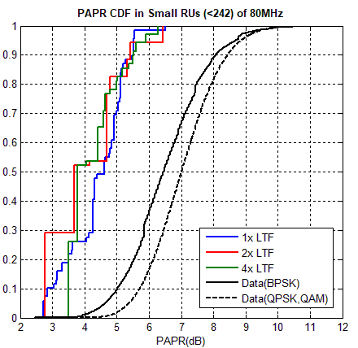
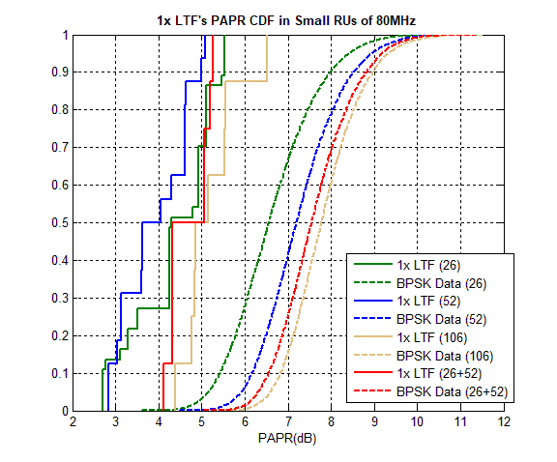
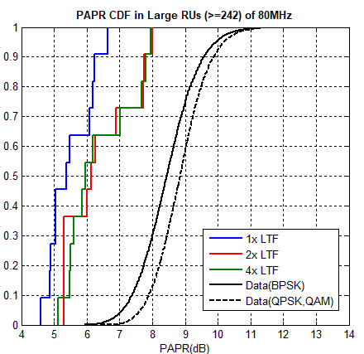
EHT-LTF for 80MHz bandwidth
There are the results of PAPR CDFs in 80MHz.
Most PAPRs are lower than median data PAPRs. 1x LTF seems to have slightly high PAPRs in Small RUs of 80MHz, but all PAPRs of 1x LTFs are lower than median BPSK’s PAPR as you can see the detail graphs per RU.
So we can reuse 80MHz HE-LTF sequences for EHT-LTF in 80MHz.

Slide 7
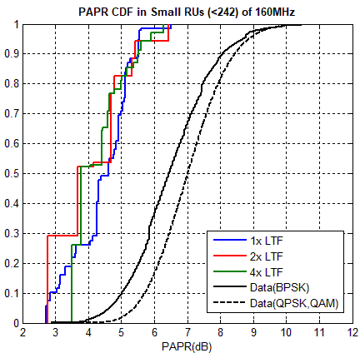
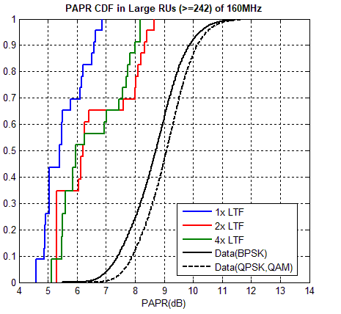
EHT-LTF for 160MHz bandwidth
In 160MHz, All PAPRs are lower than median data’s PAPRs.
The results are similar in 80+80MHz. (See Appendix)
So we can reuse HE-LTF in 160MHz.

Slide 8
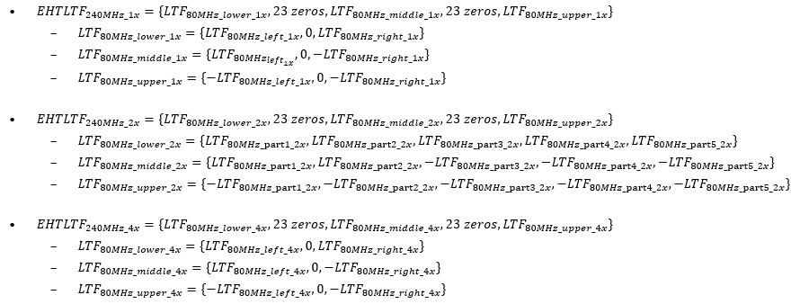
EHT-LTF for >160MHz bandwidth (1/2)
We fully searched 240/320MHz EHT-LTF sequences by changing the signs of each 80MHz_left/right in 1/4x HE-LTF sequences and 80MHz_part1/2/3/4/5 in 2x HE LTF sequences.
And we picked the sequences with good PAPRs in not only full bandwidth but also all (M-)RU and punctured cases.
240MHz EHT-LTF sequences

Slide 9
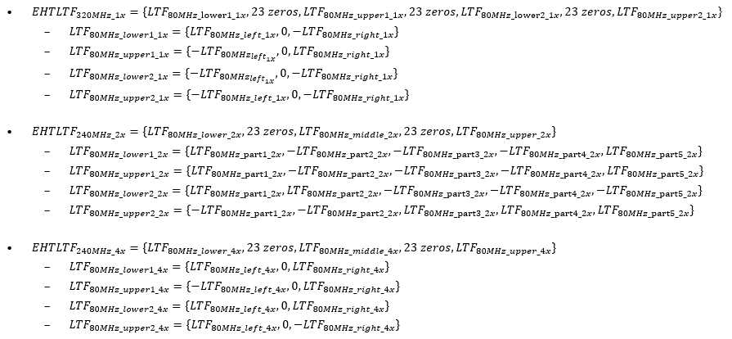
EHT-LTF for >160MHz bandwidth (2/2)
320MHz EHT-LTF sequences

Slide 10
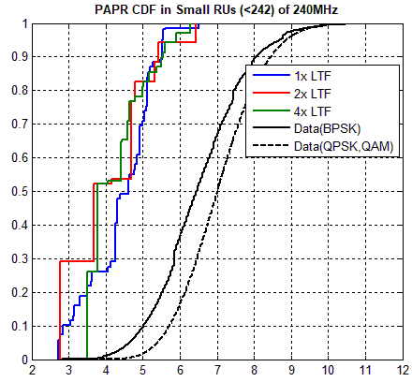
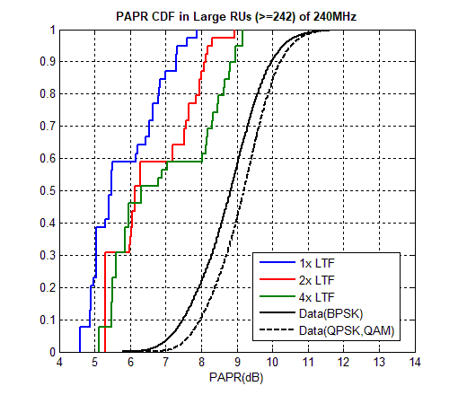
EHT-LTF for 240MHz bandwidth (1/2)
Here we shows the PAPR CDFs in all RU cases of 240MHz
Small RUs: 26/52/106/26+52 ➔ It looks okay.
Large RUs: 242/484/996/3*996/2*996/2*996+484/ 996+484 in a continuous 160MHz
➔ most PAPRs are lower than median Data’s except some PAPRs of 2/4x LTF in Large RU. But the PAPRs are in median BPSK’s PAPR in each Large RUs as the results in the next slide.
So we may use the 1/2/4x LTF sequences for EHT-LTF.

Slide 11
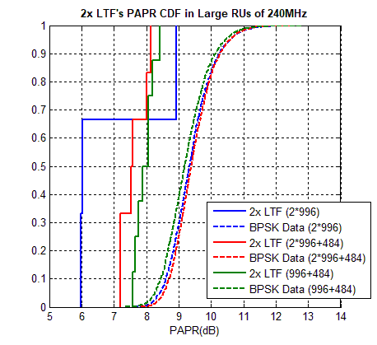
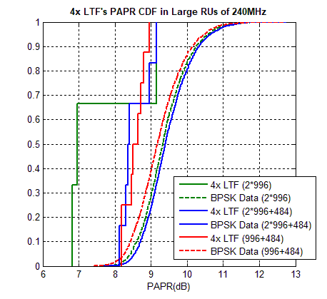
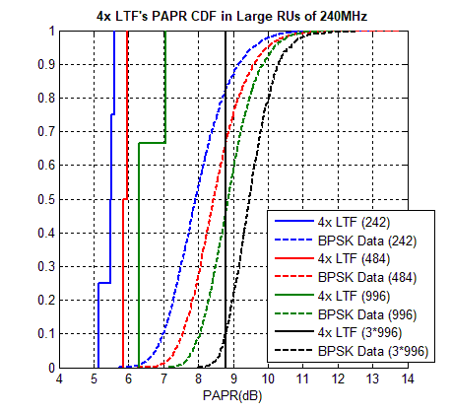
EHT-LTF for 240MHz bandwidth (2/2)

Slide 12
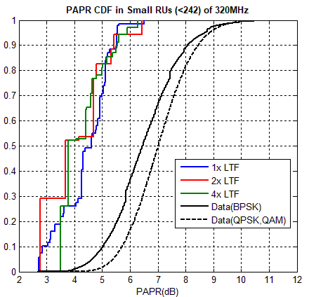
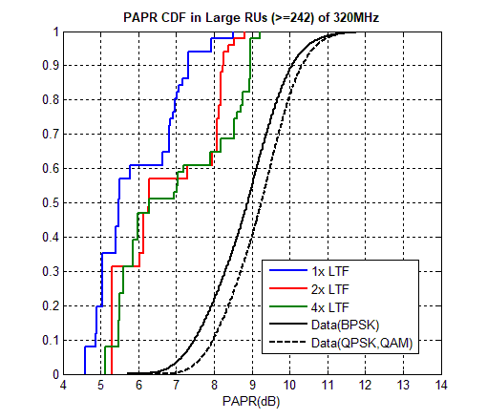
EHT-LTF for 320MHz bandwidth (1/2)
There are PAPR CDFs in all cases of 320MHz.
Small RUs: 26/52/106/26+52. ➔ It looks okay.
Large RUs: 242/484/996/2*996/4*996/3*996/ 3*996+484/ 484+996 in a continuous 160MHz. ➔ The trends are similar with 240MHz cases. The detail results of 4x LTF are in the next slide.
So we may use the 1/2/4x LTF sequences for EHT-LTF.

Slide 13
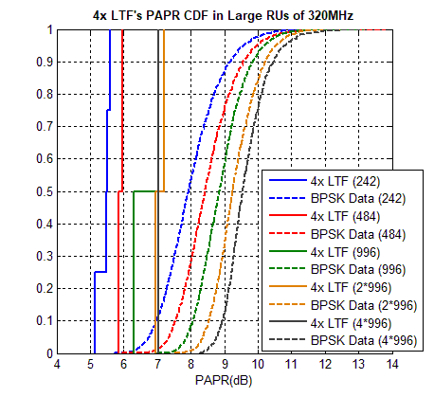
EHT-LTF for 320MHz bandwidth (2/2)

Slide 14
Conclusion
Here, we checked whether HE-LTF sequences are suitable for EHT-LTFs in 20/40/80/80+80/160MHz bandwidth.
HE-LTF sequences have lower PAPRs than median Data’s PAPR in all RU cases.
Therefore we can reuse the sequences for EHT-LTF within 160MHz.
And we tried to make EHT-LTF based on HE-LTF and checked the PAPRs in 240/320MHz, basically considering least change from 11ax.
The suggested 1/2/4x LTF sequences are made by changing the signs of each 80MHz_left/right or 80MHz_part1/2/3/4/5.
The suggested LTF sequences have lower PAPRs than median Data’s PAPR in all RU cases.
Therefore we suggest to use the sequences for EHT-LTFs in over 160MHz.

Slide 15
Appendix
PAPR CDF in Large RUs of 80+80MHz

Slide 16
Straw poll 1
Do you support to reuse 1/2/4x HE-LTF sequences for 1/2/4x EHT-LTF sequences in 20/40/80MHz?
Y/N/Abs

Slide 17
Straw poll 2
Do you support to reuse 1/2/4x HE-LTF sequences for 1/2/4x EHT-LTF sequences in 80+80/160MHz?
Y/N/Abs

Slide 18
Straw poll 3
Do you support to use a unified sequence for each 1/2/4x EHT-LTF in full bandwidth transmission as well as preamble punctured or RU aggregated transmission in each 20/40/80/80+80/160/240/320MHz?
Y/N/Abs

Slide 19
Straw poll 4
Do you support to use the 1/2/4x EHT-LTF sequences of slide 8 and 9 in 240/320MHz?
Y/N/Abs

Slide 20
References
[1] 802.11-19/1262r8, “Specification Framework for TGbe”
[2] 802.11-15/1334r1, “HE-LTF Sequence Design”
[3] 802.11-16/0052r0, “Remaining HE-LTF Sequence Design”

