Slide 1
New Parser Discussion in 11be
Date: 2020-04-09
Authors:
Name | Affiliations | Address | Phone | email
Dandan Liang | Huawei Technologies | Shenzhen |  | dandan.liang@Huawei.com
Gan Ming
Mengshi Hu
Jian Yu
Wei Lin
Chenchen Liu
David Yang
Yan Xin
Junghoon Suh

Slide 2
Abstract
In this contribution, we discuss the parser definition in 11be and propose proportional round robin RU parser for 11be.

Slide 3
Introduction
Segment Parsing methods for 11be has been proposed by the following contributions:
  [1] “Thoughts on RU Aggregation and Interleaving”, IEEE 802.11-20/0394r0, Lin Yang, et al.
  [2] “Segment Parser and Tone Interleaver for 11be”, IEEE 802.11-20/0440r1, Jianhan Liu, et al.
  [3] “Discussions on Multi RU aggregation”, IEEE 802.11-20/0495r1, Tianyu Wu.
  [4] “Segment parsing for punctured transmissions”, IEEE 802.11-20/0478r0, Sigurd Schelstraete, et al.
  [5] “Update on segment parser and tone interleaver for 11be”, Jianhan Liu, et al.
  Based on a SP in PHY session, proportional round robin parsing is the most favorable solution.
  Doubt the benefit of: joint tone mapper for the aggregated RU242+484.
      The RU/Segment Parser [1-5] is not the same segment parser as 11ac/ax, because the number of parser output branches is larger than 2 [eg:4 branches for RU484+3*RU996].
      Almost the same performance with joint and separated tone mapper for RU242+RU484.
      New RU/Segment parser with new joint tone mapper for RU242+484, which requires to design both new RU/Segment parser and new tone mapper for aggregated RU242+484.
      Alternatively, we consider a RU parser to parse data to each individual RU with the proportional round robin method and reuse existing 11ax tone mapper without additional implementation workload for joint tone mapper for the RU242+484 case.

Slide 4
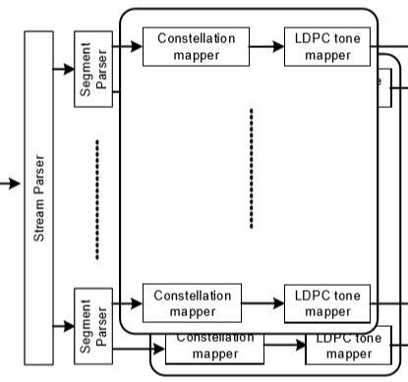
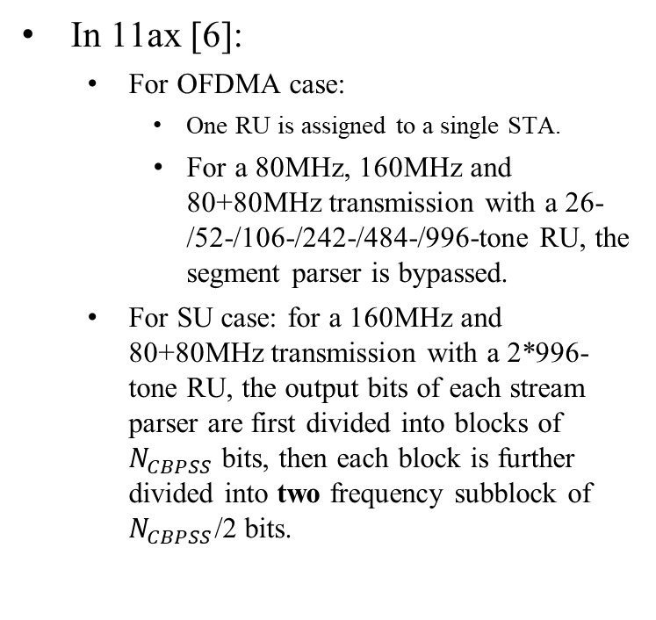
Recap
Segment Parser in 11ac/ax[6-7]
In 11ax [6]:
  For OFDMA case:
    One RU is assigned to a single STA.
    For a 80MHz, 160MHz and 80+80MHz transmission with a 26-/52-/106-/242-/484-/996-tone RU, the segment parser is bypassed.
  For SU case: for a 160MHz and 80+80MHz transmission with a 2*996-tone RU, the output bits of each stream parser are first divided into blocks of $N_{CBPSS}$ bits, then each block is further divided into two frequency subblock of $N_{CBPSS}$/2 bits.
Tx for the Data field of a VHT SU PPDU and HE SU PPDU in 160 MHz/80+80 MHz with LDPC encoding.

Slide 5
Recap
In 11be:
  More than one RUs can be assigned to a single STA.
  Preamble puncturing with 20MHz resolution has been defined for various BW.
  RU size in 11be within each 80MHz is the same with 11ax: 26-, 52-, 106-, 242-, 484- and 996-tone RU for OFDMA.

Slide 6
RU Parser in 11be
In 11ac/ax, segment parser is applied in a 160MHz/80+80MHz HE SU PPDU.
In 11be, the parser shall be redefined in an efficient way because of introducing the important techniques – MRU & Preamble Puncturing.
We propose RU parser in 11be
  The RU parser is based on the RU size of 242-, 484-tone and 996-tone RU.
RU Parser
Constellation
Mapper
LDPC Mapper
. . .
. . .
Constellation
Mapper
LDPC Mapper
Stream Parser
RU Parser
Constellation
Mapper
LDPC Mapper

Slide 7
RU Parser in 11be
Examples:
Case 1:RU484+996+996
Case 2:RU242+484+996
Case 2A: reusing 11ax existing LDPC tone mapper
Case 2B: joint tone mapper for RU242+484
RU 996
RU 996
RU 996
RU Parser
RU Parser
RU Parser
RU 484
RU 242
RU 242
RU 996
RU 484
RU 484
Case 1: There are 3 branches of RU Parser for RU484+996+996
Case 2A: Same with Case 1, there are 3 branches of RU parser, and can reuse 11ax tone mapper.
Case 2B: There are 2 branches of RU parser, but with extra implementation – adding new joint tone mapper RU242+484.

Slide 8
Proportional Round Robin Parsing
[1-5] have proposed the proportional round robin parsing. We also propose the proportional round robin parser with the smallest proportion, and if there are residual bits, the same proportion ration applied for the residual bits.
Propose the proportional round robin parsing method without adding joint tone mapper for RU242+484.
Examples:
Case 1:RU484+996+996
Case 2:RU242+484+996
Case 2A: reusing 11ax existing LDPC tone mapper
Case 2B: joint tone mapper for RU242+484
RU 996
RU 996
RU 996
2s
4s}
4s}
RU Parser
RU Parser
RU Parser
1s
RU 484
1s}
RU 242
RU 242
2s
RU 996
2s
RU 484
3s
RU 484
Proportional Ratio:1s:2s:2s
Proportional Ratio:1s:2s:4s
Proportional Ratio:3s:4s
Scheme 1

Slide 9

Proportional Round Robin Parsing
Proposed ratio m1:m2:m3:m4 for proportional round robin parsing with
RU Aggregation | Proportional Ratio (m1:m2:m3:m4)
484+996 | 1s:2s
242+484+996 | 1s:2s:4s
484+2*996 | 1s:2s:2s
484+3*996 | 1s:2s:2s:2s
2*996 | 1s:1s
3*996 | 1s:1s:1s
4*996 | 1s:1s:1s:1s
The same proportional round robin ration for the Residual bits
For RU242+484+996 case:
s
2s
4s
…
s
2s
4s
2s
4s
…
2s
4s
-RU242
-RU484
-RU996

Slide 10
Summary
We discuss and propose RU Parser (the new parser)
definition in 11be and propose proportional round robin
parser for 11be.
-The benefit of RU Parser is reusing existing 11ax tone mapper without additional implementation workload when RU-tone size >=242.

Slide 11
SP #1
Do you agree that 11be uses RU Parser with the following proportional round robin scheme for RU242+484+996?
RU Aggregation | Proportional Ratio (m1:m2:m3:m4)
242+484+996 | 1s:2s:4s

Slide 12
References
  [1] “Thoughts on RU Aggregation and Interleaving”, IEEE 802.11-20/0394r0, Lin Yang, et al.
  [2] “Segment Parser and Tone Interleaver for 11be”, IEEE 802.11-20/0440r1, Jianhan Liu, et al.
  [3] “Discussions on Multi RU aggregation”, IEEE 802.11-20/0495r1, Tianyu Wu.
  [4] “Segment parsing for punctured transmissions”, IEEE 802.11-20/0478r0, Sigurd Schelstraete, et al.
  [5] “Update on segment parser and tone interleaver for 11be”, Jianhan Liu, et al.
  [6] “IEEE 802.11ax-D6.0”
  [7] “IEEE 802.11-2016”

Slide 13
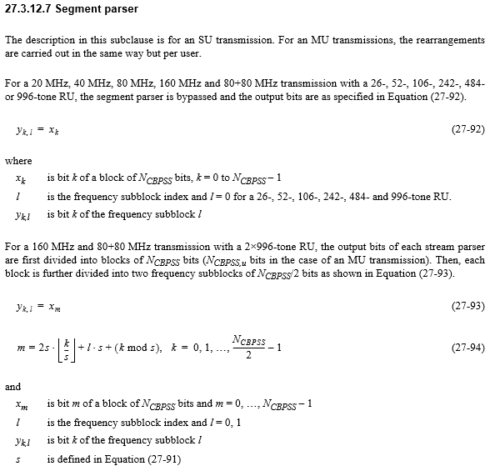
Appendix [6]

