Slide 1
New Parser Discussion in 11be
Date: 2020-04-09
Authors:
Name | Affiliations | Address | Phone | email
Dandan Liang | Huawei Technologies | Shenzhen |  | dandan.liang@Huawei.com
Gan Ming
Mengshi Hu
Jian Yu
Wei Lin
Chenchen Liu
David Yang
Yan Xin
Junghoon Suh

Slide 2
Introduction
Segment Parsing method for 11be has been proposed by the following contributions:
  [1] “Thoughts on RU Aggregation and Interleaving”, IEEE 802.11-20/0394r0, Lin Yang, et al.
  [2] “Segment Parser and Tone Interleaver for 11be”, IEEE 802.11-20/0440r1, Jianhan Liu, et al.
  [3] “Discussions on Multi RU aggregation”, IEEE 802.11-20/0495r1, Tianyu Wu.
  [4] “Segment parsing for punctured transmissions”, IEEE 802.11-20/0478r0, Sigurd Schelstraete, et al.
  [5] “Update on segment parser and tone interleaver for 11be”, Jianhan Liu, et al.
  Based on an SP in PHY session, proportional round robin is the most favorable solution.
  Doubt the gain of :
    Joint tone mapper for RU and aggregated RU size <=80MHz when RU >= 242.
      The RU/Segment Parser [1-5] is not using the same segment parser as 11ac/ax, the number of parser output branches is larger than 2 [4 branches for RU484+3*RU996]
      We can reuse the new adding branches for proportional round robin parsing and 11ax existing tone mapper without additional implementation workload for tone mapper for the RU242+RU484 case.
      In this contribution, we discuss the parser definition in 11be and propose proportional round robin RU parser for 11be.

Slide 3
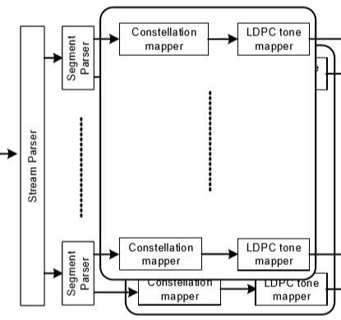
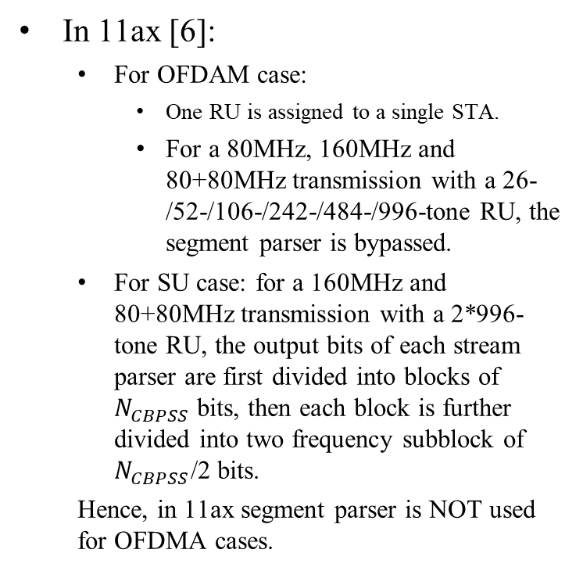
Recap
Segment Parser in 11ac/ax[6-7]
In 11ax [6]:
  For OFDAM case:
    One RU is assigned to a single STA.
    For a 80MHz, 160MHz and 80+80MHz transmission with a 26-/52-/106-/242-/484-/996-tone RU, the segment parser is bypassed.
  For SU case: for a 160MHz and 80+80MHz transmission with a 2*996-tone RU, the output bits of each stream parser are first divided into blocks of $N_{CBPSS}$ bits, then each block is further divided into two frequency subblock of $N_{CBPSS}$/2 bits.
  Hence, in 11ax segment parser is NOT used for OFDMA cases.
Tx for the Data field of a VHT SU PPDU and HE SU PPDU in 160 MHz/80+80 MHz with LDPC encoding.

Slide 4
Recap
In 11be:
  More than one RUs can be assigned to a single STA.
  Preamble puncturing with 20MHz resolution has been defined for various BW.
  RU size in 11be within each 80MHz is the same with 11ax: 26-, 52-, 106-, 242- and 996-tone RU for OFDMA.

Slide 5
New Parser in 11be
In 11ac/ax, segment parser is applied in a 160MHz/80+80MHz HE SU PPDU.
In 11be, the parser shall be redefined in an efficient way because of introducing the important techniques – MRU & Preamble Puncturing.
We propose RU parser in 11be
  The RU parser size is 242-, 484-tone and 996-tone RU.
RU Parser
Constellation
Mapper
LDPC Mapper
. . .
. . .
Constellation
Mapper
LDPC Mapper
Stream Parser
RU Parser
Constellation
Mapper
LDPC Mapper

Slide 6
New Parser in 11be
Examples:
Case 1:RU484+996+996
Case 2:RU242+484+996
Case 2A: reusing 11ax existing LDPC tone mapper
Case 2B: joint tone mapper for RU242+RU484
RU 996
RU 996
RU 996
2s
RU Parser
RU Parser
RU Parser
1s
RU 484
RU 242
RU 242
RU 996
RU 484
RU 484
2s
Case 1: There are 3 branches of New Parser for RU484+996+996
Case 2A: Same with Case 1, there are 3 branches of New parser, and can reusing 11ax tone mapper.
Case 2B: There are 2 branches of New parser, but with extra implementation – adding new joint tone mapper RU242+484.

Slide 7
Proportional Round Robin Parsing
[1-5] has proved the gain of the proportional round robin parsing method. Agree with [5] the smallest proportion provides the best performance.
Propose the proportional round robin parsing method without adding joint tone mapper for RU242+484.
RU 996
RU 996
RU 996
2s
4s}
4s}
RU Parser
RU Parser
RU Parser
1s
RU 484
1s}
RU 242
RU 242
2s
RU 996
2s
RU 484
3s
RU 484
RU484+996+996 Case
RU242+484+996 Case
Scheme 1

Slide 8

Proportional Round Robin Parsing
Proposed ratio m1:m2:m3:m4 for proportional round robin parsing with
RU Aggregation | Proportional Ratio (m1:m2:m3:m4)
484+996 | 1s:2s
(242+484)+996 | 1s:2s:4s
484+2*996 | 1s:2s:2s
484+3*996 | 1s:2s:2s:2s
2*996 | 1s:1s
3*996 | 1s:1s:1s
4*996 | 1s:1s:1s:1s

Slide 9
Summary
We discuss and propose RU Parser (the new parser) definition in 11be and propose proportional round robin parser for 11be.

Slide 10
SP #1
Do you agree that 11be uses RU Parser with the following proportional round robin scheme for RU242+484+996?
RU Aggregation | Proportional Ratio (m1:m2:m3:m4)
(242+484)+996 | 1s:2s:4s

Slide 11
References
  [1] “Thoughts on RU Aggregation and Interleaving”, IEEE 802.11-20/0394r0, Lin Yang, et al.
  [2] “Segment Parser and Tone Interleaver for 11be”, IEEE 802.11-20/0440r1, Jianhan Liu, et al.
  [3] “Discussions on Multi RU aggregation”, IEEE 802.11-20/0495r1, Tianyu Wu.
  [4] “Segment parsing for punctured transmissions”, IEEE 802.11-20/0478r0, Sigurd Schelstraete, et al.
  [5] “Update on segment parser and tone interleaver for 11be”, Jianhan Liu, et al.
  [6] “IEEE 802.11ax-D6.0”
  [7] “IEEE 802.11-2016”

Slide 12
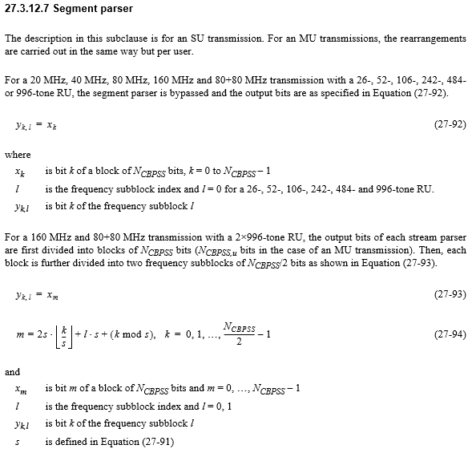
Appendix [6]

