Slide 1
Channel Width Selection for various Frame Types with Preamble Puncture and Puncture Location Indication
Date: 2020-03-10
Authors:

Slide 2
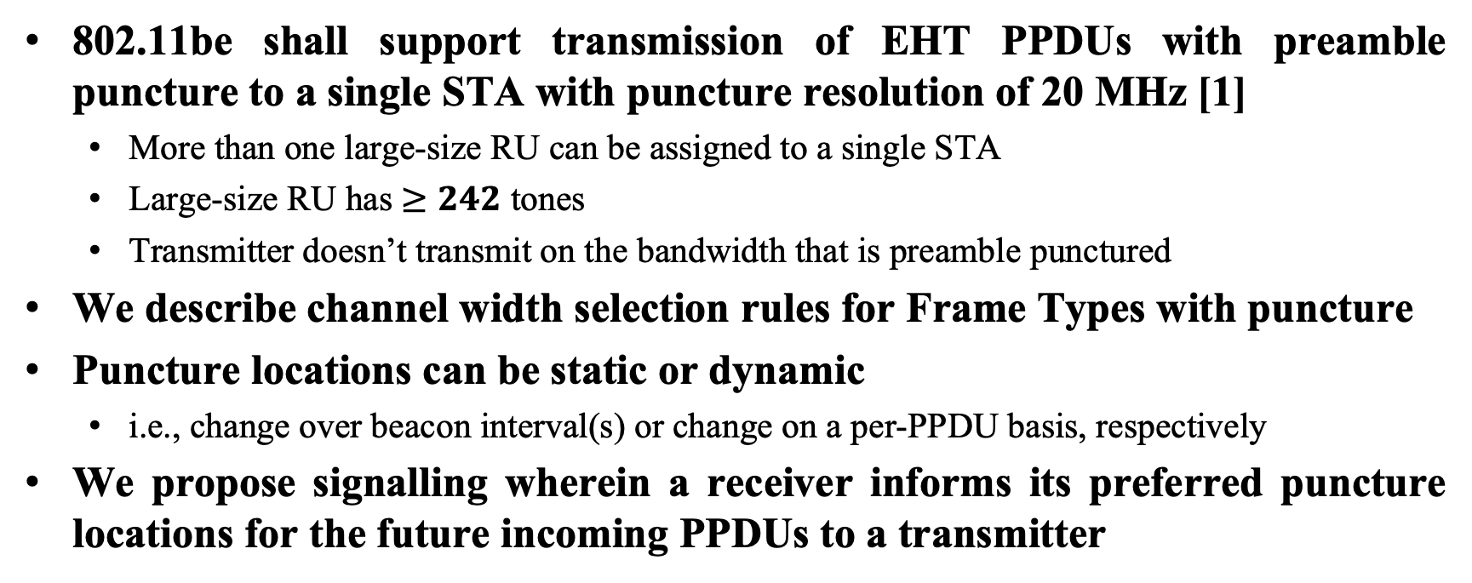
Abstract
802.11be shall support transmission of EHT PPDUs with preamble puncture to a single STA with puncture resolution of 20 MHz [1]
  More than one large-size RU can be assigned to a single STA
  Large-size RU has $≥242$ tones
  Transmitter doesn’t transmit on the bandwidth that is preamble punctured
We describe channel width selection rules for Frame Types with puncture
Puncture locations can be static or dynamic
  i.e., change over beacon interval(s) or change on a per-PPDU basis, respectively
We propose signalling wherein a receiver informs its preferred puncture locations for the future incoming PPDUs to a transmitter

Slide 3
Channel width selection for Control Frames
Control frame sent by an EHT STA in response to a
  non-HT/non-HT DUP format frame with bandwidth signaling TA and that is not a CTS is TX’ed (transmitted) on the identical BW (excluding punctured BW) on which the frame eliciting the response is received
  Non-HT/non-HT DUP format frame with non-bandwidth signaling TA is TX’ed on the BW no greater than that of the frame eliciting the response is received
  EHT format frame is TX’ed on the identical BW on which the frame eliciting the response is received

Slide 4
Channel width selection for individually addressed Data and Management frames
EHT STA shall not transmit a frame using a bandwidth that is not permitted in the BSS (Basic Service Set)
EHT STA shall not transmit a frame using a bandwidth that is determined to be subjected to preamble puncture

Slide 5
Preamble Puncture Location Determination
Transmitter determines autonomously through proprietary methods
Transmitter informed by a receiver about the preferred puncture locations
Preamble puncture location signaled multiple ways:
  In an A-Control subfield of the MAC Header
  In a BSS-wide Preamble Puncturing indication

Slide 6
Preamble Puncture Location Indication in A-Control subfield
STA indicates preferred puncture location for future incoming PPDUs in A-Control subfield of the current QoS frame
A special Control ID value indicates that Control Information includes Puncture bitmap and other information

Slide 7
BSS-wide Preamble Puncture Location Indication by AP
Define a new Information Element (e.g., Preamble Puncture Location IE) wherein a bitmap indicates the 20 MHz subchannels and the corresponding 242-tone RUs that are subject to preamble puncture
Example of the bitmap
  Length: 16 bits
    0: indicates corresponding subchannel is subject to preamble puncture
    1: indicates corresponding subchannel is available for use
  Lowest bit corresponds to the 20 MHz subchannel with the lowest frequency within BSS bandwidth

Slide 8
Summary
Here we describe channel width selection for Control frame, individually addressed Data frame and Management frame with Preamble Puncture
Additionally, we show the signalling wherein a receiver informs its preferred puncture locations for the future incoming PPDUs to a transmitter

Slide 9
References
[1] 11-19-1262-08-00be-specification-framework-for-tgbe

Slide 10
SP #1
Do you agree to the following rules for channel width selection for control frames in 11be
Control frame sent by an EHT STA in response to a
  non-HT/non-HT DUP format frame with bandwidth signaling TA and that is not a CTS is TX’ed (transmitted) on the identical BW (excluding punctured BW) on which the frame eliciting the response is received
  Non-HT/non-HT DUP format frame with non-bandwidth signaling TA is TX’ed on the BW no greater than that of the frame eliciting the response is received
  EHT format frame is TX’ed on the identical BW on which the frame eliciting the response is received
Y / N / A :

Slide 11
SP #2
Do you agree to the following rules for channel width selection for individually addressed data and management frames in 11be
EHT STA shall not transmit a frame using a bandwidth that is not permitted in the BSS (Basic Service Set)
EHT STA shall not transmit a frame using a bandwidth that is determined to be subjected to preamble puncture
Y / N / A

Slide 12
SP #3
Do you agree to define in 11be signalling wherein a receiver informs its preferred puncture locations for the future incoming PPDUs to a transmitter?
Y / N / A :

Slide 13
SP #4
Do you agree to define in 11be that a receiver signals its preferred puncture locations for the future incoming PPDUs to a transmitter in the A-Control subfield of the MAC Header of the current frame?
Y / N / A :

