Slide 1
Coordinated Spatial Reuse: Focus on Downlink
Date: 2020-05-07
Authors:

Slide 2
Recap: Coordinated SR (C-SR)
C-SR is a simple Multi-AP coordination scheme that can increase spectrum efficiency by reusing the same time/frequency resources among multiple BSSs
C-SR procedure
  C-SR procedure with unsolicited method [1]
  General C-SR procedure [2]
C-SR performance gain
  Compared to OBSS-PD and TDD [3]
  Compared to EDCA and complete control [4]
  Compared to C-OFDMA and OBSS-PD [5]
In this contribution, we divide the downlink (DL) C-SR procedure into 3 phases and investigate several issues of C-SR operation

Slide 3
Issue 1: C-SR Coordination Policy
AP
STA
[Option 1]
DL TX
C-SR gain comes from appropriate Tx power management
Option 1: bi-directional coordination
  Sharing AP and shared AP negotiate the appropriate Tx power combination
  Could be better in terms of sum throughput
  Additional signaling overhead
Option 2: one-way coordination (Preferred)
  Sharing AP determines Tx power without a coordination process and limits the Tx power of shared AP to protect transmissions of sharing AP
  Sharing AP does not need to sacrifice its performance
  Less overhead
Sharing AP
Shared AP
Negotiated power
Negotiated power
Enough power
Sharing AP
Shared AP
Less power
[Option 2]

Slide 4


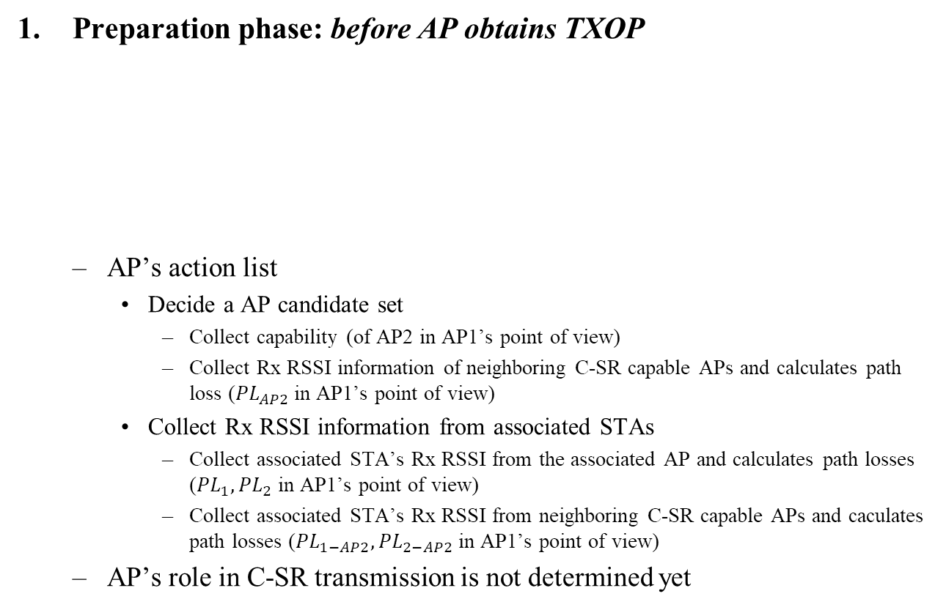



C-SR Procedure into 3 Phases
Preparation phase: before AP obtains TXOP
  AP’s action list
    Decide a AP candidate set
      Collect capability (of AP2 in AP1’s point of view)
      Collect Rx RSSI information of neighboring C-SR capable APs and calculates path loss (${PL}_{AP2}$ in AP1’s point of view)
    Collect Rx RSSI information from associated STAs
      Collect associated STA’s Rx RSSI from the associated AP and calculates path losses (${PL}_{1},{PL}_{2}$ in AP1’s point of view)
      Collect associated STA’s Rx RSSI from neighboring C-SR capable APs and caculates path losses (${PL}_{1−AP2},{PL}_{2−AP2}$ in AP1’s point of view)
  AP’s role in C-SR transmission is not determined yet
1
$${PL}_{1}$$
$${PL}_{1−AP2}$$
3
AP
AP1
$${PL}_{AP2}$$
AP2
STA
$${PL}_{2}$$
$${PL}_{2−AP2}$$
Signal
2
4

Slide 5
C-SR Procedure into 3 Phases
Announcement phase: after AP obtains TXOP
  If the AP is willing to share the obtained TXOP, it becomes a sharing AP
  Sharing AP’s action list
    Select the shared AP from the AP candidate set
      Considering DL STA’s SINR of sharing AP
    Trigger the shared AP’s transmission using announcement frame
      Essential information: AP ID, Tx power limit
Transmission phase: after the potential shared AP obtains the shared TXOP
  If an AP receives the announcement frame successfully and is willing to participate in the C-SR transmission, the AP becomes a shared AP
  Shared AP’s action list
    Set Tx power based on the guide obtained from the announcement frame
  C-SR transmissions (including block acknowledgement) of the sharing/shared APs occur simultaneously in the shared TXOP
  Assumption: start/end time of C-SR transmissions are aligned

Slide 6
Issue 2: Obtaining/Delivering Path Loss
AP who is willing to share its TXOP requires …
  Path loss with neighboring C-SR capable AP
    Can obtain from a measurement
  Path loss with associated STA
    Can obtain from a report
  Path loss between associated STA and neighboring C-SR capable AP
    Can obtain from a report
How to calculate path loss?
  STA can use beacon as a reference of path loss estimation
  (Beacon Tx power) – (Beacon Rx signal strength)
We need an element or a field which indicates beacon Tx power information. C-SR capable AP can include the element or the field in the beacon frame.

Slide 7
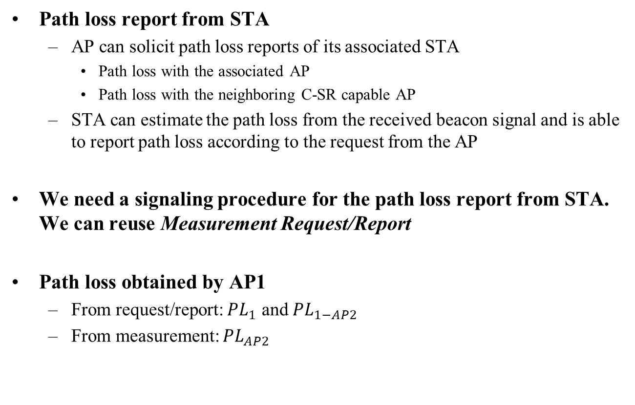



Issue 2: Obtaining/Delivering Path Loss
Path loss report from STA
  AP can solicit path loss reports of its associated STA
    Path loss with the associated AP
    Path loss with the neighboring C-SR capable AP
  STA can estimate the path loss from the received beacon signal and is able to report path loss according to the request from the AP
We need a signaling procedure for the path loss report from STA. We can reuse Measurement Request/Report
Path loss obtained by AP1
  From request/report: $PL_{1}$ and $PL_{1−AP2}$
  From measurement: $PL_{AP2}$
1
$${PL}_{1}$$
$${PL}_{1−AP2}$$
2
AP1
$${PL}_{AP2}$$
AP2

Slide 8
C-SR Procedure Example: 2-BSS DL/DL
AP1 obtains TXOP → sharing AP
AP2 obtains the shared TXOP → shared AP
Collecting
Capability/Path loss
AP1
C-SR-A
DL MU
BA
STA1-1
BA
STA1-2
DL MU
AP2
Measuring and
Collecting
Path loss
Report
BA
STA2-1
BA
STA2-2
Preparation Phase
Announcement Phase
Transmission Phase
Measurement
Report
* C-SR-A: C-SR announcement frame

Slide 9
Issue 3: Block Acknowledgement (BA) Separation
Problem
  BA transmissions of STAs simultaneously occur in the shared TXOP
  Tx power limit applies to shared AP’s transmission
Solution
  Separation of BA transmissions of the STAs associated with sharing/shared AP
Options for BA separation
  [Option 1] Non-overlapping resources for BA (preferred)
    Allocate non-overlapping frequency resources for BAs of sharing/shared AP
    Non-overlapping frequency resource allocation for BA is determined by the sharing AP and included in the announcement frame
  [Option 2] Implicit BA for sharing AP side, and delayed BA for shared AP side
    Pros: simple
    Cons: overhead

Slide 10
Issue 3: Block Acknowledgement (BA) Separation
[Option 1] Non-overlapping resources for BA in detail
  Two-level BA separation
    Level 1: BA separation among sharing/shared APs
      E.g. upper 40MHz for sharing AP, lower 40MHz for shared AP
    Level 2: BA separation between DL STAs in each BSS (DL MU PPDU case)
      STAs send the immediate response according to the resource allocation information that is carried in the TRS control subfield
frequency
C-SR Transmission of sharing AP (DL MU PPDU)
BA of STA1
BA of STA2
3
80MHz
SIFS
Shared AP
same 80MHz
1
frequency
time
C-SR Transmission of shared AP (DL MU PPDU)
Sharing AP
4
80MHz
BA of STA3
BA of STA4
2
time

Slide 11
Summary
We divide C-SR procedure into 3 phases according to TXOP acquisition status of sharing/shared AP
We believe that one-way coordination is an appropriate policy to manage the Tx power of sharing/shared AP in C-SR operation
To determine the maximum Tx power of shared AP, sharing AP collects path loss information from the associated STAs and neighboring C-SR capable APs by soliciting reports
We propose two options for BA separation

Slide 12
Straw Poll #1
Do you agree that in 11be sharing AP limits the shared AP(s)’ transmission power during the shared TXOP in C-SR procedure?
  Sharing AP may reduce its transmission power in the shared TXOP
  Shared AP(s) shall follow the transmission power limit indicated by sharing AP in the shared TXOP
  Shared AP’s transmission power limit is included in the announcement frame
  NOTE: the term, shared TXOP, can be changed
  NOTE: the field indicating transmission power limit and its encoding are TBD

Slide 13
Straw Poll #2
Do you agree that in 11be C-SR capable AP indicates its beacon transmission power in beacon frame?
  The beacon transmission power can be included in either one of element or field
  The element or field indicating the beacon transmission power and its encoding are TBD

Slide 14
Straw Poll #3
Do you agree that in 11be the signaling for reporting path loss values is required?
  Signaling details are TBD

Slide 15
Straw Poll #4
Do you agree that in 11be sharing AP allocates non-overlapping frequency resources of block acknowledgements for each sharing AP and shared AP(s) for C-SR operation?
  Allocating non-overlapping frequency resource shall be determined by sharing AP
  The way of indicating non-overlapping frequency resources for block acknowledgement is TBD

Slide 16
Reference
[1] 802.11-20/0410r4 “Coordinated Spatial Reuse Procedure”, Sungjin Park
[2] 802.11-20/0576r1 “Coordinated Spatial Reuse Protocol”, Yongho Seok
[3] 802.11-20/0457r1 “Discussion on Coordinated Spatial Reuse Operation”, Kosuke Aio
[4] 802.11-20/0107r1 “Multi-AP coordination for spatial reuse”, Dmitry Akhmetov
[5] 802.11-20/0073r0 “On Coordinated Spatial Reuse in 11be”, Jianhan Liu

Slide 17
APPENDIX

Slide 18

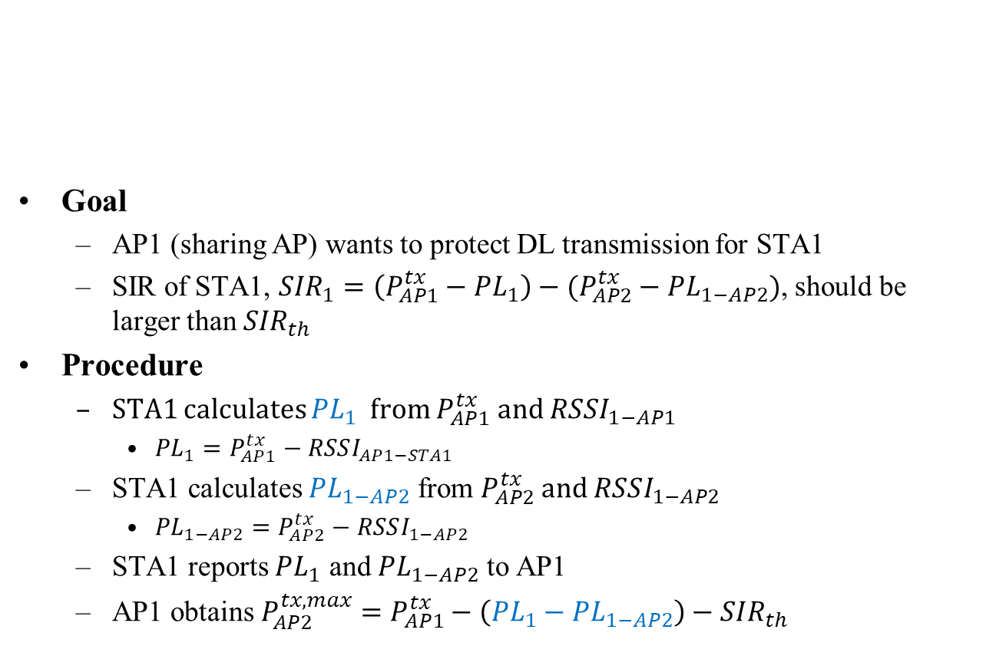




Calculation of Shared AP’s Tx Power Limit
Goal
  AP1 (sharing AP) wants to protect DL transmission for STA1
  SIR of STA1, ${SIR}_{1}=\left(P_{AP1}^{tx}−PL_{1}\right)−(P_{AP2}^{tx}−PL_{1−AP2})$, should be larger than ${SIR}_{th}$
Procedure
  STA1 calculates ${PL}_{1}$ from $P_{AP1}^{tx}$ and $RSSI_{1−AP1}$
    ${PL}_{1}=P_{AP1}^{tx}−RSSI_{AP1−STA1}$
  STA1 calculates $PL_{1−AP2}$ from $P_{AP2}^{tx}$ and $RSSI_{1−AP2}$
    ${PL}_{1−AP2}=P_{AP2}^{tx}−RSSI_{1−AP2}$
  STA1 reports $PL_{1}$ and $PL_{1−AP2}$ to AP1
  AP1 obtains $P_{AP2}^{tx,max}=P_{AP1}^{tx}−\left(PL_{1}−PL_{1−AP2}\right)−SIR_{th}$
1
$${PL}_{1}$$
$${PL}_{1−AP2}$$
3
AP
AP1
$${PL}_{AP2}$$
AP2
STA
$${PL}_{2}$$
$${PL}_{2−AP2}$$
Signal
2
4

Slide 19
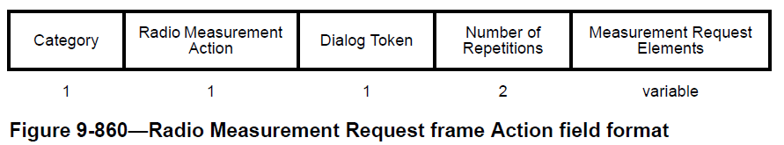
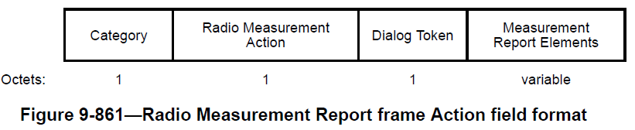
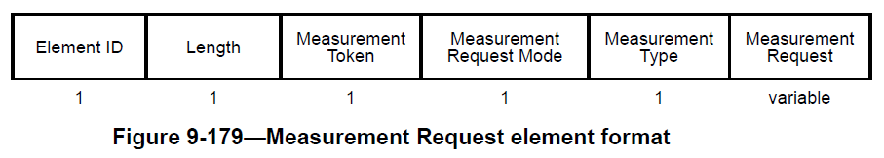
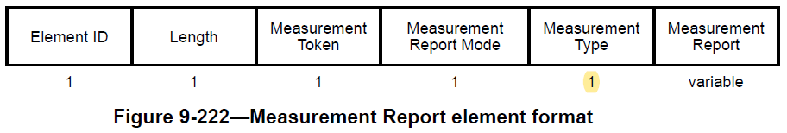
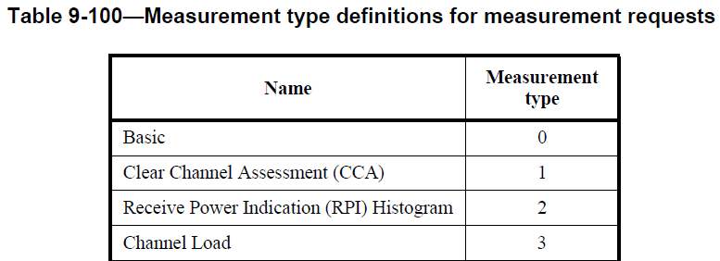
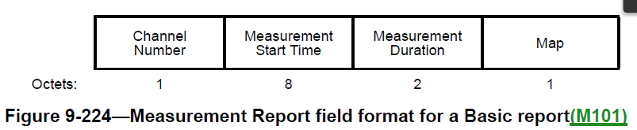
Measurement Request/Report
Action frame: Radio Measurement Request/Response frame
Measurement Request/Report element
Measurement type and Report field definitions

Slide 20
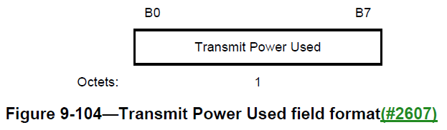
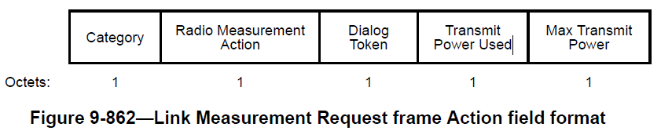
Transmit Power Used Field
8-bit field
Link Measurement Request Frame

