Slide 1
Coordinated Spatial Reuse: Focus on Downlink
Date: 2020-05-07
Authors:

Slide 2
Recap: Coordinated SR (C-SR)
C-SR is a simple Multi-AP coordination scheme that can increase spectrum efficiency by reusing the same time/frequency resources among multiple BSSs
C-SR procedure
  C-SR procedure with unsolicited method [1]
  General C-SR procedure [2]
C-SR performance gain
  Compared to OBSS-PD and TDD [3]
  Compared to EDCA and complete control [4]
  Compared to C-OFDMA and OBSS-PD [5]
In this contribution, we divide the downlink (DL) C-SR procedure into 3 phases and investigate several issues of C-SR operation

Slide 3
Issue 1: C-SR Coordination Policy
AP
STA
C-SR gain comes from appropriate Tx power management
Option 1: bi-directional coordination
  Sharing AP and shared AP negotiate the appropriate Tx power combination
  Could be better in terms of sum throughput
  Additional signaling overhead
Option 2: one-way coordination (Preferred)
  Sharing AP determines Tx power without a coordination process and limits the Tx power of shared AP to protect transmissions of sharing AP
  Sharing AP does not need to sacrifice its performance
  Less overhead
DL TX
Sharing AP
Shared AP
Negotiated power
Negotiated power
Enough power
Sharing AP
Shared AP
Less power

Slide 4


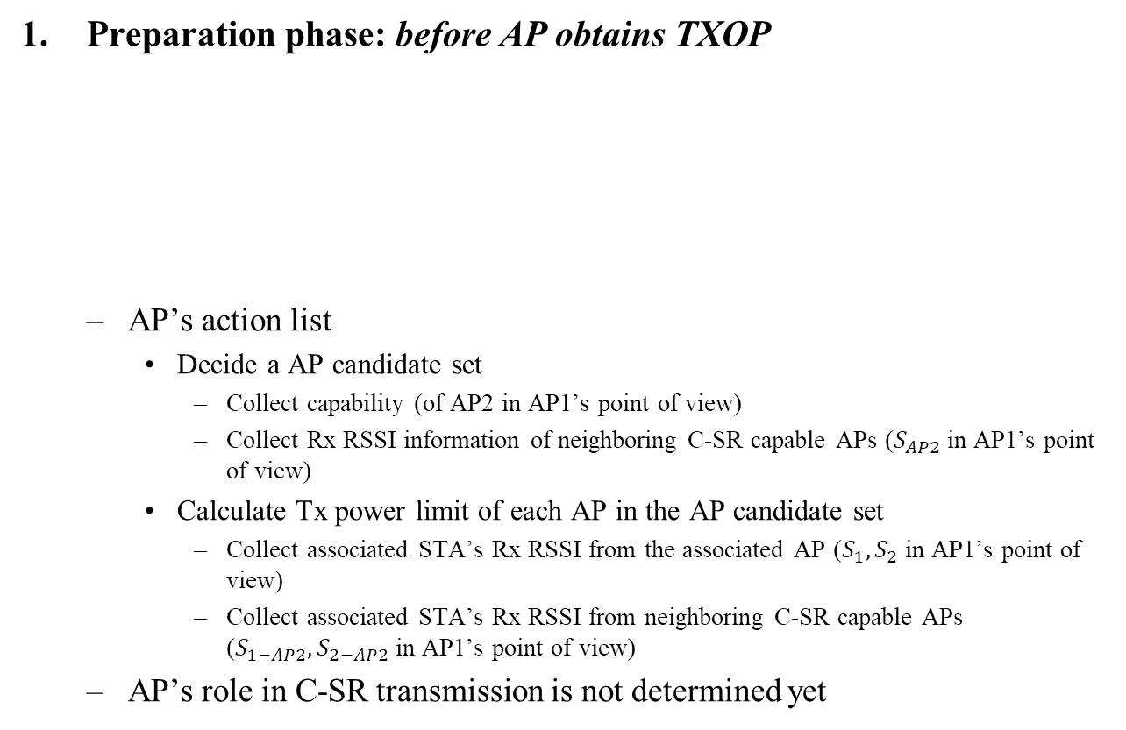



C-SR Procedure into 3 Phases
Preparation phase: before AP obtains TXOP
  AP’s action list
    Decide a AP candidate set
      Collect capability (of AP2 in AP1’s point of view)
      Collect Rx RSSI information of neighboring C-SR capable APs ($S_{AP2}$ in AP1’s point of view)
    Calculate Tx power limit of each AP in the AP candidate set
      Collect associated STA’s Rx RSSI from the associated AP ($S_{1},S_{2}$ in AP1’s point of view)
      Collect associated STA’s Rx RSSI from neighboring C-SR capable APs ($S_{1−AP2},S_{2−AP2}$ in AP1’s point of view)
  AP’s role in C-SR transmission is not determined yet
1
$$S_{1}$$
$$S_{1−AP2}$$
3
AP
AP1
$$S_{AP2}$$
AP2
STA
$$S_{2}$$
$$S_{2−AP2}$$
Signal
2
4

Slide 5
C-SR Procedure into 3 Phases
Announcement phase: after AP obtains TXOP
  If the AP is willing to share the obtained TXOP, it becomes a sharing AP
  Sharing AP’s action list
    Select the shared AP from the AP candidate set
      Considering DL STA’s SINR of sharing AP
    Trigger the shared AP’s transmission using announcement frame
      Essential information: AP ID, Tx power limit
Transmission phase: after the potential shared AP obtains the shared TXOP
  If an AP receives the announcement frame successfully and is willing to participate in the C-SR transmission, the AP becomes a shared AP
  Shared AP’s action list
    Set Tx power based on the guide obtained from the announcement frame
  C-SR transmissions (including block acknowledgement) of the sharing/shared APs occur simultaneously in the shared TXOP
  Assumption: start/end time of C-SR transmissions are aligned

Slide 6
C-SR Procedure Example: 2-BSS DL/DL
AP1 obtains TXOP → sharing AP
AP2 obtains the shared TXOP → shared AP
Collecting
Capability/RSSI
AP1
C-SR-A
DL MU
BA
STA1-1
Collecting
Measurement
Report
BA
STA1-2
DL MU
AP2
BA
STA2-1
BA
STA2-2
Preparation Phase
Announcement Phase
Transmission Phase
* C-SR-A: C-SR announcement frame

Slide 7
Issue 2: Contents of Announcement Frame
Function of Announcement frame
  Indicating the start of C-SR procedure
  Medium reservation (Setting NAV)
  Soliciting transmission of shared AP(s)
Essential contents of announcement frame
  Common info
    Multi-AP coordination type (C-SR)
  Per-AP info for each shared AP
    AP identifier
    Tx power limit of the shared AP
    Non-overlapping frequency resource allocation for block acknowledgement info (to be explained in the following slides)

Slide 8
Issue 3: Block Acknowledgement (BA) Separation
Problem
  BA transmissions of STAs simultaneously occurs in the shared TXOP
  Shared AP may transmit DL MU PPDU in the shared TXOP
  Tx power limit applies to shared AP’s transmission
Options for BA separation
  [Option 1] Non-overlapping resources for BA (preferred)
    Allocate non-overlapping frequency resources for BAs of sharing/shared BSS*
    Non-overlapping frequency resource allocation for BA is determined by the sharing AP and included in the announcement frame
    Pros: less time overhead
    Cons: non-overlapping resource allocation required, UL power control required
  [Option 2] Implicit BA for sharing BSS, and delayed BA for shared BSS
    Pros: simple
    Cons: time overhead
* Sharing BSS: BSS that sharing AP belongs to * Shared BSS: BSS that shared AP belongs to

Slide 9
Issue 3: Block Acknowledgement (BA) Separation
[Option 1] Non-overlapping resources for BA in detail
  Two-level BA separation
    Level 1: BA separation among sharing/shared APs
      E.g. upper 40MHz for sharing AP, lower 40MHz for shared AP
    Level 2: BA separation between DL STAs in each BSS (DL MU PPDU case)
      STAs send the immediate response according to the resource allocation information that is carried in the TRS control subfield
frequency
C-SR Transmission of sharing AP (DL MU PPDU)
BA of STA1
BA of STA2
3
80MHz
SIFS
Shared AP
same 80MHz
1
frequency
time
C-SR Transmission of shared AP (DL MU PPDU)
Sharing AP
4
80MHz
BA of STA3
BA of STA4
2
time

Slide 10
Summary
We divide C-SR procedure into 3 phases according to TXOP acquisition status of sharing/shared AP and investigate the list of things to do in each phase
We believe that one-way coordination is an appropriate policy to manage the Tx power of sharing/shared AP in C-SR operation
We propose two options for BA separation

Slide 11
Reference
[1] 802.11-20/0410r4
[2] 802.11-20/0576r0
[3] 802.11-20/0457r1
[4] 802.11-20/0107r1
[5] 802.11-20/0073r0

Slide 12
Straw Poll #1
Do you agree that in 11be sharing AP limits the shared AP’s transmission power during the shared TXOP for C-SR operation?

Slide 13
Straw Poll #2
Do you agree that in 11be sharing AP allocates non-overlapping frequency resources of block acknowledgements for each sharing AP and shared AP(s) for C-SR operation?
  Allocating non-overlapping frequency resource shall be determined by sharing AP
  The way of indicating non-overlapping frequency resources for block acknowledgement is TBD

