Slide 1
Coordinated Spatial Reuse: Focus on Downlink
Date: 2020-05-07
Authors:

Slide 2
Recap: Coordinated SR (C-SR)
C-SR is a simple Multi-AP transmission that can increase spectrum efficiency by reusing the same time/frequency resources among multiple BSSs
C-SR procedure
  C-SR procedure with unsolicited method [1]
  General C-SR procedure [2]
C-SR performance gain
  Compared to OBSS-PD and TDD [3]
  Compared to EDCA and complete control [4]
  Compared to C-OFDMA and OBSS-PD [5]
In this contribution, we divide the downlink (DL) C-SR procedure into 3 phases and investigate some issues in C-SR operation

Slide 3
Issue 1: C-SR Coordination Policy
AP
STA
C-SR gain comes from appropriate Tx power management
Option 1: bi-directional coordination
  Sharing AP and shared AP negotiate the appropriate Tx power combination
  Could be better in terms of sum throughput
  Additional signaling overhead
  Scalability
Option 2: one-way coordination (Preferred)
  Sharing AP determines Tx power without a coordination process and limits the Tx power of shared AP to protect transmissions of sharing AP
  Encouraging sharing AP to share its TXOP
  Simple, scalable
DL TX
Sharing AP
Shared AP
Negotiated power
Negotiated power
Enough power
Sharing AP
Shared AP
Less power

Slide 4


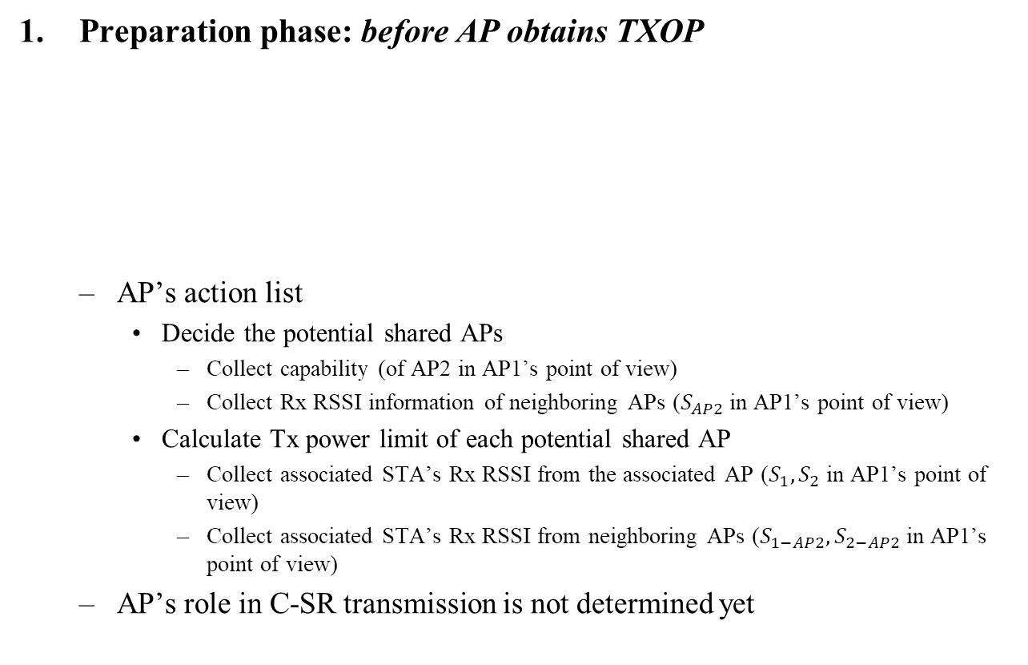



C-SR Procedure into 3 Phases
Preparation phase: before AP obtains TXOP
  AP’s action list
    Decide the potential shared APs
      Collect capability (of AP2 in AP1’s point of view)
      Collect Rx RSSI information of neighboring APs ($S_{AP2}$ in AP1’s point of view)
    Calculate Tx power limit of each potential shared AP
      Collect associated STA’s Rx RSSI from the associated AP ($S_{1},S_{2}$ in AP1’s point of view)
      Collect associated STA’s Rx RSSI from neighboring APs ($S_{1−AP2},S_{2−AP2}$ in AP1’s point of view)
  AP’s role in C-SR transmission is not determined yet
1
$$S_{1}$$
$$S_{1−AP2}$$
3
AP
AP1
$$S_{AP2}$$
AP2
STA
$$S_{2}$$
$$S_{2−AP2}$$
Signal
2
4

Slide 5
C-SR Procedure into 3 Phases
Announcement phase: after AP obtains TXOP
  If the AP is willing to share the obtained TXOP, it becomes a sharing AP
  Sharing AP’s action list
    Select the shared AP from the potential shared APs
      To minimize DL interference from the shared AP
    Trigger the shared AP’s transmission using announcement frame
      Essential information: AP ID, Tx power limit
Transmission phase: after the potential shared AP obtains the shared TXOP
  If a potential shared AP receives the announcement frame successfully and has willing to participate in the C-SR transmission, the AP becomes a shared AP
  Shared AP’s action list
    Set Tx power based on the guide obtained from the announcement frame
  C-SR transmissions (including block acknowledgement) of the sharing/shared APs occur simultaneously in the shared TXOP
  Assumption: start/end time of C-SR transmissions are aligned

Slide 6
C-SR Procedure Example: 2-BSS DL/DL
AP1 obtains TXOP → sharing AP
AP2 obtains the shared TXOP → shared AP
Collecting
Capability/RSSI
AP1
C-SR-A
DL
BA
STA1-1
Collecting
Measurement
Report
BA
STA1-2
DL-SAP
AP2
BA
STA2-1
BA
STA2-2
Preparation Phase
Announcement Phase
Transmission Phase
* C-SR-A: C-SR announcement frame *DL-SAP: Downlink transmission of shared AP

Slide 7
Issue 2: Contents of Announcement Frame
Function of Announcement frame
  Indication of C-SR procedure start (Reservation of medium)
    Followed by sharing AP’s transmission
  Soliciting transmission of shared AP
Essential contents of announcement frame
  Common info
    Multi-AP coordination type (C-SR)
  Per-AP info for each shared AP
    AP identifier
    Tx power limit
    Non-overlapping frequency resource allocation for block acknowledgement info (to be explained in the following slides)

Slide 8
Issue 3: Block Acknowledgement (BA) Separation
Problem
  Tx power limit applies only for shared AP’s DL transmission
  STAs’ BA transmission will interfere each other
Options for BA separation
  [Option 1] Non-overlapping resources for BA (preferred)
    Allocate non-overlapping frequency resources for BAs of sharing/shared BSS*
    Non-overlapping frequency resource allocation for BA is determined by the sharing AP and included in the announcement frame
    Pros: low overhead
    Cons: RU assignment required, UL power control required
  [Option 2] Implicit BA for sharing BSS, and delayed BA for shared BSS
    Pros: simple
    Cons: overhead
* Sharing BSS: BSS that sharing AP belongs to * Shared BSS: BSS that shared AP belongs to

Slide 9
Issue 3: Block Acknowledgement (BA) Separation
[Option 1] Non-overlapping resources for BA in detail
  Two-level BA separation
    Level 1: BA separation among sharing/shared BSSs
      20MHz granularity separation using announcement frame
    Level 2: BA separation between DL STAs in each BSS (DL MU PPDU case)
      STAs receives QoS data frame within HE MU PPDU
      STAs send the immediate response according to the resource allocation information that is carried in the TRS control subfield
frequency
C-SR Transmission of sharing AP (DL MU PPDU)
BA of STA1
BA of STA2
3
80MHz
SIFS
Shared AP
same 80MHz
1
frequency
time
C-SR Transmission of shared AP (DL MU PPDU)
Sharing AP
4
80MHz
BA of STA3
BA of STA4
2
time

Slide 10
Summary
We divide C-SR procedure into 3 phases according to TXOP acquisition status of sharing/shared AP and clarify the list of things to do in each phase
We believe that one-way coordination is an appropriate policy to manage the Tx power in C-SR operation
We investigate the contents of announcement frame
We propose two options for BA separation

Slide 11
Straw Poll #1
Do you agree that in 11be sharing AP limits the shared AP’s transmission power during the shared TXOP for C-SR operation?

Slide 12
Straw Poll #2
Do you agree that in 11be sharing AP allocates non-overlapping frequency resources of block acknowledgements for each sharing AP and shared AP(s) for C-SR operation?
  Allocating non-overlapping frequency resource shall be determined by sharing AP
  The way of indicating non-overlapping frequency resources for block acknowledgement is TBD

Slide 13
Reference
[1] 802.11-20/0410r4
[2] 802.11-20/0576r0
[3] 802.11-20/0457r1
[4] 802.11-20/0107r1
[5] 802.11-20/0073r0

Slide 14
AppenDIX

Slide 15
Passed Motions related to C-SR Operation
11be shall define a mechanism to determine whether an AP is part of an AP candidate set and can participate as a shared AP in coordinated AP transmission initiated by a sharing AP.
Define a procedure for an AP to share its frequency/time resources of an obtained TXOP with a set of APs
An AP that intends to use the resource (i.e., frequency or time) shared by another AP shall be able to indicate its resource needs to the AP that shared the resource.
In all modes of operation wherein an AP shares its frequency/time resource of an obtained TXOP with a set of APs,
  Define a mechanism for the sharing AP to optionally solicit feedback from one or more APs from the AP candidate set to learn the resource needs and the intend to participate in a coordinated AP transmission.

Slide 16
Passed Motions related to C-SR Operation
In all modes of operation wherein an AP shares its frequency resource with a set of APs, the AP shall share its frequency resource in multiples of 20MHz channels with a set of APs in an obtained TXOP?
  PPDU format of the transmission on the shared resource is TBD
Do you support to introduce a coordinated spatial reuse operation in TGBe?
  Whether it is in R1 or R2 is TBD.

