Slide 1
Overview on MU-MIMO for LC
Date: 2020-04-03
Authors:

Slide 2
Abstract
This presentation aims to discuss the main challenge of applying MU-MIMO for LC and its possible solutions

Slide 3
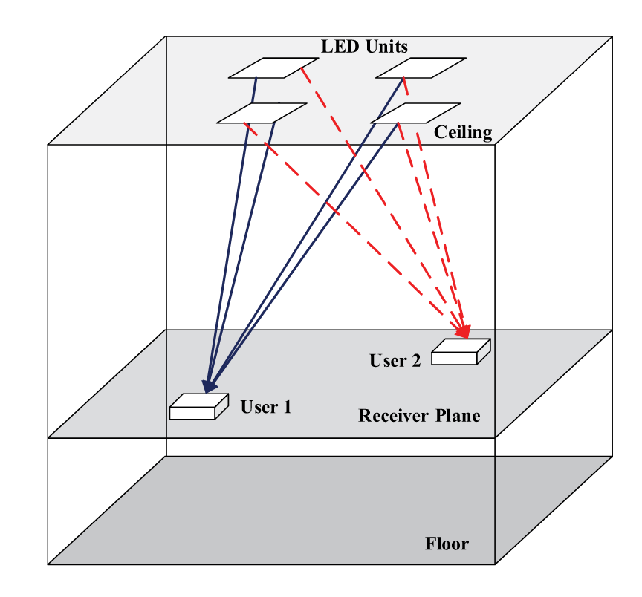
MU-MIMO in LC
Possible issues:
  Highly-correlated channel gain matrix if users or the access points
  are too close together [1,2]
  Different delay of CIRs due to different distance [1]
  Beamforming feedback is required [3]
    What is the coherence time of the LC channel with mobile users?
Taken from [1]
[1] Q. Wang, Z. Wang and L. Dai, "Multiuser MIMO-OFDM for Visible Light Communications," in IEEE Photonics Journal, vol. 7, no. 6, pp. 1-11, Dec. 2015, Art no. 7904911.
[2] T. Fath and H. Haas, "Performance Comparison of MIMO Techniques for Optical Wireless Communications in Indoor Environments," in IEEE Transactions on Communications, vol. 61, no. 2, pp. 733-742, February 2013.
[3] IEEE 802.11ax specification

Slide 4
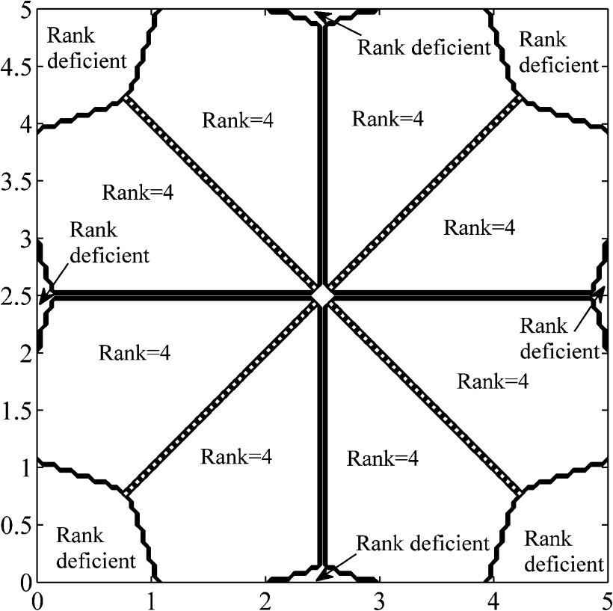
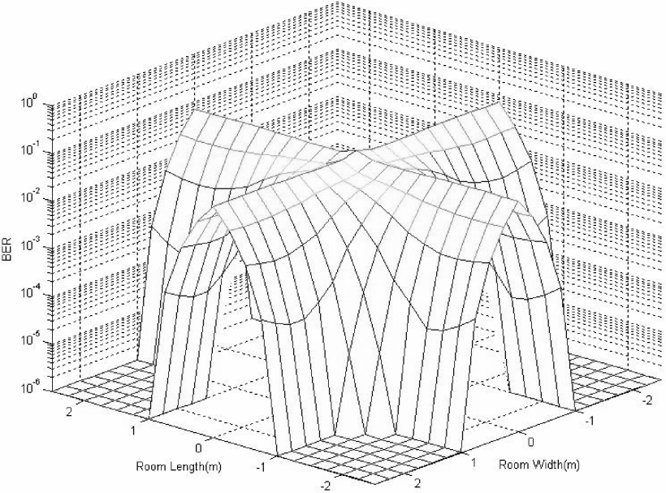
Highly-Correlated Channel Gain Matrix: Background
Why?
  IM/DD + close distance of LEDs and PDs [1,2]
Effects
  Rank deficiency → Very bad error performance
Taken from [1]
Taken from [3]
(the setups are not the same, but BER = 0.5 shows the locations where the corresponding rank is deficient)
[1] L. Zeng et al., "High data rate multiple input multiple output (MIMO) optical wireless communications using white led lighting," in IEEE Journal on Selected Areas in Communications, vol. 27, no. 9, pp. 1654-1662, December 2009.
[2] T. Fath and H. Haas, "Performance Comparison of MIMO Techniques for Optical Wireless Communications in Indoor Environments," in IEEE Transactions on Communications, vol. 61, no. 2, pp. 733-742, February 2013.
[3] T. Q. Wang, R. J. Green and J. Armstrong, "MIMO Optical Wireless Communications Using ACO-OFDM and a Prism-Array Receiver," in IEEE Journal on Selected Areas in Communications, vol. 33, no. 9, pp. 1959-1971, Sept. 2015.

Slide 5
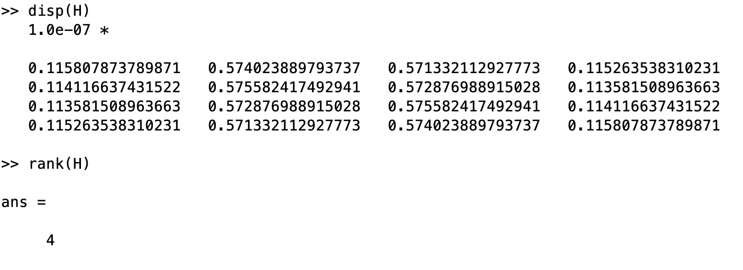
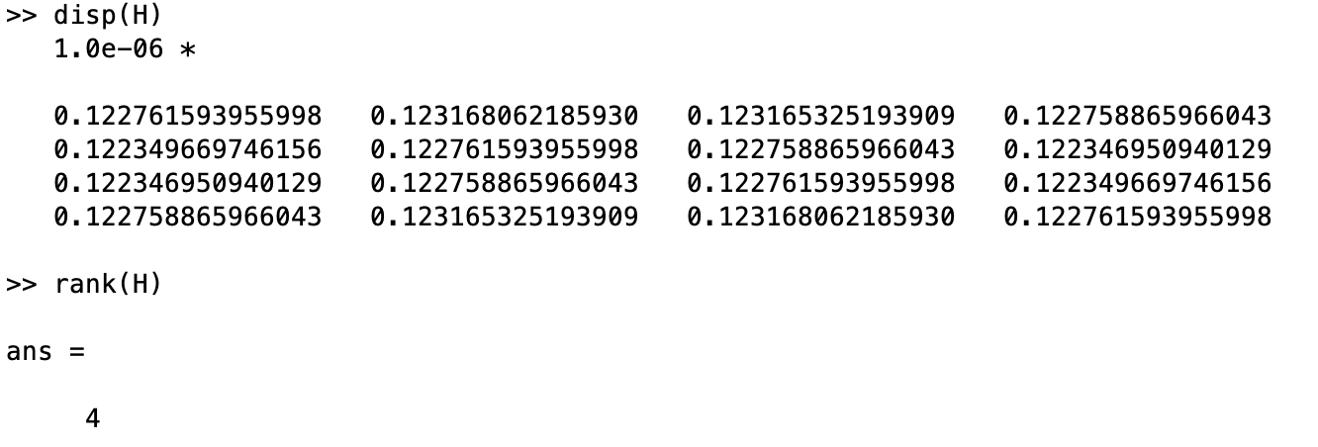
The Channel Matrix Allows Spatial Multiplexing Gains
Macro-MIMO
Micro-MIMO
FoV = 60º
m = 1 (Lambertian mode)
Vertical distance UE-AP = 1.5 m
Distance between neighbor AP in the Macro-MIMO = 1 m

Slide 6
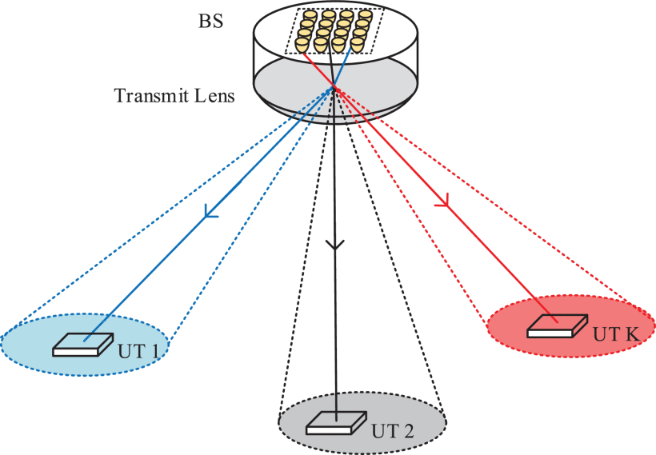
Highly-Correlated Channel Gain Matrix: Possible Solutions (1)
Imaging receivers
  Ex:
    K. D. Dambul, D. C. O'Brien and G. Faulkner, "Indoor Optical Wireless MIMO System With an Imaging Receiver," in IEEE Photonics Technology Letters, vol. 23, no. 2, pp. 97-99, Jan.15, 2011.
  Downside: lack of mobility
Beam domain
  Ex:
    C. Sun, X. Gao, J. Wang, Z. Ding and X. Xia, "Beam Domain Massive MIMO for Optical Wireless Communications With Transmit Lens," in IEEE Transactions on Communications, vol. 67, no. 3, pp. 2188-2202, March 2019.
  Downside: require special lens

Slide 7
Highly-Correlated Channel Gain Matrix: Possible Solutions (2)
WDM
  Ex:
    I. Lu, C. Lai, C. Yeh, and J. Chen, "6.36 Gbit/s RGB LED-based WDM MIMO Visible Light Communication System Employing OFDM Modulation," in Optical Fiber Communication Conference, OSA Technical Digest (online) (Optical Society of America, 2017), paper W2A.39.
  Each LED-PD pair occupies different wavelength
  Downside: there should be a protocol that can handle the negotiation of the operating wavelength for each link
  However, each transmitter and receiver can have N LEDs and PDs, where N is the number of occupied wavelengths. In this case, a channel gain with the channel condition of 1 (full rank and very good-conditioned matrix) can be obtained.

Slide 8
Highly-Correlated Channel Gain Matrix: Possible Solutions (3)
Power imbalanced and link blockage
  Ex:
    T. Fath and H. Haas, "Performance Comparison of MIMO Techniques for Optical Wireless Communications in Indoor Environments," in IEEE Transactions on Communications, vol. 61, no. 2, pp. 733-742, February 2013.
  Downside: does not fix the rank deficiency problem, but only improve the channel condition
Heterogeneous PDs’ configuration
  Ex:
    C. He, T. Q. Wang and J. Armstrong, "Performance of Optical Receivers Using Photodetectors With Different Fields of View in a MIMO ACO-OFDM System," in Journal of Lightwave Technology, vol. 33, no. 23, pp. 4957-4967, 1 Dec.1, 2015.
  Downside: only works on special scenarios

Slide 9
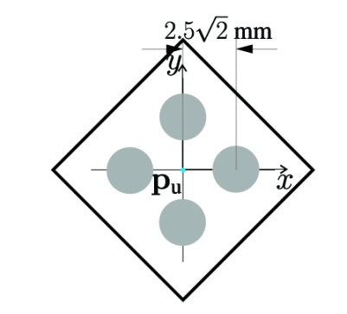
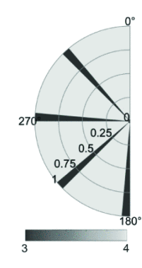
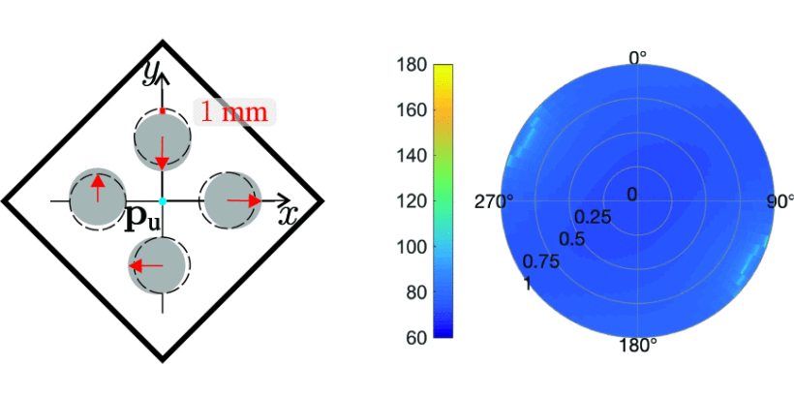
Highly-Correlated Channel Gain Matrix: Possible Solutions (4)
Asymmetry placement
  A. A. Purwita, A. Yesilkaya, I. Tavakkolnia, M. Safari and H. Haas, "Effects of Irregular Photodiode Configurations for Indoor MIMO VLC with Mobile Users," 2019 IEEE 30th Annual International Symposium on Personal, Indoor and Mobile Radio Communications (PIMRC), Istanbul, Turkey, 2019, pp. 1-7.
    Theoretical background:
      T. Tao, V. Vu, "Smooth analysis of the condition number and the least singular value", Math. Comput, vol. 79, no. 272, pp. 2333-2352, Oct. 2010.
      The random matrix is full-rank with overwhelming probability based on Tao’s paper.
  Downside: require optimization to find the optimal configuration
(left) symmetric configuration
(right) rank of the channel at different locations, where rank of 3 means rank deficient
(left) asymmetric configuration
(right) condition number of the channel, where no rank deficient is observed

Slide 10
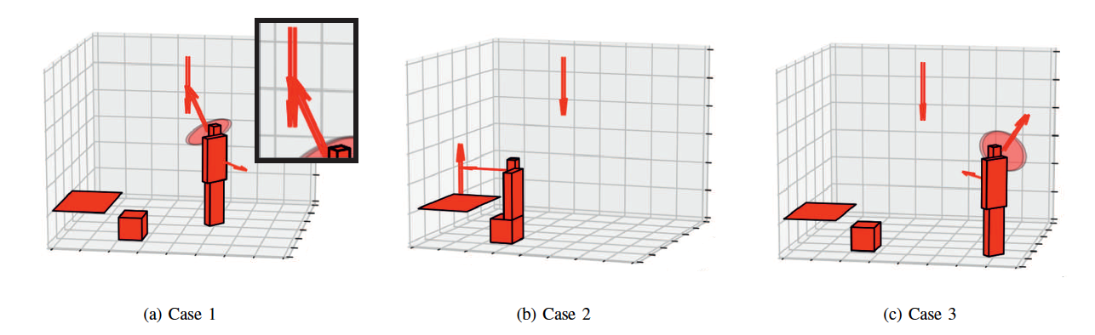
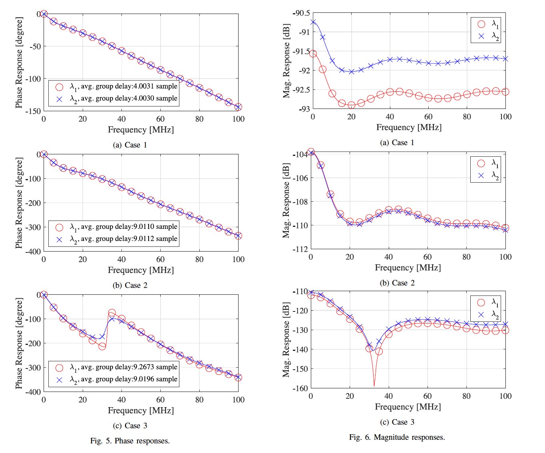
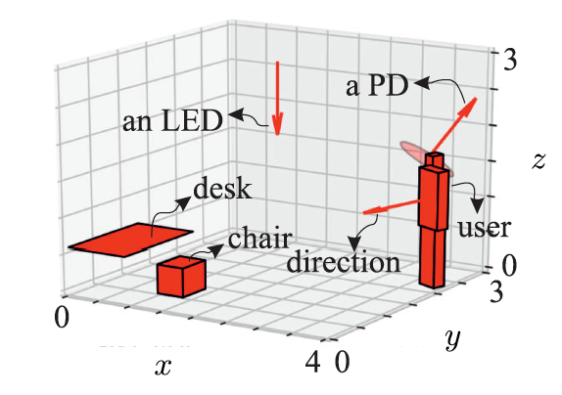
Different delay of CIRs due to different distance
It can be neglected if the distance of LEDs or PDs is in the order of cm
5 cm

Slide 11
Coherence Time of LiFi channel
Based on [1-3], coherence time is in the order of tens to hundreds of ms, which translates to 30 cm of coherence distance
Even with random mobility and random orientation, LiFi channel is quasi static.
Using 802.11n, ref [4] reports the 50-ms update interval of channel state information. Hence, a feedback mechanism for LiFi is still feasible.
[1] Dima Bykhovsky, "Coherence distance in indoor optical wireless communication channels," Opt. Lett. 43, 2248-2251 (2018)
[2] A. A. Purwita, M. D. Soltani, M. Safari and H. Haas, "Terminal Orientation in OFDM-Based LiFi Systems," in IEEE Transactions on Wireless Communications, vol. 18, no. 8, pp. 4003-4016, Aug. 2019.
[3] M. D. Soltani, A. A. Purwita, Z. Zeng, H. Haas and M. Safari, "Modeling the Random Orientation of Mobile Devices: Measurement, Analysis and LiFi Use Case," in IEEE Transactions on Communications, vol. 67, no. 3, pp. 2157-2172, March 2019.
[4] L. Deek, E. G. Villegas, E. Belding, S. Lee, and K. Almeroth, "A practical framework for 802.11 MIMO rate adaptation," in Comput. Netw. 83, pp. 332–348, June 2015.

Slide 12
Conclusions
The LC channel allows for MU-MIMO and can be defined to enable spatial multiplexing
It is possible to define MIMO channels to higher rank by increasing the spatial distance between the transmitters and receivers or by changing the angular diversity of the system.
The most promising method is the WDM because it’s easy to implement and has an almost perfect channel matrix (identity matrix if cross talk is neglected)
The basic MU-MIMO algorithms do not need to change and core differentiation can be incorporated in the front-end design.

