Slide 1
Updates on RU/Segment Parser and Tone Mapper for 11be
Date: 2020-03-31
Authors:
Name | Affiliations | Address | Phone | Email
Jianhan Liu | Mediatek | 2840 Junction Ave. San Jose, CA, 95134 |  | jianhan.liu@mediatek.com
Shengquan Hu
Thomas Pare

Slide 2
Introduction
The following straw polls have been passed [1]:
  Do you support joint interleaving for RU and aggregated RU size <=80 MHz?
  Do you agree with the following LDPC tone mapper scheme for multi-RU aggregation in 11be?
    For aggregated RUs and PPDU BW larger than 80MHz, separate LDPC tone mapper is applied in each 80MHz segment.
  Do you agree that 11be uses 80MHz segment parser with proportional round robin (PRR) scheme?
The detailed tone mapper schemes have been decided with passed straw polls for DTM for different size of combined Rus.
The detailed proportional round robin (PRR) scheme is still not decided.
  We provide more simulation results and discussions to finalize the PRR scheme.

Slide 3
Recap on Proportional Round Robin (PRR) Scheme

Slide 4
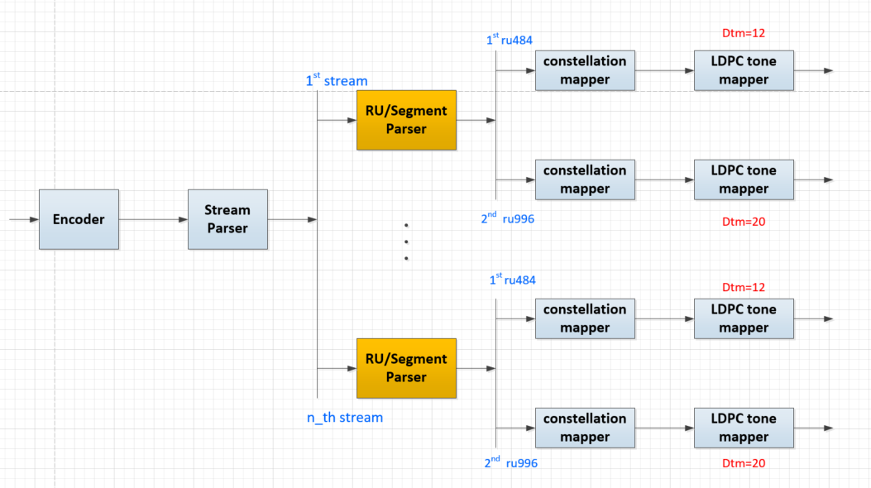
Example for 484+996 in 160MHz
484+996-tone RU Aggregation
tone interleaved within 80MHz

Slide 5
Joint Interleave v.s. Separated Tone Interleaver
For RU aggregation crossing 80MHz segments and 160/240/320MHz PPDU, we compared the performance of joint tone interleave and separate tone interleave.
To get optimal DTM, we allow some tones (Ndrop) are not interleaver.
DTM for joint tone interleave crossing 80MHz segment
RU combine | vNsd | Dtm | Ndrop
484+996 | 1448 | 38 or (32) or (36) or (30) | 4 or (8) or (8) or (8)
(242+484)+996 | 1682 | 41 or (40) or (29) or (35) | 1 or (2) or (0) or (2)
484+2*996 | 2428 | 55 (or 44) | 8 (or 8)
484+3*996 | 3408 | 71 (or 48) | 0 (or 0)
2*996 | 1960 | 40 | 0
3*996 | 2940 | 60 or (49) | 0 or (0)
4*996 | 3920 | 80 or (70) or (56) | 0

Slide 6
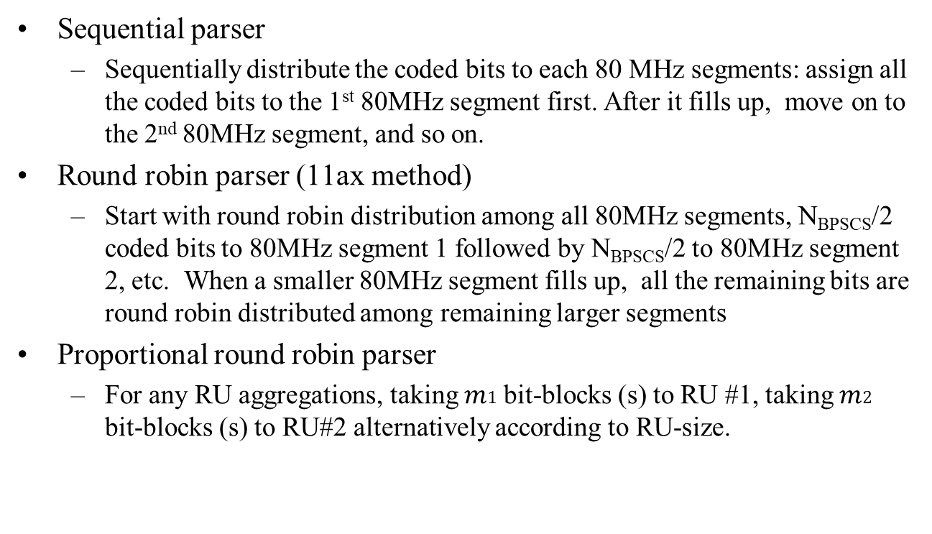
Options for Segment Parser
Sequential parser
  Sequentially distribute the coded bits to each 80 MHz segments: assign all the coded bits to the 1st 80MHz segment first. After it fills up, move on to the 2nd 80MHz segment, and so on.
Round robin parser (11ax method)
  Start with round robin distribution among all 80MHz segments, N_{BPSCS}/2 coded bits to 80MHz segment 1 followed by N_{BPSCS}/2 to 80MHz segment 2, etc. When a smaller 80MHz segment fills up, all the remaining bits are round robin distributed among remaining larger segments
Proportional round robin parser
  For any RU aggregations, taking $m1$ bit-blocks (s) to RU #1, taking $m2$ bit-blocks (s) to RU#2 alternatively according to RU-size.

Slide 7

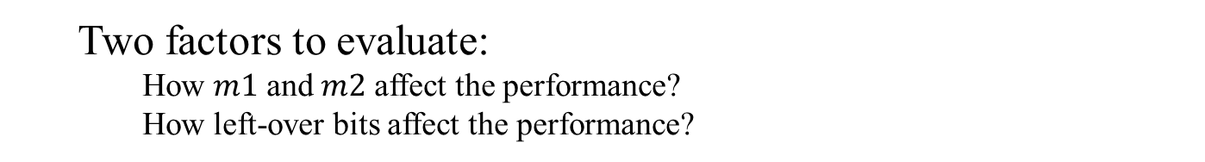
Proposed RU/Segment Parser
  Two factors to evaluate:
    How $m1$ and $m2$ affect the performance?
    How left-over bits affect the performance?
Proposed ratio m1:m2:m3:m4 for proportional round robin parser
RU Aggregation | Nsd_total | Proportional Ratio (m1:m2:m3:m4) | Leftover bits (per symbol)
484+996 | 1448 | 1s:2s | 44*Nbpscs on ru996
(242+484)+996 | 1682 | 3s:4s | 44*Nbpscs on ru996
484+2*996 | 2428 | 1s:2s:2s | 44*Nbpscs on ru996
484+3*996 | 3408 | 1s:2s:2s:2s | 44*Nbpscs on ru996
2*996 | 1960 | 1s:1s | 0
3*996 | 2940 | 1s:1s:1s | 0
4*996 | 3920 | 1s:1s:1s:1s | 0
Where:

Slide 8
Summary on Results in [2]
Simulation results show that the smallest proportion provides the best performance.
  Larger proportion causes 0.2dB to 0.6dB performance loss.
Simulation results show that joint tone interleave crossing 80MHz segment has almost the same performance as proportional round robin.
  Joint tone interleave crossing 80MHz segment requires significant architecture change.
  Optimal DTM for joint tone interleave needs extra processing on dropped out tones.
Different treatments on left-over bits have no impact on performance.
  The simplest scheme is to apply the same proportional round robin on left-over bits.

Slide 9
Updated Slides
Added the formula description of the proposed propositional round robin scheme.
Added simulations of proposed segment parser under channel D.
Added discussions and comparison with schemes proposed in [3] and [4].

Slide 10
Proportional Round Robin Parser (1/3)
RU combine | Nsd_total | Proportional Ratio (m0:m1:m2:m3) | Leftover bits (per symbol)
484+996 | 1448 | 1s:2s | 44*Nbpscs on ru996
(242+484)+996 | 1682 | 3s:4s | 44*Nbpscs on ru996
484+2*996 | 2428 | 1s:2s:2s | 44*Nbpscs on ru996
484+3*996 | 3408 | 1s:2s:2s:2s | 44*Nbpscs on ru996
2*996 | 1960 | 1s:1s | 0
3*996 | 2940 | 1s:1s:1s | 0
4*996 | 3920 | 1s:1s:1s:1s | 0
Where:
To 1st RU996
To 2nd RU996
Leftover bits

Slide 11




Proportional Round Robin Parser (2/3)
NOTE: this generalized equation works for all cases of RU aggregations, such as 484+2x996, 3x996, 2x996, etc

Slide 12


Proportional Round Robin Parser (3/3)
*Special thanks to Wook Bong Lee for correcting errors in the above formula.

Slide 13


11ax Segment Parser vs. 11be PRR Parser
11ax segment parser:
11be PRR segment parser:

Slide 14
Simulations of Proportional Round Robin Parser (over D-NLOS channel)

Slide 15
BW160, RU484+996, D-NLOS, MCS7, 2x1

Slide 16
BW160, RU484+996, D-NLOS, MCS11, 4x2

Slide 17
BW160, RU(242+484)+996, D-NLOS, MCS7, 4x2

Slide 18
BW240, RU484+2x996, D-NLOS, MCS5, 2x1

Slide 19
Proportional Round Robin Parser (with larger ratio [3])
Larger ratio m0:m1:m2:… but without leftover bits
RU combine | vNsd | Across-80M Ratio | Proportional Ratio (m0:m1:m2:m3) | Leftover bits (per symbol)
484+996 | 1448 | 468/980 | 117s:245s | 0
(242+484)+996 | 1682 | 702/980 | 351s:490s | 0
484+2*996 | 2428 | 468/980 | 117s:245s:245s | 0
484+3*996 | 3408 | 468/980 | 117s:245s:245s:245s | 0
Larger ratio causes performance loss

Slide 20
Proportional Round Robin Parser (with larger ratio)

Slide 21
Proportional Round Robin Parser (with larger ratio)

Slide 22
Discussions on Different PRR Schemes
In [3], a larger ratio of PRR scheme has been proposed to avoid left-over bits.
  There is no performance loss with left-over bits, no need to avoid them.
  Our simulation shows there is 0.2dB to 0.6dB performance loss for larger proportion PRR
  All of simulations use 1944 length LDPC code, so long LDPC code can not reduce the performance gap.
In [4], PRR with multiple ratios has been proposed.
  There is no performance loss with left-over bits, no need to avoid them.
  Multiple ratio switch points during the packet TX encoding/RX decoding cause extra complexity.
  It is unclear how this extends to 3 or 4 segments for 448+996x2 and 448+996x3. It can be more complicated.
    Compared to [4], our PRR scheme has the left-over tones either 0 or 44 no matter how many segments.

Slide 23
Straw Poll #1
Do you agree that 11be uses 80HMz segment parser with the following parameters for proportional round robin scheme?
RU Aggregation | Nsd_total | Proportional Ratio (m1:m2:m3:m4) | Leftover bits (per symbol)
484+996 | 1448 | 1s:2s | 44*Nbpscs on ru996
484+2*996 | 2428 | 1s:2s:2s | 44*Nbpscs on ru996
484+3*996 | 3408 | 1s:2s:2s:2s | 44*Nbpscs on ru996
2*996 | 1960 | 1s:1s | 0
3*996 | 2940 | 1s:1s:1s | 0
4*996 | 3920 | 1s:1s:1s:1s | 0
Where:

Slide 24
Straw Poll #2
Do you agree the same proportional round robin is applied to left-over bits?
  The same ratios are used in the entire segment parsing process except the ratios of those already filled segment becomes 0.
To 1st RU
To 2nd RU
Leftover bits

Slide 25
References
[1] “Compendium of straw polls and potential changes to the Specification Framework Document”, Edward Au, IEEE 802.11-20/0566r0.
[2] “Segment Parser and Tone Interleaver for 11be”, IEEE 802.11-20/0440r1, Jianhan Liu, etc.
[3] “Discussions on Multi RU aggregation”, IEEE 802.11-20/0495r1, Tianyu Wu.
[4] “Segment parsing for punctured transmissions”, IEEE 802.11-20/0478r0, Sigurd Schelstraete, etc.

Slide 26
Back Up Slides

Slide 27
Study on Proportional Round Robin Ratio
Observation:
The smallest proportion provides the best performance.

Slide 28
The effect of m1 and m2 on RU996+996
Note: the largest step-size corresponds to sequential parser

Slide 29
The effect of m1 and m2 on RU484+996
Note: the largest step-size corresponds to sequential parser

Slide 30
The effect of m1 and m2 on RU(242+484)+996
Note: the largest step-size corresponds to sequential parser

Slide 31
Joint Interleave vs. Separate Interleave
Observations:
Joint tone interleaver crossing 80MHz segment with optimal DTM have same performance as separated tone interleave.
Proportional round robin outperforms round robin by 0.2~0.5dB.

Slide 32
Joint Tone Interleaver Across 80M segment vs Per-80M Segment Tone Interleaver

Slide 33
RU484+996, MCS9, 2x1, BF off, B-LOS

Slide 34
Simulation Results: RU484+2*996, MCS5, 2x1, BF on, B-LOS

Slide 35
Simulation Results: RU484+3*996, MCS5, 1x1, BF off, B-LOS

Slide 36
Simulation Results: RU484+996, MCS7, 2x1, BF on, B-LOS

Slide 37
Simulation Results: RU(242+484)+996, MCS7, 4x2, BF on, B-LOS

Slide 38
Study on Left-over Bits
Observations:
Different treatments on left-over bits have no impact on performance.

Slide 39
Treatments of left-over tones
1. Sequentially Distribute the leftover bits over last 44 tones on each RU996
To 1st RU996
To 2nd RU996
Leftover bits
2. Proportional Distribute the leftover bits over last 44 tones between RU996
To 1st RU996
To 2nd RU996
Leftover bits
3. Evenly Distribute the leftover bits over each RU996
N iterations
Extra m2, m3
N iterations
Extra m2, m3
Every N iterations, get one more extra m2 s-blk for 1st RU996, and m3 s-blk for 2nd RU996

Slide 40
Simulation Results: RU484+3*996, MCS9, 1x1, BF off, B-LOS

Slide 41
Simulation Results: RU484+996, MCS10, 2x1, BF on, B-LOS

Slide 42
Simulation Results: RU484+996, MCS9, 4x2, BF on, B-LOS

