Slide 1
On RU Allocation Singling in EHT-SIG
Date: 2020-03-31
Authors:
Name | Affiliations | Address | Phone | Email
Jianhan Liu | Mediatek |  |  | Jianhan.liu@mediatek.com
Shengquan Hu
Thomas Pare

Slide 2
RU Signaling in 11be SFD
In the 11be SFD, the passed motions imply that the EHT-SIG signaling are similar to11ax HE-SIGB.
The EHT-SIG (immediately after the U-SIG) in an EHT PPDU sent to multiple users shall have a common field and user-specific field(s).
Special case compressed modes (e.g., full BW MU-MIMO) are TBD.
[Motion 44, [3] and [21]]
An RU Allocation subfield is present in the Common field of the EHT-SIG field of an EHT PPDU sent to multiple users.
Compressed modes are TBD.
Contents of the RU Allocation subfield are TBD.
[Motion 57, [9] and [25]]
The pass motions imply that RU allocation signaling schemes in EHT-SIG is similar to the signaling scheme in 11ax HE-SIGB.

Slide 3
Proposals on RU Signaling in 11be
In IEEE 802.11be teleconference call, quite a few people proposed the RU allocation signaling schemes based on 11ax HE-SIGB.
0370r0, “RU Allocation Subfield Design for Multi-RU Support”, Wook Bong Lee (Samsung)
0400r0, “Multi-RU Combination and Signaling”, Ross Yu (Huawei)
0403r0, “Signaling of Multiple RU aggregation in OFDMA”, Dongguk Lim (LG)
All three proposals proposed schemes to extend the RU allocation table by adding two bits.

Slide 4
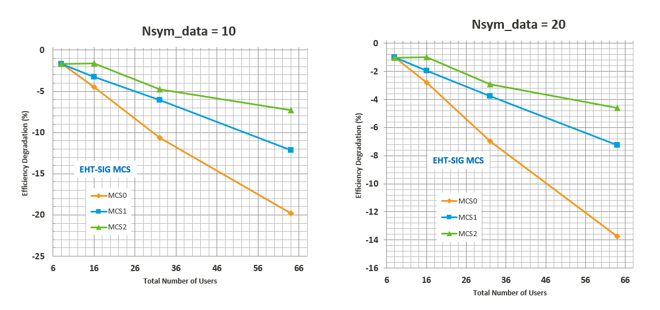
On EHT-SIG Efficiency
We evaluated that trigger-based RU singling method (or self-contained) degrade efficiency for relatively large number of users.

Slide 5
RU Allocation Subfield Table
We agree to extend 2 bits for RU allocation table to include aggregated RU, large bandwidth and more users for MU-MIMO (16 SS).
We organize the RU allocation table by RU size.
Adding two bits to RU allocation subfields to extend the RU allocation table (similar to proposals by Samsung, Huawei and LG).
Organized by small RUs and large RUs.
The detailed format of RU allocation table for 11be is up to further discussions.

Slide 6
RU Allocation Subfield Table: Small RU (1/2)
B9 | B8B7….B1B0 | #1 | #2 | #3 | #4 | #5 | #6 | #7 | #8 | #9 | # of Entries
0 | 0 ("000000000") | 26 | 26 | 26 | 26 | 26 | 26 | 26 | 26 | 26 | 1
0 | 1 ("000000001") | 26 | 26 | 26 | 26 | 26 | 26 | 26 | 52 |  | 1
0 | 2("000000010") | 26 | 26 | 26 | 26 | 26 | 52 |  | 26 | 26 | 1
0 | 3 ("000000011") | 26 | 26 | 26 | 26 | 26 | 52 |  | 52 |  | 1
0 | 4 ("000000100") | 26 | 26 | 52 |  | 26 | 26 | 26 | 26 | 26 | 1
0 | 5 ("000000101") | 26 | 26 | 52 |  | 26 | 26 | 26 | 52 |  | 1
0 | 6 ("000000110") | 26 | 26 | 52 |  | 26 | 52 |  | 26 | 26 | 1
0 | 7 ("000000111") | 26 | 26 | 52 |  | 26 | 52 |  | 52 |  | 1
0 | 8 ("000001000") | 52 |  | 26 | 26 | 26 | 26 | 26 | 26 | 26 | 1
0 | 9 ("000001001") | 52 |  | 26 | 26 | 26 | 26 | 26 | 52 |  | 1
0 | 10 ("000001010") | 52 |  | 26 | 26 | 26 | 52 |  | 26 | 26 | 1
0 | 11 ("000001011") | 52 |  | 26 | 26 | 26 | 52 |  | 52 |  | 1
0 | 12 ("000001100") | 52 |  | 52 |  | 26 | 26 | 26 | 26 | 26 | 1
0 | 13 ("000001101") | 52 |  | 52 |  | 26 | 26 | 26 | 52 |  | 1
0 | 14 ("000001110") | 52 |  | 52 |  | 26 | 52 |  | 26 | 26 | 1
0 | 15 ("000001111") | 52 |  | 52 |  | 26 | 52 |  | 52 |  | 1
0 | 16~23 ("000010y2y1y0") | 52 |  | 52 |  | / | 106 |  |  |  | 8
0 | 24~31 ("000011y2y1y0") | 106 |  |  |  | / | 52 |  | 52 |  | 8
0 | 32~39 ("000100y2y1y0") | 26 | 26 | 26 | 26 | 26 | 106 |  |  |  | 8
0 | 40~47 ("000101y2y1y0") | 26 | 26 | 52 |  | 26 | 106 |  |  |  | 8
0 | 48~55 ("000110y2y1y0") | 52 |  | 26 | 26 | 26 | 106 |  |  |  | 8
0 | 56~63 ("000111y2y1y0") | 52 |  | 52 |  | 26 | 106 |  |  |  | 8
0 | 64~71 ("001000y2y1y0") | 106 |  |  |  | 26 | 26 | 26 | 26 | 26 | 8
0 | 72~79 ("001001y2y1y0") | 106 |  |  |  | 26 | 26 | 26 | 52 |  | 8
0 | 80~87 ("001010y2y1y0") | 106 |  |  |  | 26 | 26 | 26 | 52 | 26 | 8
0 | 88~95 ("001011y2y1y0") | 106 |  |  |  | 26 | 52 |  | 52 |  | 8
0 | 96~111 ("001100y1y0z1z0") | 106 |  |  |  | / | 106 |  |  |  | 16
0 | 112 ("001110000") | 52 |  | 52 |  | / | 52 |  | 52 |  | 1
0 | 113~127 ("001110001"~"001111111") | reserved |  |  |  |  |  |  |  |  | 15
0 | 128~191 ("010y2y1y0z2z1z0") | 106 |  |  |  | 26 | 106 |  |  |  | 64
0 | 192~255 ("011000000"~"011111111") | reserved |  |  |  |  |  |  |  |  | 64

Slide 7
RU Allocation Subfield Table: Small RU (2/2)
B9 | B8B7….B1B0 | #1 | #2 | #3 | #4 | #5 | #6 | #7 | #8 | #9 | # of Entries
0 | 256 ("100000000") | 26 | 78 |  |  | 26 | 26 | 26 | 26 | 26 | 1
0 | 257 ("100000001") | 26 | 78 |  |  | 26 | 26 | 26 | 52 |  | 1
0 | 258 ("100000010") | 26 | 78 |  |  | 26 | 52 |  | 26 | 26 | 1
0 | 259 ("100000011") | 26 | 78 |  |  | 26 | 52 |  | 52 |  | 1
0 | 260 ("100000100") | 26 | 26 | 26 | 26 | 26 | 78 |  |  | 26 | 1
0 | 261 ("100000101") | 52 |  | 26 | 26 | 26 | 78 |  |  | 26 | 1
0 | 262 ("100000110") | 26 | 26 | 52 |  | 26 | 78 |  |  | 26 | 1
0 | 263 ("100000111") | 52 |  | 52 |  | 26 | 78 |  |  | 26 | 1
0 | 264 ("100001000") | 26 | 78 |  |  | 26 | 78 |  |  | 26 | 1
0 | 265~287 ("100001001"~100011111") | reserved |  |  |  |  |  |  |  |  | 22
0 | 288~295 ("100100y2y1y0") | 26 | 78 |  |  | 26 | 106 |  |  |  | 8
0 | 296~303 ("100101y2y1y0") | 106 |  |  |  | 26 | 78 |  |  | 26 | 8
0 | 304~311 ("100110y2y1y0") | 132 |  |  |  |  | 26 | 26 | 26 | 26 | 8
0 | 312~319 ("100111y2y1y0") | 132 |  |  |  |  | 26 | 26 | 52 |  | 8
0 | 320~327 ("101000y2y1y0") | 132 |  |  |  |  | 52 |  | 26 | 26 | 8
0 | 328~335 ("101001y2y1y0") | 132 |  |  |  |  | 52 |  | 52 |  | 8
0 | 336~343 ("101010y2y1y0") | 26 | 26 | 26 | 26 | 132 |  |  |  |  | 8
0 | 344~351 ("101011y2y1y0") | 52 |  | 26 | 26 | 132 |  |  |  |  | 8
0 | 352~359 ("101100y2y1y0") | 26 | 26 | 52 |  | 132 |  |  |  |  | 8
0 | 360~367 ("101101y2y1y0") | 52 |  | 52 |  | 132 |  |  |  |  | 8
0 | 368~375 ("101110y2y1y0") | 26 | 78 |  |  | 132 |  |  |  |  | 8
0 | 376~383 ("101111y2y1y0") | 132 |  |  |  |  | 78 |  |  | 26 | 8
0 | 384~447 ("110y2y1y0z2z1z0") | 132 |  |  |  |  | 106 |  |  |  | 64
0 | 448~511 ("111y2y1y0z2z1z0") | 106 |  |  |  | 132 |  |  |  |  | 64
NOTE-1: Another option is using LSB “B0” to indicate Small RU or Large RU
NOTE-2: Small RU (including small M-RU) is defined as size < 242; Large RU (including large M-RU) is defined as size >=242
NOTE-3: In Small RU Allocation Subfield table, it is assumed that max. number of MU-MIMO users is limited to 8;

Slide 8
RU Allocation Subfield Table: Large RU
B9 | B8B7….B1B0 | #1 | #2 | #3 | #4 | #5 | #6 | #7 | #8 | #9 | #10 | #11 | #12 | #13 | #14 | #15 | #16 | Number of Entries
1 | "00000y3y2y1y0" | 242 |  |  |  |  |  |  |  |  |  |  |  |  |  |  |  | up to 16
1 | "00001y3y2y1y0" | 484 |  |  |  |  |  |  |  |  |  |  |  |  |  |  |  | up to 16
1 | "00010y3y2y1y0" | 996 |  |  |  |  |  |  |  |  |  |  |  |  |  |  |  | up to 16
1 | "00011y3y2y1y0" | 2x996 |  |  |  |  |  |  |  |  |  |  |  |  |  |  |  | up to 16
1 | "00100y3y2y1y0" |  | 242 | 484 |  |  |  |  |  |  |  |  |  |  |  |  |  | up to 16
1 | "00101y3y2y1y0" | 242 |  | 484 |  |  |  |  |  |  |  |  |  |  |  |  |  | up to 16
1 | "00110y3y2y1y0" | 484 |  |  | 242 |  |  |  |  |  |  |  |  |  |  |  |  | up to 16
1 | "00111y3y2y1y0" | 484 |  | 242 |  |  |  |  |  |  |  |  |  |  |  |  |  | up to 16
1 | "01000y3y2y1y0" |  |  | 484 |  | 996 |  |  |  |  |  |  |  |  |  |  |  | up to 16
1 | "01001y3y2y1y0" | 484 |  |  |  | 996 |  |  |  |  |  |  |  |  |  |  |  | up to 16
1 | "01010y3y2y1y0" | 996 |  |  |  |  |  | 484 |  |  |  |  |  |  |  |  |  | up to 16
1 | "01011y3y2y1y0" | 996 |  |  |  | 484 |  |  |  |  |  |  |  |  |  |  |  | up to 16
1 | "01100y3y2y1y0" |  |  | 484 |  | 996 |  |  |  | 996 |  |  |  |  |  |  |  | up to 16
1 | "01101y3y2y1y0" | 484 |  |  |  | 996 |  |  |  | 996 |  |  |  |  |  |  |  | up to 16
1 | "01110y3y2y1y0" | 996 |  |  |  |  |  | 484 |  | 996 |  |  |  |  |  |  |  | up to 16
1 | "01111y3y2y1y0" | 996 |  |  |  | 484 |  |  |  | 996 |  |  |  |  |  |  |  | up to 16
1 | "10000y3y2y1y0" | 996 |  |  |  | 996 |  |  |  |  |  | 484 |  |  |  |  |  | up to 16
1 | "10001y3y2y1y0" | 996 |  |  |  | 996 |  |  |  | 484 |  |  |  |  |  |  |  | up to 16
1 | "10010y3y2y1y0" | 996 |  |  |  | 996 |  |  |  | 996 |  |  |  |  |  |  |  | up to 16
1 | "10011y3y2y1y0" | 996 |  |  |  | 996 |  |  |  |  |  |  |  | 996 |  |  |  | up to 16
1 | "10100y3y2y1y0" | 996 |  |  |  |  |  |  |  | 996 |  |  |  | 996 |  |  |  | up to 16
1 | "10101y3y2y1y0" |  |  |  |  | 996 |  |  |  | 996 |  |  |  | 996 |  |  |  | up to 16
1 | "101100000" |  | 242 | 484 |  | 996 |  |  |  |  |  |  |  |  |  |  |  | 1
1 | "101100001" | 242 |  | 484 |  | 996 |  |  |  |  |  |  |  |  |  |  |  | 1
1 | "101100010" | 484 |  |  | 242 | 996 |  |  |  |  |  |  |  |  |  |  |  | 1
1 | "101100011" | 484 |  | 242 |  | 996 |  |  |  |  |  |  |  |  |  |  |  | 1
1 | "101100100" | 996 |  |  |  |  | 242 | 484 |  |  |  |  |  |  |  |  |  | 1
1 | "101100101" | 996 |  |  |  | 242 |  | 484 |  |  |  |  |  |  |  |  |  | 1
1 | "101100110" | 996 |  |  |  | 484 |  |  | 242 |  |  |  |  |  |  |  |  | 1
1 | "101100111" | 996 |  |  |  | 484 |  | 242 |  |  |  |  |  |  |  |  |  | 1
1 | "101101000" |  |  |  |  | 996 |  |  |  | 996 |  |  |  |  |  |  |  | 1
1 | "101101001" | 996 |  |  |  |  |  |  |  | 996 |  |  |  |  |  |  |  | 1
1 | "101101010" | 242 (for empty RU with zero user) |  |  |  |  |  |  |  |  |  |  |  |  |  |  |  | 1
1 | "101101011" | 484 (for empty RU with zero user) |  |  |  |  |  |  |  |  |  |  |  |  |  |  |  | 1
1 | "101101100" | 996 (for empty RU with zero user) |  |  |  |  |  |  |  |  |  |  |  |  |  |  |  | 1
1 | "101101101"~ "101111111" | reserved |  |  |  |  |  |  |  |  |  |  |  |  |  |  |  | 19
1 | "11000y3y2y1y0" | 996 |  |  |  | 996 |  |  |  | 996 |  |  |  | 484 |  |  |  | up to 16
1 | "11001y3y2y1y0" | 996 |  |  |  | 996 |  |  |  | 996 |  |  |  |  |  | 484 |  | up to 16
1 | "11010y3y2y1y0" | 996 |  |  |  | 996 |  |  |  | 484 |  |  |  | 996 |  |  |  | up to 16
1 | "11011y3y2y1y0" | 996 |  |  |  | 996 |  |  |  |  |  | 484 |  | 996 |  |  |  | up to 16
1 | "11100y3y2y1y0" | 996 |  |  |  | 484 |  |  |  | 996 |  |  |  | 996 |  |  |  | up to 16
1 | "11101y3y2y1y0" | 996 |  |  |  |  |  | 484 |  | 996 |  |  |  | 996 |  |  |  | up to 16
1 | "11110y3y2y1y0" | 484 |  |  |  | 996 |  |  |  | 996 |  |  |  | 996 |  |  |  | up to 16
1 | "11111y3y2y1y0" |  |  | 484 |  | 996 |  |  |  | 996 |  |  |  | 996 |  |  |  | up to 16

Slide 9
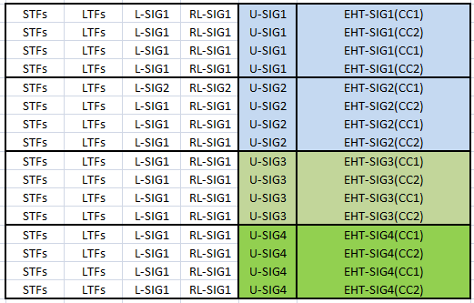
Problem to Solve: Flexibly indicate RUs in different EHT-SIGs
EHT-SIG shall have Common field and User Specific field
RU allocation subfield shall be present in Common field
EHT-SIG can be variant on each 80MHz segment
STA can park on any 80MHz segment
Each STA only need decode one 80MHz segment
U-SIG duplicated per-20MHz within 80MHz segment
Each 80MHz segment can have different U-SIG
BW and puncturing information to be carried on U-SIG
80MHz
80MHz
80MHz
80MHz

Slide 10
Header Bits for RU Location in EHT-SIG
Header bits:
To globally indicate each RU Allocation subfield for which RU or aggregate RU over the whole BW.
Header bits in each 80MHz can be different: allowing flexible indication of RU in any place and efficient signaling.
The number of Header bits can be BW dependent
For our proposed scheme, 8 bits are needed for 160MHz BW PPDU and 16 bits are needed for 320MHz BW PPDU.

Slide 11
Example for one 80MHz Segment
Common Field
User Specific Field
Header bits:
bit “1” position in the Header represents the location of each 242 RU
total number of “1” bits in the Header represents the total number of RU Allocation subfields
The Header bits length is BW and EHT-SIG Signaling Mode dependent
1st 80MHz
2nd 80MHz
3rd 80MHz
4th 80MHz
Starting for RA1
Starting for RA2
Starting for RA3
Starting for RA4

Slide 12
Example of EHT-SIG Signaling for two 80MHz Segments
1st 80MHz
2nd 80MHz
3rd 80MHz
4th 80MHz
Header bits and RU Allocation Subfields are signaled in the first 80M segment EHT-SIG
M-RU
Common field: “1000000010000000” RA1 RA3
Header bits and RU Allocation Subfields are signaled in the second 80M segment EHT-SIG
Common field: “0010000001000000” RA2 RA4
Slide 12
Jianhan Liu, Mediatek Inc.

Slide 13
Summary
We think 11ax HE-SIGB based RU signaling is the best scheme for RU signaling in the EHT preamble.
We present the RU allocation table organized by RU size.
We present a scheme to enable flexible RU signaling combined with per 80MHz EHT-SIG structure.

Slide 14
Straw Poll #1
Which option do you prefer to EHT-SIG RU allocation signaling (not for 11be SFD)?
Option 1: 11ax HE-SIGB based schemes
Option 2: Self-contained schemes

