Slide 1
RTS and CTS Procedure in Synchronous Multi-link Operation
Date: 2020-08-06
Authors:

Slide 2
Recap: Constrained Multi-Link Device (MLD)
A Constrained MLD is a MLD with which in-device coexistence (IDC) interference occurs when more than one STA within the MLD simultaneously transmits and receives frames on multiple links.
When simultaneous Tx and Rx occur on 2.4 GHz band and 5 GHz links, the IDC interference is probably negligible.
But, the IDC interference caused by simultaneous Tx and Rx on 5 GHz band and 6 GHz band links may be significantly worse depending on some implementation factors such as RF filter performance.

Slide 3
Recap: Constrained Multi-Link Device (MLD)
Synchronization requirement [1]
A difference between the ending times of PPDU transmissions shall be less than SIFS - (10%×aSlotTime).
Because a minimum inter-frame space is not less than SIFS, Tx and Rx are not overlapped.
A margin of 10%×aSlotTime considers the SIFS accuracy of the IEEE 802.11-2016 spec.
Difference between the ending times of the transmissions is less than SIFS - (10%×aSlotTime).
AP
Data
MAC Padding
PHY Padding
PE
6GHz
STA
SIFS
Ack
MAC Padding
PHY Padding
PE
AP
Data
MAC Padding
PHY Padding
PE
5GHz
STA
SIFS
Block Ack

Slide 4
RTS and CTS procedure for DL Synchronous MLO
When an AP MLD initiates a TXOP on multiple links with the RTS and CTS frames in a non-HT (duplicated) PPDU format, the ending time alignment of the transmissions may not be possible.
Because the non-HT (duplicated) PPDU does not support any MAC padding mechanism.
AP
RTS
6GHz
STA
No CTS
Interference
leakage
AP
RTS
A-MPDU
5GHz
STA
SIFS
CTS

Slide 5
RTS and CTS procedure for DL Synchronous MLO
The solution is to use the MU-RTS and CTS frames, where the MU-RTS frame has the Padding field.
The Padding field in the first MU-RTS frame is used to meet the ending times requirement. So, the CTS response of the first MU-RTS frame is delayed until the second RTS/MU-RTS frame on other link is received.
AP
RTS/MU-RTS
A-MPDU
6GHz
STA
SIFS
CTS
AP
MU-RTS
Padding
A-MPDU
5GHz
STA
SIFS
CTS

Slide 6
RTS and CTS procedure for DL Synchronous MLO
Simulation Setup
Topology
1 EHT AP and 1 EHT STA.
The distance between AP and STA is 10m.
Parameters:
Each UDP packet is 1460B. Each UDP packet burst is 14.6KB (10 UDP packets).
PPDU time is 5.484ms for MCS9 (390Mbps) and 3ms for MCS2 (87.8Mbps).

Slide 7
RTS and CTS procedure for DL Synchronous MLO
Simulation Setup
EHT AP Mode
MPC: Multiple Primary Channel (It supports the STR).
EHT STA Mode
Single Link.
AP not aligned: No ending time alignment.
AP aligned: The ending times of PPDUs carrying Data frames are aligned.
AP/RTS aligned: Besides the ending times of PPDUs carrying Data frames are aligned, the ending times of PPDUs carrying RTS and CTS frames are aligned.

Slide 8
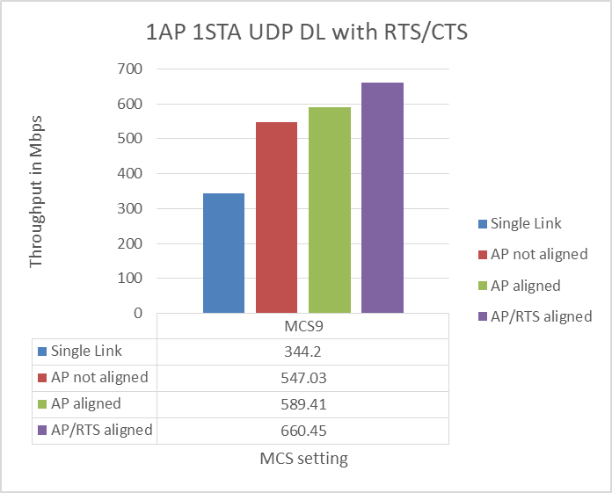
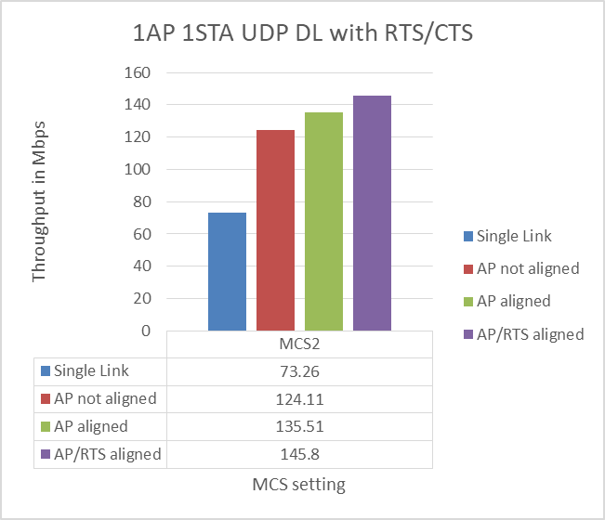
RTS and CTS procedure for DL Synchronous MLO
Simulation Results

Slide 9
Conclusion
When the AP MLD simultaneously transmits frames on multiple links to the constrained MLD, the ending time alignment of the DL transmissions always provides the best performance.
The MU-RTS frame with has the Padding field can support the ending time alignment for the RTS and CTS procedure.

Slide 10
References
[1] https://mentor.ieee.org/802.11/dcn/19/11-19-1305-00-00be-synchronous-multi-link-operation.pptx

Slide 11
Straw Poll 1
Do you support that the padding procedures of 11ax can be used when transmitting a Trigger frame to extend the frame length to meet the ending time requirement of the PPDU carrying the Trigger frame in the MLO?
NOTE- The Padding field in the Trigger frame is also included in the padding procedure.
Approved with unanimous consent

