Slide 1
RTS and CTS Procedure in Synchronous Multi-link Operation
Date: 2020-04-13
Authors:

Slide 2
Recap: Constrained Multi-Link Device (MLD)
A Constrained MLD is a MLD with which in-device coexistence (IDC) interference occurs when more than one STA within the MLD simultaneously transmits and receives frames on multiple links.
When simultaneous Tx and Rx occur on 2.4 GHz band and 5 GHz links, the IDC interference is probably negligible.
But, the IDC interference caused by simultaneous Tx and Rx on 5 GHz band and 6 GHz band links may be significantly worse depending on some implementation factors such as RF filter performance.

Slide 3
Recap: Constrained Multi-Link Device (MLD)
Synchronization requirement [1]
A difference between the ending times of PPDU transmissions shall be less than SIFS - (10%×aSlotTime).
Because a minimum inter-frame space is not less than SIFS, Tx and Rx are not overlapped.
A margin of 10%×aSlotTime considers the SIFS accuracy of the IEEE 802.11-2016 spec.
Difference between the ending times of the transmissions is less than SIFS - (10%×aSlotTime).
AP
Data
MAC Padding
PHY Padding
PE
6GHz
STA
SIFS
Ack
MAC Padding
PHY Padding
PE
AP
Data
MAC Padding
PHY Padding
PE
5GHz
STA
SIFS
Block Ack

Slide 4
RTS and CTS procedure for DL Synchronous MLO
When an AP MLD initiates a TXOP on multiple links with the RTS and CTS frames in a non-HT (duplicated) PPDU format, the ending time alignment of the transmissions may not be possible.
Because the non-HT (duplicated) PPDU does not support any MAC padding mechanism.
Back-off
AP
6
5
4
3
2
1
0
RTS
6GHz
STA
No CTS
Back-off
Interference
leakage
AP
2
1
0
RTS
A-MPDU
5GHz
STA
SIFS
CTS

Slide 5
RTS and CTS procedure for DL Synchronous MLO
The solution is to use the MU-RTS and CTS frames, where the MU-RTS frame has the Padding field.
The Padding field in the first MU-RTS frame is used to delay the CTS response of the first MU-RTS frame until the second MU-RTS frame on other link can be sent before the CTS response of the first MU-RTS frame.
Back-off
AP
6
5
4
3
2
1
0
MU-RTS
Padding
A-MPDU
6GHz
STA
SIFS
CTS
Back-off
AP
2
1
0
MU-RTS
Padding
A-MPDU
5GHz
STA
SIFS
CTS

Slide 6
RTS and CTS procedure for DL Synchronous MLO
The length of the Padding field in the first MU-RTS frame is based on the expected channel access latency on another link.
The expected channel access latency is determined to a value which is greater than or equal to the minimum among {AIFS[AC] + backoff counter for that AC * aSlotTime} for all ACs or specific one or more ACs.
And, the expected channel access latency shall be less than some threshold that is locally configured.
If the expected channel access latency meeting the above condition does not exist, the Padding field is not present in the MU-RTS frame.

Slide 7
RTS and CTS procedure for DL Synchronous MLO
Simulation Setup
Topology
1 EHT AP and 1 EHT STA.
The distance between AP and STA is 10m.
Parameters:
Each UDP packet is 1460B. Each UDP packet burst is 14.6KB (10 UDP packets).
PPDU time is 5.484ms for MCS9 (390Mbps) and 3ms for MCS2 (87.8Mbps).

Slide 8
RTS and CTS procedure for DL Synchronous MLO
Simulation Setup
EHT AP Mode
MPC: Multiple Primary Channel (It supports the STR).
EHT STA Mode
Single Link.
AP not aligned: No ending time alignment.
AP aligned: The ending times of PPDUs carrying Data frames are aligned.
AP/RTS aligned: Besides the ending times of PPDUs carrying Data frames are aligned, the ending times of PPDUs carrying RTS and CTS frames are aligned.

Slide 9
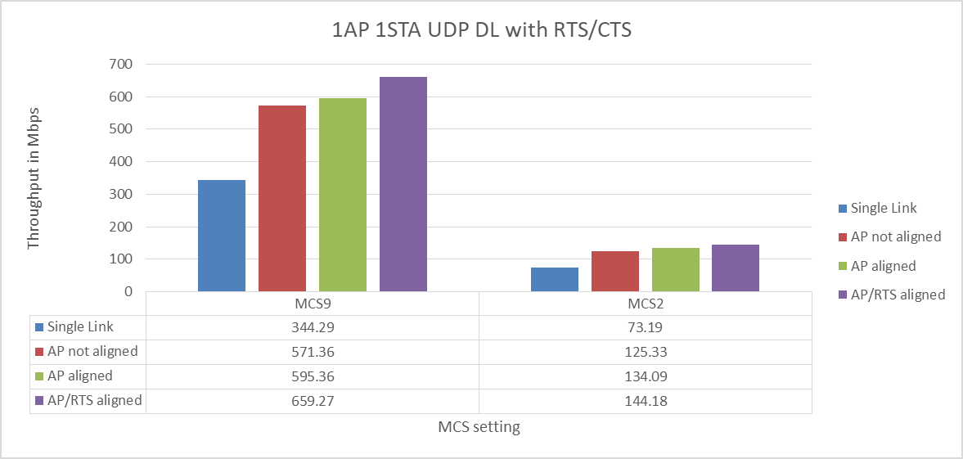
RTS and CTS procedure for DL Synchronous MLO
Simulation Results

Slide 10
RTS and CTS procedure for UL Synchronous MLO
When a transmission of a STA in a non-AP MLD causes an interference leakage which is greater than ED threshold to another STA in the same non-AP MLD, the channel access on another STA is paused.
The PIFS-based channel access can be a solution when the STAs in the non-AP MLD are operating in the same band.
AP
SIFS
CTS
6GHz
Back-off
STA
8
7
6
5
4
3
RTS
A-MPDU
PIFS
AP
Back-off
SIFS
CTS
6GHz
STA
5
4
3
2
1
0
RTS
A-MPDU

Slide 11
RTS and CTS procedure for UL Synchronous MLO
When the regulation does not allow the PIFS-based channel access, we propose that the backoff counters of STAs in the same MLD are set to the common value.
E.g., when the MLD simultaneously invokes the backoff procedure of more than one STAs in the same MLD,
Each STA in the MLD chooses a value randomly with a uniform distribution taking values in the range 0 to CW[AC].
The MLD determines the largest value among the chosen integer values to the common backoff counters.
AP
SIFS
CTS
6GHz
Back-off
STA
5
4
3
2
1
0
RTS
A-MPDU
Backoff counters of STAs in the MLD are set to the common value.
AP
Back-off
SIFS
CTS
5GHz
STA
5
4
3
2
1
0
RTS
A-MPDU

Slide 12
RTS and CTS procedure for UL Synchronous MLO
Even though the common backoff counter is used, if the slot boundaries of multiple links are not synchronized, the MLD can’t simultaneously obtain TXOPs.
To address this unsynchronized slot boundary issue, the slot boundaries of multiple links are synchronized as the following.
The backoff procedure for each STA on multiple links is resumed with the same slot boundary.
Slot boundary
AP
BlockAck
MAC Padding
PHY Padding
6GHz
Back-off
STA
Data
MAC Padding
PHY Padding
AIFS
2
1
0
Data
AP
BlockAck
MAC Padding
PHY Padding
5GHz
Back-off
STA
Data
MAC Padding
PHY Padding
AIFS
2
1
0
Data

Slide 13
RTS and CTS procedure for UL Synchronous MLO
Simulation Setup
Topology
5 OBSS legacy APs and STAs on Link 1.
5 OBSS legacy APs and STAs on Link 2.
1 EHT AP and 1 EHT STA
EHT AP: STR AP MLD.
EHT STA: non-STR non-AP MLD.
Parameters:
Background traffic
Symmetrical UDP traffic on both links.
Different % of loading is tested.
Randomized TXOP limit between 1ms and 5.4ms for each AP <-> STA.
Each UDP packet is 1460B. Each UDP packet burst is 14.6KB (10 UDP packets).

Slide 14
RTS and CTS procedure for UL Synchronous MLO
Simulation Setup
EHT AP Mode
MPC: Multiple Primary Channel (It supports the STR).
EHT STA Mode
SLK: Single Link.
SPC: Single Primary Channel.
C+MPC: Constraint Multiple Primary Channel.. When there is tx on one link, the EDCA of the other link will be deaf.
C+MPC+: Same as C+MPC, but when one link backoff counter reaches 0, it allows the other link to do PIFS check and transmits if it’s clean.
C+MPC-Align-RTS: Same as C+MPC, when backoff has started on one link, the other link will choose a backoff time so both backoff end at the same time. RTS will be sent on both link at the same time.

Slide 15
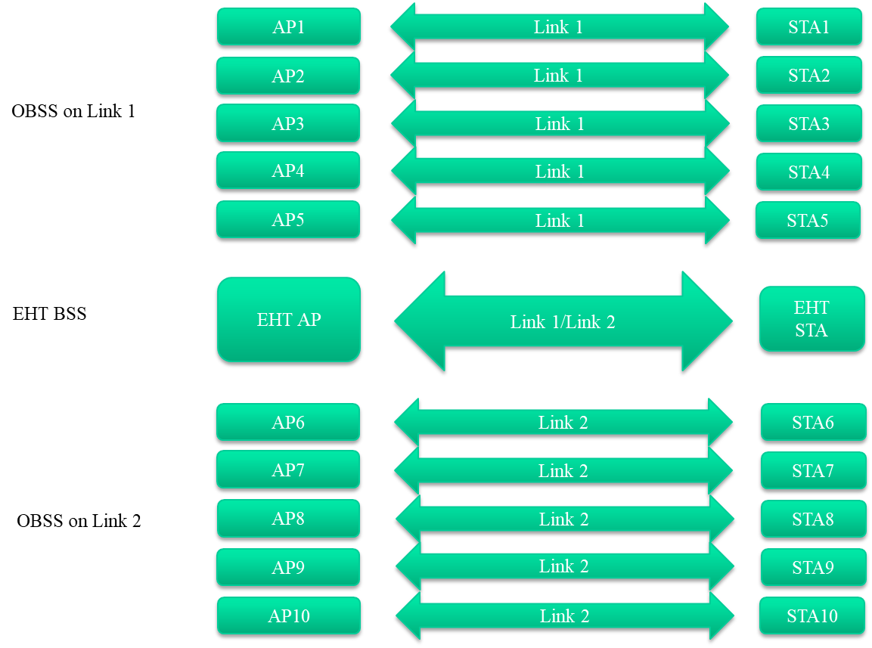
RTS and CTS procedure for UL Synchronous MLO

Slide 16
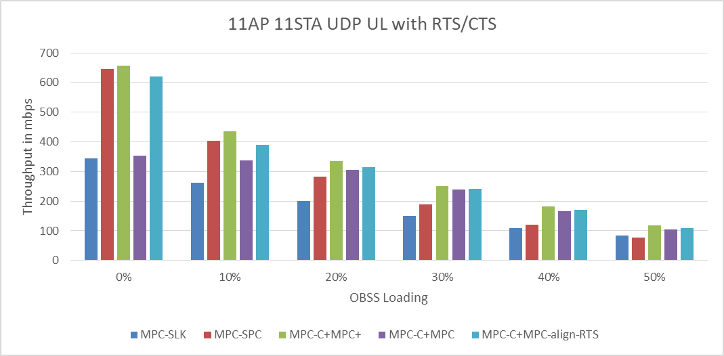
RTS and CTS procedure for UL Synchronous MLO
Simulation Results

Slide 17
Conclusion
When the AP MLD simultaneously transmits frames on multiple links to the constrained MLD, the ending time alignment of the DL transmissions always provides the best performance.
The MU-RTS frame with has the Padding field can support the ending time alignment for the RTS and CTS procedure.
In order to support the simultaneous UL transmissions from the constrained MLD, when more than one STAs in the constrained MLD invoke the backoff procedure at the same time, the backoff counters of STAs are set to the common value.

Slide 18
References
[1] https://mentor.ieee.org/802.11/dcn/19/11-19-1305-00-00be-synchronous-multi-link-operation.pptx

Slide 19
Straw Poll 1
Do you support the ending time alignment of the RTS and CTS procedure through the MU-RTS frame?

Slide 20
Straw Poll 2
Do you support the backoff counters of STAs in the constrained MLD are set to the common value when the backoff procedures of the STAs are invoked at the same time?

