Slide 1
Coordinated Spatial Reuse (C-SR) Protocol
Date: 2020-05-07
Authors:

Slide 2
Motivation
Previous contributions [1-3] showed the performance gain of the multi-AP coordinated spatial reuse.
This contribution proposes a general coordinated spatial reuse protocol.

Slide 3
Assumptions
An AP does not manage its OBSS STAs
APs participating in a C-SR are in range of each other
TXOP Owner orchestrates the C-SR transmission in a SR TXOP
No backhaul coordination between APs, instead the coordination via over-the-air signaling

Slide 4
C-SR General Procedure
The C-SR general procedure consist of C-SR phse1 (interference measurement & report) and C-SR phase 2 (C-SR transmission) in a single TXOP.
  But, the C-SR phase 1 for the interference measurement & report is not always required before the C-SR transmission. It can be skipped.
TXOP
AP1
Trigger
Trigger
C-SR Announcement
A-MPDU
STA11
TB PPDU
BA
C-SR transmission
AP2
Measure RSSI
Per-RU RSSI Report
CCA
A-MPDU
STA21
BA
C-SR Phase 1: Interference measurement & report
C-SR Phase 2: C-SR Transmission

Slide 5
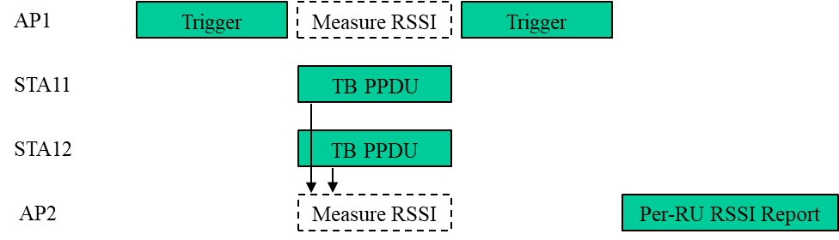
C-SR Phase 1: Interference measurement & report
A sharing AP among the AP candidate set for the C-SR solicits TB PPDUs (e.g., BSR, BFR) from its associated STAs.
  The sharing AP specifies in the User Info fields in the Trigger frame one or more shared AP(s) among the AP candidate set to request the RSSI measurement on each RU allocated in the soliciting Trigger frame.
The sharing AP and the requested shared AP(s) measure the RSSI on each RU, and the shared AP(s) reports to the sharing AP the Per-RU RSSI Report frame having the measurement results.
  The sharing AP may send the Trigger frame to get the Per-RU RSSI Reports from multiple shared APs simultaneously.

Slide 6
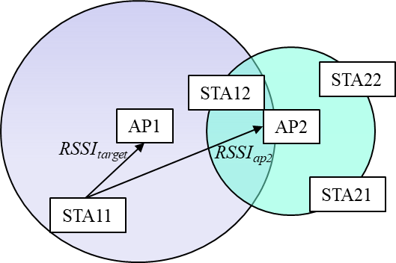
C-SR Phase 1: Interference measurement & report
Since the shared AP (e.g., AP2) reports RSSI_{ap2} in the Per-RU RSSI Report frame to the sharing AP (e.g., AP1), the sharing AP can calculate the interference level (RSSI_{target} – RSSI_{ap2}) caused by the shared AP (e.g., AP2) on its associated STA (STA11) when the AP1 and the AP2 simultaneously transmit the downlink frames at the same transmit power.
  NOTE- See the detail in the Slide 18.

Slide 7
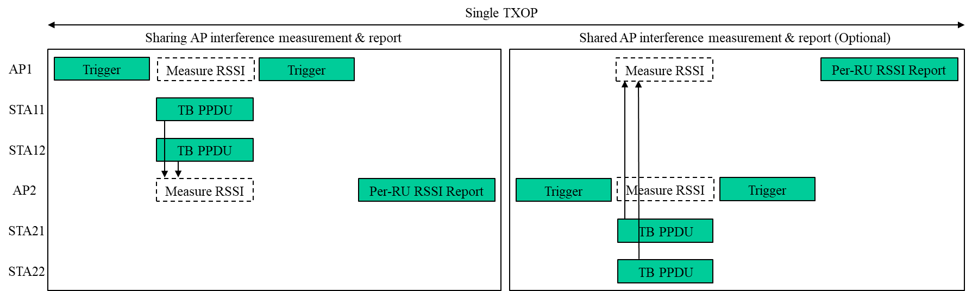
C-SR Phase 1: Interference measurement & report
Each sharing AP among the AP candidate set for the C-SR performs the interference measurement and report procedure at its owned TXOP.
The shared AP can sequentially perform the interference measurement and report procedure at the sharing AP's TXOP when the sharing AP allows.
  The first Per-RU RSSI Report contains the measured RSSI on the shared AP.
  The second Per-RU RSSI Report contains the measured RSSI on the sharing AP.

Slide 8
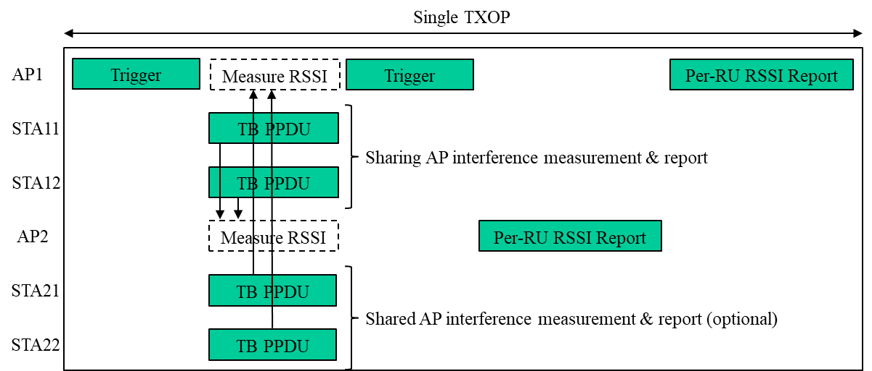
C-SR Phase 1: Interference measurement & report
The sharing AP and shared AP can perform the interference measurement and report procedure simultaneously in an OFDMA manner when the sharing AP allows.
  The STAs associated with the shared AP respond with the TB PPDU when the Trigger frame sent by the sharing AP requests to perform the interference measurement and report procedure.
  The first Per-RU RSSI Report contains the measured RSSI on the shared AP side.
  The second Per-RU RSSI Report contains the measured RSSI on the sharing AP side.

Slide 9
C-SR Phase 2: C-SR Transmission
A sharing AP among the AP candidate set for the C-SR initiates the C-SR transmission by sending the C-SR Announcement frame.
The shared AP performs the CCA during the SIFS after the C-SR Announcement frame.
  The shared AP disregards the NAV set by the sharing AP.
If both the physical and virtual CS are idle, the shared AP exchanges frames with its associated STAs during the C-SR duration time within the C-SR bandwidth.

Slide 10
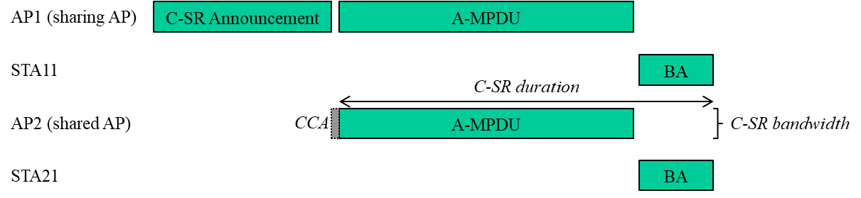
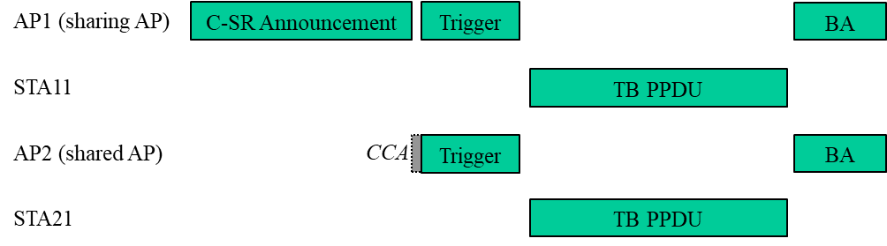
C-SR Phase 2: C-SR Transmission
C-SR DL transmission
C-SR UL TB transmission

Slide 11
C-SR Phase 2: C-SR Transmission
The C-SR Announcement frame specifies for each shared AP that is granted in the C-SR transmission the following constraints:
  The C-SR duration (in units of TU).
  The C-SR bandwidth (P20, P40, P80, P160, P240, P320).
  The C-SR maximum transmit power of shared AP (in units of dBm).
    The transmit power of the shared AP shall be less than or equal to the C-SR maximum transmit power of shared AP.
    When the sharing AP schedules the downlink PPDU, the C-SR maximum transmit power of shared AP is used for limiting the interference level caused by the shared AP on the sharing AP’s scheduled STA.
  The C-SR transmit power of sharing AP (in units of dBm).
    When the shared AP schedules the downlink C-SR transmission, the C-SR transmit power of the sharing AP is used for calculating the interference level caused by the sharing AP on the scheduled STA.

Slide 12
C-SR Phase 2: C-SR Transmission
The C-SR Announcement frame specifies for each shared AP that is granted in the C-SR transmission the following constraints:
  The C-SR tolerable maximum interference signal strength (in units of dBm).
    The total interference signal strength effecting to the sharing AP shall be less than the C-SR tolerable maximum interference signal strength indicated in the C-SR Announcement frame.
    If the C-SR tolerable maximum interference signal strength is set to 0, the shared AP in the C-SR TXOP can’t solicit TB PPDUs except for the TB PPDU for the control response frame.
  The C-SR shared AP interference signal strength (in units of dBm).
    The C-SR shared AP interference signal strength indicates the total interference signal strength effecting from the sharing AP to the shared AP.
    The C-SR shared AP interference signal strength is used on the scheduling algorithm on the shared AP (e.g., the target STA, the resource unit, and the MCS).

Slide 13
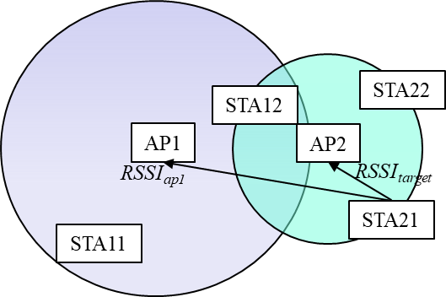
C-SR Phase 2: C-SR Transmission
Since the sharing AP (e.g., AP1) reports RSSI_{ap1} in the Per-RU RSSI Report frame to the shared AP (e.g., AP2), the shared AP can calculate the interference level (RSSI_{ap1} – RSSI_{target}) caused by the TB PPDU effecting to the sharing AP.
  The UL Target RSSI field in the Trigger frame shall be set to the value meeting the C-SR tolerable maximum interference signal strength constraint.
  If the total interference level caused by the TB PPDUs effecting to the sharing AP is greater than or equal to the C-SR tolerable maximum interference signal strength, the shared AP shall not solicit additional TB PPDUs.

Slide 14
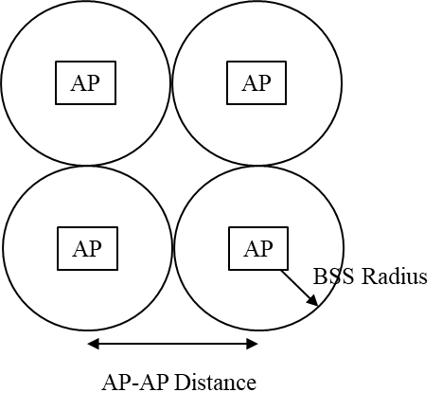
Simulation Setup
Topology
  Four APs
  AP-AP distance = 20m
  BSS Radius = 10m
  Randomly drop a STA in BSS
AP/STA Configuration
  4T AP, 2R STA, 2ss
  TX = +21 dBm per AP
Channel
  80MHz, D-NLOS
  TGn Path loss model
Metric
  Sum Goodput
Modes
  Coordinated OFDMA (C-OFDMA) - Each AP TXs in a different 20M RU
  Spatial Reuse (SR) – All APs transmit simultaneously at full power
  Coordinated Spatial Reuse with TPC (CSR+TPC) - Exhaustive search to select Transmit Power Control (TPC) for each AP that maximizes sum goodput. MCS and TPC selection is based on CSI for all AP-STA combinations
  Coordinated Spatial Reuse with TPC (CSR+PL TPC) – Same as CSR+TPC but TPC and MCS selection is based on path loss

Slide 15
Simulation Results
Higher Goodput for CSR+TPC versus SR.
CSR performance when Pathloss is used to select MCS and TPC is nearly the same as the performance when full CSI is used.

Slide 16
Conclusion
The proposed C-SR protocol needs the support from only AP. Also, no PHY change is needed.
  The STA does not needs any protocol update.
The protocol overhead is minimized because the existing 11ax UL MU procedure is reused.
  In single TXOP, only the Per-RU RSSI Report frame (even it is not required for every TXOPs) and the C-SR Announcement frame are additional overhead.
Comparing with other multi-AP features, only C-SR can achieve both the low complexity and high performance (throughput and latency) gain.
So, we propose C-SR as the multi-AP R1 feature.

Slide 17
Referecnes
[1] https://mentor.ieee.org/802.11/dcn/20/11-20-0073-00-00be-on-coordinated-spatial-reuse-in-11be.pptx
[2] https://mentor.ieee.org/802.11/dcn/20/11-20-0033-01-00be-coordinated-spatial-reuse-operation.pptx
[3] https://mentor.ieee.org/802.11/dcn/20/11-20-0107-01-00be-multi-ap-coordination-for-spatial-reuse.pptx

Slide 18
Backup

Slide 19
C-SR Phase 1: Interference measurement & report
A sharing AP among the AP candidate set for the C-SR solicits TB PPDUs (e.g., BSR, BFR) from its associated STAs.
  The sharing AP specifies in the User Info fields in the Trigger frame one or more shared AP(s) among the AP candidate set to request the RSSI measurement on each RU allocated in the soliciting Trigger frame.
  The interference measurement dialog token is also included in the User Info field in the Trigger frame to identify the interference measurement and report transaction.
The requested shared AP(s) measures the RSSI on each RU and reports to the sharing AP the Per-RU RSSI Report frame having the measurement results and the associated interference measurement dialog token.
  The measurement and report can be in the same or different TXOPs.
  The sharing AP may send the Trigger frame to solicit one or more the Per-RU RSSI Report frames from multiple shared APs.

Slide 20
C-SR Phase 1: Interference measurement & report
The Per-RU RSSI Report frame format
  The RA field is set to the MAC address of the sharing AP that requests the RSSI measurement on each RU allocated in the soliciting Trigger frame.
  The TA field is set to the MAC address of the shared AP that is sending the Per-RU RSSI Report frame.
  The Interference Measurement Dialog Token field is set to the same value as in the Interference Measurement Dialog Token field in the soliciting Trigger frame.
  The AID Associated With Reported RU field is set to the AID associated with the reported RU, that is obtained from the AID12 subfield associated with the reported RU in the soliciting Trigger frame.
  The Measured RSSI On Reported RU field is set to the measured RSSI on the reported RU.
Category (Public Action) | Action (Per-RU RSSI Report) | Interference Measurement Dialog Token | Number Of Reported RUs | AID Associated With Reported RU | Measured RSSI On Reported RU
1 octet | 1 octet | 1 octet | 1 octet | 2 octet | 1 octet
 |  |  |  | Repeated as indicated in the Number Of Reported RSSIs field

Slide 21
C-SR Phase 1: Interference measurement & report
At completion of interference and measurement reporting each AP can compile the following SIR table using the appropriate information.
  This information can allow either DL or UL C-SR operation
  The SIR values can be controlled by adjusting TXPWR_{AP1} and TXPWR_{AP2}.
SIR Table
 | AP1 | AP2
STA 11 | (TXPWR_{AP1} - TXPWR_{AP2})+ (RSSI_{STA11->AP1} – RSSI_{STA11->AP2}) | (TXPWR_{AP2} – TXPWR_{AP1})+ (RSSI_{STA11->AP2} – RSSI_{STA11->AP1})
STA 12 | (TXPWR_{AP1} - TXPWR_{AP2})+ (RSSI_{STA12->AP1} – RSSI_{STA12->AP2}) | (TXPWR_{AP2} – TXPWR_{AP1})+ (RSSI_{STA12->AP2} – RSSI_{STA12->AP1})
STA 21 | (TXPWR_{AP1} - TXPWR_{AP2})+ (RSSI_{STA21->AP1} – RSSI_{STA21->AP2}) | (TXPWR_{AP2} – TXPWR_{AP1})+ (RSSI_{STA21->AP2} – RSSI_{STA21->AP1})
STA 22 | (TXPWR_{AP1} - TXPWR_{AP2})+ (RSSI_{STA22->AP1} – RSSI_{STA22->AP2}) | (TXPWR_{AP2} – TXPWR_{AP1})+ (RSSI_{STA22->AP2} – RSSI_{STA22->AP1})
From
To
NOTE-
TXPWR_{AP1} is the TX Power of AP1 (dBm).
TXPWR_{AP2} is the TX Power of AP2 (dBm).
RSSI_{STAi->APj} is the received signal strength indicator (dB) at AP_{j} of the signal sent by the STA_{i}.

