Slide 1
TXOP Protection in 11be and coexistence with 11ax
Date: 2020-05-11
Authors:
Name | Affiliations | Address | Phone | email
Payam Torab | Facebook Inc. | 1 Hacker way Menlo Park, CA |  | torab@ieee.org
Chunyu Hu |  |  |  | chunyuhu@fb.com

Slide 2
Introduction
There are 11be proposals for MAC-level mechanisms to protect TXOP for PPDUs with bandwidth > 160MHz and/or PPDUs with preamble puncture
  MAC-level mechanisms involve changes to RTS, MU-RTS and CTS frames and NAV set/reset procedures
  Related contributions and straw polls (Section 3.3 (TXOP) in [4]),
    Do you support that 11be defines a MAC mechanism to protect TXOP for PPDUs with [bandwidth] >160MHz and/or PPDUs with preamble puncturing?
      [20/0062r0 (Protection with more than 160MHz PPDU and puncture operation, Liwen Chu, NXP][1]
      Y/N/A/No answer: 41/5/17/31
    Do you support to transmit the MU-RTS/RTS and CTS frames in a non-HT duplicate PPDU on 20 MHz subchannels which are not punctured?
      [19/2125r2 (EHT RTS and CTS procedure, Yongho Seok, MediaTek][2]
      Y/N/A/No answer: 35/2/18/26
We discuss performance impact of new MAC-level mechanisms, the way they are currently formulated, on 11ax devices
We also propose two design principles to avoid performance impact on 11ax (past/present) as well as future (post 11be) generations
Notes:
We think that we need to be very careful in defining any new txop protection mechanism:
Not to cause coexistence issues, in particular, in the “clean” 6GHz potentially released for unlicensed use.
Not to hurt legacy device performance, especially 11ax/11ac, which are popularly deployed

Slide 3
Existing TXOP protection mechanisms in MAC
RTS/CTS/DATA/ACK or CTS/DATA/ACK
  NAV set/reset rules per 10.3.2.4 (Setting and resetting the NAV) (discussed later)
  NAV operation
    Single NAV − 11a/b/g/n/ac devices
    Two NAV − 11ax devices (mandatory for non-AP, optional for AP)
Sounding frame sequence
  NDPA/NDP/SFB…: introduced in 11ac
  NDPA/NDP/Trigger/…: introduced in 11ax
  TXOP honored by 11ac/ax devices accordingly
Trigger/HE-TB/ACK: introduced in 11ax
MU-RTS/CTS for DL-MU: introduced in 11ax
  MU-RTS is a special trigger frame
  NAV protection is trickier/weaker, as CTS is transmitted in form of simultaneous-CTS
  NAV setting follows RTS/CTS rule

Slide 4
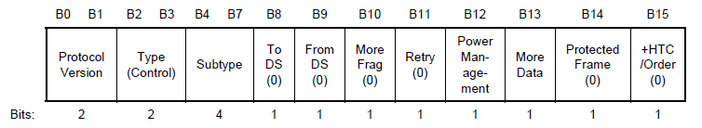
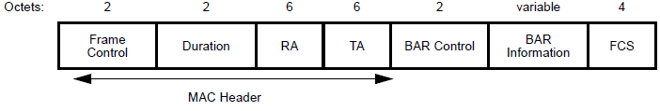
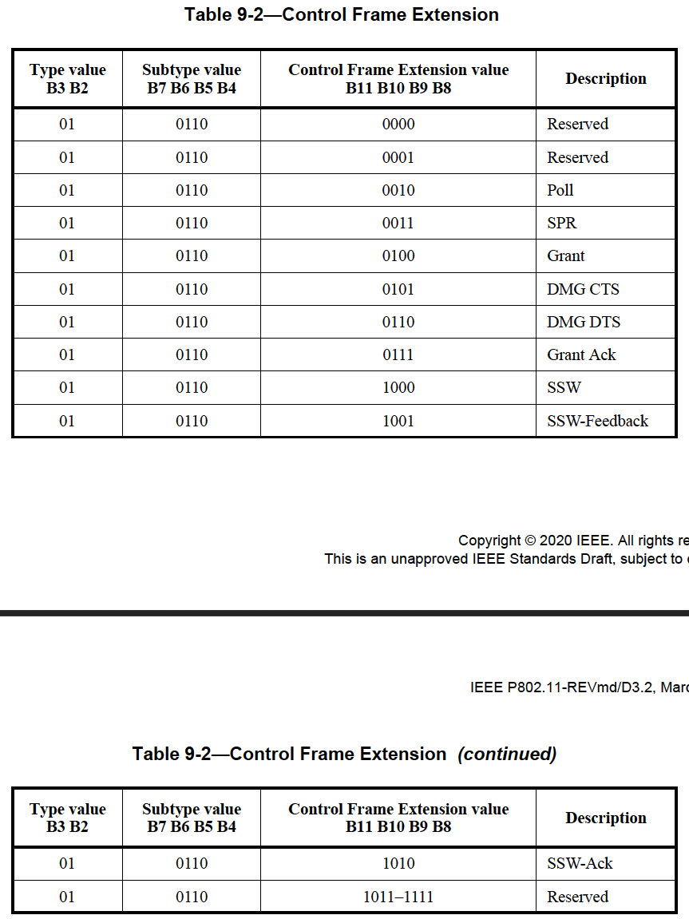
MAC-level protection proposals under discussion
Approach to define new frame variants [1]
[1] New (Enhanced) RTS, CTS and possibly NDPA frames through an “Extended Control” subtype value [1]
[1] Extending newer control frames (NDP Announcement, Trigger) to realize Enhanced RTS/CTS (using a reserved AID for example)
Note: New “Extended Control” subtype in [1] not to be confused with “Control Frame Extension” subtype (6), which reuses Frame Control bits 8-11 for additional control frames (all DMG currently).
It is however possible to define subtype 6 (and derivative new control frames) differently in 5 and 6 GHz, which allows defining up to 16 new control frames without consuming a new subtype value (and optionally without an additional “Extended Subtype” field).
That is, make current Table 9-2 DMG-specific and create a similar table for lower bands.
(Extended
Control)
Frame Control field of Extended Control frame
1
Extended Subtype
Control Information

Slide 5
MAC-level protection proposals under discussion
Using new frames to signal preamble puncturing [2]
[2] New (enhanced) RTS and CTS frames with punctured channel information
  EHT MU-RTS carries a “Disallowed subchannel bitmap” subfield to indicate subchannels/channels on which the EHT MU-RTS frame is not sent/duplicated
  Non-AP STA disallowed to transmit CTS over disallowed subchannel(s)
EHT RTS
frame format
Frame Control | Duration | RA | TA | Punctured Channel Information | FCS
2 octets | 2 octets | 6 octets | 6 octets | TBD | 4 octets
EHT CTS
frame format
Frame Control | Duration | RA | Punctured Channel Information | FCS
2 octets | 2 octets | 6 octets | TBD | 4 octets

Slide 6
11ax performance with new mechanisms
Unrecognized RTS and NAV reset rules
NAV reset rules in baseline (10.3.2.4) allow a non-target STA that receives the RTS/MU-RTS to reset its NAV if no PHY-RXSTART detected within a short (<< typical TXOP duration) timeout period after RTS
  NAVTimeout = 2×aSIFSTime + CTS_Time + aRxPHYStartDelay + 2×aSlotTime
If 11ax STAs do not recognize the new RTS frame (or the new MU-RTS frame, in case one is defined), they will not have the option of resetting their NAV in the absence of PHY-RXSTART within the timeout period
New RTS (or MU-RTS)
TXOP Duration
11be
STA
CTS
Earliest time device can reset its NAV
Observing
11be
STA
(non-target)
NAVTimeout
O(10²) µsec
Earliest time device can reset its NAV
Observing
11ax
STA
(non-target)
TXOP Duration
O(10⁴) µsec

Slide 7
TXOP protection design suggestions
Frame formats
Define extensible formats for RTS, CTS and MU-RTS for all current/future devices to understand
In the case of 11ax, make the new formats applicable to HE, under a capability to be defined
  For example, Extended Capabilities element (9.4.2.26)
There is no reason for a MAC-level TXOP protection mechanism not to be applicable to HE (in fact, that’s another benefit of a MAC-level mechanism)
Fairness with 11ax (with regards to TXOP protection for this presentation) is not a matter of legacy support given where 11ax is today − in IEEE (unapproved draft), and in industry (certification program launched less than a year ago)

Slide 8
Proposal
Make all MAC-level TXOP protection mechanisms introduced in 11be (including changes/extensions to RTS, MU-RTS and CTS frames and procedures)
  Compatible with future generations (i.e., rich/extensible packet formats)
    Similar approach as the U-SIG design in EHT preamble
  Compatible with (understood by) 11ax (under a capability)
For new/enhanced RTS/MU-RTS/CTS frames,
  Define a common extensible format for each, early on
  Leave additional details and refinements to further 11be design
  Make the frames and procedures applicable to HE under a capability
    Amending 11ax draft, or defined in 11be

Slide 9
Straw Poll 1
Do you support defining new MAC-level mechanism for TXOP protection in 11be as HE capability?
  Yes:
  No:
  Abstain:
  Notes
  Examples of MAC-level mechanisms include modified or new RTS, MU-RTS and CTS frames, and NAV set/reset procedures to the extent that they are independent of EHT PHY header
  A feature can be defined as an HE capability through using bits/fields in HE Capabilities element (9.4.2.247), Extended Capabilities element (9.4.2.26), or similar fields/elements accessible to HE STAs

Slide 10
Straw Poll 2
Do you support requiring formats for new RTS, MU-RTS and CTS frames (if defined) to be forward compatible?
  Yes:
  No:
  Abstain:
  Notes
  One examples of forward compatibility is using a version field; see 802.11-19-1519/r5 for ”forward compatibility” discussion
  Combination of Straw Polls #1 and #2 means “forward compatibility” to start from 11ax, but for 11ax as optional (capability)

Slide 11
Straw Poll 3
Do you support defining new control frames in 11be using the existing “Control Frame Extension” subtype (6) and using bits 8-11 in Frame Control field?
  Yes:
  No:
  Abstain:
  Notes
  This means different definitions for control frames under “Control Frame Extension” subtype (6) in 2.4/5/6 GHz and in 60 GHz

Slide 12
References
IEEE 802.11-20/0062/r0, “BW Negotiation, TXOP Protection with >160MHz PPDU and Puncture Operation”
IEEE 802.11-19/2125r1, “EHT RTS and CTS Procedure”
IEEE 802.11-20/0399r0, “BW Negotiation, TXOP Protection with >160MHz PPDU and Puncture Operation”
IEEE 802.11-20/0566r1, “Compendium of straw polls and potential changes to the Specification Framework Document”

