Slide 1
EHT PPDU Scrambler
Date: 03/25/20
Authors | Email
Xiaogang Chen | Xiaogang.c.chen@intel.com
Vituri Shlomi
Lavi, Noam
Qinghua Li
Thomas Kenney
Feng Jiang
Assaf Gurevitz

Slide 2
Outline
Recap of the 11a scrambler;
The issue of reusing 11a scrambler in 11be;
Simulations;
Solution.

Slide 3
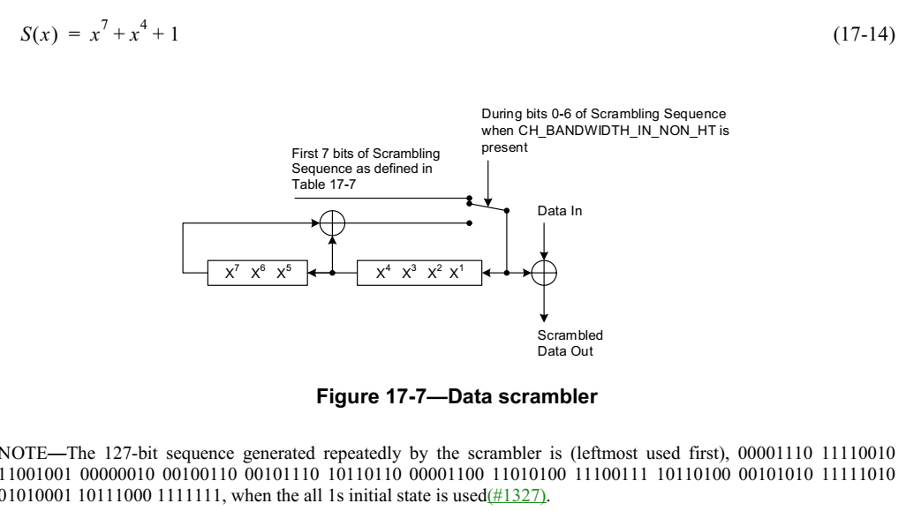
Recap of the 11a scrambler
The scrambler repeats every 127 bits;
Defined in 11a and keep reusing till 11ax.

Slide 4
Issue of the 11a scrambler (1/2)
The IFFT of a non-random signal (e.g. [1111000011110000]) has much higher PAPR than the IFFT of a random signal.
If the 127 bits scrambler XOR with non-random data, very likely the scrambled signal has a non-random pattern.
  N_DBPS significantly increased from 540 (1SS,MCS7,40MHz) in 11n to 16333 (1SS,MCS11,160MHz) in 11ax.
    11be will doubles the N_DBPS.
  A larger N_DBPS means higher chance to generate non-random data pattern (after scrambled by the 11a scrambler).

Slide 5
Issue of the 11a scrambler (2/2)
Non-random data may come from:
  Unencrypted transmission, especially for the video or photo files.
  MAC padding: EOF padding subframes have 4*N Byte and repeat every 4 Bytes.
Channel coding can randomize the scrambled data and mitigate PAPR but the randomization is not sufficient.

Slide 6
Simulations
Assumptions:
  BW: 20/80/160/320MHz;
  MCS: 9/11/13, 1SS;
  Data size: 150Kb;
  LDPC;
  Polynomial for larger PN generation: x^11 + x^9 + 1.
Average PAPR (dB) in the data fields
MCS\Data pattern | All Zero scrambled by 11a PN Seq | Other Non-random Patterns scrambled by 11a PN Seq | Random | All Zero scrambled by larger PN Seq
VHT 20MHz MCS9 | 8.66 | 8.02 ~8.8 | 7.8 | 7.87
EHT 80MHz MCS9 | 12.88 | 11.9 ~ 13.74 | 8.71 | 8.83
EHT 160MHz MCS11 | 15.3 | 14.3~17.2 | 9.09 | 9.11
EHT 320MHz MCS13 | 18.83 | 16.65~19.3 | 9.43 | 9.41

Slide 7
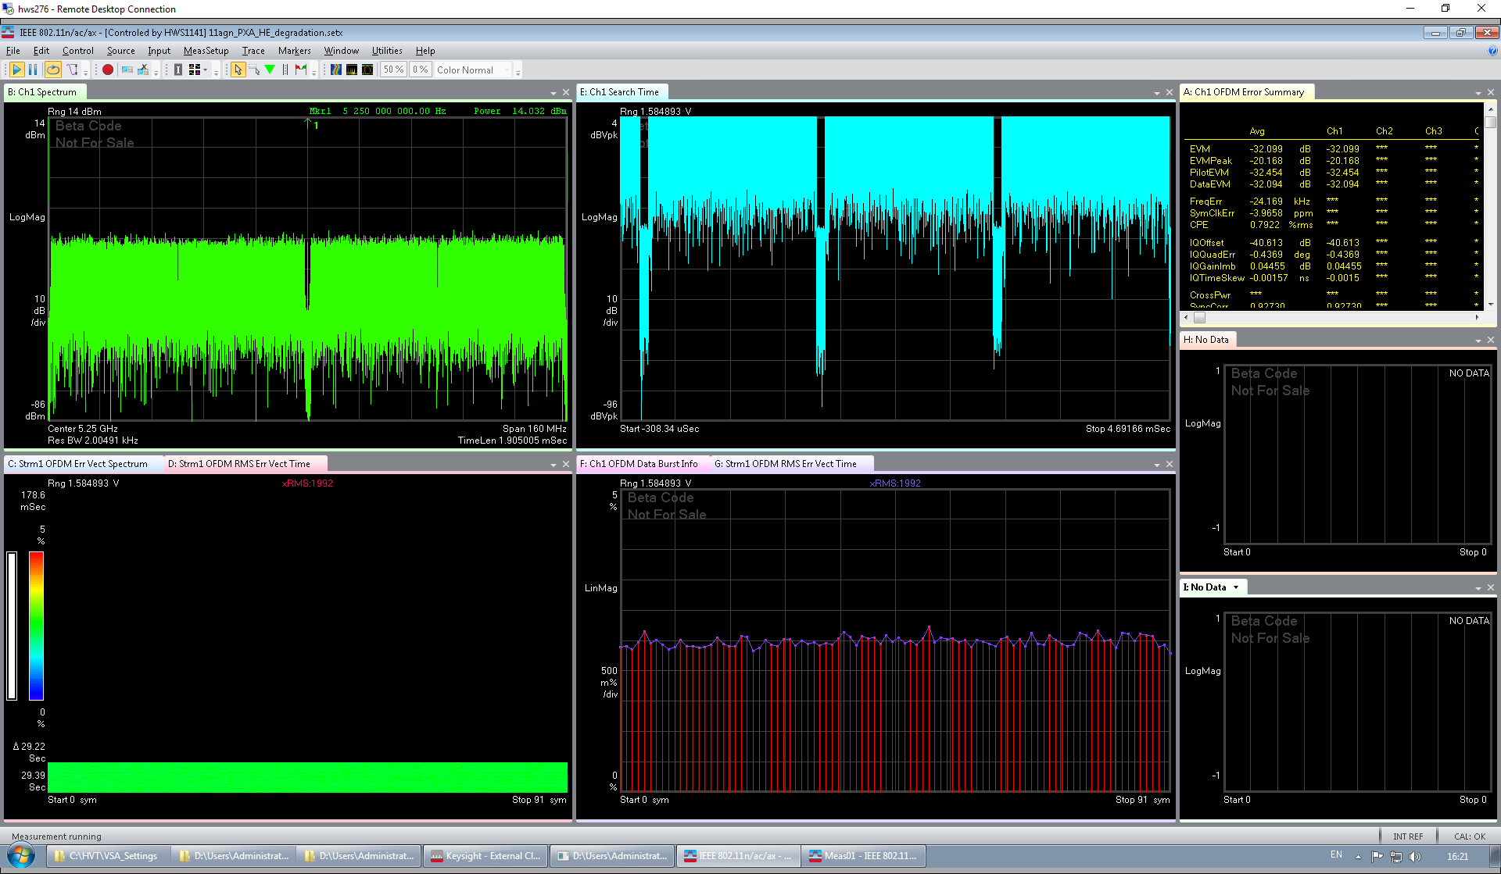
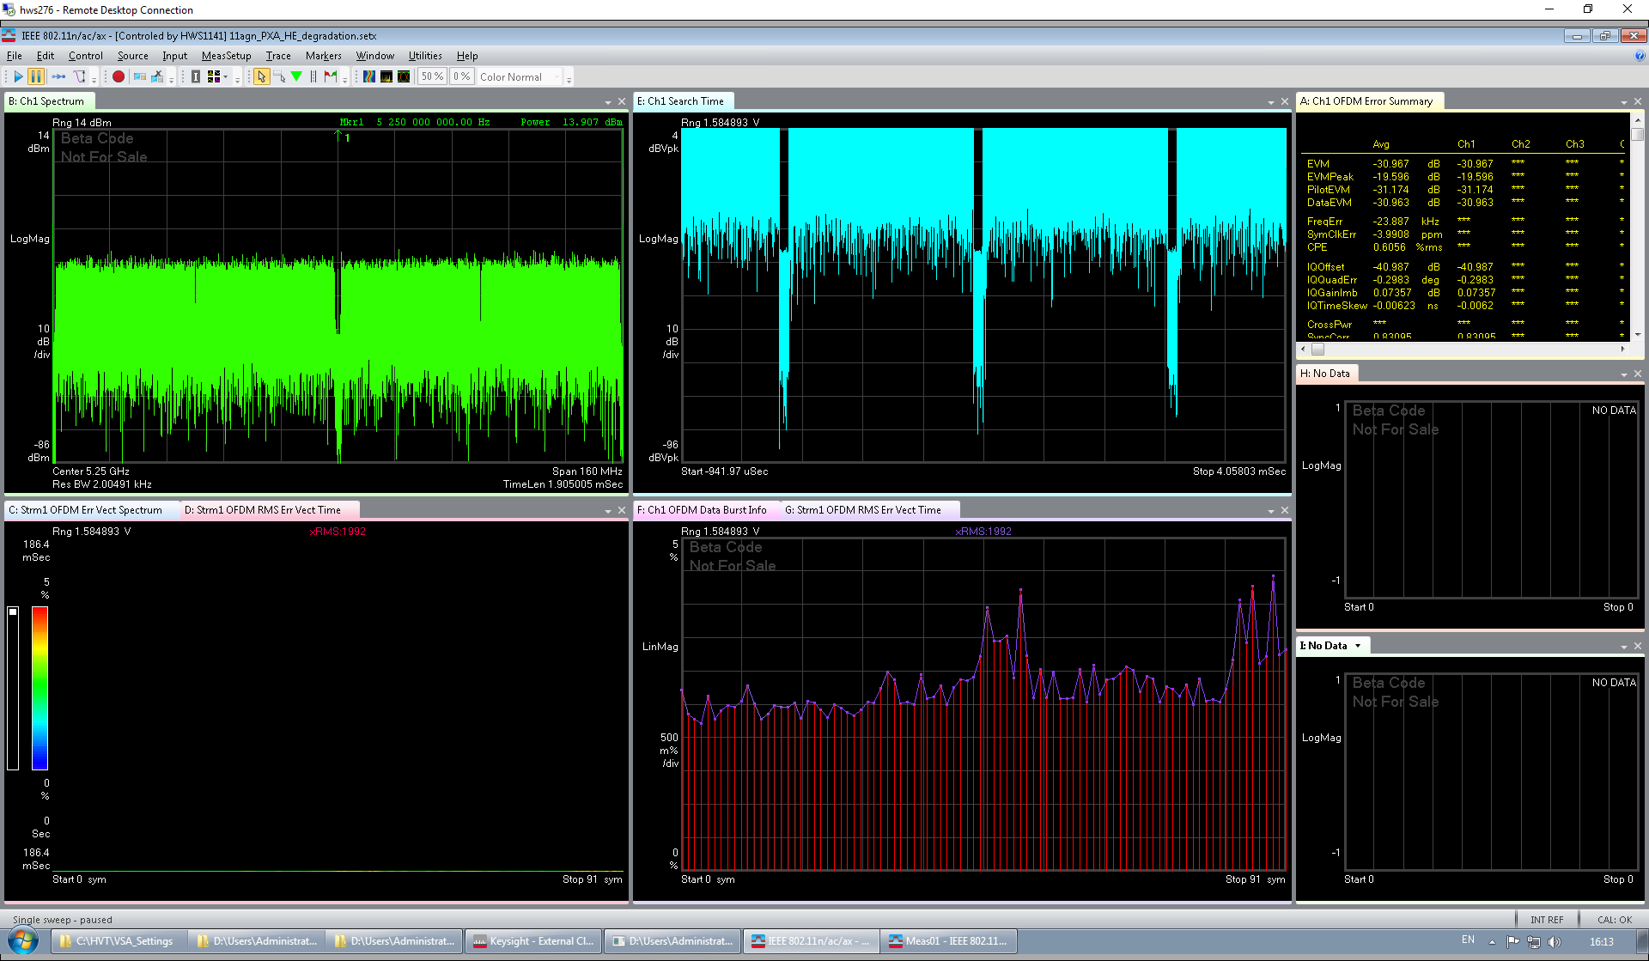
Lab measurements
Left: random data MCS9 160MHz;
Right: non-random data MCS9 160MHz;
For the same Tx power, non-random data get more chance to violate the EVM requirement.
EVM=-32
EVM=-32

Slide 8

Solutions
Opt.1) Extend the periodicity of the 11a scrambling sequence;
Opt.2) Phase rotation;
Opt.3) Optimized (structured) 11a scrambler.
S$\left(x\right)=x^{11}+x^{9}+1$

Slide 9
Comparisons of different options for PAPR mitigation (1/2)
Options in comparison:
  Phase rotation: [1 -1 -1 -1 j -j -j -j];
  Polynomial order 10,11,15;
  Structured 11a scrambler.
    Kronecker_XOR (11a_seq, 11a_seq). Length = 127^2.
Sims parameters:
  160/320MHz;
  All 0 data;
  1024QAM/4096QAM, 1SS;
    More SS were simulated but not listed since they have almost the same PAPR.
  LDPC.

Slide 10
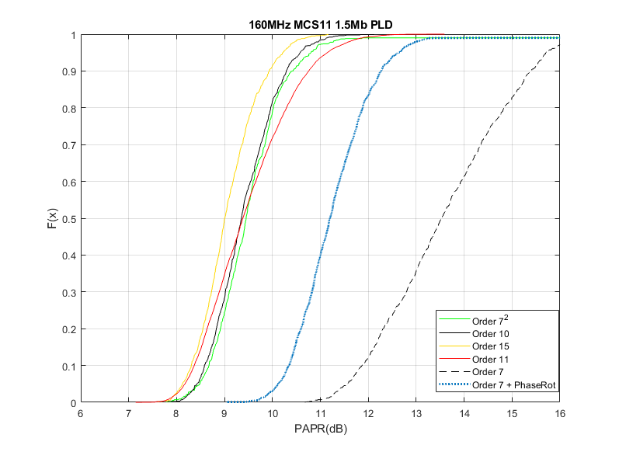
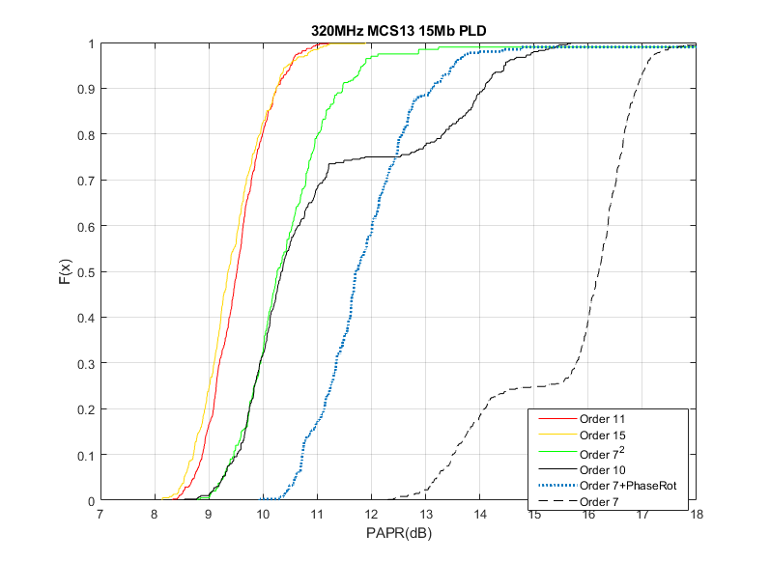
Comparisons of different options for PAPR mitigation (2/2)
Phase rotation cannot reach similar performance as high order PN sequences;
Different high order PN seq have similar performance in 160MHz;
Order 11,15 outperform other options in 320MHz.
  Order 11 may simplify the implementation if the sequence needs to be saved in memory.

Slide 11
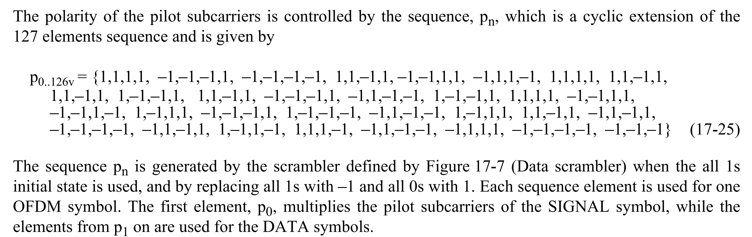
Polarity of pilot subcarrier
The generation of the pilot polarity is copied as below;
Prefer to keep as is to simplify the implementation and validation.

Slide 12
Summary
Reusing 11a scrambler in 11be will introduce high PAPR for high MCS and large BW;
A straight forward solution is to increase the order of the scrambler generation polynomial to extend the periodicity of the scrambler sequence.

Slide 13
SP
Do you agree to use the following generator polynomial to generate the PPDU synchronous scrambler for EHT PPDU?
  The 11 bits used for the scrambler initialization are randomly assigned by the transmitter.
  The polarity of the pilot subcarrier is derived from the same sequence as 11ax.
S$\left(x\right)=x^{11}+x^{9}+1$

Slide 14

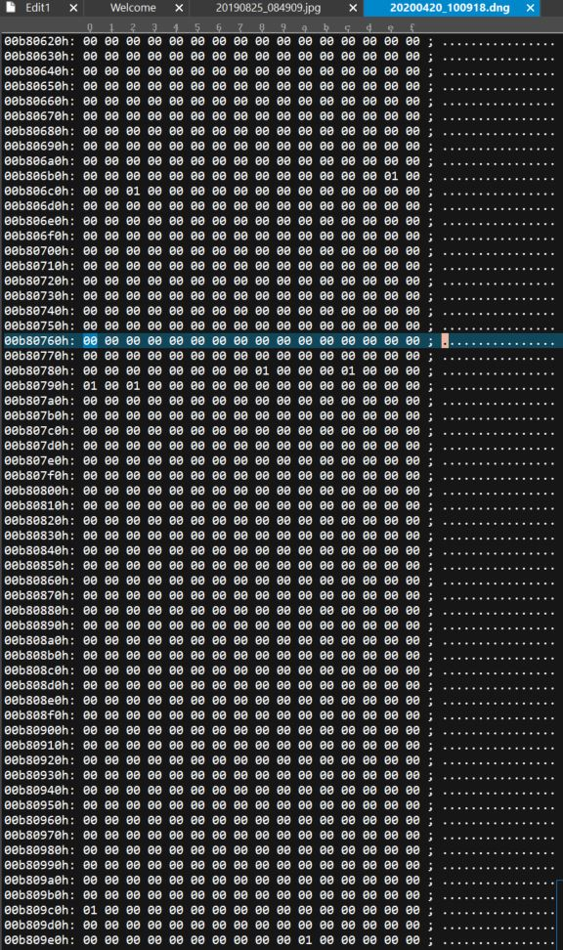
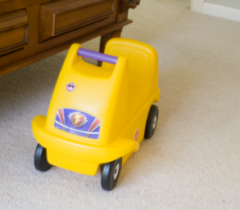
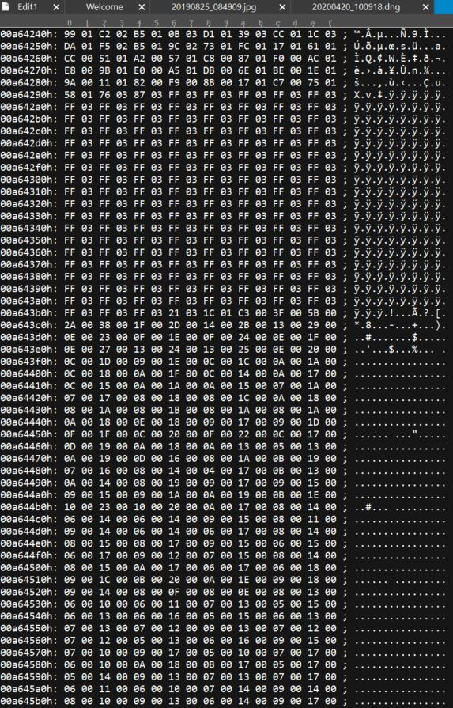
Backup - RAW file contents

Slide 15

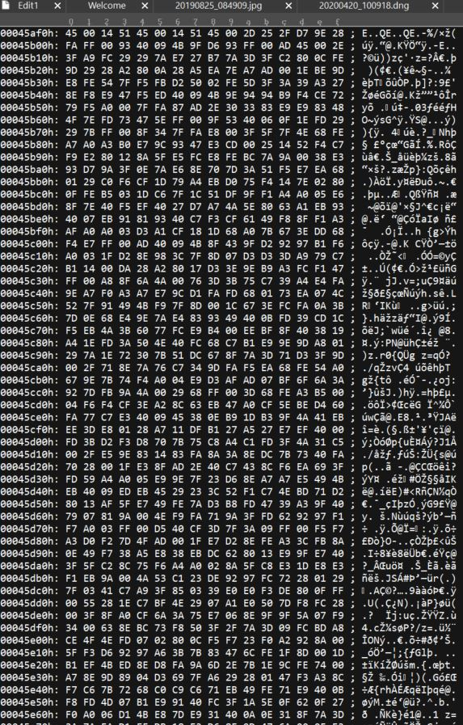
Backup - Compressed file contents

Slide 16
Back up - Scrambler in other technologies
The scrambler in other technologies has significant longer periodicity than WiFi.
Technologies | FFT size | Bits/Symbol | PRBS Polynomial Degree | PRBS period (bit)
802.11be | 4096 | ~40K | ? | ?
802.11ax/ac/n/a | 2048 | ~20K | 7 | 127
802.16e | 2048 | ~12K | 15 | 32K
LTE | 2048 | ~12K | 31 | 2G

