Slide 1
Multi-AP Configuration and Resource Allocation
Date: 2020-04-01
Authors:
Name | Affiliations | Address | Phone | Email
Po-Kai Huang | Intel
Arik Klein
Ofer Schreiber
Laurent Cariou
Cheng Chen
Notes:
September 2012

Slide 2
Background
Collaboration group have reached consensus on COFDMA, CSR, CBF, and JT, and general sequence flow seem to be the following
We discuss our understanding of configuration and resource allocation in this slide deck
AP1
AP Trigger Frame
Coordinated Transmission: AP1 to STA1
AP2
Coordinated Transmission: AP2 to STA2
Acknowledgement
STA1 to AP1
STA1
STA2
Acknowledgement
STA2 to AP2

Slide 3
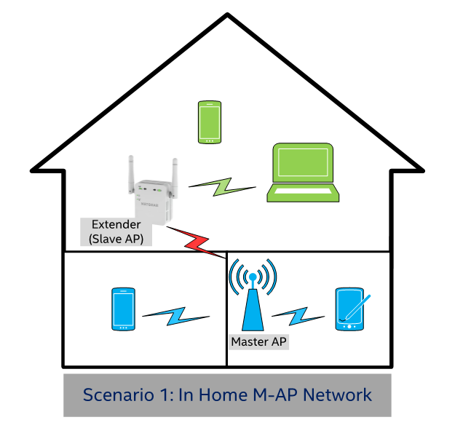
Motivation
Our main use case of multi-AP coordination is in home environment, where AP with gateway connection needs to coordinate with extender to improve system performance
Same or different primary channels/configurations may be used for the AP with gateway and extender
Extender
AP with gateway

Slide 4
Primary Channel Configuration and BSS Operating Channel
For a sharing AP to trigger transmission of the shared AP, the primary channel of shared AP needs to be in the BSS Operating Channel of sharing AP
  If shared AP’s primary channel is not in the BSS operating channel of sharing AP, then AP Trigger frame can not be delivered from sharing AP to shared AP over the air
Examples below:
Ex 3
Ex 4
Ex 1
Ex 2

Slide 5
Primary Channel Configuration and BSS Operating Channel
For a shared AP to communicate with sharing AP, it is easier to have the primary channel of sharing AP within the BSS Operating Channel of shared AP
Examples below:

Slide 6
Resource Allocation related to BSS Operating Channel
We think the allocated one or more 20 MHz channels for an shared AP shall be within the BSS operating channel of the shared AP
  Allocate resource outside the BSS operating channel may not have the proper capability and calibration
Sharing AP can only allocate at most 160 MHz to Shared AP

Slide 7
Resource Allocation related to BSS Operating Channel
An sharing AP can only allocate 20 MHz channels within its BSS operating channel to other shared APs
  Allocate resource outside the BSS operating channel means that medium can not be even reserved
Sharing AP can allocate at most 160 MHz to shared AP

Slide 8
Conclusion
We discuss the configuration and resource allocation of multi-AP protocols.
We propose the following:
  Sharing AP and Shared AP may not have the same primary 20 MHz channel
  For an shared AP to be coordinated, the primary 20 MHz channel of the shared AP shall be within the BSS operating channel of the sharing AP
  For an design simplification, the primary 20 MHz channel of the sharing AP shall be within the BSS operating channel of the shared AP
  20 MHz channels allocated to a shared AP shall be within the BSS operating channel of the shared AP
  20 MHz channels allocated from a sharing AP shall be within the BSS operating channel of the sharing AP (essentially only the channel that the sharing AP gained channel access)

Slide 9
Straw Poll #1
Do you support the following:
  Sharing AP and Shared AP may not have the same primary 20 MHz channel
  The primary 20 MHz channel of the shared AP shall be within the BSS operating channel width of the sharing AP
  The primary 20 MHz channel of the sharing AP shall be within the BSS operating channel width of the shared AP

Slide 10
Straw Poll #2
Do you support defining the modes of AP coordination that share frequency resources with one or more APs within the AP candidate set only for:
  20 MHz channels allocated by a sharing AP to a shared AP within the BSS operating channel of the shared AP
  Note: 20 MHz channels allocated by a sharing AP within the 20 MHz channels on which the sharing AP gained channel access

